Slide 1
Java IM Project – Group 3
Kary Guo

Slide 2
Agenda
Architecture
Protocol
Modules/Classes

Slide 3
Architecture
-user list
-session
Client
Server
req
socket
res
Thread Pool
Client
req
socket
res
1 Thread -> 1 Socket -> 1 Response -> n Request

Slide 4
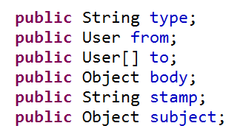
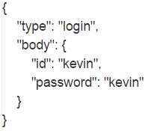
Protocol

Slide 5
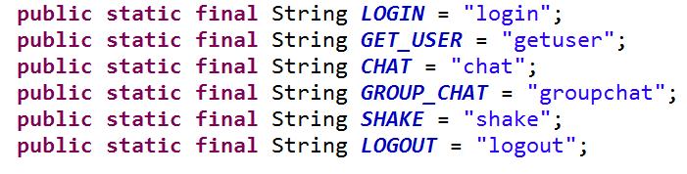
Protocol
Package Types

Slide 6
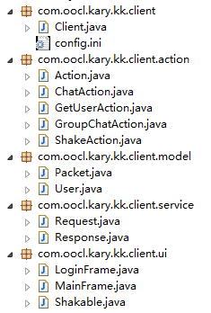
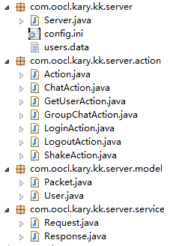
Modules/Classes
Client
Server

Slide 7
Thanks
Q&A

