Slide 1

CP2 Report:
Status: All finished.

Slide 2
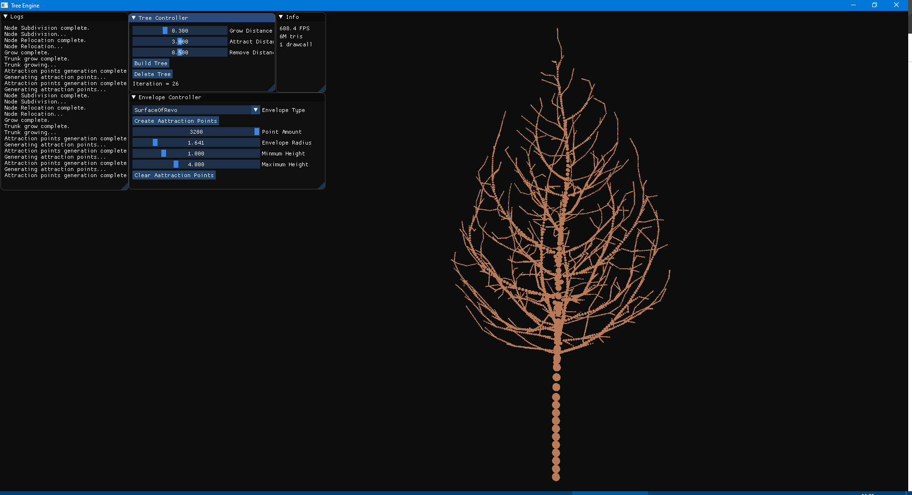
Surface of revolution:

Slide 3
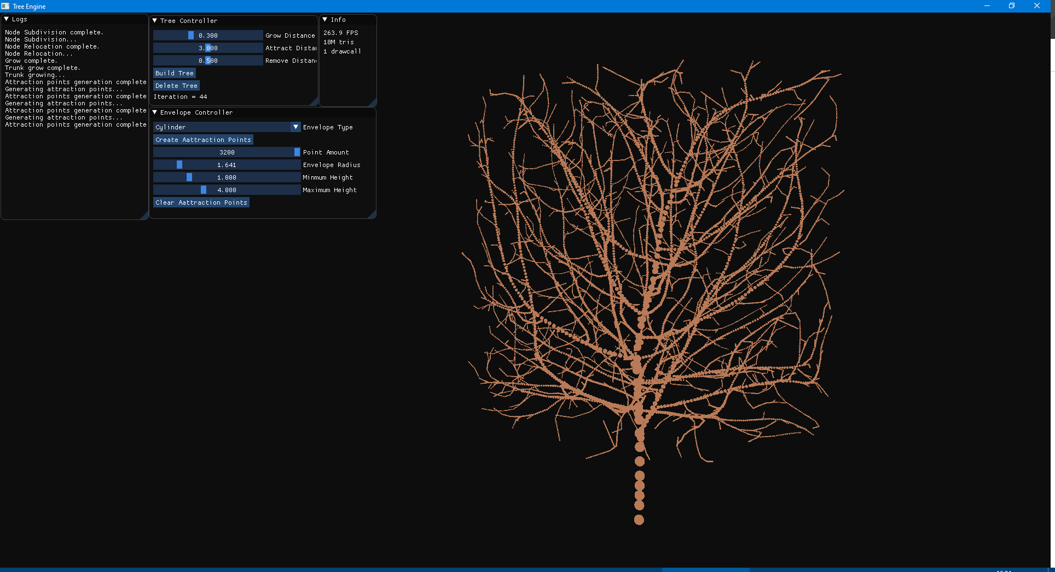
Cylinder

Slide 4
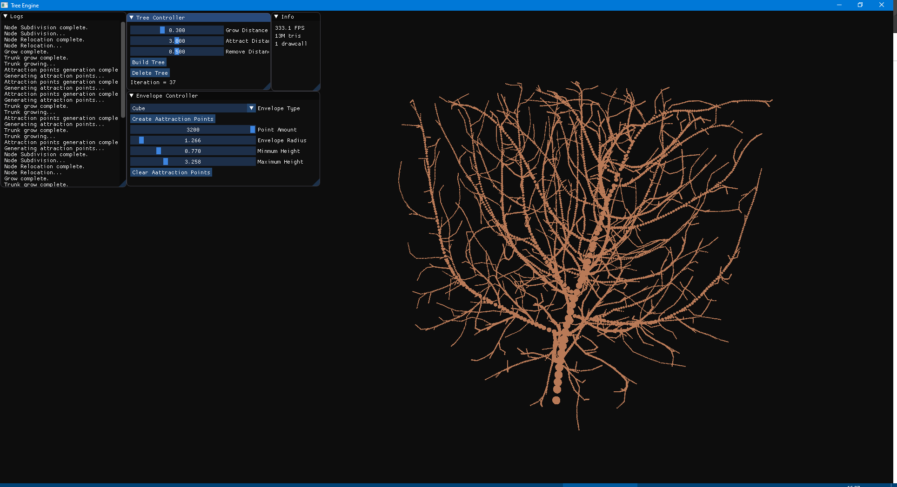
Cube

