Slide 1
Expectations for checkpoint 1:
Input: A set of parameters representing the shape of the envelope, and another set for attraction points.
Output: A graphic framework displaying the 3D envelope of tree crown with user-controlled attraction points fed.
Detailed objectives:
A good framework that support rendering both low-level primitives (attraction points) and high-level mesh models (envelope of tree crown).
(a) 2. Other modules to help testing. E.g., camera, time, transform with hierarchy (relative position/rotation/scale, matrix4x4…).

Slide 2
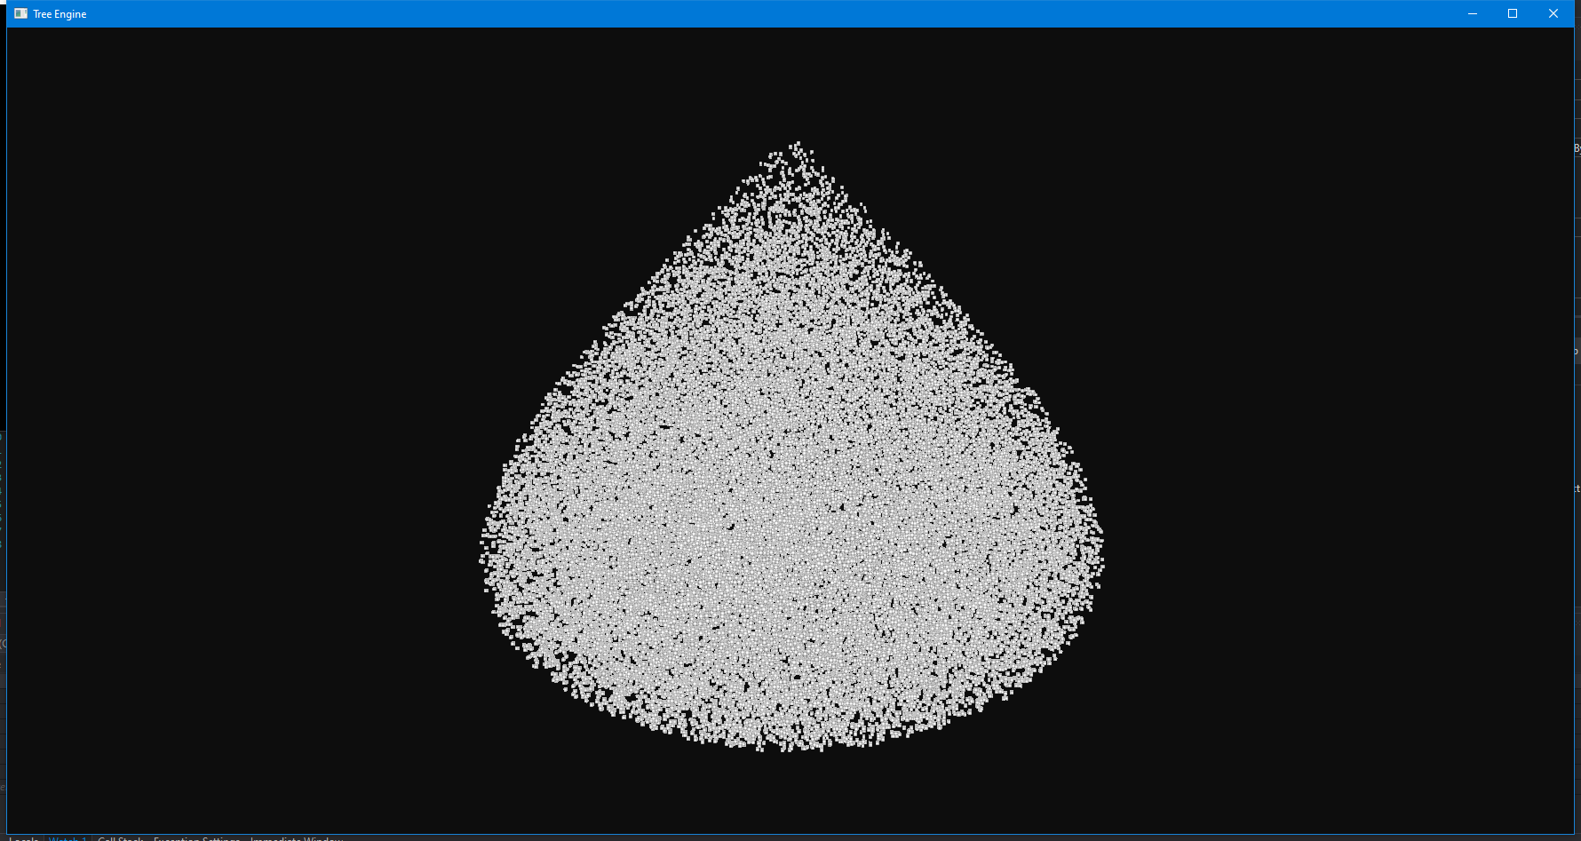
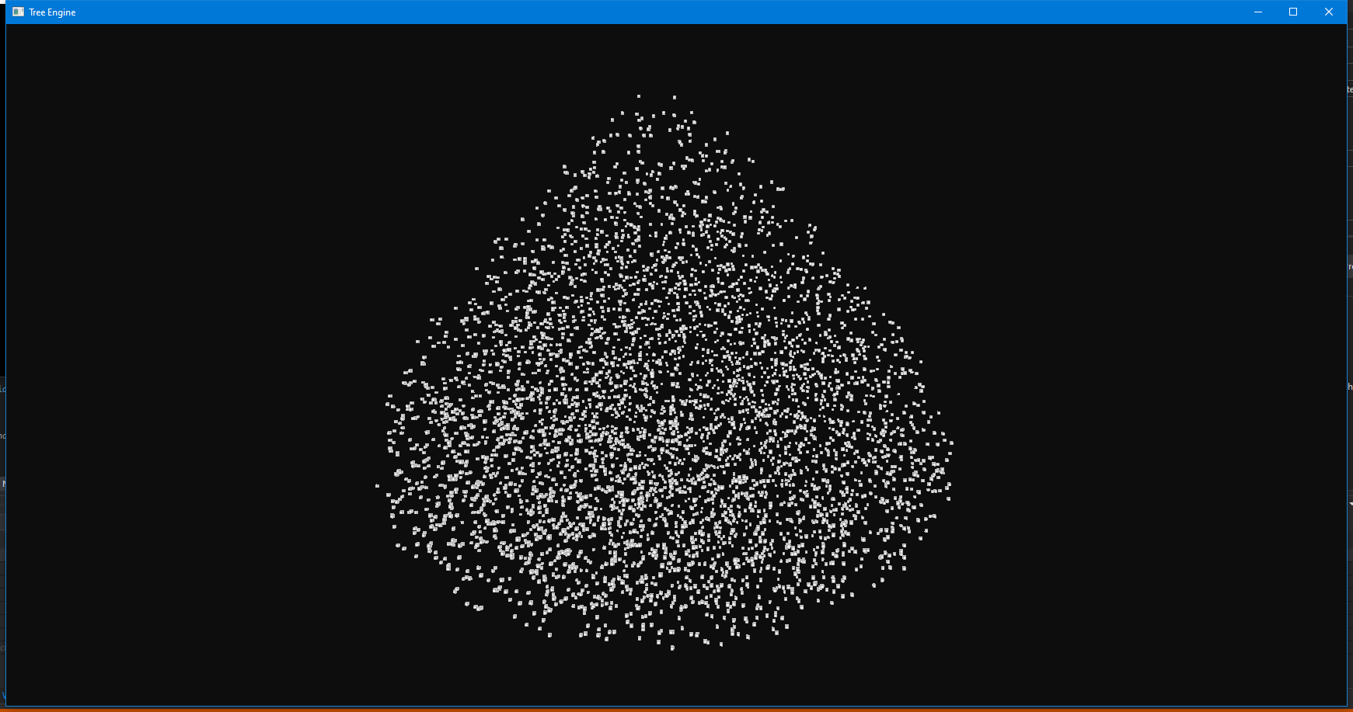
Results:
With 50000 attraction points seeded:
With 5000 attraction points seeded:

Slide 3
Objective 1:
A good framework that support rendering both low-level primitives (attraction points) and high-level mesh models (envelope of tree crown).
Approach:
Graphics.h: Normal rendering (high-level mesh models) + Instanced rendering(low-level primitives)
Attraction points(multiple low-primitive): directly call graphics function. (Header files/ECS/External/System/SCTResourceSystem.h)
Nano-Suit (high-level mesh): Information stored in entities and draw in RenderSystem. I didn’t draw envelope because the scatter pattern of attraction points already showed the envelope’s shape. The nano-suit is just a proof that the framework is capable of drawing complex geometries.
Note: The model of nano-suit comes from internet, the code for loading obj file comes from (https://learnopengl.com/Model-Loading/Model) and is modified to adapt my own entity component system.

Slide 4
Objective 2:
2. Other modules to help testing. E.g., camera, time, transform with hierarchy (relative position/rotation/scale, matrix4x4…).
Approach (A major part of these are inspired from unity’s new DOTS stack, but no codes copied, and unity is not open source):
Entity component system. (ECSInternal.h)
Components:
Mesh.h, Material.h, Texture.h (internal defined shared components), etc.
Translation.h, Rotation.h, Scale.h, etc (internal defined components)
(InternalComponents.h)
Shared Component: where multiple entity may share the same component, they are store as pointers to object in entity.
Component: Each entity must have its own data; they are stored as structs in entity.
System: Update components for each render loop
Entity: Link components together. (Entity.h)
Note: The camera, shader code comes from learnopengl.com and is modified to suit in my framework.

