Slide 1
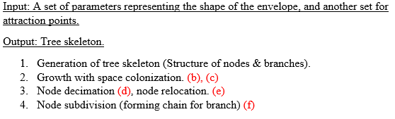
CP2 Report:
Status: All finished.

Slide 2
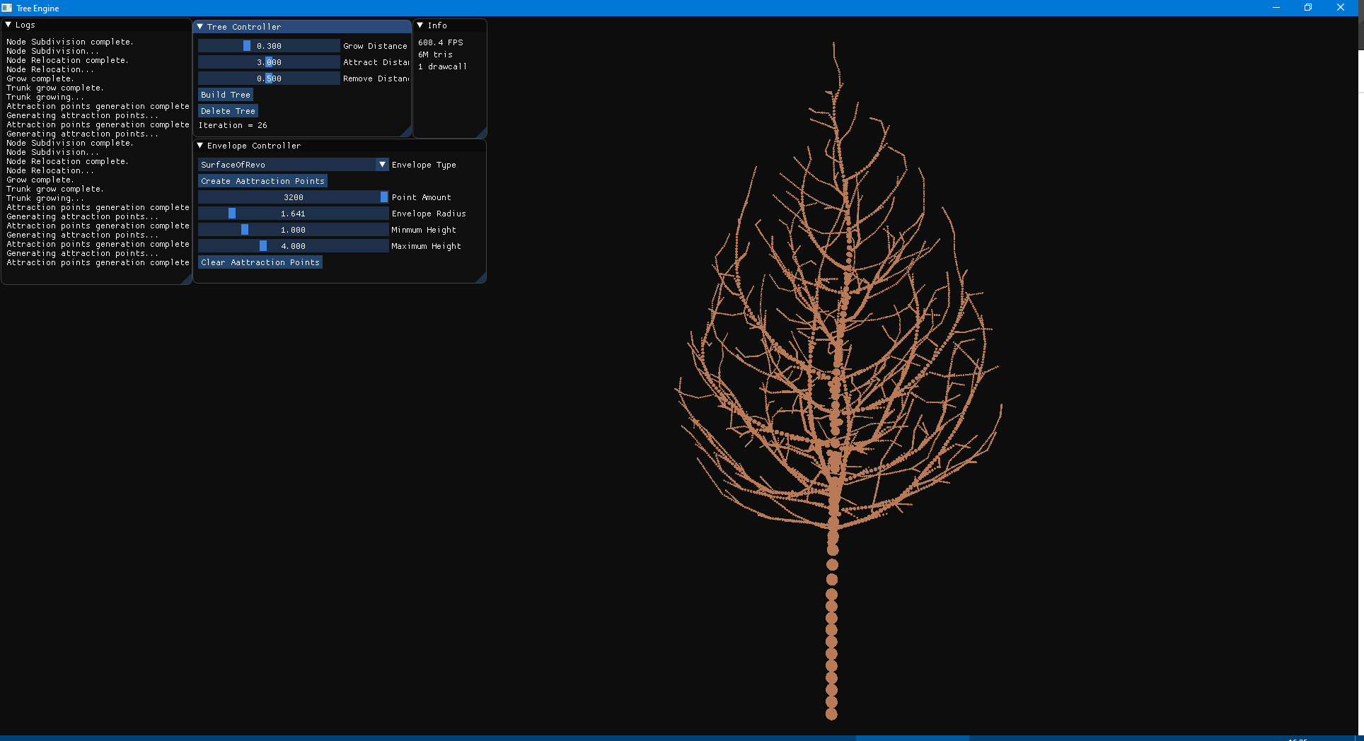
Surface of revolution:

Slide 3
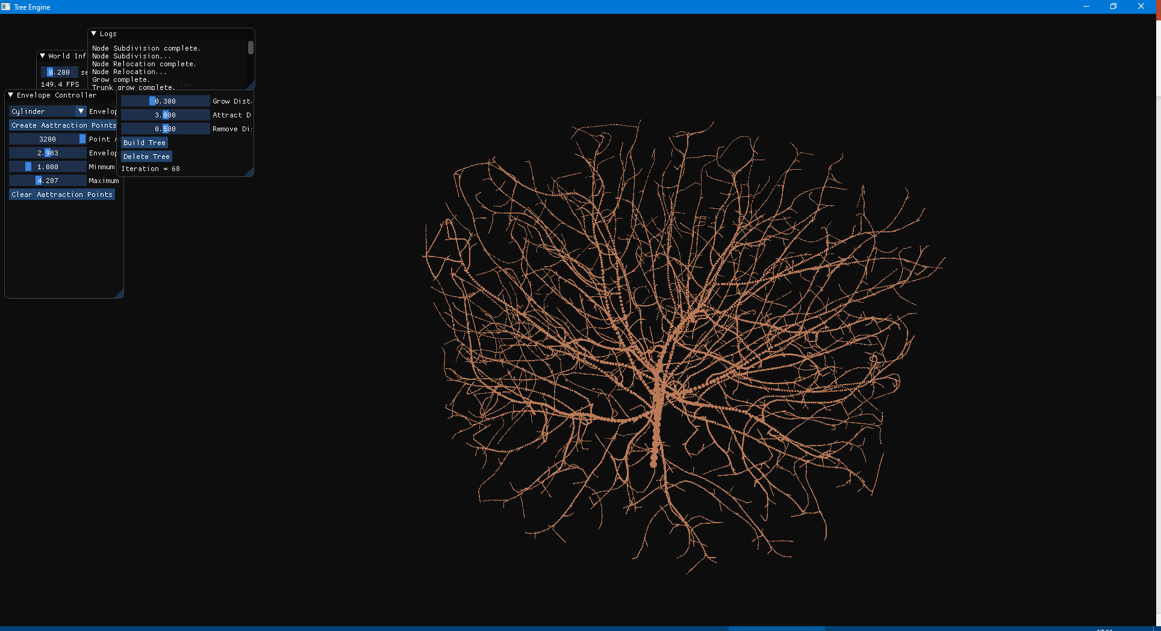
Cylinder

Slide 4
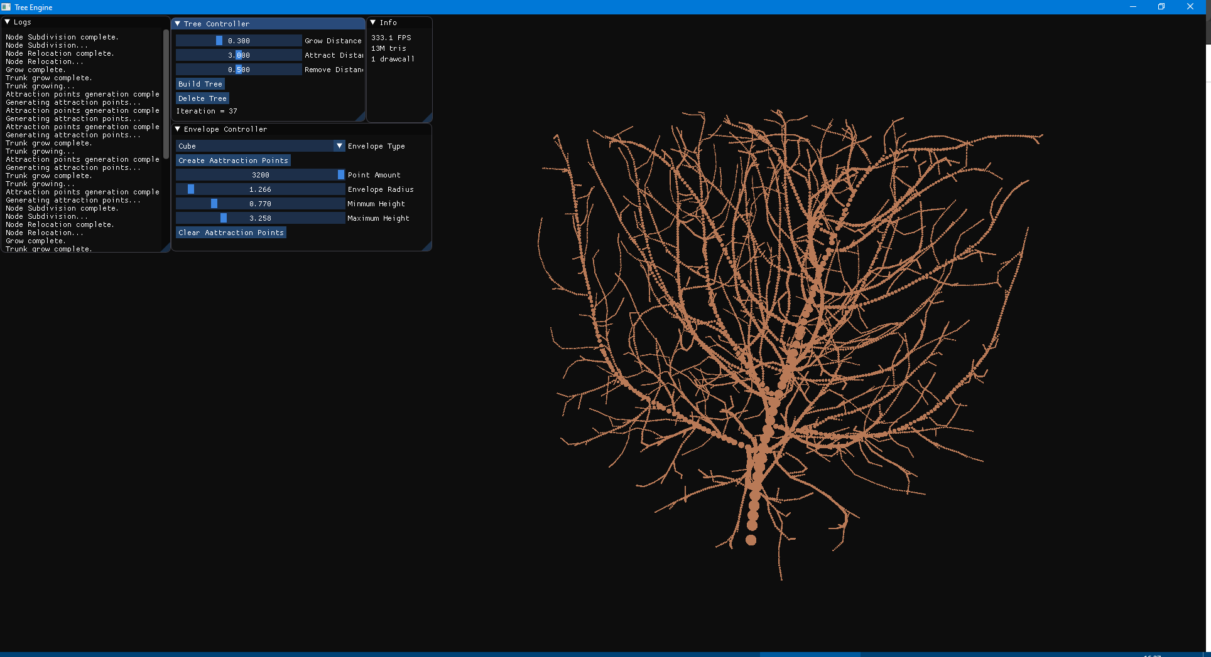
Cube

Slide 5
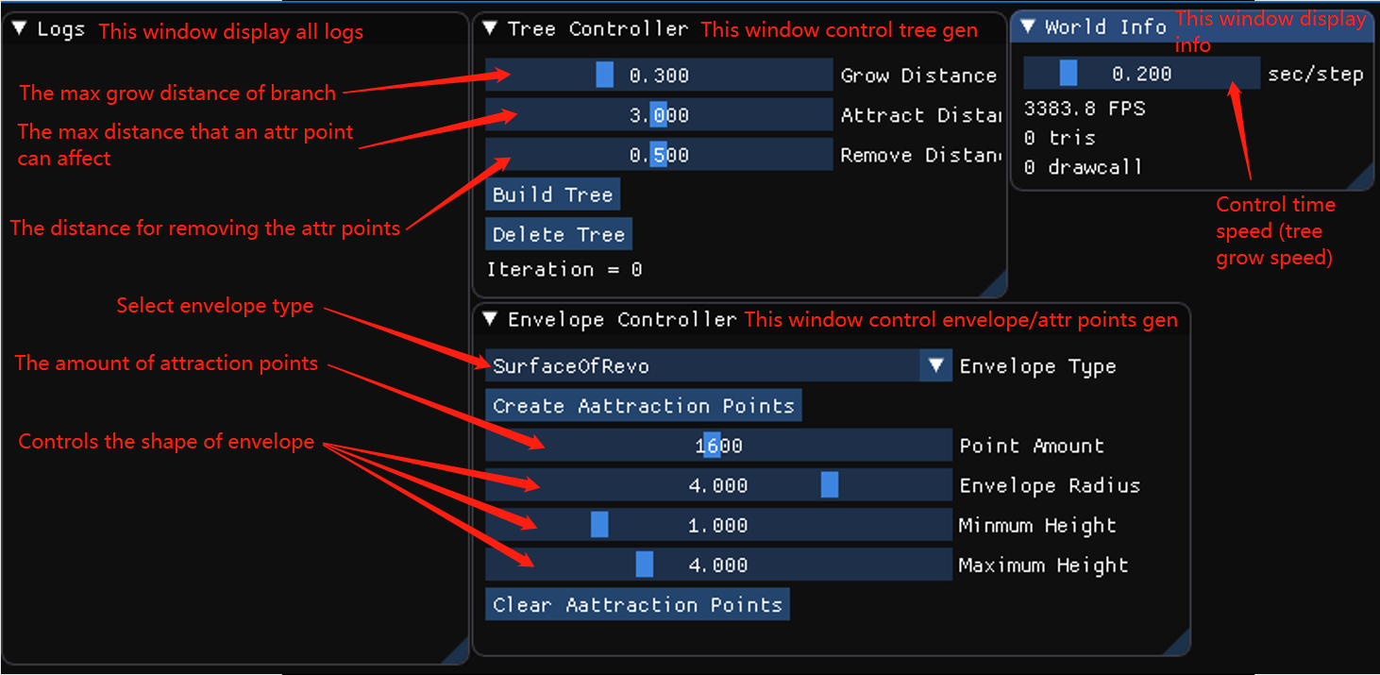
Menu

Slide 6
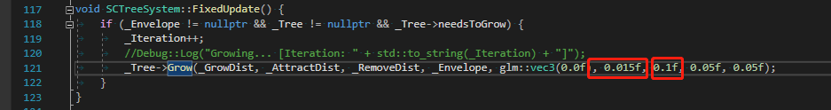
Other controls
Grow distance: On the paper, it was not discussed about factors that decide the changing of the grow distance throughout different iterations (Branches tends to grow shorter in later iterations). However, the pictures on paper clearly showed the decrease of the grow distance. Therefore I added my own decrease method:
For a new child from the same branch, the grow distance decrease significantly.
For every higher level of branch, the grow distance decrease by a constant, until it reaches minimum preset.
In the program the decrease rate is set to 0.015, and minimum distance is set to 0.1. Changing these factors may result in tree that is unable to consume all attraction points.

Slide 7
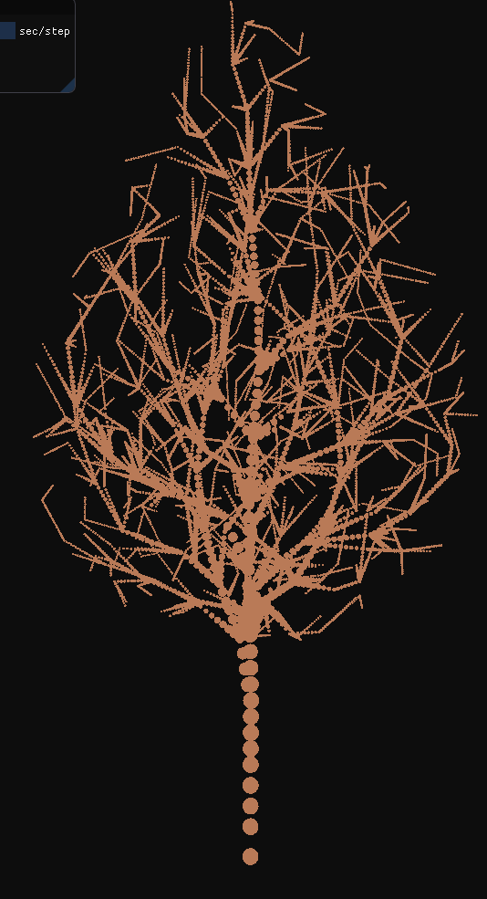
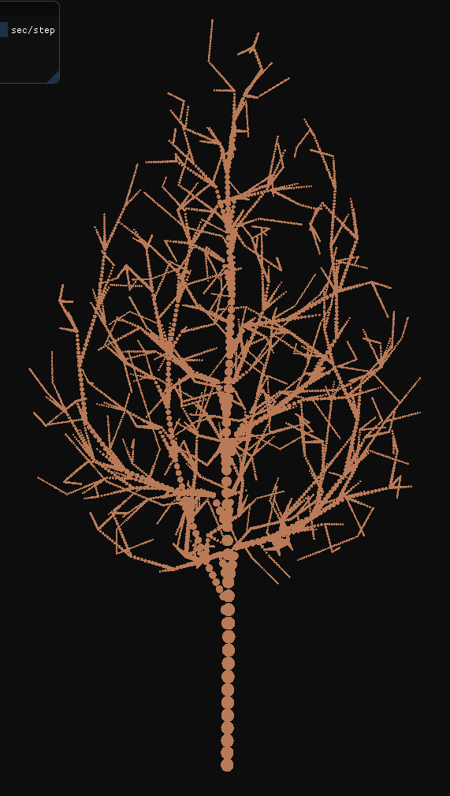
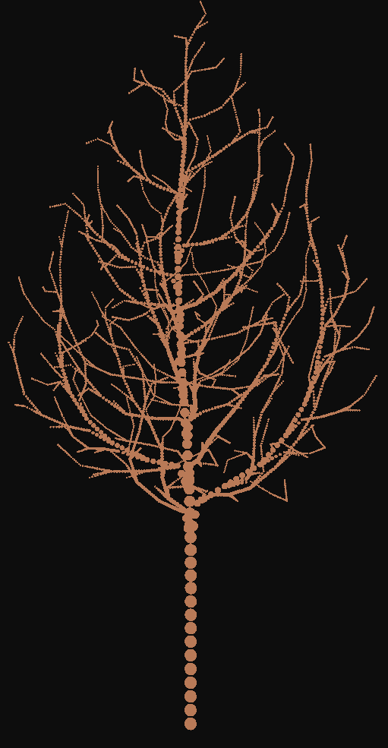
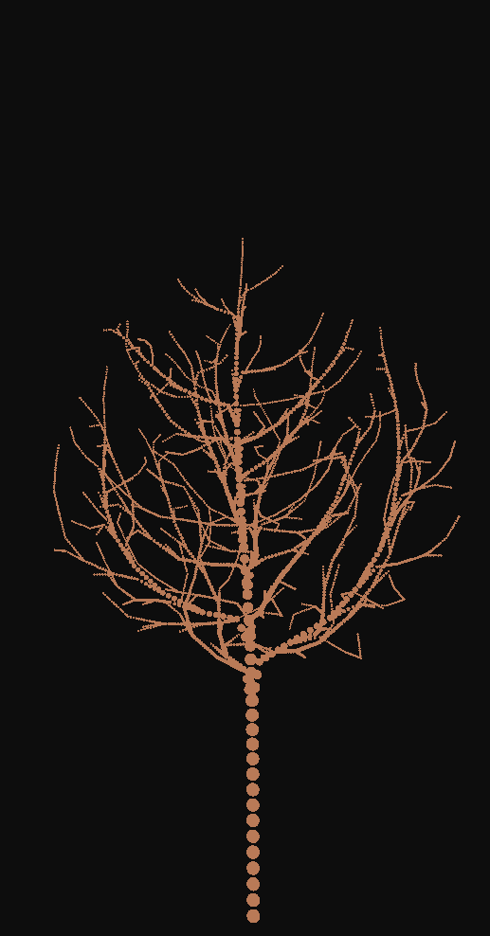
(Continues…)
The tree with constant grow distance from the start to the end.
The tree with decreased grow distance for new children for same branch.
The tree with decreased grow distance for new children for same branch, and decreased grow distance every new level of branches.
Same from 3 with the minimum grow distance set to 0, which results in tree that is unable to consume all attraction points before finishing.

Slide 8
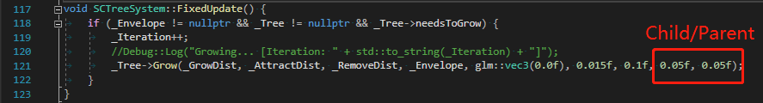
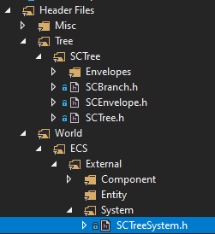
Node decimation
The node will be decimated if it is too close to its parent or any of its children. The distance can be set from here:

Slide 9
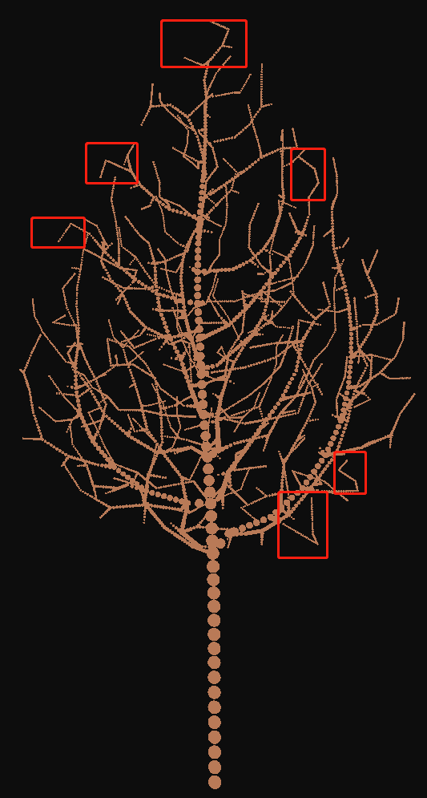
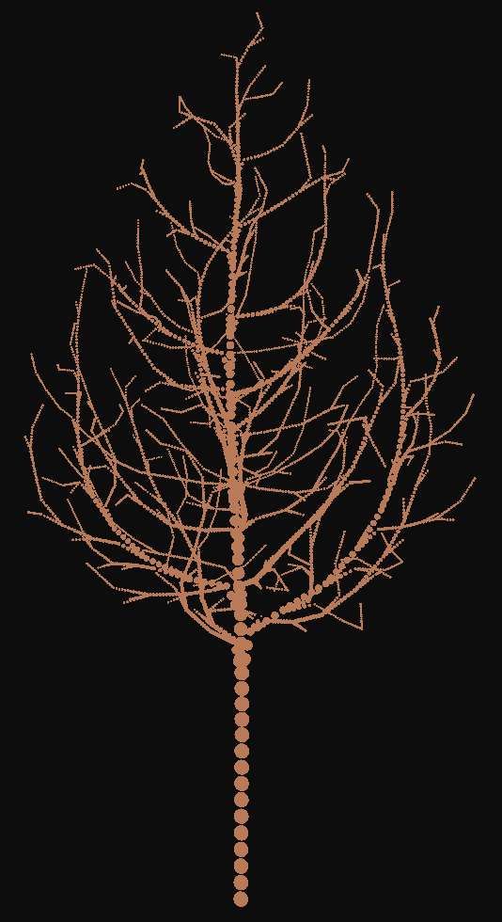
Node relocation
(Create more natural appearance…)
Before
After

Slide 10
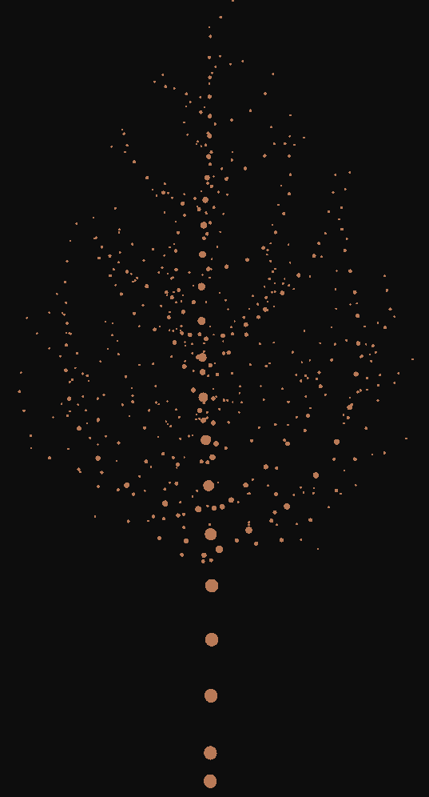
Node Subdivision
(Forming chains for each branch…)
Before
After

