Slide 1
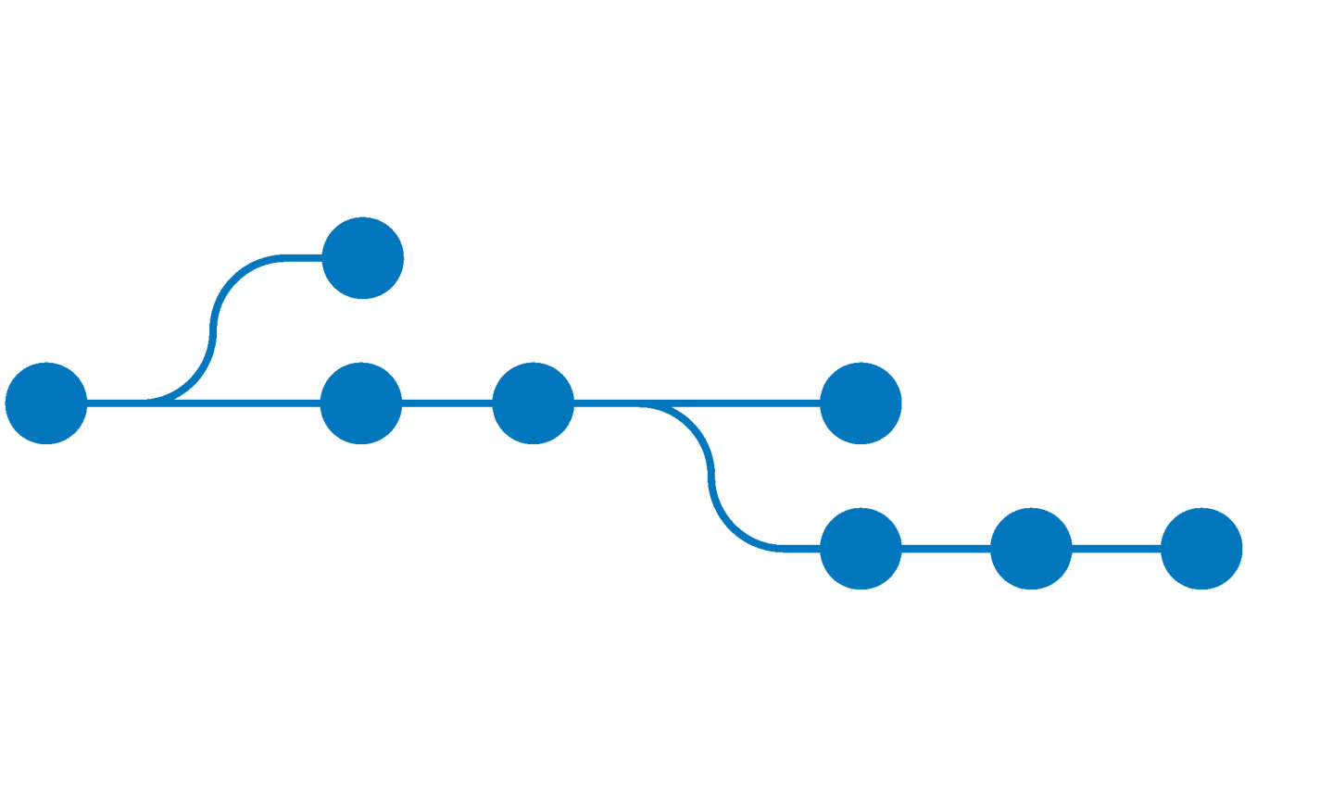
Gettin’ the hang of git
Version control and why git matters

Slide 2
What we’ll talk about
Collaborative software development
Struggles and problems
git – how does git work?
Basic workflow (to git gud ( ͡° ͜ʖ ͡° ))
Hints regarding RoboLab 2018
Feel free to raise your hand and ask questions.

Slide 3
Software Engineering in a team
Complex projects require teams of developers
Modern SE is collaborative and distributed
Division of labor as central aspect
Integration of sub parts to one whole
→ How do you manage the code base?

Slide 4

Easy!
USB drives! Just share source code between colleagues via flash drives!
?!

Slide 5
Problems with the“easy” solution
Division of labor is difficult
File corruptions and other catastrophes?
Undo changes?
Versioning?
What is the current common ground?
Recover from chaos, hate and despair?

Slide 6
Version Control System (VCS)
Tracking of distributed documents and changes to them
Source code management
Recover previous states
Automatic integration (merging) of changes and revisions
Essential for organization of multi-developer-projects

Slide 7
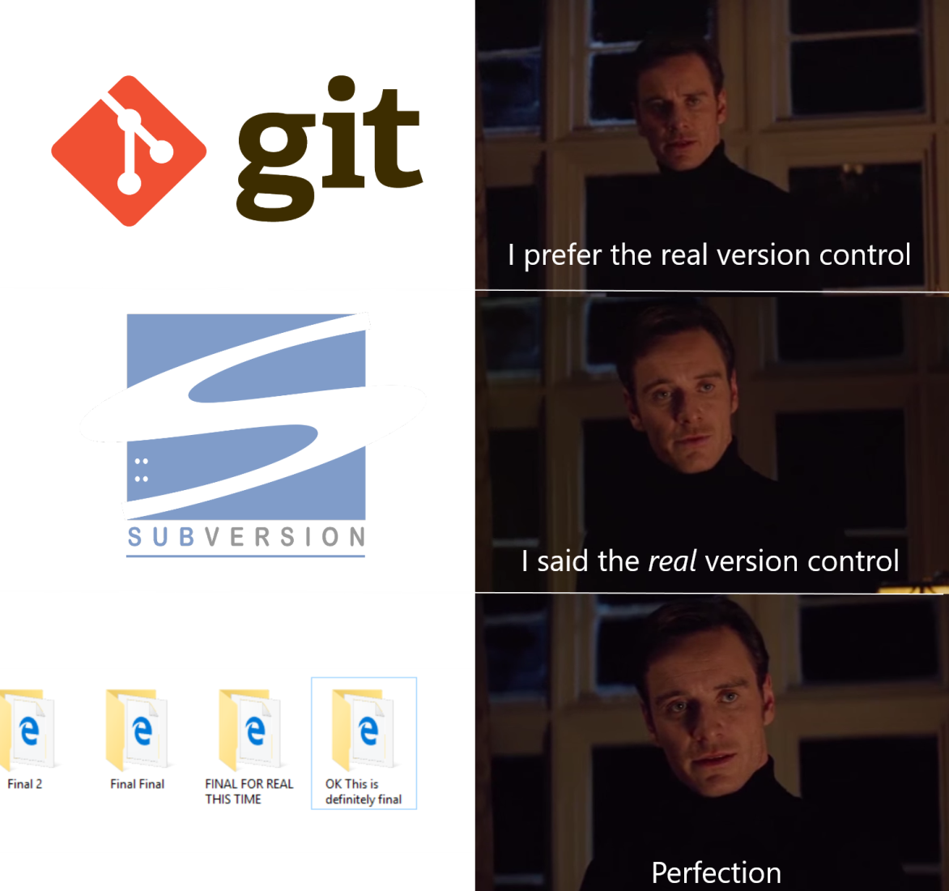

Slide 8


git to the rescue
Distributed VCS
Cooperative working on a project
Managing projects in form of repositories
Support by web-based hosting services like GitHub or Bitbucket
Available for Linux, Windows and macOS

Slide 9
The guts of git
Every developer works on a local copy of the project (local repository)
git manages changes in the form of commits
Commits are published on remote repositories
Developers can integrate changes of other devs by using the remote repository

Slide 10
How to get git
Debian/Ubuntu/WSL
Windows
git bash: https://git-scm.com/download/windows
WSL (Windows Subsystem for Linux)
macOS
https://git-scm.com/download/mac
sudo apt-get install git-all

Slide 11
git – basic workflow
Every directory can be managed by git.
Initializes/copies a repository in the current working directory
Now files can be added to the index
git manages all files that were added to the index
git init
or
git clone <url>

Slide 12
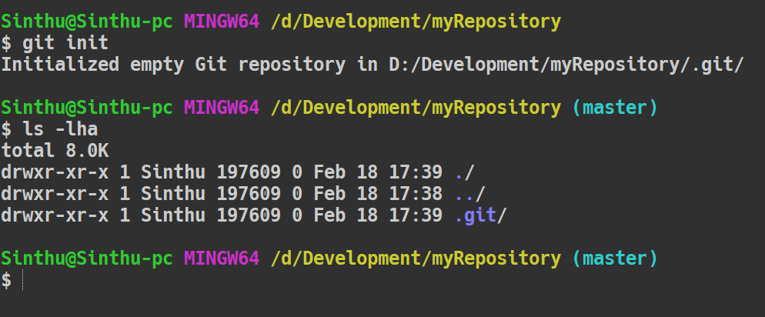
git init - result
hidden folder for git
master branch (explained later)

Slide 13
git – basic workflow
Copies an existing repository in the current working directory
URL specifies the location of the remote
git clone <url>

Slide 14
git – basic workflow
After initialization or cloning, work can be done on files
Creating/updating/deleting files
git registers changes in the current working directory
Changes can then be published
add, commit, branch, push , pull and merge are elementary commands

Slide 15
status of the repository
git status
Summary of changes since the last commit
Lists new, deleted and changed files
Tool to decide which changes should be included in the next commit

Slide 16
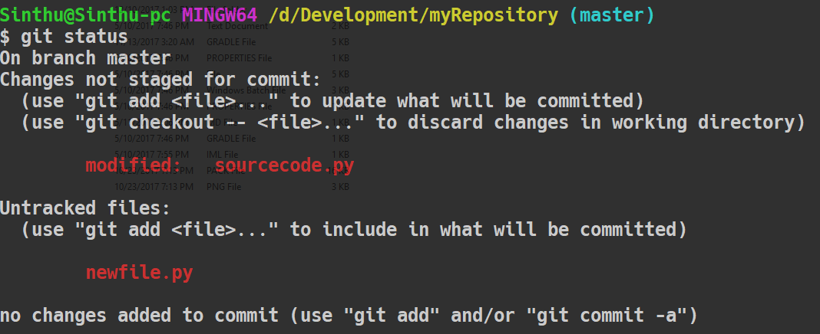
git status - result
Tracked, but modified
Not in the index yet

Slide 17
git – basic workflow
Adding files to the git index is called staging.
git add <filename>
git add *.<exstension>
adds file <filename> to the index
git add .
adds all files of extension <extension> to the index
adds all files to the index

Slide 18
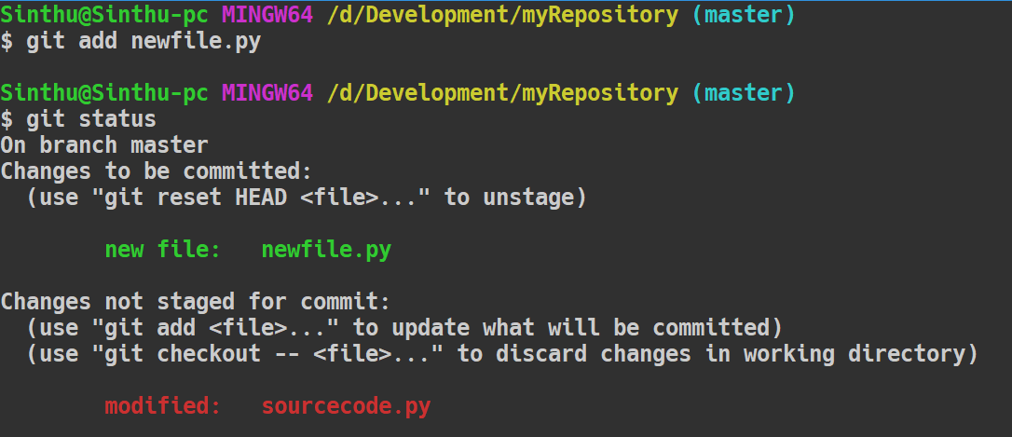
Adding changes and status check
adding newfile.py
A new file in the commit appeared!
I’m not new, but different

Slide 19
git commit
„A commit describes and adds a set of changes on resources to a repository.“

Slide 20
git commit
git commit –m “commit message”
Bundles changes to a commit
Changes are committed to the VCS and saved locally
commit message
Should be a meaningful description of changes made by the dev
Is visbible information for other developers

Slide 21
The emphasis lays on meaningful…
Bad commit messages I encountered @robolab and/or @work:
git commit –m “still crashes -.- pls end me!”
git commit –m “fixed some merge conflict sh*t”
git commit –m “kill it! just kill it with fire.”
git commit –m “what am even I doing with my life?”

Slide 22
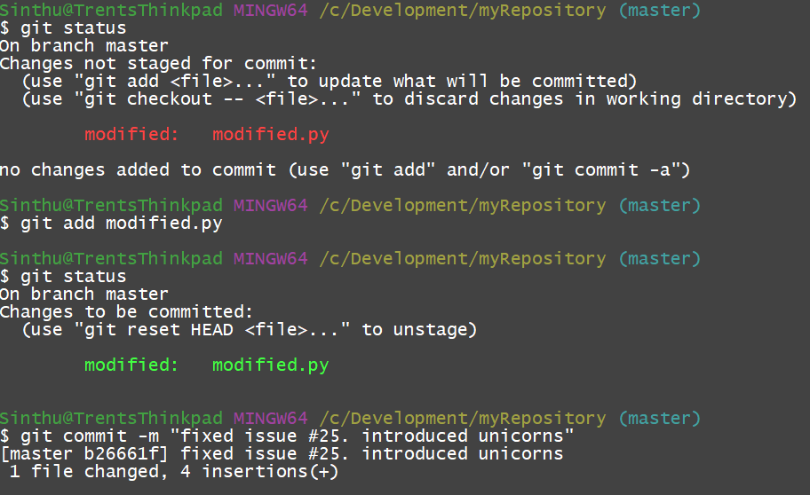
Preppin’ a little commit…

Slide 23
git commit
Every commit can be identified by a hash value associated to it
Repositories can be reset to a previous state with the hash values
Commits are initially local and only influence your own working directory

Slide 24

Now, you might ask yourself…
How is this process collaborative?
How do you publish your changes?
And most important: where do you publish your changes to?

Slide 25
git remote got you covered
git remote add <alias> <url>
Connects local repository with a remote repository
<alias>: alias, under which the remote is known locally
<url>: location of the remote repository
Lists all available remote repositories
git remote –v

Slide 26
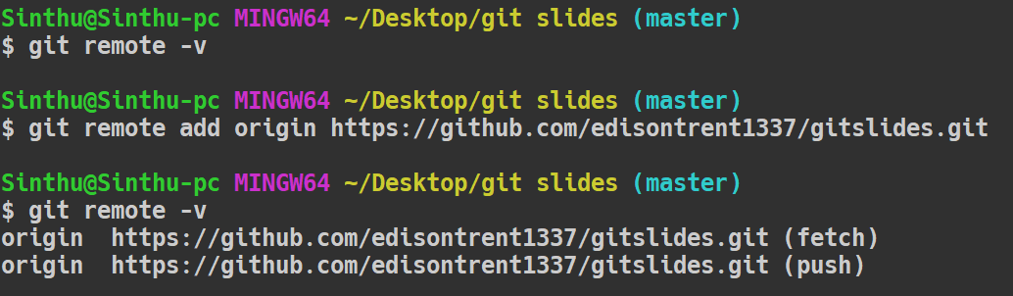
Establishing some connections
Mapping of aliases and remote URLs

Slide 27
git remote – update URL
git remote set-url <alias> <url>
Updates the remote URL of a given alias
You need this instruction later when starting to work with the template

Slide 28
Share your bugs with the world!™
git push <alias> <branch>
Pushes all unpublished commits on the branch <branch> of the remote repository called <alias>
origin is default local alias for remote repository
Alias simplifies pushes, fully qualifying the URL is not required
Authentication is required every time when using https

Slide 29
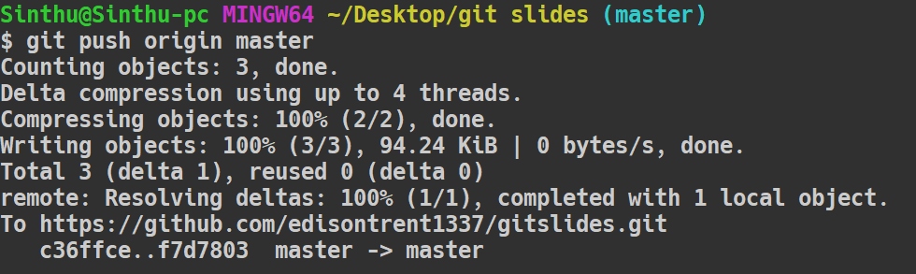
A successful push

Slide 30
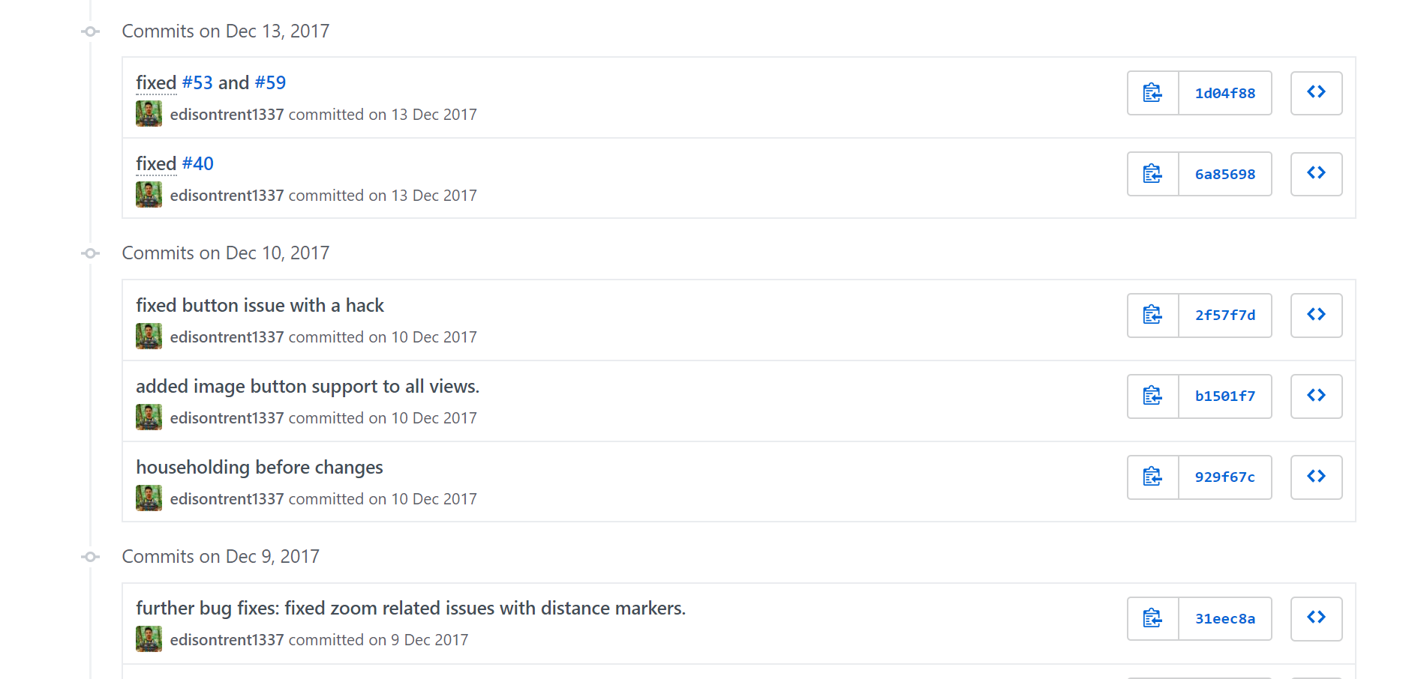

Slide 31
Branches – let’s get crazy
Represent separate history of a state of the repository
Separate views on the same repository
Used to develop features independently from other branches and developers
master is the default branch

Slide 32
git branch
Creates a new branch called <name>
Branch is an exact copy of the current branch → both branches are even
Changes the current branch to <branch>
Future changes now only apply to new branch
git branch <name>
git checkout <branch>

Slide 33
Dude… check out ‘git checkout’
Enables changing between views of different objects in the repository
git checkout works for single files, commits and branches
Short form for creating a branch and switching to it immediately
git checkout -b <branch>

Slide 34
Branching visualized
commits
awesome_feature
2
master
1
3
4
5
other_feature
6
7
8
new branch checkout

Slide 35
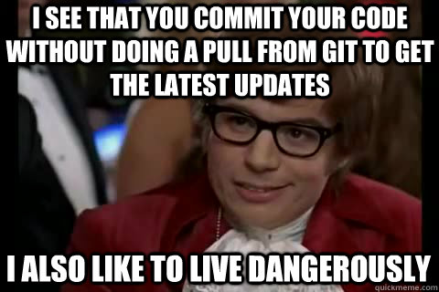
Staying up-to-date
How to integrate the new bugs my colleague just programmed?

Slide 36
git pull
git pull
Fetches the most recent state of the remote repository
Local view of the repository gets updated
Short hand for fetching remote state and auto merging
git tries to auto-merge both versions of the codebase
What could possibly go wrong?

Slide 37
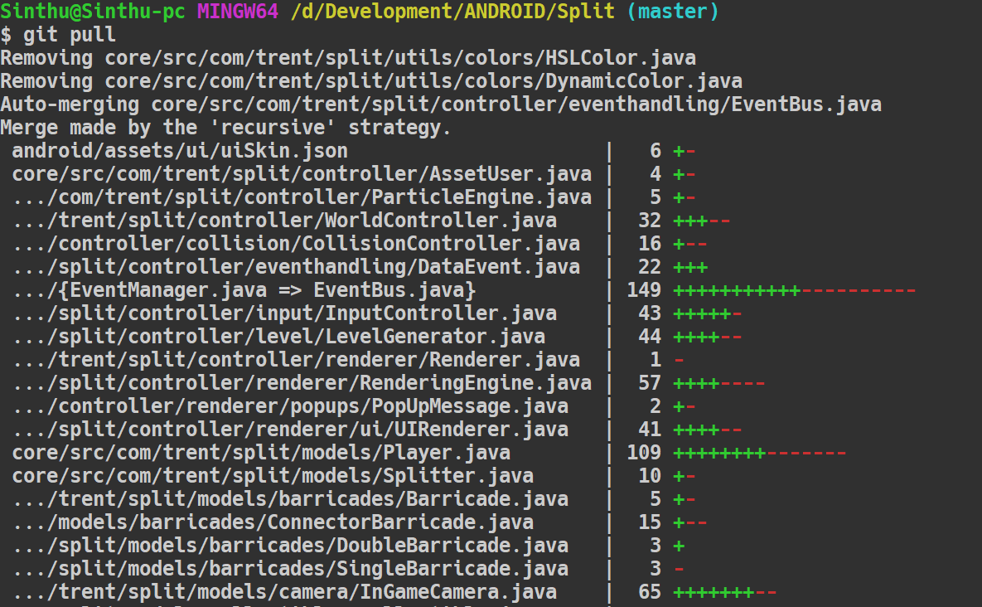
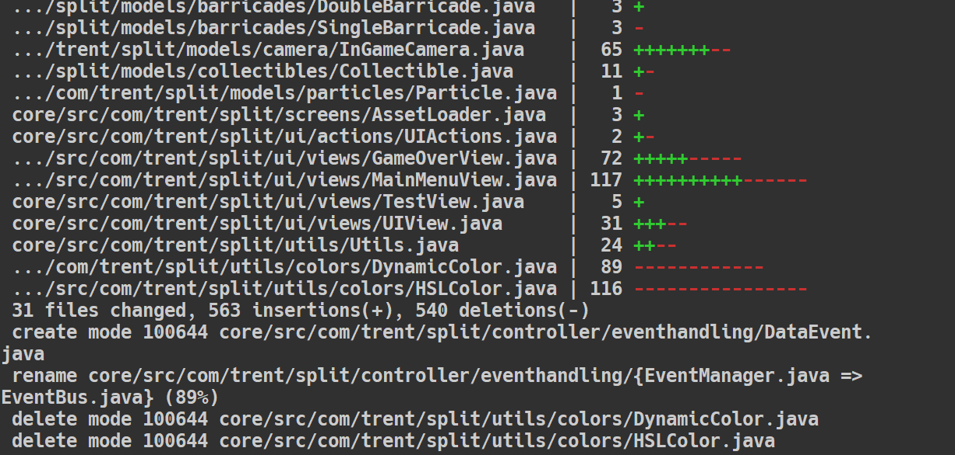

Slide 38
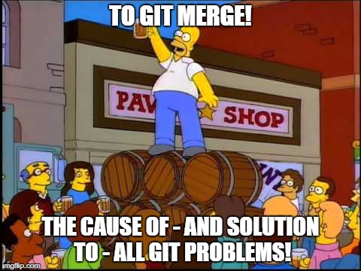
git merge

Slide 39
git merge – The integration step
git merge <otherbranch>
Integrates state of <otherbranch> into current branch
Is always triggered on a pull
If merge fails (and boy they do), you are presented with merge-conflicts
That sounds terrifying, because at first, it is!

Slide 40
A simple file in conflict
<<<<<<< HEAD:hello_world.py
print(“Hello World!")
=======
print(“Hello!")
print(“Good Bye, World!")
>>>>>>>24b9b78:hello_world.py
local version
conflict resolution markers
remote version
hello_world.py

Slide 41
Resolve the conflict by hand
Remove the conflict resolution markers
Craft a solution of the code that fits your needs
Solution can be a mix of the local and remote state
Add the resolved files, commit and push them

Slide 42
Faith in humanity restored
print(“Hello World!")
print(“Good Bye, World!")
local version
merged version
remote version
hello_world.py

Slide 43
Merge conflicts
Conflicts occur if…
Remote changes were not integrated properly
Remote and local state of files or branches differ “too much”
So please…
Always pull remote changes before you start working
Communicate in your team to avoid merge conflicts
Use branches to divide work
Avoid multiple people working on the same file

Slide 44
Undoing your screwing
git reset
Unstages a commit in progress but your local changes stay
Unstages all files and deletes all changes since last commit
Do not do this if there is work you want to keep!
git reset –-hard

Slide 45
Almost done
Any general questions before we tackle details to git during RoboLab2018?
?

Slide 46
Hints regarding the internship
The use of git is mandatory
Commit regularly: avoid 1000 line monolithic commits
Commit quality and frequency can and will influence your grade
Commits should be evenly distributed between all members
On exam day, the last state of the master branch counts

Slide 47
Gettin’ started
Create a Bitbucket account & tell your tutor your username, also install git ( ͡° ͜ʖ ͡° )
You will be granted access to the robolab-template-lab repository
Only one of the team members clones the repository using the following instruction (recursively!!)
git clone --recursive https://bitbucket.com/SE-Robolab/robolab-template-lab.git

Slide 48
Gettin’ started
Change the remote URL to point to your own team repository on Bitbucket that we prepared for you, using
Replace <id> with your group id with leading zeros!
Verify that the remote now points to your team repo with
git remote set-url origin https://bitbucket.org/robolab-autumn-18/group-<id>
git remote -v

Slide 49
Getting’ started
Perform an initial commit and push it using
All remaining team members clone the freshly populated team repo using:
git push origin master
git clone https://bitbucket.org/robolab-autumn-18/group-<id>

Slide 50
Last advice for working with git
Be careful!
Read the documentation!
Do not blame the software, blame yourself!
Talk to each other to avoid conflicts! Communication is key!
And of course: Have fun!

Slide 51
Done. It’s time to GIT GUD
Any questions remaining?
Please ask!
?

