Slide 1
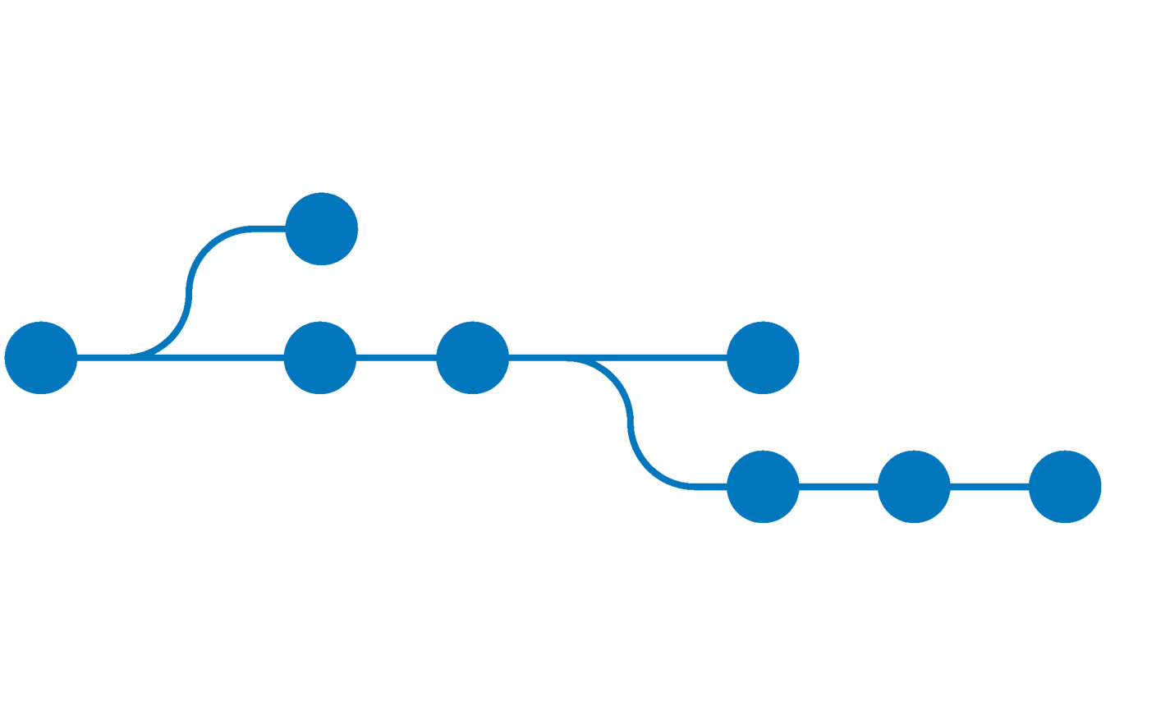
Gettin’ the hang of git
Version control and why git matters

Slide 2
What we’ll talk about
collaborative software development
struggles and problems
git – how does git work?
basic workflow (to git gud ( ͡° ͜ʖ ͡° ))
hints regarding Robolab 2018

Slide 3
Software Engineering in a team
complex projects require teams of developers
modern SE is collaborative and distributed
division of labor as central aspect
integration of sub parts to one whole
→ How do you manage the code base?

Slide 4

Easy!
USB drives! Just share source code between colleagues via flash drives!
?!

Slide 5
Problems with the“easy” solution
division of labor is difficult
file corruptions and other catastrophes?
undo changes?
versioning?
recover from chaos, hate and despair?
What is the current common work base?

Slide 6
Version Control System (VCS)
Tracking of distributed documents and changes to them
Source code management
recover previous states
automatic integration (merging) of changes and revisions
essential for organization of multi-developer-projects

Slide 7


git to the rescue
distributed VCS
cooperative working on a project
managing projects in form of repositories
support by web-based hosting services like GitHub or Bitbucket
for Linux, Windows and macOS available

Slide 8
The guts of git
every developer works on a local copy of the project (local repository)
git manages changes in form of commits
commits are published on remote repositories
developers can integrate changes of other devs by using the remote repository

Slide 9

How to get git
Debian/Ubuntu und WSL
Windows
git bash: https://git-scm.com/download/windows
WSL (Windows Subsystem for Linux)
macOS
https://git-scm.com/download/mac

Slide 10

git – basic workflow
Every directory can be managed by git.
initializes a repository in the current working directory
now files can be added to the index
git manages all files that were added to the index

Slide 11
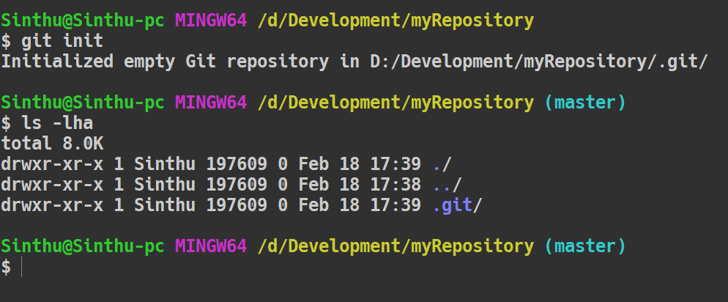
git init - result
hidden folder for git
master branch (explained later)

Slide 12
git – basic workflow
after initialization, work can be done on the
creating/updating/deleting files
git registers changes in the current working directory
changes can then be published
add, commit, branch, push and pull are elementary commands

Slide 13

status of the repository
resume of changes since the last commit
lists new, deleted and changed files
tool to decide which changes should be included in the next commit

Slide 14
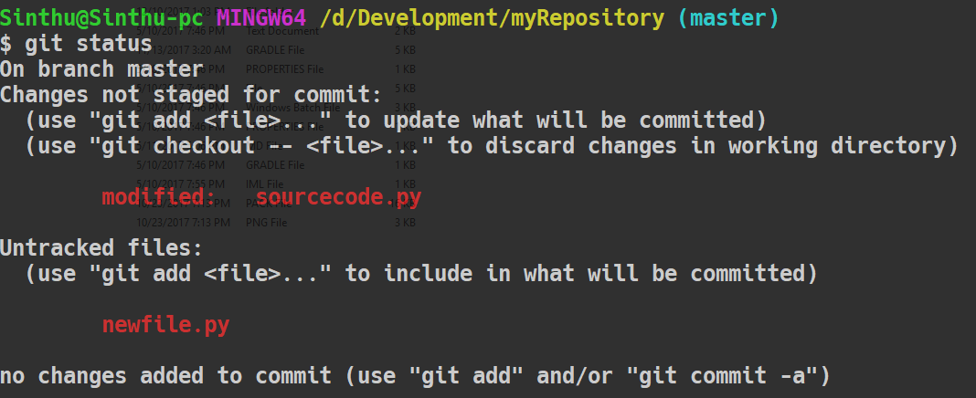
sourcecode.py
was modified
new file newfile.py

Slide 15



git – basic workflow
Adding files to the git index is called staging.
adds file <filename> to the index
adds all files of extension <extension> to the index
adds all files to the index

Slide 16
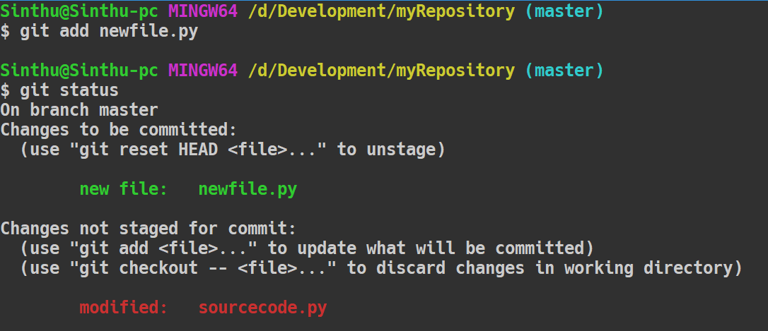
adding newfile.py
new file newfile.py
already exists in the index, but was modified

Slide 17
git commit
„A commit describes a set of changes on resources of a repository.“

Slide 18

git commit
bundles changes to a commit
changes are committed and saved locally
commit message
should be a senseful description of the changes made by the dev
is visbible for other developers
“changed stuff”, “bug fix“, “more work“, “minor changes“ or “pls kill me“ are no good messages…

Slide 19
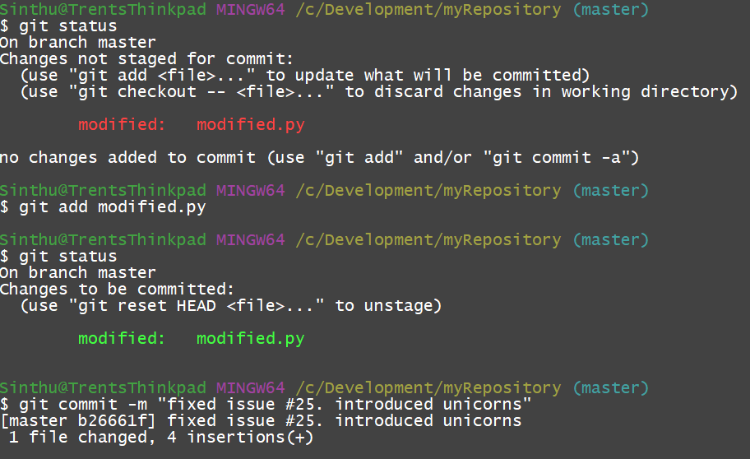

Slide 20
git commit
every commit can be identified by a hash value associated to it
repositories can be reset to a previous state with the hash values
commits are purely local and only influence your own working directory

Slide 21

Now, you might ask yourself…
How is this process collaborative?
How do you publish your changes?
And most important: where do you publish your changes?

Slide 22


git remote got you covered
connects local repository with a remote repository
<alias>: alias, under which the remote is known locally
<url>: location of the remote repository
lists all available remote repositories

Slide 23
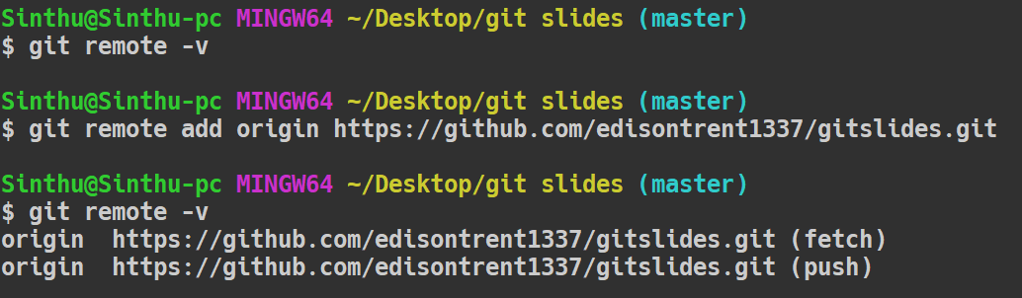
fetch and push for read and write from / to remote
alias origin represents a long URL

Slide 24

Share your bugs with the world!
pushes all unpublished commits on the branch <branch> of the remote repository called <alias>
origin is default local alias for remote repository
alias simplifies pushes, fully qualifying the URL is not requiered

Slide 25
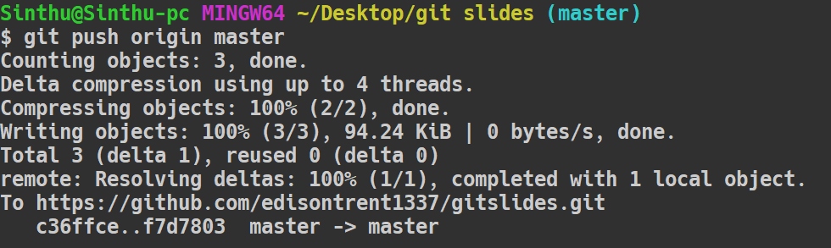

Slide 26
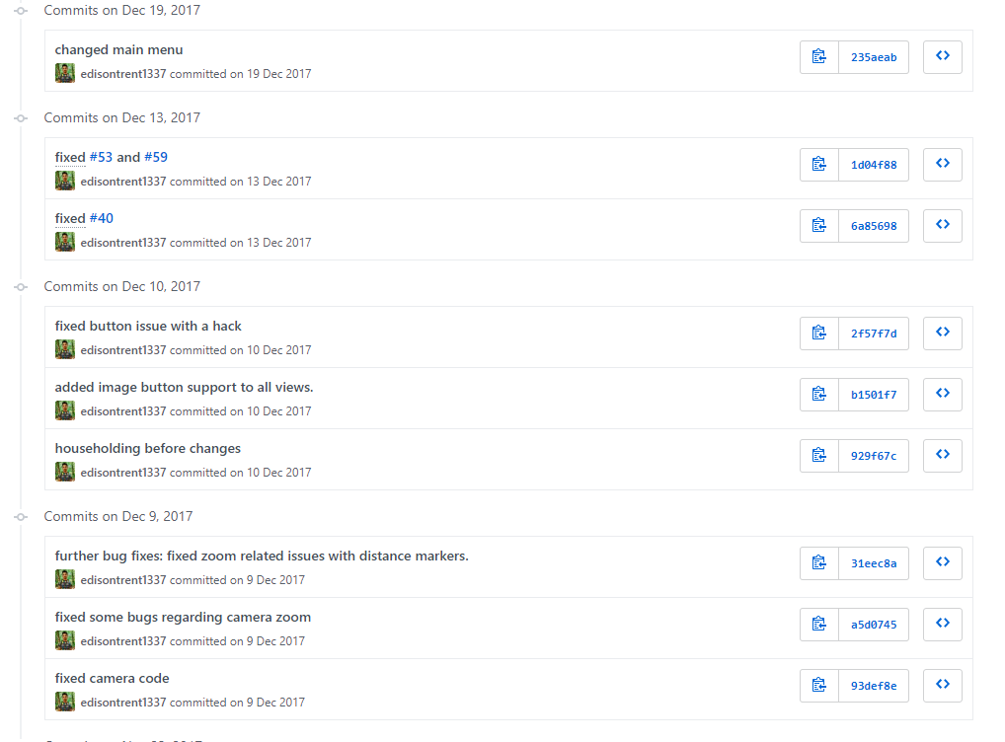

Slide 27
Staying up-to-date
How to integrate the new bugs my colleague just programmed?

Slide 28
Branches
represent separate history of a state of the repository
separate views on the same repository
used to develop features independently from other branches and developers
master is the default branch

Slide 29


git branch
creates a new branch called <name>
branch is an exact copy of the current branch (both branches are even)
changes the current branch to <branch>
future changes now only apply to new branch

Slide 30

Dude… check out ‘git checkout’
enables changing between views of different objects in the repository
git checkout works for single files, commits and branches possible
short form for creating a branch and changing to it immediately

Slide 31
Branching visualized
commits
awesome_feature
2
master
1
3
4
5
other_feature
6
7
8
new branch checkout

