Slide 1


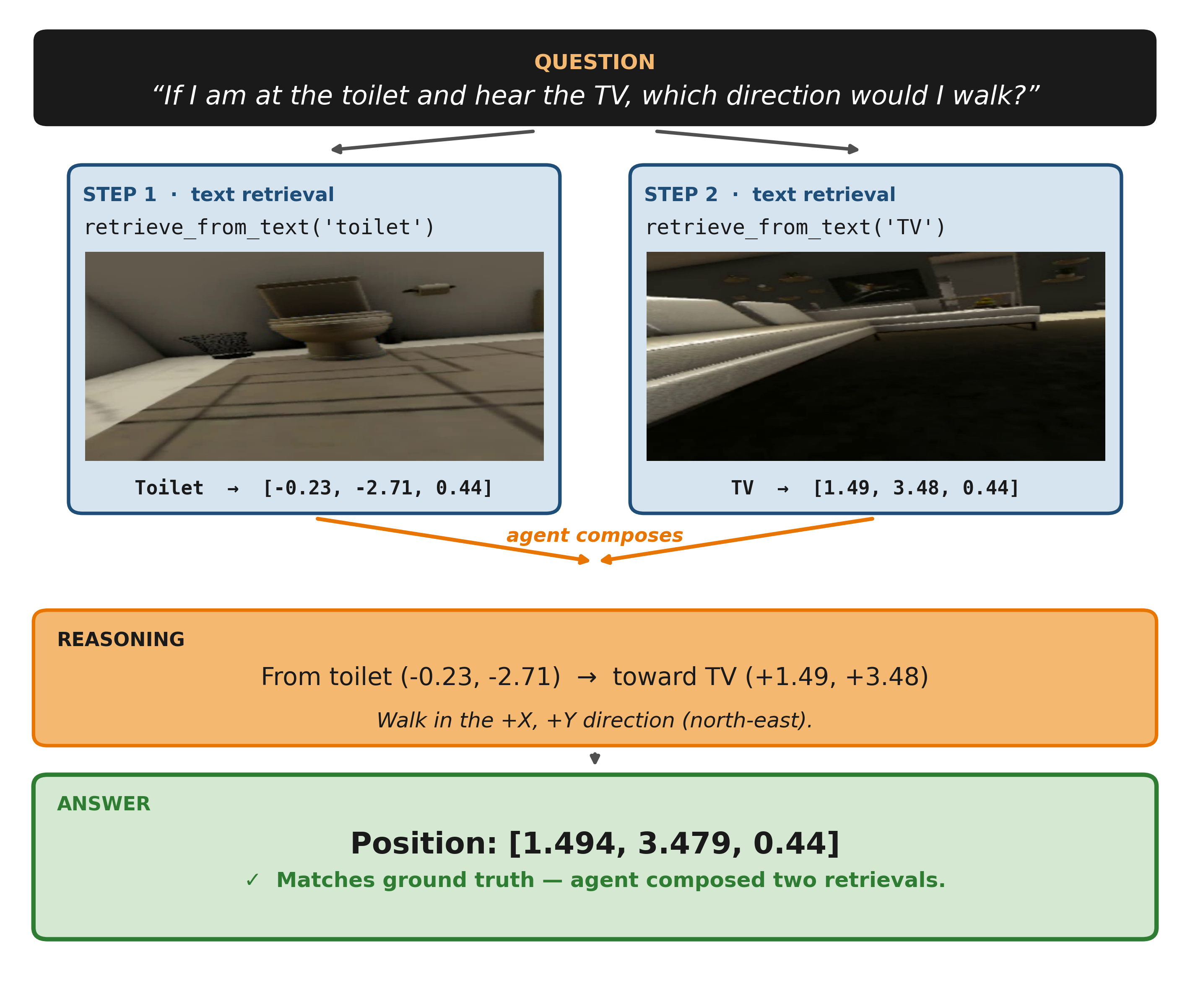
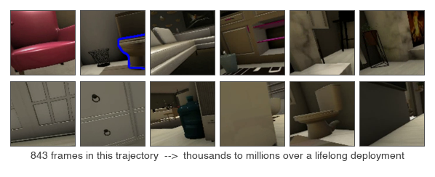
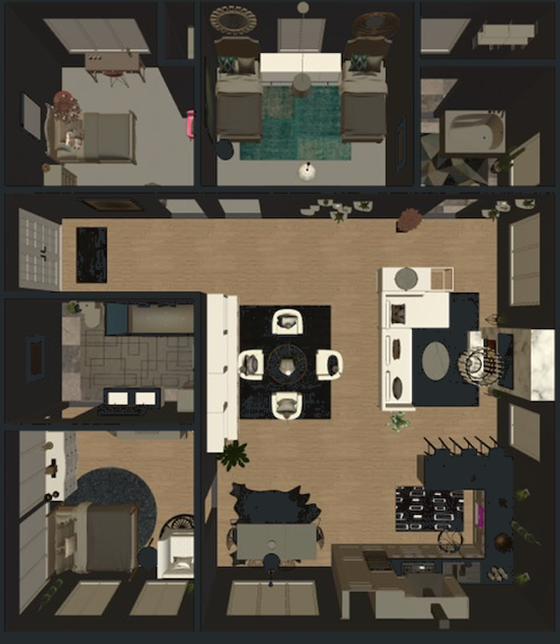
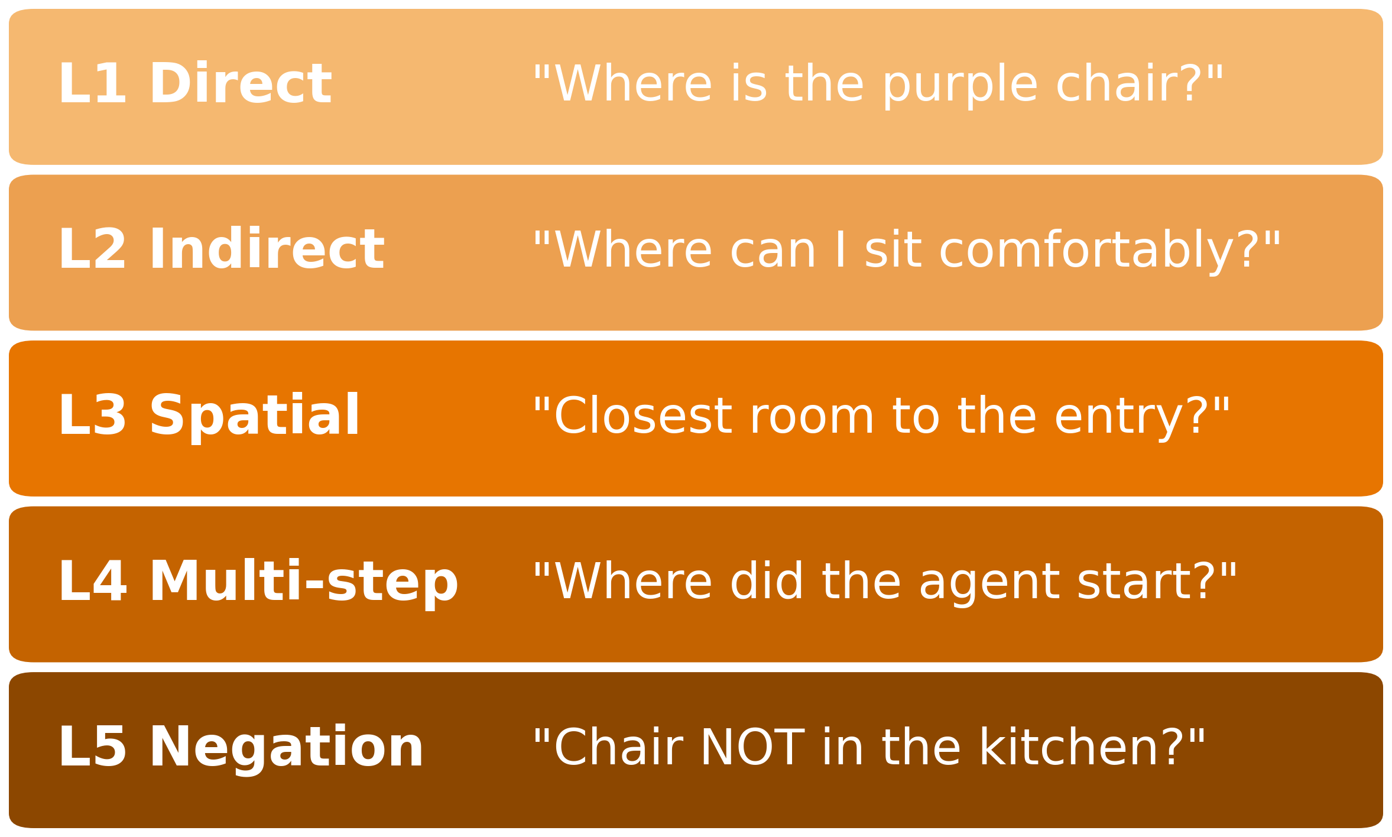
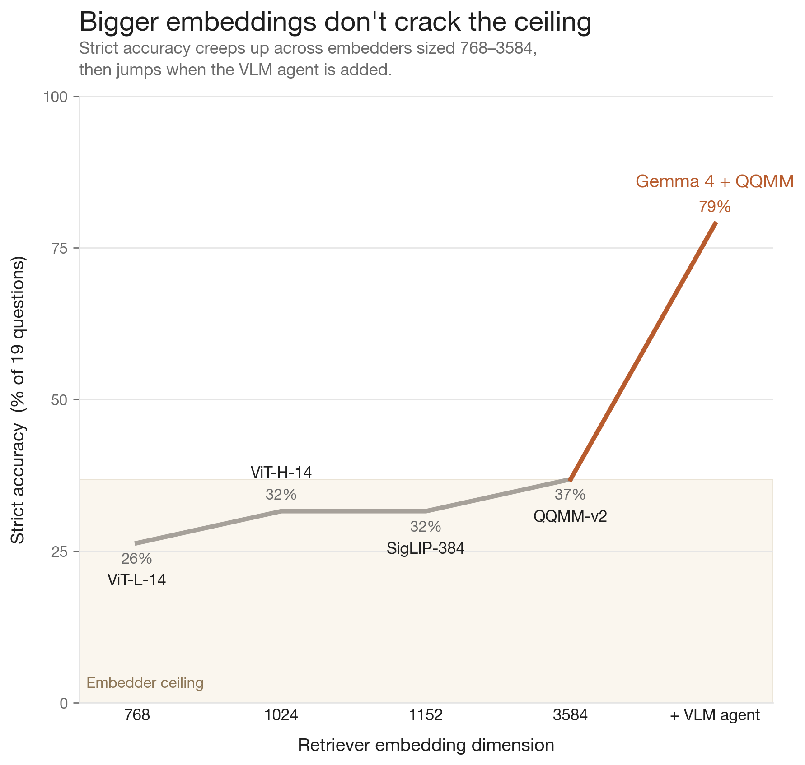
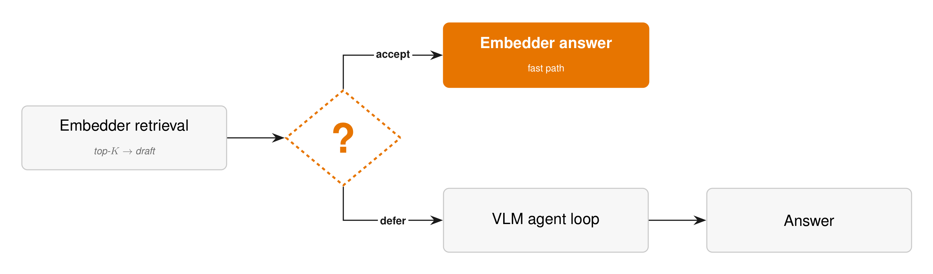
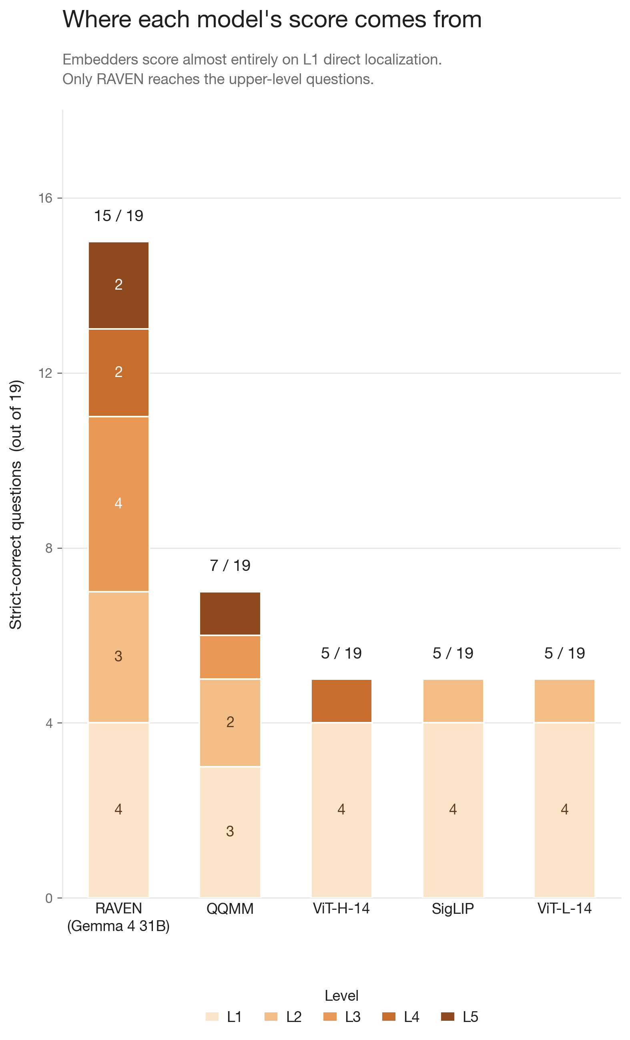
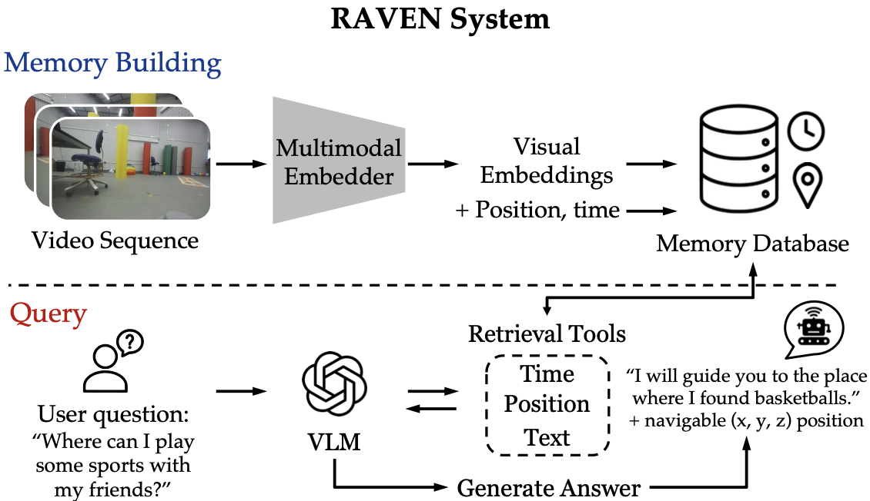
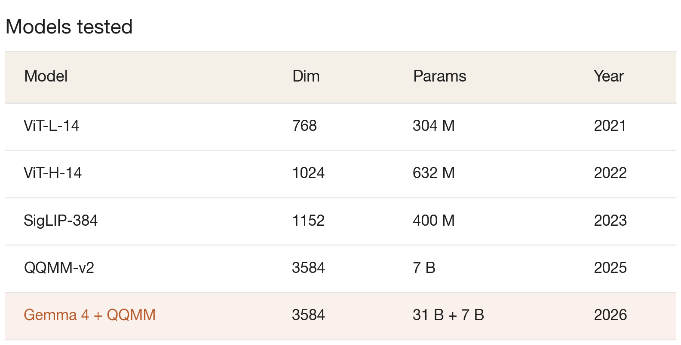
Long-Term Local Memory For Robot Reasoning and Navigation
Edison Zhu, Yixun Hu, Dhruv Shah
How can robots remember?
How well can RAVEN run without the agent, using local models?
Long-term deployment demands memory that is compact (scales to days of experience), information-rich (preserves fine-grained visual detail), and grounded (in space and time).
Today's memory systems fail at least one:
Categorical maps → closed vocabulary, no fine detail.
Raw video → too large to store, too redundant to search.
Caption-based memory → lossy image-to-text bottleneck; loses
pixel-level details and textures.
RAVEN pairs an embedder with a VLM agent that reasons iteratively over retrieved memories. The agent adds compute, latency, and a dependency on closed-source frontier APIs: none of which work offline on a real robot.
This work tests two local configurations:
1. Embedder-only retrieval: a single nearest-neighbor lookup. No agent, no reasoning, no iteration.
2. Full RAVEN with an open-source VLM in the agentic loop.
What did we learn?
Yes, RAVEN runs offline. A local open VLM agent, Gemma 4, on top of QQMM lifts our system from 42% to 82% on the 19-question suite: and that +40 pp gain is concentrated on L3 spatial (+75 pp), L4 multi-step (+38 pp), and L5 negation (+37 pp).
The retriever determines what is findable; the agent determines what is answerable. Embedder-only is a hard ceiling at direct localization (L1) and partial concept generalization (L2) — the agent earns its compute only on the hard half of the suite.
Failure cases are split across both layers:
1. Retrieval-side — embedder fails on abstract/temporal queries
and confuses similar surfaces (marble floor → countertop)
2. Agent-side — retrieval loops on out-of-distribution objects and context carryover from prior wrong answers.
What is RAVEN?
Methodology
We ran every model on the same trajectory: 843 egocentric frames (~14 minutes) captured by an agent walking through an indoor Habitat residence: living room, kitchen, bath, and dining.
We authored a tiered 19-question benchmark over that trajectory. Each level isolates a different capability, so we can pinpoint where on the difficulty curve the VLM agent stops being optional.
RAVEN encodes each robot-view frame with a multimodal encoder and stores it with pose and timestamp in a vector database. A VLM agent retrieves and reasons over these memories iteratively, by semantics, space, or time, to produce text answers and navigation goals.
Memory entry: (visual embedding, position, timestamp)
✓ Compact — sub-linear vector retrieval; scales more easily
✓ Information-rich —preserves texture and detail; no captioning
✓ Grounded — pose + time enable spatial and temporal queries
Future Work
The VLM agent loop costs 2 - 6 VLM calls + tool-use overhead per query; the embedder is essentially free. On L1 and some questions for L2 the embedder already returns the right answer, so if we can decide per query whether to trust it, we skip the agent on every easy query.
Future work proposes three candidate gate mechanisms:
1. Cosine similarity threshold. Gate on retrieved frame’s score
2. Cheap LLM classifier. Small LLM tags query as direct or complex.
3. Trained classifier. Fine-tuned text encoder for queries
References
[1] Y. Hu, Z. Zheng, L. Zha, C. Xing, R. Singh, O. Hossain, A. Loquercio, D. Shah. RAVEN: Long-Horizon Reasoning and Navigation with a Visuo-Spatial-Temporal Memory. RSS, 2026.
[2] A. Anwar et al. ReMEmbR: Building and Reasoning Over Long-Horizon Spatio-Temporal Memory for Robot Navigation. 2024.
[3] A. Radford et al. Learning Transferable Visual Models from Natural Language Supervision (CLIP). ICML, 2021.
[4] X. Zhai et al. Sigmoid Loss for Language-Image Pre-training (SigLIP). ICCV, 2023.
[5] Z. Xue et al. QQMM-embed-v2. huggingface.co/youzexue/QQMM-embed-v2, 2025.
[6] J. Johnson, M. Douze, H. Jégou. Billion-scale similarity search with GPUs (FAISS). IEEE TBD, 2019.
[7] Habitat-Sim / Habitat AI Challenge. aihabitat.org.
[8] JIRL (UPenn). DARPA TIAMAT Competition Code. github.com/Jirl-upenn/darpa-tiamat-competition-code, 2025.
Figure from Hu, Zheng, et al. [1].

