Slide 1
App Building with Node and Express
April 23, 2016

Slide 2
Today’s Task

Slide 3

Use Your Own API
Node + Express allow you to build applications that fuel front-end using backend logic and data that YOU create.

Slide 4
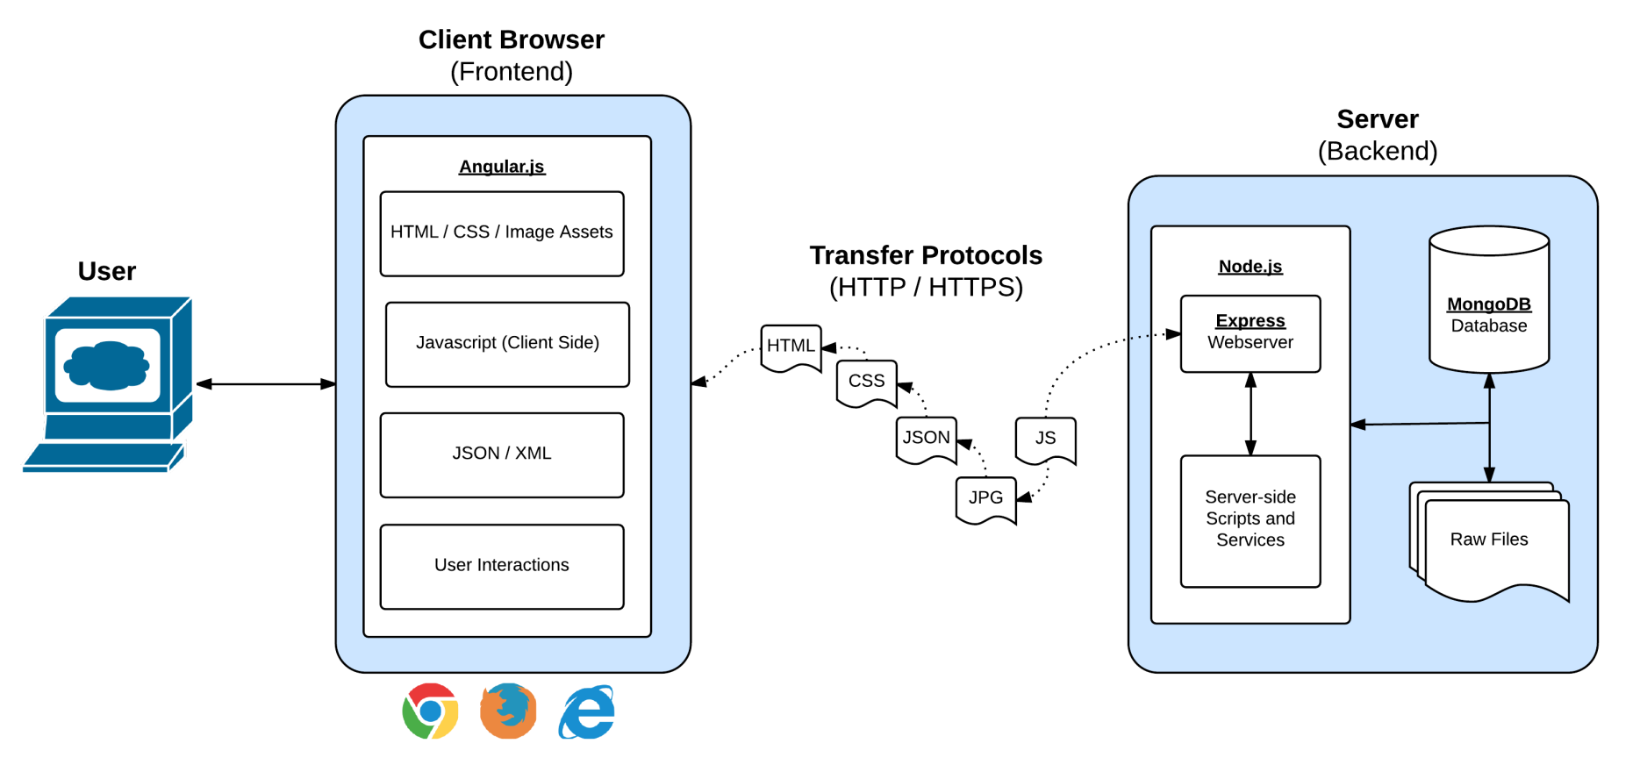
Full-Stack Development
In modern web applications there is a constant back-and-forth communication between the visuals displayed on the user’s browser (frontend) and the data and logic stored on the server (backend).

Slide 5
Stuff To Read Outside
Helpful Resources
https://scotch.io/tutorials/build-a-restful-api-using-node-and-express-4
https://www.codeschool.com/courses/building-blocks-of-express-js
https://scotch.io/tutorials/use-expressjs-to-deliver-html-files
https://scotch.io/tutorials/use-expressjs-to-get-url-and-post-parameters
https://scotch.io/tutorials/keeping-api-routing-clean-using-express-routers

Slide 6

Create a Restaurant Reservation Scheduler!

Slide 7
Create a Restaurant Reservation Scheduler!
Overview:
Your restaurant will have a max of 10 tables. If more than 10 reservations are made, all other customers will be added to the waitlist.
Restaurant admins will be able to notify when a table is available.
Your front-end application will utilize a back-end api to keep track of the available tables, the admins, and the waitlist.
In your first iteration – don’t worry about differentiating admins from customers. We’ll come back to that if we have time.
If you get through everything, begin looking into ways you can send email or text notifications to customers if they can be moved off the waitlist.
Lastly, we’ll deploy our application to Heroku.

Slide 8
Create a Restaurant Reservation Scheduler!
Requirements:
App will have three pages viewable in the browser.
Table Page – listing out all of the seated customers and customers on the wait-list
Reservation Page – a form that triggers customers to be added to available tables or wait-lists
Admin Page – listing out all of the admins to the site
The server will store data inside of a data folder with the following files. Each of these files will hold a simple JSON object that will be “exported” and made available to the express routes.
admin-data
table-data
waitinglist-data
The application will utilize a Express/Node server which has at least the following routes:
GET / – this route will direct viewers to a static: “Welcome to the site!”.
GET /reserve – this route will direct viewers to the reservation page
GET /tables – this route will direct viewers to the table page
GET /admin – this route will direct viewers to the admin page
GET /api/tables – this route will direct viewers to see a JSON of all table data
GET /api/waitlist – this route will direct viewers to see a JSON of all waitlist data
GET /api/admin – this route will direct viewers to see a JSON of all admin data
POST /api/tables – this route will push a user to the table if one is available. If not post to waitlist
POST /api/waitlist – this route will post to the waitlist and should be called if the tables are filled
POST api/admin – this route will create a new admin

Slide 9
Questions

