Slide 1

It’s Game Time: Project Week
Day ??
Rutgers Coding Bootcamp | March 14, 2016
© 2016 | RCB - All Rights Reserved
Notes:
Start at 6:45 PM

Slide 2
Project Week Overview
© 2016 | RCB - All Rights Reserved
Notes:
7:00 – 7:05

Slide 3

Yay!
You made it!!!
© 2016 | RCB - All Rights Reserved
© 2016 | Rutgers Coding Bootcamp - All Rights Reserved

Slide 4
Project Week
Today’s Class:
Divide into groups
Begin researching APIs
Outlining project ideas
Submitting Project Proposal for Approval
Initial Design work
Next Class:
Hardcore Development
Presentation prep
Saturday Class:
Group Presentations
Pizzzzzza!
Awards!!
© 2016 | RCB - All Rights Reserved
© 2016 | Rutgers Coding Bootcamp - All Rights Reserved

Slide 5
The Great Push
Be serious about project week!
Use this as an opportunity to push yourself and prove what you know.
Because you DO KNOW your stuff.
© 2016 | RCB - All Rights Reserved
© 2016 | Rutgers Coding Bootcamp - All Rights Reserved

Slide 6
Teams
© 2016 | RCB - All Rights Reserved
Notes:
7:00 – 7:05

Slide 7
Group Teams
1 – Brian, Adam, Shawn, Wojciech
2 – Dhaval, Dan, Greg, Jeremy
3 – Raghav, Anthony, Maike, Chris
4 – James Kim, Kevin, Robert, Eugene
5 – Waverly, James D, Bryant, Al
6 – Mariah, Leslie, Aaron, Eric
© 2016 | RCB - All Rights Reserved
© 2016 | Rutgers Coding Bootcamp - All Rights Reserved

Slide 8
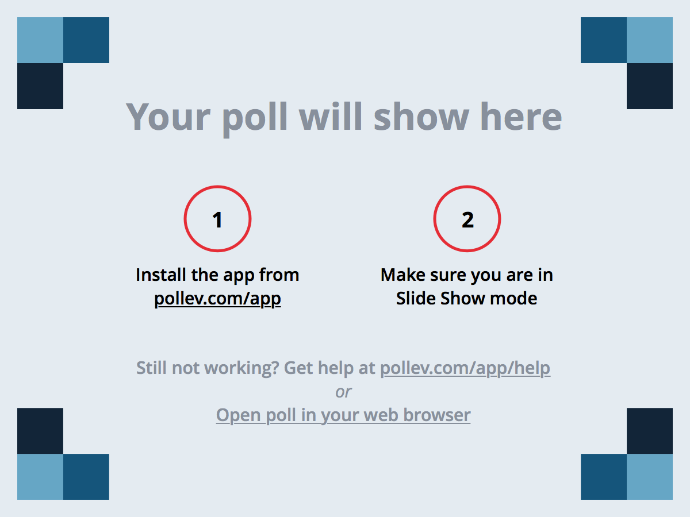
Notes:
Poll Title: During RCB, which of the following has been MOST helpful to your learning? https://www.polleverywhere.com/multiple_choice_polls/rLHIDvpgHzxQ5ho

Slide 9
Task
© 2016 | RCB - All Rights Reserved
Notes:
7:00 – 7:05

Slide 10
Project Task
To build some awesome shiz.
© 2016 | RCB - All Rights Reserved
© 2016 | Rutgers Coding Bootcamp - All Rights Reserved

Slide 11
Coding Requirements
Must uses at least two APIs
Must use AJAX to pull data
Must utilize at least one new library or technology that we haven’t discussed
Must have a polished frontend / UI
Must meet good quality coding standards (indentation, scoping, naming)
Must NOT use alerts, confirms, or prompts (look into modals!)
Must have some sort of repeating element (table, columns, etc)
Must use Bootstrap or Alternative CSS Framework
Must be Deployed (Heroku or Firebase)
Must have User Input Validation
© 2016 | RCB - All Rights Reserved
© 2016 | Rutgers Coding Bootcamp - All Rights Reserved

Slide 12
Coding – Nice To Haves
Utilize Firebase for Persistent Data Storage (Actually I want this. So its basically a requirement)
Mobile Responsive
Use an alternative CSS framework like Material or Foundation
© 2016 | RCB - All Rights Reserved
© 2016 | Rutgers Coding Bootcamp - All Rights Reserved

Slide 13
Presentation Requirement
You will also be responsible for preparing a 10 minute presentation.
This will be a formal presentation.
One in which you explain in detail:
Your overall application’s concept
The motivation for its development
Your design process
The technologies you used (and briefly how they work)
A demonstration of its functionality
Directions for future development
Treat the presentation seriously!
Talking intelligently about tech > doing tech sometimes.
© 2016 | RCB - All Rights Reserved
© 2016 | Rutgers Coding Bootcamp - All Rights Reserved

Slide 14
Metrics
© 2016 | RCB - All Rights Reserved
Notes:
7:00 – 7:05

Slide 15
Metrics
Concept
Design
Functionality
Collaboration
Presentation
© 2016 | RCB - All Rights Reserved
© 2016 | Rutgers Coding Bootcamp - All Rights Reserved

Slide 16
Awards Yay!
Most Awe-Inspiring
Most Useful
Most Creative
Best Use of Tech
Best UI/UX
Most Hilarious
Most Disruptive
Most Socially Conscious
© 2016 | RCB - All Rights Reserved
© 2016 | Rutgers Coding Bootcamp - All Rights Reserved

Slide 17
Past Projects
© 2016 | RCB - All Rights Reserved
Notes:
7:00 – 7:05

Slide 18
Last Class
Let’s take a moment to see what the last class built…
© 2016 | RCB - All Rights Reserved
© 2016 | Rutgers Coding Bootcamp - All Rights Reserved

Slide 19
Last Class
BitCurrent:
http://bitcurrents.herokuapp.com/
FaceCurrent:
http://face-check.herokuapp.com/
ToGoList:
http://to-go-list.herokuapp.com/
GymTrition:
http://gymtrition.herokuapp.com/
OurPets:
https://showusapet.herokuapp.com/
Uh?
https://immense-forest-3648.herokuapp.com/
© 2016 | RCB - All Rights Reserved
© 2016 | Rutgers Coding Bootcamp - All Rights Reserved

Slide 20
Last Class
Yeah. So I think we can crush them.
© 2016 | RCB - All Rights Reserved
© 2016 | Rutgers Coding Bootcamp - All Rights Reserved

Slide 21
API Suggestions
© 2016 | RCB - All Rights Reserved
Notes:
7:00 – 7:05

Slide 22
API Suggestions
Stick to APIs that do all of the following:
Allows CORS
Simple or no authentication
JSON response returned
Well documented
© 2016 | RCB - All Rights Reserved
© 2016 | Rutgers Coding Bootcamp - All Rights Reserved

Slide 23
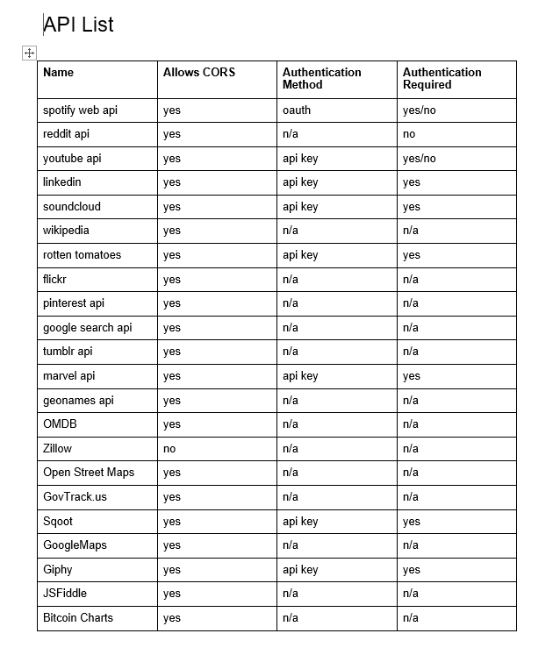
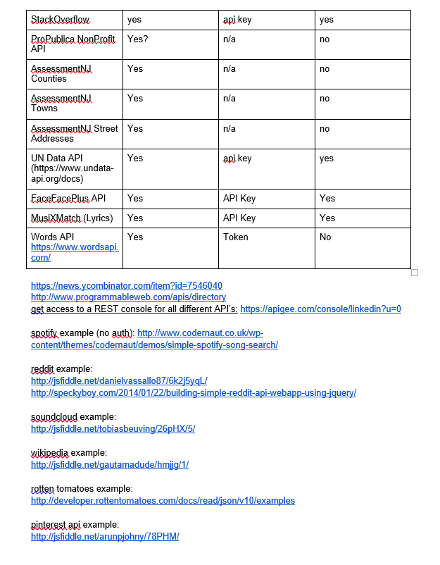
API Suggestions
© 2016 | RCB - All Rights Reserved
© 2016 | Rutgers Coding Bootcamp - All Rights Reserved

Slide 24
Tools
© 2016 | RCB - All Rights Reserved
Notes:
7:00 – 7:05

Slide 25
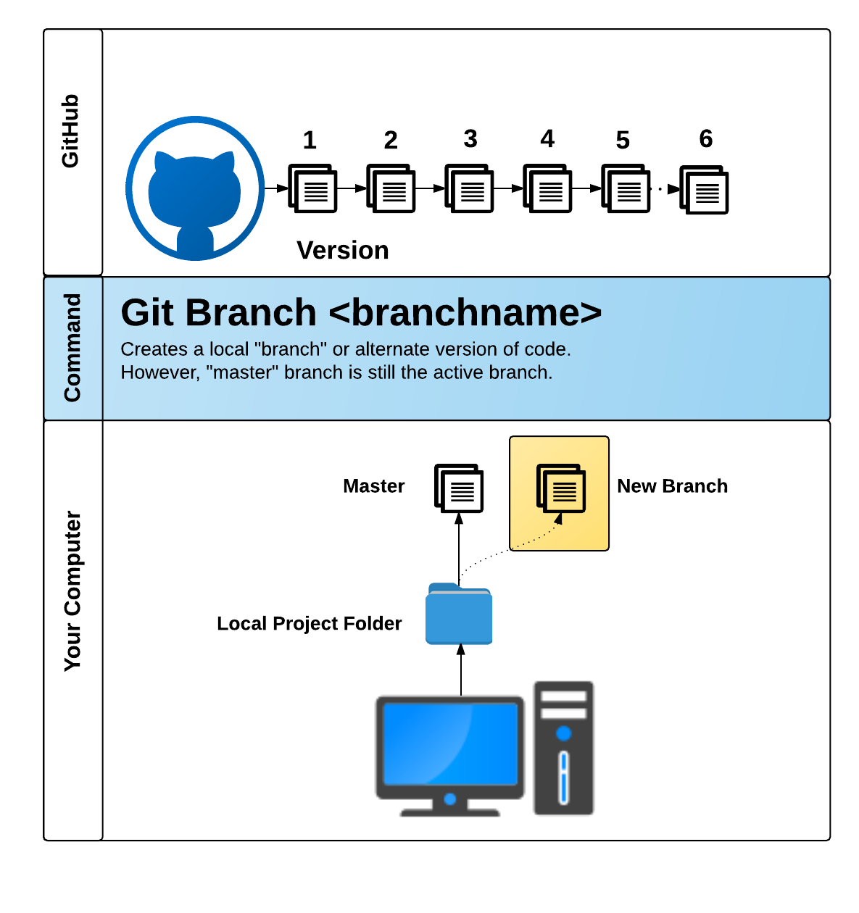
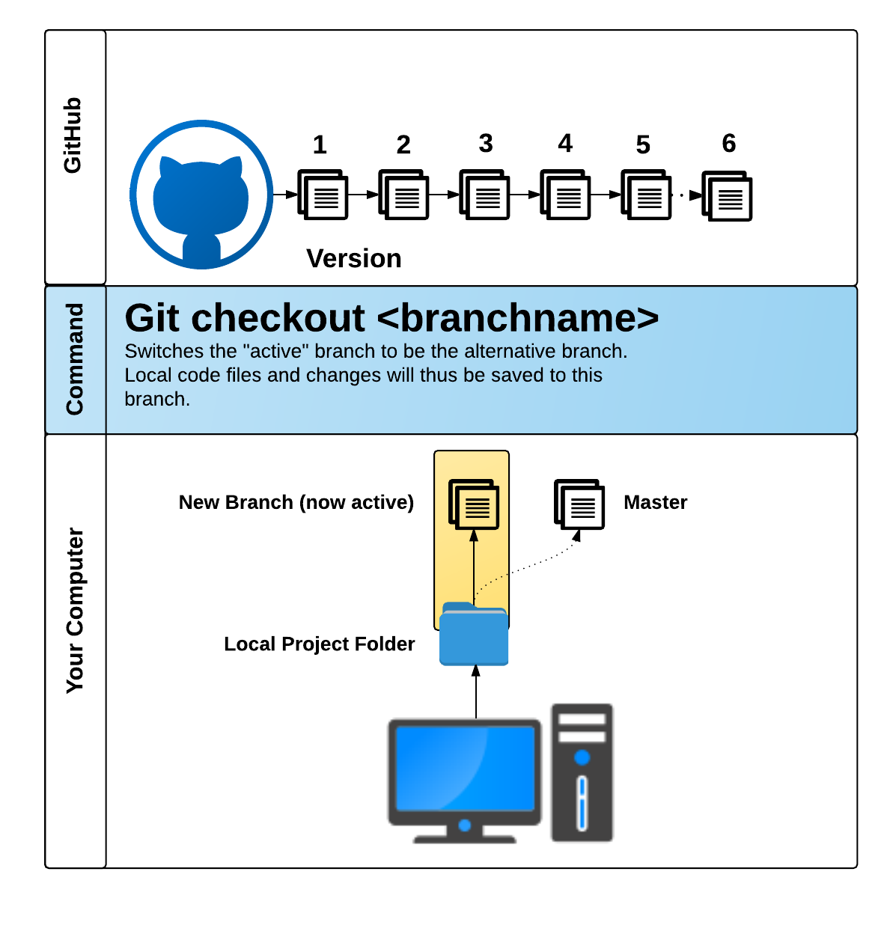
Time to Get Git…
© 2016 | RCB - All Rights Reserved
© 2016 | Rutgers Coding Bootcamp - All Rights Reserved

Slide 26
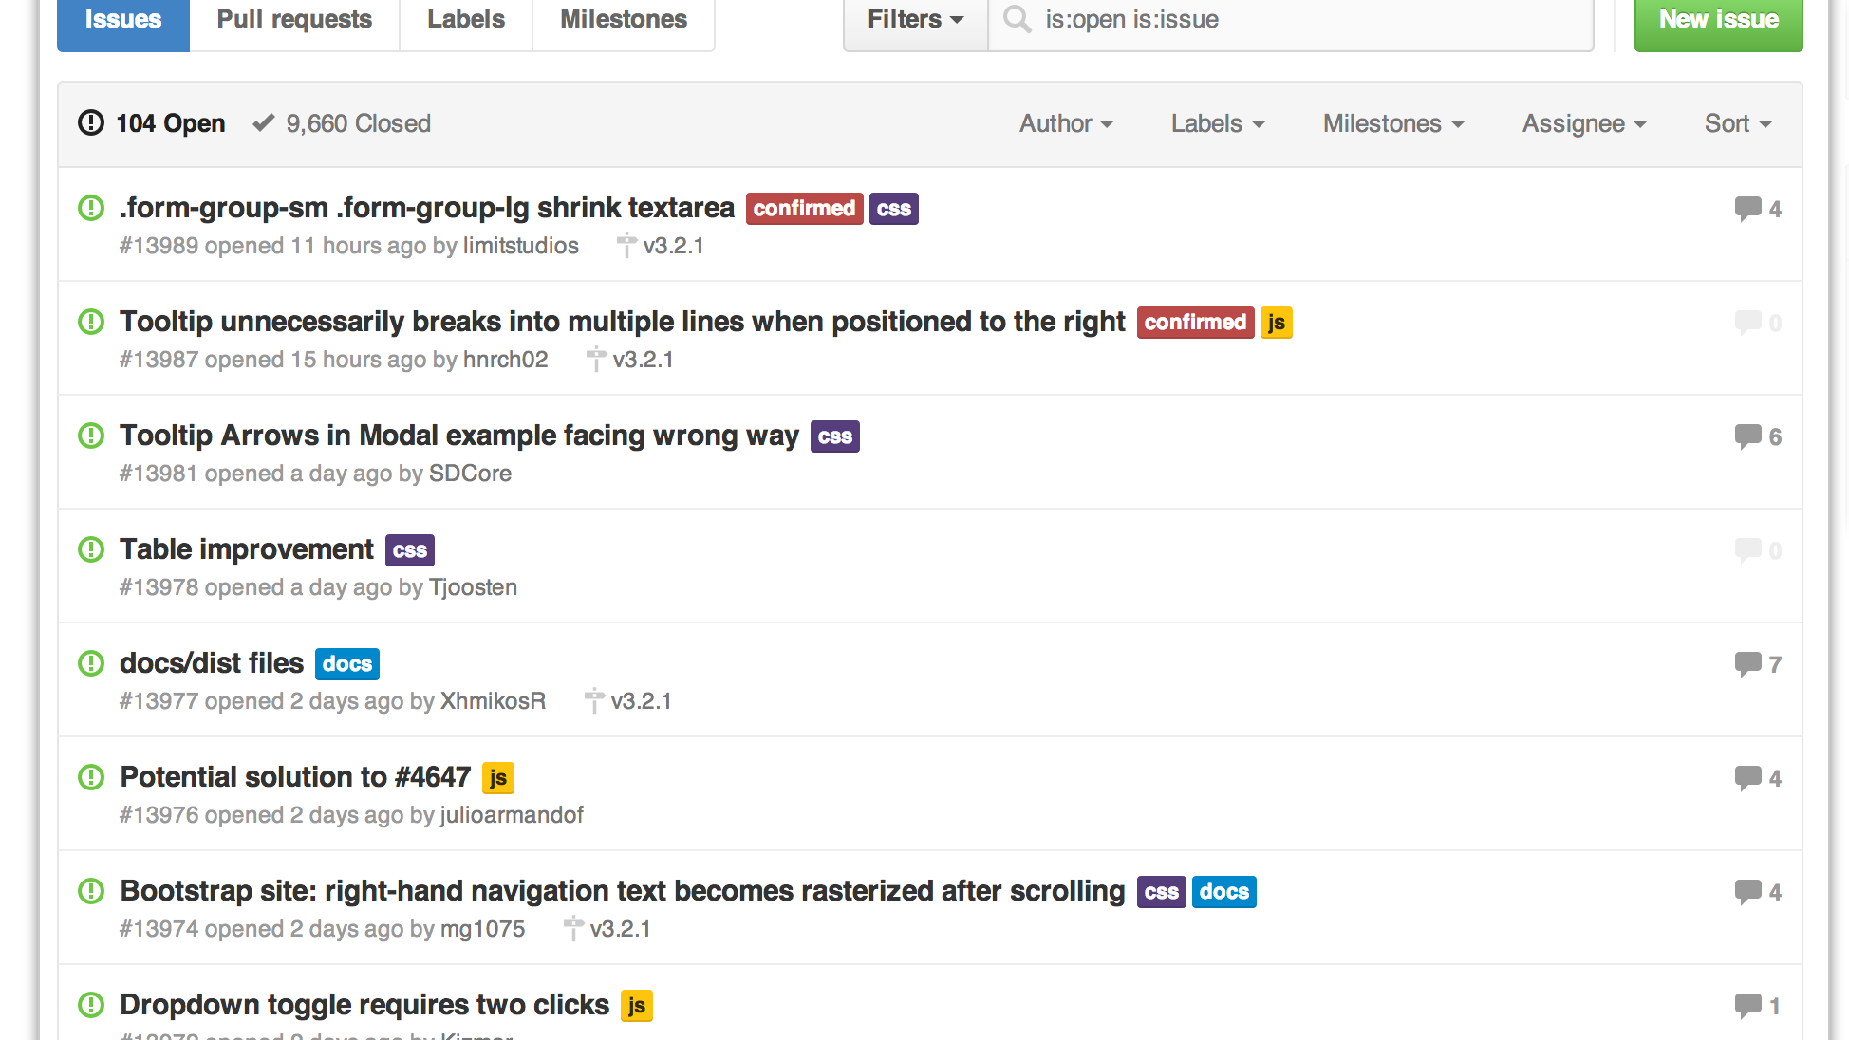
Git Collaboration + Issues
© 2016 | RCB - All Rights Reserved
© 2016 | Rutgers Coding Bootcamp - All Rights Reserved

Slide 27
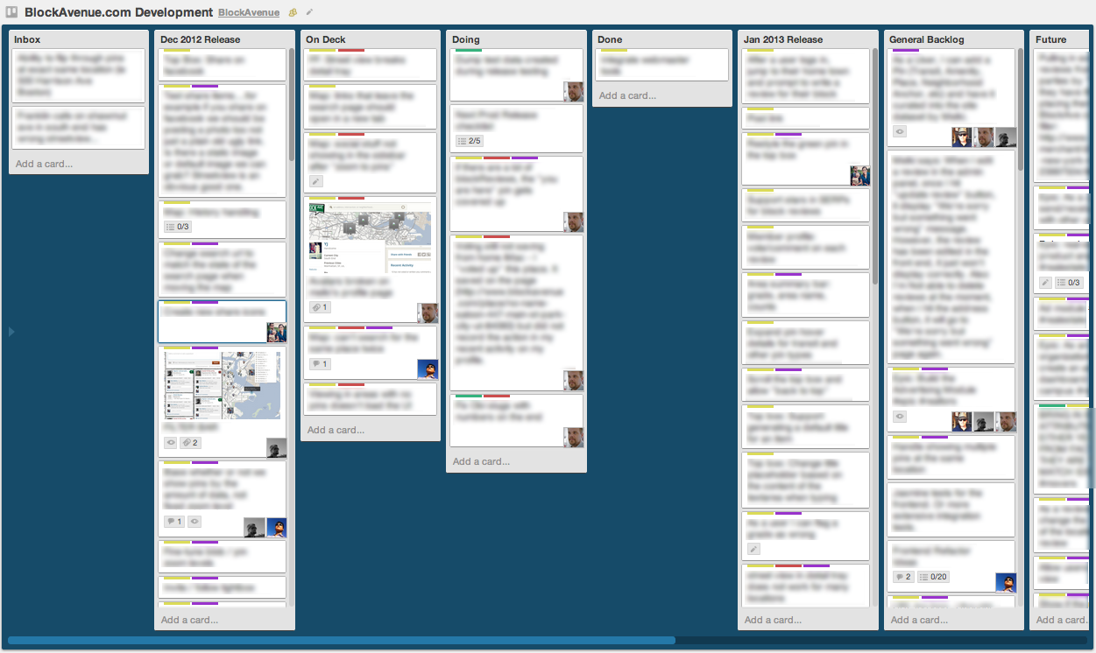
Trello
© 2016 | RCB - All Rights Reserved
© 2016 | Rutgers Coding Bootcamp - All Rights Reserved

Slide 28
Project Ideas
© 2016 | RCB - All Rights Reserved
Notes:
7:00 – 7:05

Slide 29
GitHub Viewer
Utilizes the Github API to create a new frontend for Github
Hover over commit message words to get definitions (utilizing WordsAPI)
Search Giphy using commit messages to return animated GIF’s
© 2016 | RCB - All Rights Reserved
© 2016 | Rutgers Coding Bootcamp - All Rights Reserved

Slide 30
Student / Employer Site
Utilize Firebase to show a list of students and employers (think social network)
Employers can view student pages and pull in information from Github API
Rutgers Coding Bootcamp would use this!
© 2016 | RCB - All Rights Reserved
© 2016 | Rutgers Coding Bootcamp - All Rights Reserved

Slide 31
Deal Searcher
Users type in a street address
Address is Geocoded via Google Maps API
Deals are searched (via Sqoot API) in that vicinity
Flickr Images pertaining to that deal are shown
© 2016 | RCB - All Rights Reserved
© 2016 | Rutgers Coding Bootcamp - All Rights Reserved

Slide 32
Superhero Central
Use the Marvel API to let the user search for a story / character / concept
Cross correlate that with Flickr images of that concept
Search the OMDB to see if any movies / shows exist for that character / story
© 2016 | RCB - All Rights Reserved
© 2016 | Rutgers Coding Bootcamp - All Rights Reserved

Slide 33
Homework Submission
Create a new way for your fellow students to submit homework
Look up their Github Repo automatically when they enter their Github username
Mark as “done” / “late” via Firebase
© 2016 | RCB - All Rights Reserved
© 2016 | Rutgers Coding Bootcamp - All Rights Reserved

Slide 34
UN Data API
Use the Unofficial UN Data API to search a user specified country
Return relevant data for the users’ desire
Use a secondary data source (Google Maps, Flickr, YouTube, etc) to provide additional context or data
Examples: Per Capita Govt Expenditures on Health, # of Physicians, Deaths due to HIV, Malaria Cases etc, low birth weight newborns
© 2016 | RCB - All Rights Reserved
© 2016 | Rutgers Coding Bootcamp - All Rights Reserved

Slide 35
Facial Recognition
Use the Face++ API
Allow users to provide a URL link to a facial image then provide viewers with information on the image’s gender, race, whether they are wearing glasses, and their age
Use Firebase to update ALL users of the site about the current search
© 2016 | RCB - All Rights Reserved
© 2016 | Rutgers Coding Bootcamp - All Rights Reserved

Slide 36
Finance App
Use a Finance API in conjunction with the New York Times Article API to observe changes in stock prices against new articles about a company
Allow users to scan for % changes in companies over 1, 5, 10 day periods
© 2016 | RCB - All Rights Reserved
© 2016 | Rutgers Coding Bootcamp - All Rights Reserved

Slide 37
Today’s Focus
© 2016 | RCB - All Rights Reserved
Notes:
7:00 – 7:05

Slide 38
Today’s Focus
Brainstorm possible ideas
Begin API Research
Create an initial draft / sketch of the final design
Make sure you know how to use Git Collaboratively. (PRACTICE THIS!!!!)
Create a short 1 page proposal listing out each of the following:
Project Title
Team Members
Project Description
Sketch of Final Product
APIs to be Used
Rough Breakdown of Tasks
© 2016 | RCB - All Rights Reserved
© 2016 | Rutgers Coding Bootcamp - All Rights Reserved

Slide 39
Questions
© 2016 | RCB - All Rights Reserved
Notes:
7:00 – 7:05

