Slide 1

Catch Up!
Day 15???
Rutgers Coding Bootcamp | February 24, 2016
© 2016 | RCB - All Rights Reserved
Notes:
Start at 6:45 PM

Slide 2
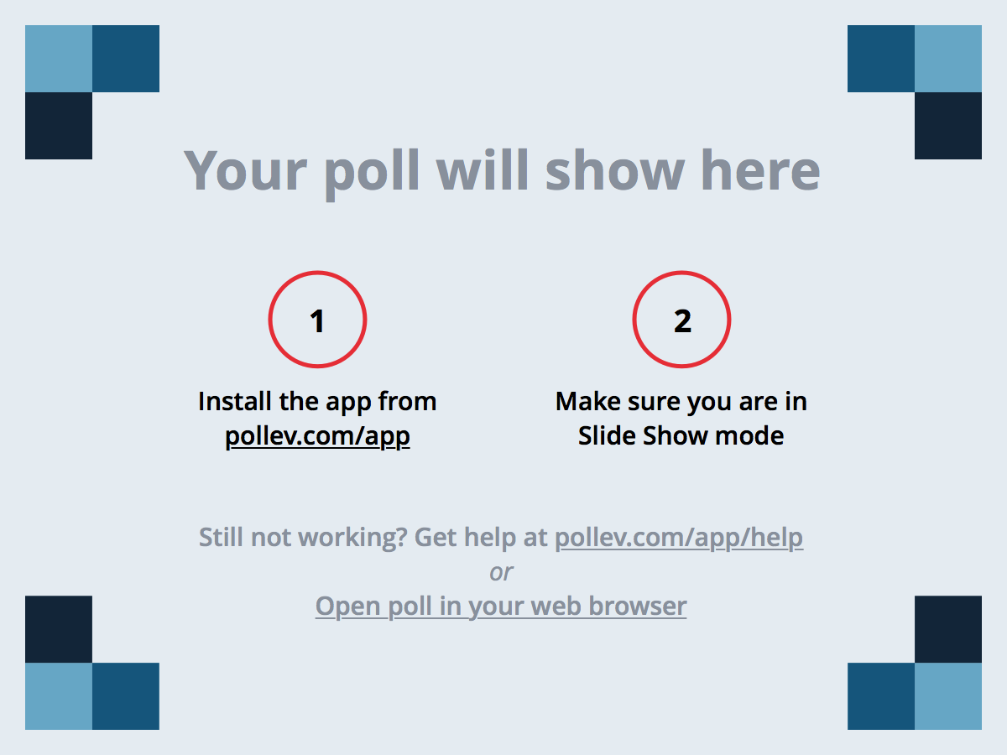
Notes:
Poll Title: Off the top of your head, what general topics or concepts seem most hazy to you? https://www.polleverywhere.com/free_text_polls/tduJa6FWLLqpViy

Slide 3
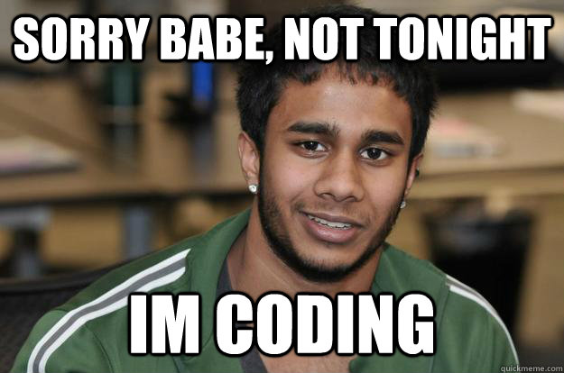

Today’s Plan
We will go over any lingering questions (15 mins)
I will outline the most important topics through today (30-40 mins)
Break into groups for a heavily supported coding session (2 hours)
© 2016 | RCB - All Rights Reserved
© 2016 | Rutgers Coding Bootcamp - All Rights Reserved

Slide 4

Today’s Groups
Group 1
Allen, Steven G, Kevin G
Group 2
Greg, Zintis, Lou, John
Group 3
Walter, Matt, Stephen S, Andrew
Group 4
Jordan, Neena, Jerome, Luis
Group 5
Analben, Rachelle, Aisha
Group 6
Jorge, Michael, Stephen M, Darion
Group 7
Jacob, Jasmine, Jeremiah, Nathan
And in London… Mauricio
© 2016 | RCB - All Rights Reserved
© 2016 | Rutgers Coding Bootcamp - All Rights Reserved

Slide 5
Recap of Subjects
© 2016 | RCB - All Rights Reserved
Notes:
7:00 – 7:05

Slide 6
The Important Stuff…
HTML / CSS:
Basic Parts of an HTML Document (<html>, <doctype>, <p>, <h1>, etc.).
Using in-line, internal, and external CSS stylesheets.
Using relative pathways to link CSS and other assets.
Using html ids (#), classes (.), and element names to attach css styles.
Git:
The advantages of using Git and source control management.
Using Git Bash or Terminal to perform basic Git commands.
Understanding how to use Git clone, add/commit, push.
Understanding branching via Git branch, checkout, and pull-requests
© 2016 | RCB - All Rights Reserved
© 2016 | Rutgers Coding Bootcamp - All Rights Reserved

Slide 7
The Important Stuff…
Bootstrap / Mobile Responsiveness
The concept of using a pre-built CSS library.
The steps to include Bootstrap CSS into your existing website.
The process of dissecting a layout into the Bootstrap grid system.
A general understanding of how to use Bootstrap components (e.g. panels, Jumbotron, navigation bars, etc.)
A general understanding of @media queries and mobile responsiveness.
© 2016 | RCB - All Rights Reserved
© 2016 | Rutgers Coding Bootcamp - All Rights Reserved

Slide 8
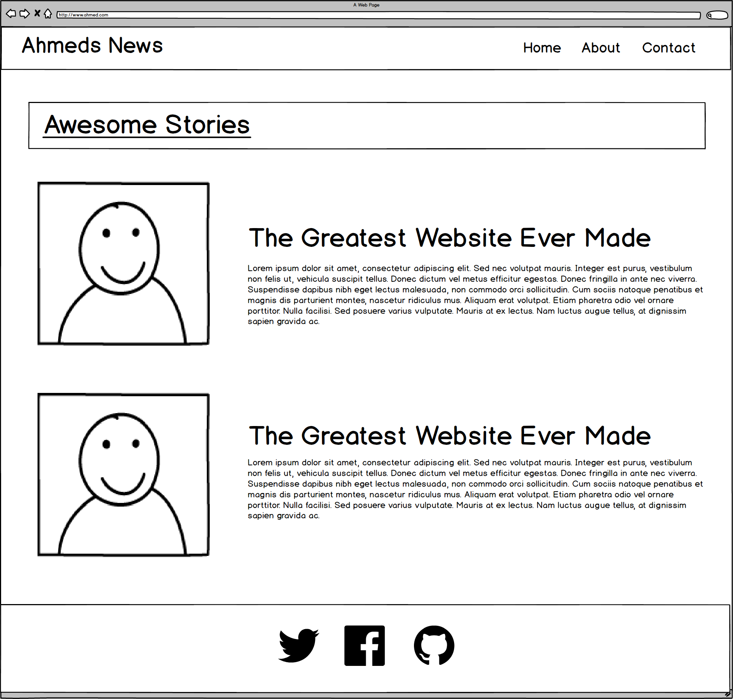
ROWS
1
1
1
4
Total
1
Notes:
7:00 – 7:05

Slide 9
COLUMNS
1
2
2
1
Total Not relevant
Notes:
7:00 – 7:05

Slide 10
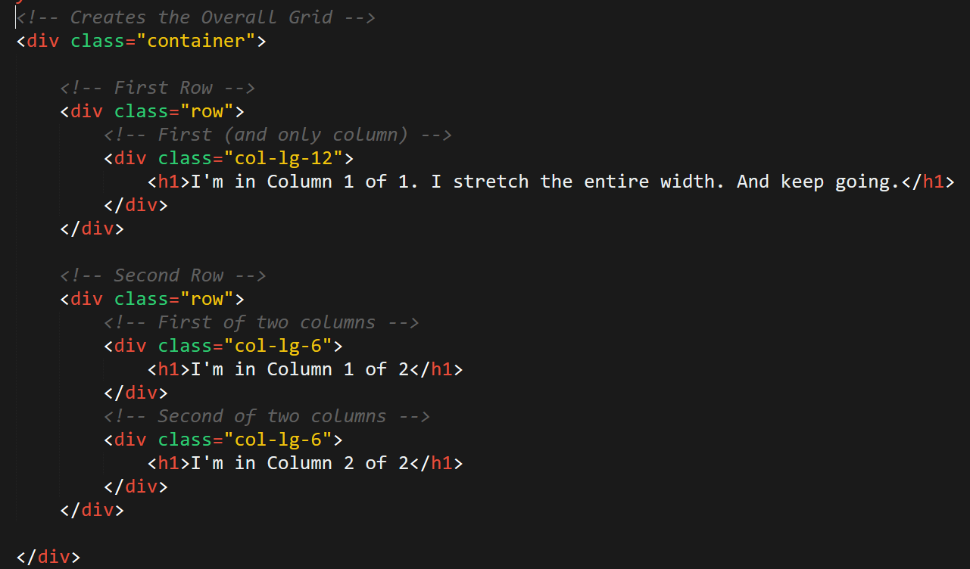
Bootstrap Grid
Note the rows, columns (col-lg-6), and containers
© 2016 | RCB - All Rights Reserved
© 2016 | Rutgers Coding Bootcamp - All Rights Reserved

Slide 11

The Important Stuff…
Javascript
Understand what purpose Javascript serves in relation to HTML and CSS
Understand both the uses and syntax for creating the below:
Variables
Arrays
Console.log, Alerts, Confirms, and Prompts
If-Then Statements
For Loops
Functions
Objects
Scope
Methods
© 2016 | RCB - All Rights Reserved
© 2016 | Rutgers Coding Bootcamp - All Rights Reserved

Slide 12
The Important Stuff…
Javascript continued…
Understand how to organize a Javascript program with regards to global variables, functions, and function calls.
Be able to use old Javascript code to capture keyclicks.
Be able to use old Javascript code to generate random numbers.
jQuery
Be able to explain why we might use a Javascript library like jQuery
Be able to explain what the jQuery $(_) syntax means.
Be able to use jQuery to capture button clicks.
Be able to provide a few examples of jQuery methods for changing HTML.
Be able to use jQuery and Javascript to change HTML in response to code.
© 2016 | RCB - All Rights Reserved
© 2016 | Rutgers Coding Bootcamp - All Rights Reserved

Slide 13
<h1> Your Turn!!! </h1>
Spend a few moments to seriously look over the “important topics” we’ve covered.
Then write down any of the following:
What still seems fuzzy or challenging to you?
What specific questions do you have about these topics?
What conceptual topics do you have about these topics?
Once you’ve written them down:
Turn to the members of your group and ask if they know the answers to your questions or if they can explain a topic:
Write down any questions or topics that are still left unanswered (or weren’t answered well).
© 2016 | RCB - All Rights Reserved
Notes:
8:20 -8:35

Slide 14
Group Work
© 2016 | RCB - All Rights Reserved
Notes:
7:00 – 7:05

Slide 15
Where to Start…
Can you and each person in your group…
Comfortably build the Hangman Game (HW 3) from scratch?
No? Then start with Hangman
Explain conceptually how “Ahmed The Game” works?
No? Then start by dissecting Ahmed the Game.
Comfortably use jQuery to modify HTML based on clicks?
No? Then start with Lottery Generator.
Comfortably create a grid-based design with Twitter Bootstrap?
No? Then start with Twitter Bootstrap Assignment.
© 2016 | RCB - All Rights Reserved
© 2016 | Rutgers Coding Bootcamp - All Rights Reserved

Slide 16
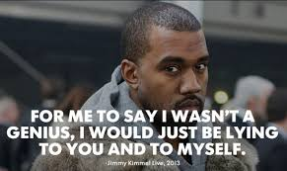
Where to Start…
If and ONLY IF you and everyone in your group felt confident about the above….
Then, I want you and your group to come up with your own activity.
The activity must involve creating a deliverable and uploading it to heroku.
The final product could be a website design , interactive application (JS), a game, etc.
Be sure to choose something that each member is interested in.
While working on this assignment, make sure to create a single GitHub repository and to submit code changes using pull requests from each collaborator.
© 2016 | RCB - All Rights Reserved
© 2016 | Rutgers Coding Bootcamp - All Rights Reserved

Slide 17
Questions?
© 2016 | RCB - All Rights Reserved
Notes:
7:00 – 7:05

