Slide 1
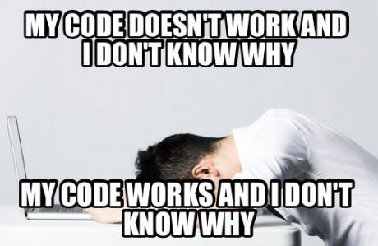

Obstacle #1 – The Great Confusion
© 2016 | RCB - All Rights Reserved
Notes:
7:00 – 7:05

Slide 2

Obstacle #2 – The Great Doubt
© 2016 | RCB - All Rights Reserved
Notes:
7:00 – 7:05

Slide 3
Learning is “Frustrating”
“You can’t tell whether you’re learning something when you’re learning it—in fact, learning feels a lot more like frustration.”
“What I’ve learned is that during this period of frustration is actually when people improve the most, and their improvements are usually obvious to an outsider. If you feel frustrated while trying to understand new concepts, try to remember that it might not feel like it, but you’re probably rapidly expanding your knowledge.”
Phillip Dickey, Author of Write Modern Web Apps with the MEAN Stack: Mongo, Express, AngularJS, and Node.JS
© 2016 | RCB - All Rights Reserved
Notes:
7:00 – 7:05

Slide 4
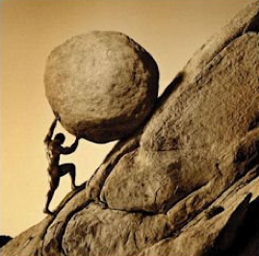
Advice for the Journey
Throughout this course, always remember to:
Work Hard!!
© 2016 | RCB - All Rights Reserved
Notes:
7:00 – 7:05 PM

Slide 5
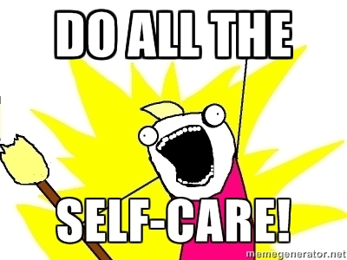
Advice for the Journey
Throughout this course, always remember to:
Work Hard!!
Appreciate your successes
© 2016 | RCB - All Rights Reserved
Notes:
7:00 – 7:05 PM

Slide 6

Advice for the Journey
Throughout this course, always remember to:
Work Hard!!
Appreciate your successes
Trust yourself
© 2016 | RCB - All Rights Reserved
Notes:
7:00 – 7:05 PM

Slide 7
Daily Schedule
For each class we’ll run through the following:
Set Objectives
Brief Background Lecture
Watch Me / Coding Demos
Code Discussions
In-Class Exercises
Project Work
The Super Important Stuff!!!
i.e. Always be coding!
© 2016 | RCB - All Rights Reserved
Notes:
7:05 – 7:10

Slide 8
Software Checklist
At this point, you should have each of these installed:
Slack
Sublime Text 3
Git for Version Control
Git Bash (Windows) or Terminal (Mac)
Google Chrome
Heroku Toolbelt
If you don’t have these installed then we can
Worry about these later since we don’t use these for some time
Node.js
MySQL
Heidi SQL (Windows) or Sequel Pro (Mac)
© 2016 | RCB - All Rights Reserved
Notes:
7:10 – 7:30

Slide 9
Accounts Checklist
You should also now have accounts for:
GitHub (with SSH Integration)
Heroku
LinkedIn
Stack Overflow
Twitter
© 2016 | RCB - All Rights Reserved
© 2016 | Rutgers Coding Bootcamp - All Rights Reserved
Notes:
7:10 – 7:30

Slide 10
Self-Check
Let’s do some quick checks of the following
Sublime Check
Git Bash / Terminal Check
Node Check
Git Check
Heroku Check
© 2016 | RCB - All Rights Reserved
© 2016 | Rutgers Coding Bootcamp - All Rights Reserved
Notes:
7:30 – 7:35

Slide 11
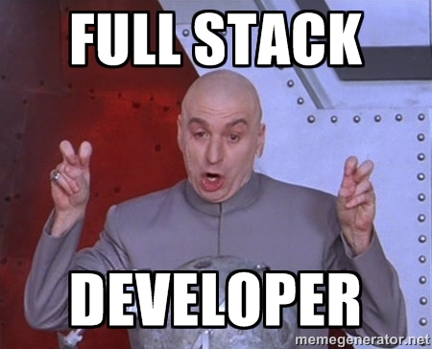
Full-Stack Development?
© 2016 | RCB - All Rights Reserved
Notes:
7:35 – 7:50 PM

Slide 12
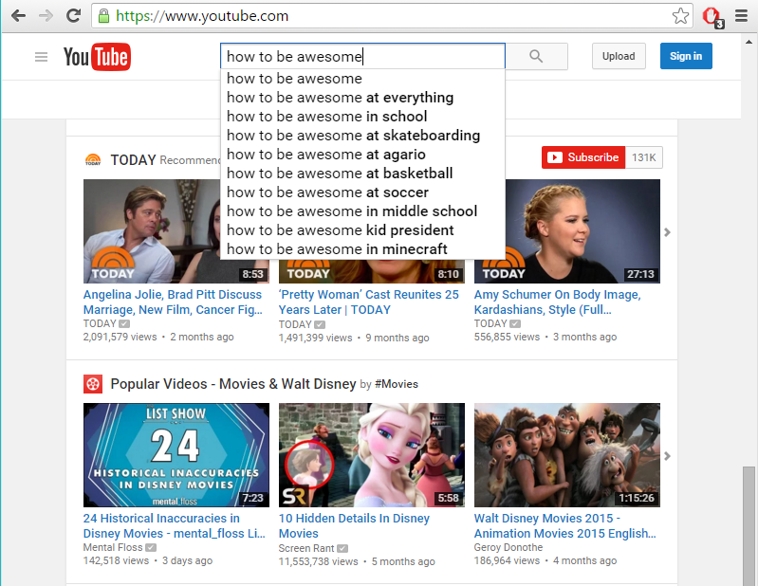
The “Magic” of YouTube
© 2016 | RCB - All Rights Reserved
Notes:
7:35 – 7:50 PM

Slide 13
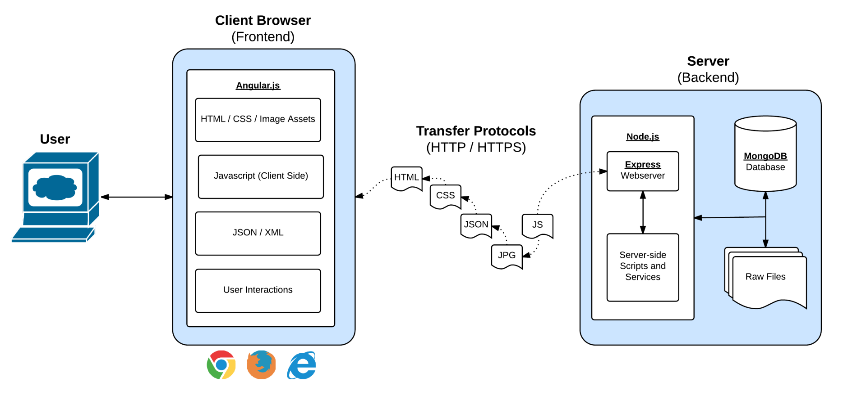
Full-Stack Development
In modern web applications there is a constant back-and-forth communication between the visuals displayed on the user’s browser (frontend) and the data and logic stored on the server (backend).
© 2016 | RCB - All Rights Reserved
Notes:
7:35 – 7:50 PM

Slide 14
Full-Stack Development
Full-Stack Development is the concept of building every aspect of the web application – from the visuals and interactions, to the data transfer and processing.
© 2016 | RCB - All Rights Reserved
Notes:
7:35 – 7:50 PM

Slide 15
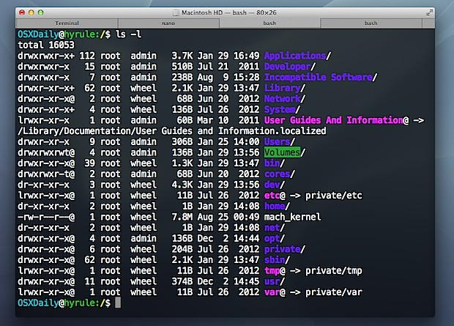
> Intro to Console
© 2016 | RCB - All Rights Reserved
Notes:
8:05 – 8:20 PM

Slide 16

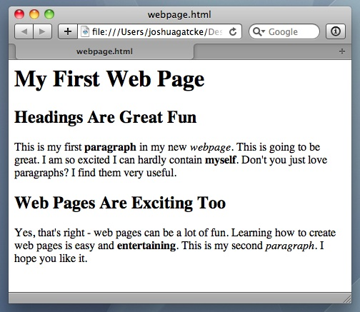
<title> Intro to HTML </title>
HTML is one of the three base languages behind every single website.
It defines all of the basic content and a bit of formatting.
© 2016 | RCB - All Rights Reserved
Notes:
8:35 – 8:50 PM

