Slide 1

Join.me Information
join.me/<meeting info>
© 2016 | RCB - All Rights Reserved
Notes:
7:00 – 7:05

Slide 2
Heroku!
Day 4
Rutgers Coding Bootcamp | February 2, 2016
© 2016 | RCB - All Rights Reserved
Notes:
Start at 6:45 PM

Slide 3

So Far…
You’re all doing well
Yes, you’re frustrated
But you’re trying and sticking with it
Lots of content in my repo at https://github.com/RutgersCodingBootcamp/1027-tue-thu-in-class-code
© 2016 | RCB - All Rights Reserved
© 2016 | Rutgers Coding Bootcamp - All Rights Reserved

Slide 4
A Few Admin Things…
© 2016 | RCB - All Rights Reserved
Notes:
7:00 – 7:05

Slide 5
Homework Assignment #1
Remember, Homework #1 is due on Thursday (2/4/16).
Homework Link: https://github.com/RutgersCodingBootcamp/All-Classwork-Homework/tree/master/week-1-html-css-git-heroku
Remember to submit Homework via GitHub (and Heroku) link: https://docs.google.com/forms/d/1-0jQJXI_WBtwJNkKjUjzzwmd-ie9sqcEP0_ZxAUOTYY/viewform
© 2016 | RCB - All Rights Reserved
© 2016 | Rutgers Coding Bootcamp - All Rights Reserved

Slide 6
Homework Assignment #2
Remember, Homework #2 has just been released, it’s due on Tuesday (2/9/16).
Homework Link: https://github.com/RutgersCodingBootcamp/All-Classwork-Homework/tree/master/week-2-html-css-bootstrap-three-days
Remember to submit Homework via GitHub (and Heroku) link: https://docs.google.com/forms/d/1-0jQJXI_WBtwJNkKjUjzzwmd-ie9sqcEP0_ZxAUOTYY/viewform
© 2016 | RCB - All Rights Reserved
© 2016 | Rutgers Coding Bootcamp - All Rights Reserved

Slide 7
Office Hours + Additional Help
Also, remember….
In Class Office Hours: 45 minutes before class, 30 minutes after
Virtual Office Hours: Tuesdays 6:30 – 8:00 PM
Review In Class Material (Exercises and Slides): https://github.com/RutgersCodingBootcamp/0125-mw-class-content
Re-Watch Class Videos:
https://github.com/RutgersCodingBootcamp/All-Classwork-Homework/blob/master/class-recordings.md
© 2016 | RCB - All Rights Reserved
© 2016 | Rutgers Coding Bootcamp - All Rights Reserved

Slide 8

Note on Slack Etiquette!
Try to ask your questions in the rut0126fsf and virtual-office-hours channels. This way others can see your questions!
You may contact me directly at @johndougherty if you need to
Be sure to give us at least 24 hours at least to respond!
© 2016 | RCB - All Rights Reserved
© 2016 | Rutgers Coding Bootcamp - All Rights Reserved

Slide 9

Join.me
Going forward, we’ll be using join.me. This means:
We’ll be uploading our class videos more frequently.
In the (rare) case where you can’t make it to class, you’ll be able to view the live session remotely.
We’ll be able to share screens and troubleshoot problems in class.
© 2016 | RCB - All Rights Reserved
© 2016 | Rutgers Coding Bootcamp - All Rights Reserved

Slide 10
Quick CSS Reminders
© 2016 | RCB - All Rights Reserved
Notes:
7:00 – 7:05

Slide 11
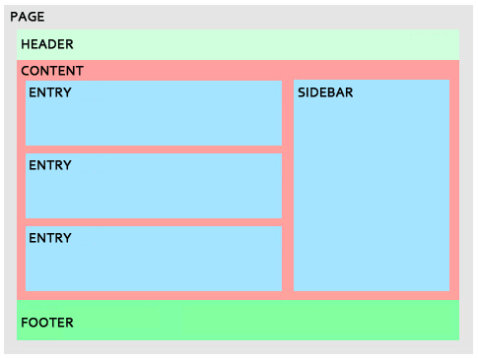
Divs, Sections, Navs, Etc….
Fundamentally, all web layouts are composed of containers, traditionally called “divs”.
© 2016 | RCB - All Rights Reserved
© 2016 | Rutgers Coding Bootcamp - All Rights Reserved

Slide 12
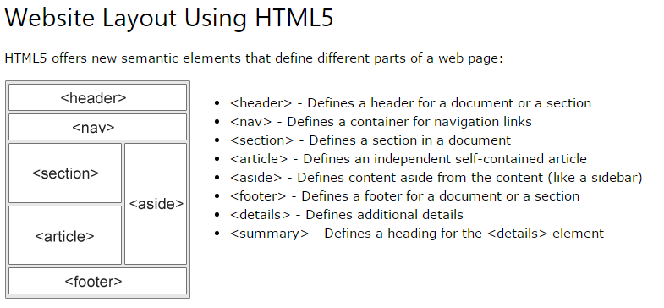
Divs, Sections, Navs, Etc….
HTML5 introduced the concept of “semantic layouts” meaning “divs” could be given more “meaningful names.”
In theory, this helps with organization and search engine optimization.
© 2016 | RCB - All Rights Reserved
© 2016 | Rutgers Coding Bootcamp - All Rights Reserved

Slide 13
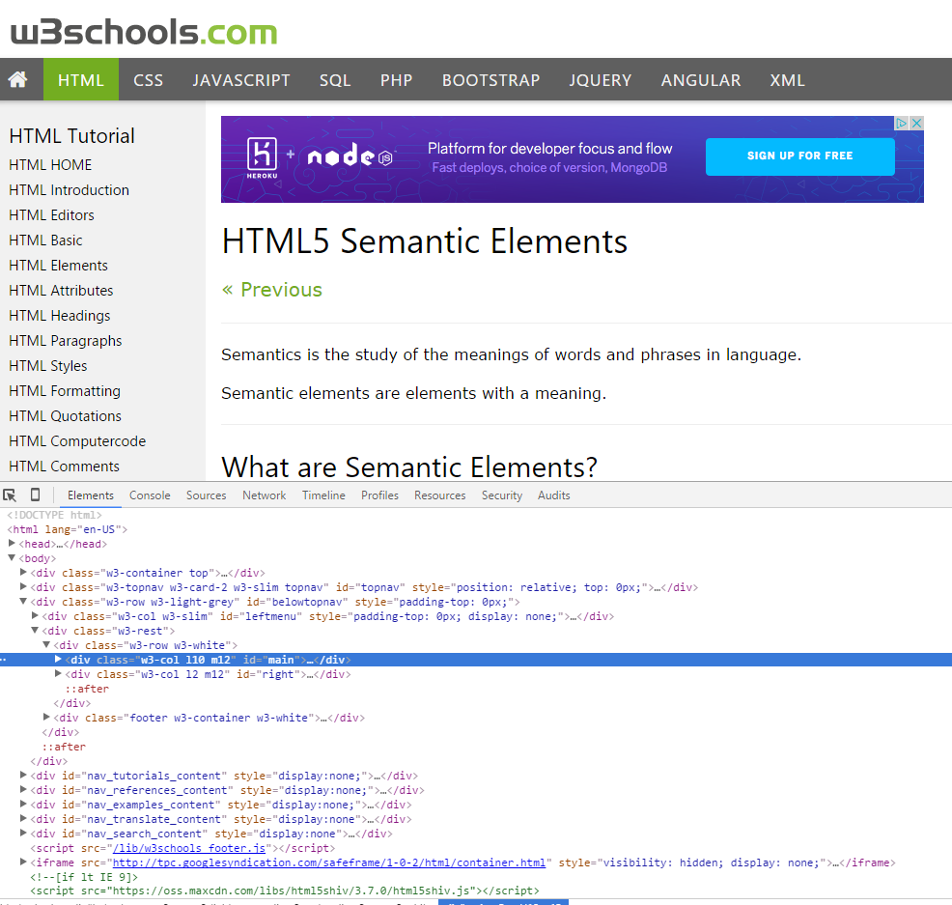
Divs, Sections, Navs, Etc….
That said… many (if not most) websites, seem to still be using basic divs.
There are reasons for this that we’ll showcase in later sections.
Additionally, it’s possible to include “semantics” by using id names and classes.
© 2016 | RCB - All Rights Reserved
© 2016 | Rutgers Coding Bootcamp - All Rights Reserved

Slide 14
Divs, Sections, Navs, Etc….
div?
Section?
Bottom line: Follow your homework’s instructions. But when you get out in the “real world”, follow the convention of where you work!
© 2016 | RCB - All Rights Reserved
© 2016 | Rutgers Coding Bootcamp - All Rights Reserved

Slide 15

Classes vs. IDs
Classes = Barcode (all IPod)
IDs = Serial Number (unique Ipod)
When choosing between a CSS ID and a CSS Class follow the convention:
Classes (.classname) are to be used if the same style will be used on multiple HTML elements
IDs (#idname) are to be used if a style is unique to that HTML element.
© 2016 | RCB - All Rights Reserved
© 2016 | Rutgers Coding Bootcamp - All Rights Reserved

Slide 16
> YOUR TURN!!
Assignment
For the next 15 minutes, take a website that you commonly use (Amazon, Google, Huff Po, etc.) and heavily modify it using the Google Developer Tools.
Be sure to at least modify:
Content (Change words)
Colors
Spacing
Etc.
Send a screenshot to the class’ slack profile when you’re done.
© 2016 | RCB - All Rights Reserved
Notes:
Send snapshot from Git command line

Slide 17
Let’s Publish!
© 2016 | RCB - All Rights Reserved
Notes:
7:00 – 7:05

Slide 18

The Internet
A deep and complex diagram above on how the internet works.
© 2016 | RCB - All Rights Reserved
Notes:
7:00 – 7:05

Slide 19

The World Will See Our Greatness!
Heroku provides a cloud application hosting platform – which means we can deploy our websites and applications onto their servers for the world to see.
© 2016 | RCB - All Rights Reserved
Notes:
7:00 – 7:05

Slide 20
Deploying Static Websites to Heroku
Basic Steps:
Go to folder you want to host (must be .git enabled)
Add a file called composer.json and include an empty bracket {}.
Add a file called index.php with the following inside:
Run Heroku login (for windows users, remember the workaround!)
Run git remote –v
Run heroku create
Run git remote –v
Run git push heroku master
© 2016 | RCB - All Rights Reserved
Notes:
7:00 – 7:05

Slide 21
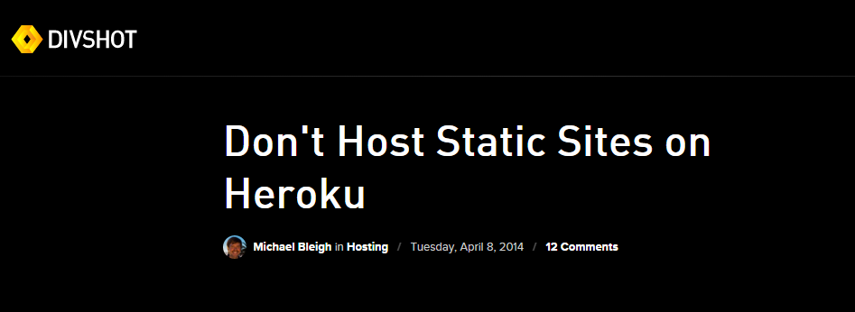
Deploying Static Websites to Heroku
Remember:
This is just a hacked approach for learning.
Professionally, Heroku isn’t the best place to deploy static websites.
© 2016 | RCB - All Rights Reserved
Notes:
7:00 – 7:05

Slide 22

Better Alternatives for Static Pages…
Look into Amazon Web Services | S3 and Route 53
© 2016 | RCB - All Rights Reserved
Notes:
7:00 – 7:05

Slide 23
> YOUR TURN!!
Assignment
Time to take your newfangled website and deploy it to the cloud. Setup your own instance of Heroku and deploy one of your HTML creations to Heroku.
Additional instructions to be sent via Slack.
© 2016 | RCB - All Rights Reserved
Notes:
Send snapshot from Git command line

Slide 24
And Back to HTML/CSS..
© 2016 | RCB - All Rights Reserved
Notes:
7:00 – 7:05

Slide 25
> YOUR TURN!!
Assignment
For this next exercise, I want you to push beyond what you already know how to do to try building something you don’t.
Initial instructions will be sent to you via slack.
But pay close attention to “small details” about what’s different!
© 2016 | RCB - All Rights Reserved
Notes:
Send snapshot from Git command line

Slide 26
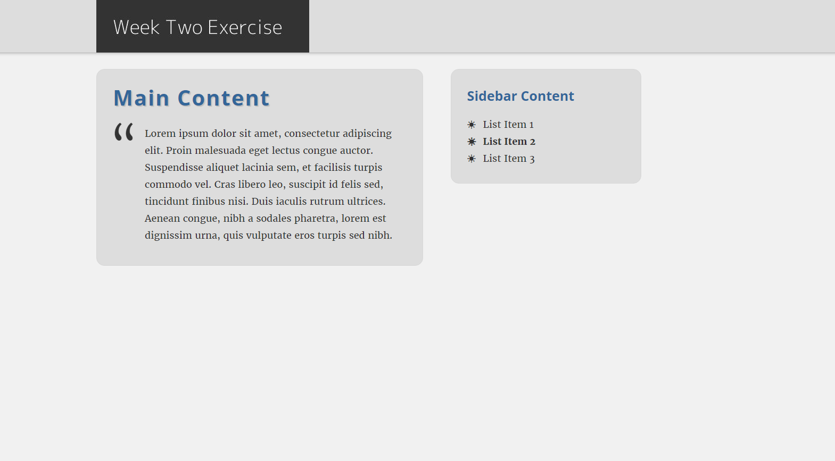
> YOUR TURN!!
© 2016 | RCB - All Rights Reserved
Notes:
Send snapshot from Git command line

Slide 27
And Back to Git…
© 2016 | RCB - All Rights Reserved
Notes:
7:00 – 7:05

Slide 28

The Group Project
OMG. I HAZ THE GREATEST HTML IDEA!!!!!
JORDAN’S JAMZZZZ!!!!
© 2016 | RCB - All Rights Reserved
Notes:
7:00 – 7:05

Slide 29


The Group Project
Programming Away…
Jordan’s idea is dumb. We should call it…
JASMINE’S JAMZZZZ!!!!
© 2016 | RCB - All Rights Reserved
Notes:
7:00 – 7:05

Slide 30
The Group Project – Tragedy 1 (Revisited)
Programming Away…
Now they have two completely different versions.
Programming Away…
© 2016 | RCB - All Rights Reserved
Notes:
7:00 – 7:05

Slide 31
The Group Project – Push vs Pull
Main Branch (Jordan’s)
Jordan continues programming
1
2
3
4
5
This is NON-IDEAL
Jasmine pushes her code changes into the main branch.
If Jasmine is allowed to push her code, it could seriously ruin Jordan’s vision and working code.
Jasmine’s Branch
© 2016 | RCB - All Rights Reserved
Notes:
7:00 – 7:05

Slide 32
The Group Project – Push vs Pull
OMG. I HAZ THE GREATEST HTML IDEA!!!!!
JORDAN’S JAMZZZZ!!!!
© 2016 | RCB - All Rights Reserved
Notes:
7:00 – 7:05

Slide 33
The Group Project – Push vs Pull
Main Branch (Jordan’s)
Jordan continues programming
1
2
3
4
5
Jordan’s idea is dumb. We should call it…
JASMINE’S JAMZZZZ!!!!
© 2016 | RCB - All Rights Reserved
Notes:
7:00 – 7:05

Slide 34
The Group Project – Push vs Pull
Main Branch (Jordan’s)
Jordan continues programming
1
2
3
4
5
Jasmine’s Branch
© 2016 | RCB - All Rights Reserved
Notes:
7:00 – 7:05

Slide 35
The Group Project – Push vs Pull
Main Branch (Jordan’s)
Jordan continues programming
1
2
3
4
5
Ideal Approach – Using Pull Requests
Because Jordan controls the “master branch” Jordan must elect to pull Jasmine’s Code. All Jasmine can do is submit a “pull request”
This is the ideal way to maintain code in version control.
?
Jasmine’s Branch
© 2016 | RCB - All Rights Reserved
Notes:
7:00 – 7:05

Slide 36
Key Git Commands
Git Branch For creating a “clean/editable copy” of code that can be easily reincorporated into the main branch.
Git Checkout Changes the working branch in the local directory. All changes saved in git will be saved to this branch.
Git Clone For creating a “clean/editable copy” of code that contains no intrinsic link to the original code.
Git Pull For taking code from a Git branch and bringing the changes back into the original branch.
© 2016 | RCB - All Rights Reserved
Notes:
7:00 – 7:05

Slide 37
Branch Creation and Switching
Two Ways to Create a branch
Method 1
git branch branch-name – Creates a new branch
git checkout branch-name – Switches to the new branch
Method 2
git branch –b branch-name – Makes a new branch and immediately switches to it.
Pushing to a Specific Branch
git push origin branch-name – Pushes the contents to the specific branch (will not affect master branch)
Returning to Master Branch
git checkout master – switches the local branch back to the master branch
© 2016 | RCB - All Rights Reserved
Notes:
7:00 – 7:05

Slide 38
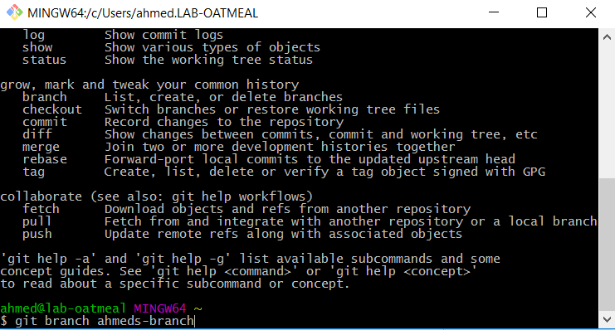
Git Show!
© 2016 | RCB - All Rights Reserved
Notes:
7:00 – 7:05

Slide 39
> YOUR TURN!!
Assignment
Time to take your newfound collaborative git skills to the real-world. Find a partner and follow the steps sent via slack to
Share each other’s code
Make modifications
Submit a Pull Request
Accept the Pull Changes
© 2016 | RCB - All Rights Reserved
Notes:
Send snapshot from Git command line

Slide 40
Questions?
© 2016 | RCB - All Rights Reserved
Notes:
7:00 – 7:05

