Slide 1

Livestream Info
join.me/XXX-XXX-XXX
© 2016 | RCB - All Rights Reserved
Notes:
7:00 – 7:05

Slide 2
More and More About CSS
Day 5
Rutgers Coding Bootcamp | February 4, 2016
© 2016 | RCB - All Rights Reserved
Notes:
Start at 6:45 PM

Slide 3
Before We Begin
© 2016 | RCB - All Rights Reserved
Notes:
7:00 – 7:05

Slide 4

Poll!
https://pollev.com/johndoughert650?_ga=1.265625103.1270642152.1454628444
Or https://goo.gl/noOh2H
© 2016 | RCB - All Rights Reserved
© 2016 | Rutgers Coding Bootcamp - All Rights Reserved

Slide 5
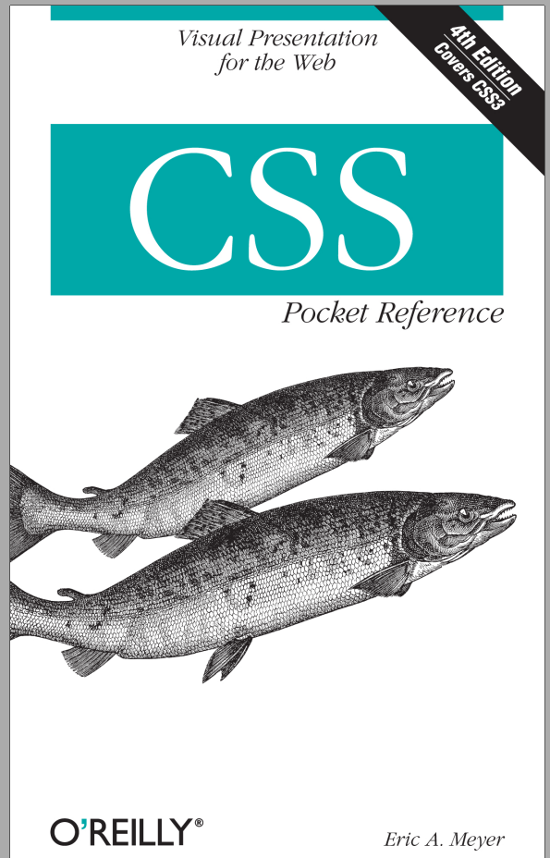
Free Book!
A reference guide only! So you can focus on the subjects in class
© 2016 | RCB - All Rights Reserved
© 2016 | Rutgers Coding Bootcamp - All Rights Reserved

Slide 6
Homework
Homework will always be due on Thursday.
One week after it’s assigned
Take advantage of
Virtual Office Hours
In-Class Office Hours
At least 45 minutes before every class
30 minutes after every class
But wait, there’s more!
When we get the new assignments on Thursday we’ll give the homework a push
I’ll give a few hints
Also, how to avoid pitfalls
© 2016 | RCB - All Rights Reserved
© 2016 | Rutgers Coding Bootcamp - All Rights Reserved

Slide 7
Here We Go!
© 2016 | RCB - All Rights Reserved
Notes:
7:00 – 7:05

Slide 8
New Git Commands
Git Branch Creates a new “branch”, or copy of the data which can be merged back into the other branch(es) as needed.
Git Checkout Changes the working branch to the one specified in the command. Any new changes will be commited to this branch.
Git Clone Creates a new copy of the code which is not “connected” to the existing branch(es).
Git Pull For taking code from a Git branch
Git Merge Merges branches into one branch (e.g. after using a branch to make lots of changes)
© 2016 | RCB - All Rights Reserved
Notes:
7:00 – 7:05

Slide 9
Branch Creation and Switching
Two Ways to Create a branch
Method 1
git branch branch-name – Creates a new branch
git checkout branch-name – Switches to the new branch
Method 2
git branch –b branch-name – Makes a new branch and immediately switches to it.
Pushing to a Specific Branch
git push origin branch-name – Pushes the contents to the specific branch (will not affect master branch)
Returning to Master Branch
git checkout master – switches the local branch back to the master branch
© 2016 | RCB - All Rights Reserved
Notes:
7:00 – 7:05

Slide 10
> YOUR TURN!! For later!
Assignment
Time to take your newfound collaborative git skills to the real-world. Find a partner and follow the steps sent via slack to
Share each other’s code
Make modifications
Submit a Pull Request
Accept the Pull Changes
© 2016 | RCB - All Rights Reserved
Notes:
Send snapshot from Git command line

Slide 11
CSS Typography
© 2016 | RCB - All Rights Reserved
Notes:
7:00 – 7:05

Slide 12
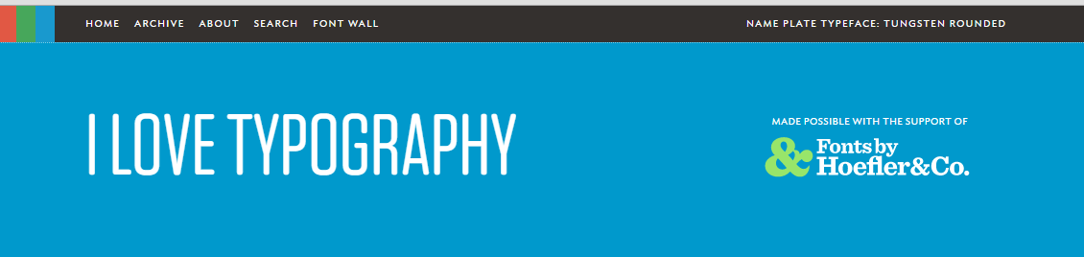


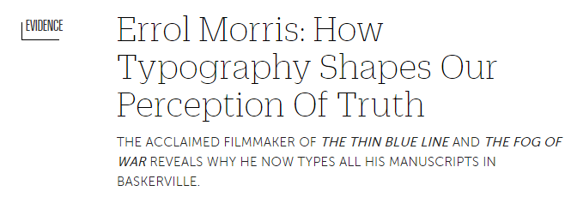
Typography is Huge
© 2016 | RCB - All Rights Reserved
Notes:
7:00 – 7:05

Slide 13

Typography is Huge
Typography can play a huge role in the visual aesthetic and emotional identity of a webpage.
© 2016 | RCB - All Rights Reserved
Notes:
7:00 – 7:05

Slide 14
Typographic Properties
Line Height Distance between lines of text on a page. (Golden Ratio of 1.5x font).
Font-Size Actual size of lettering. Should be at least 16 px on modern pages. https://www.smashingmagazine.com/2011/10/16-pixels-body-copy-anything-less-costly-mistake
Line Length Not a CSS property but rather a standard. Should be about 50-75 characters per line on a desktop http://baymard.com/blog/line-length-readability
Letter Spacing Spacing between individual letters (try to avoid cramping)
San Serif vs Serif Sans-serif (have no line underneath) and are easier to read online
© 2016 | RCB - All Rights Reserved
Notes:
7:00 – 7:05

Slide 15
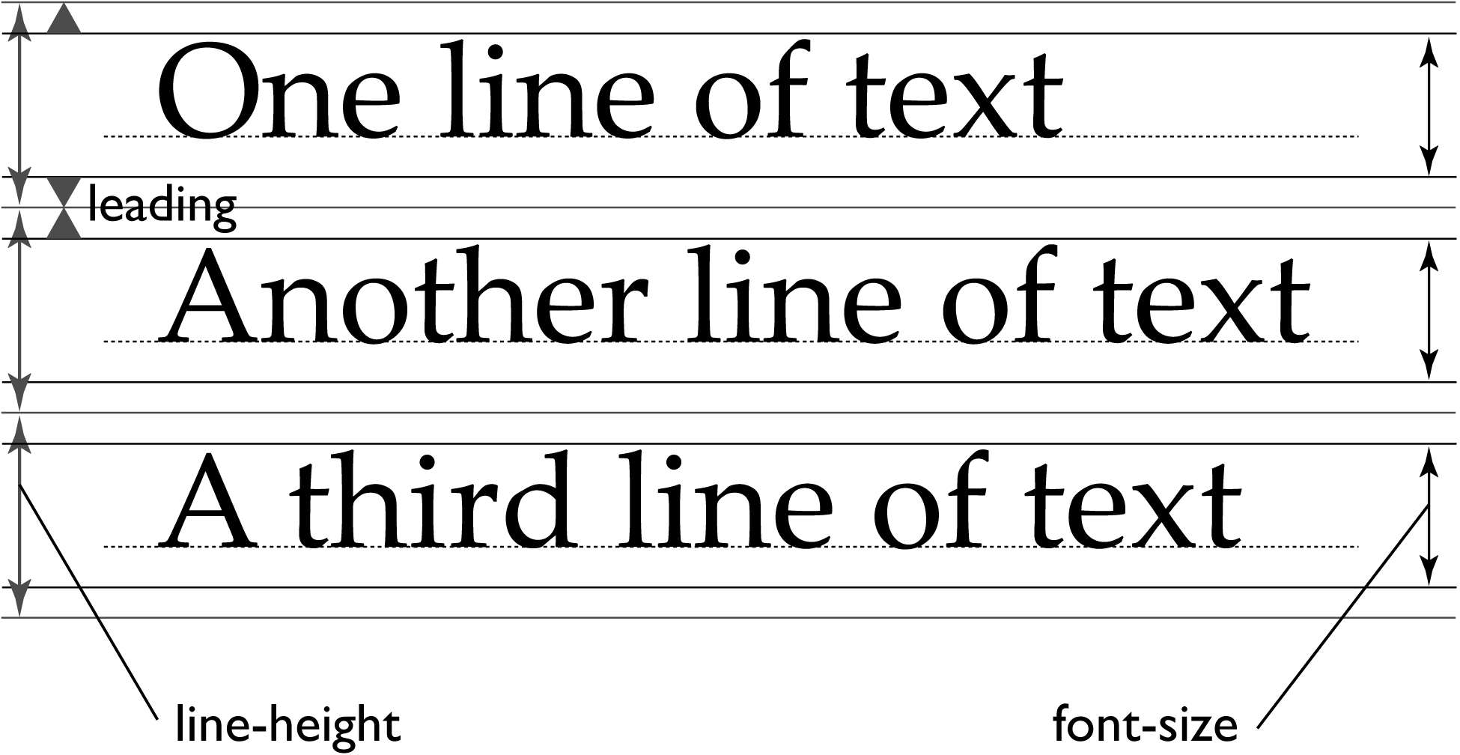
Line Height vs Fonts
© 2016 | RCB - All Rights Reserved
Notes:
7:00 – 7:05

Slide 16
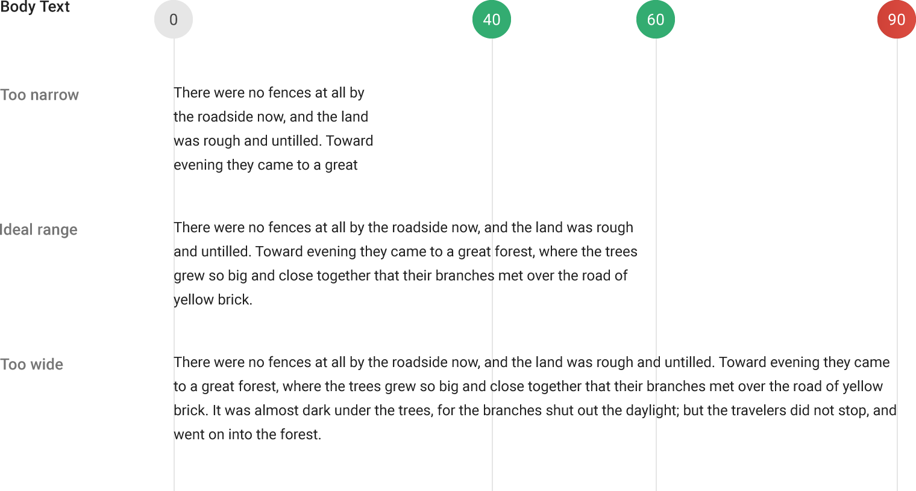
Line Length
© 2016 | RCB - All Rights Reserved
Notes:
7:00 – 7:05

Slide 17

Serif vs Sans Serif
© 2016 | RCB - All Rights Reserved
Notes:
7:00 – 7:05

Slide 18
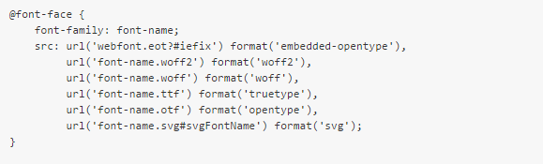
Custom Fonts
Modern CSS allows developers / designers to include their own fonts as part of their webdesign.
This allows viewers to see a website with fonts that their computer doesn’t have installed.
Defining Fonts looks like the below:
© 2016 | RCB - All Rights Reserved
Notes:
7:00 – 7:05

Slide 19
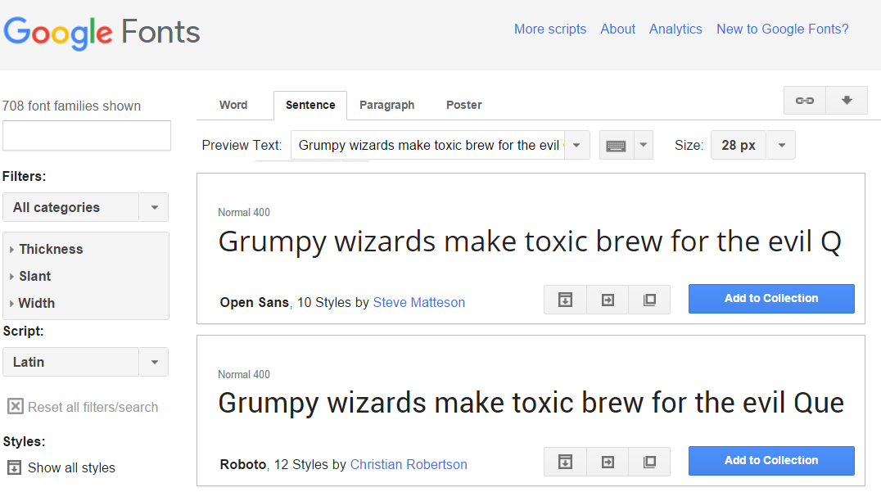
Google Fonts
Google Custom Fonts can be easily incorporated
© 2016 | RCB - All Rights Reserved
Notes:
7:00 – 7:05

Slide 20
> YOUR TURN!!
Assignment
Work through the process of incorporating a custom Google Font into some of your past code. Be sure to incorporate both a serif font and a sans-serif font.
Then proceed through the steps to create a Git branch and create a pull-request on your own code.
Additional details sent via Slack.
© 2016 | RCB - All Rights Reserved
Notes:
Send snapshot from Git command line

Slide 21
Pseudo Styles
© 2016 | RCB - All Rights Reserved
Notes:
7:00 – 7:05

Slide 22
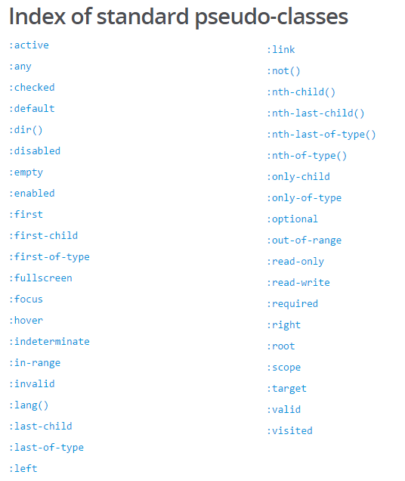
Pseudo Classes
Additionally, CSS has keywords that can be added to selectors to highlight a special state of the element selected.
Great example: CSS can hook onto the specific moment when a link is hovered over using the :hover pseudo-class.
Complete list of pseudo-classes found here: https://developer.mozilla.org/en-US/docs/Web/CSS/Pseudo-classes
© 2016 | RCB - All Rights Reserved
Notes:
7:00 – 7:05

Slide 23
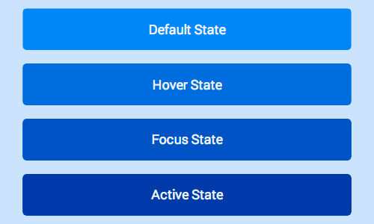
Button with Various States
© 2016 | RCB - All Rights Reserved
Notes:
7:00 – 7:05

Slide 24

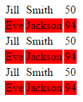
Pseudo Classes
You can even use pseudo classes to target a specific component of a larger element.
Example: Target every other bullet point. Target very other table row a certain way.
Code Snippet See code to the left
© 2016 | RCB - All Rights Reserved
Notes:
7:00 – 7:05

Slide 25
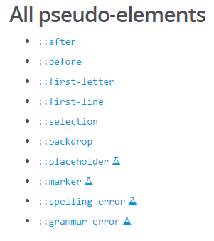
Pseudo Elements
Additionally, CSS has keywords that can be added to style particular parts of an HTML document.
Great example: You can use pseudo-elements to dynamically identify the first-letter or first line. More experimentally you can also use it to style spelling errors or grammar errors a certain way.
© 2016 | RCB - All Rights Reserved
Notes:
7:00 – 7:05

Slide 26
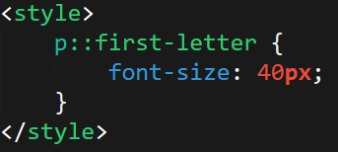
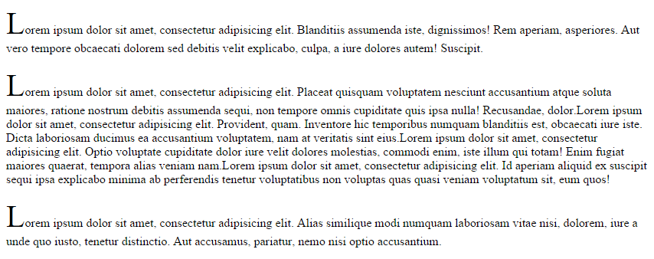
Pseudo Elements
© 2016 | RCB - All Rights Reserved
Notes:
7:00 – 7:05

Slide 27
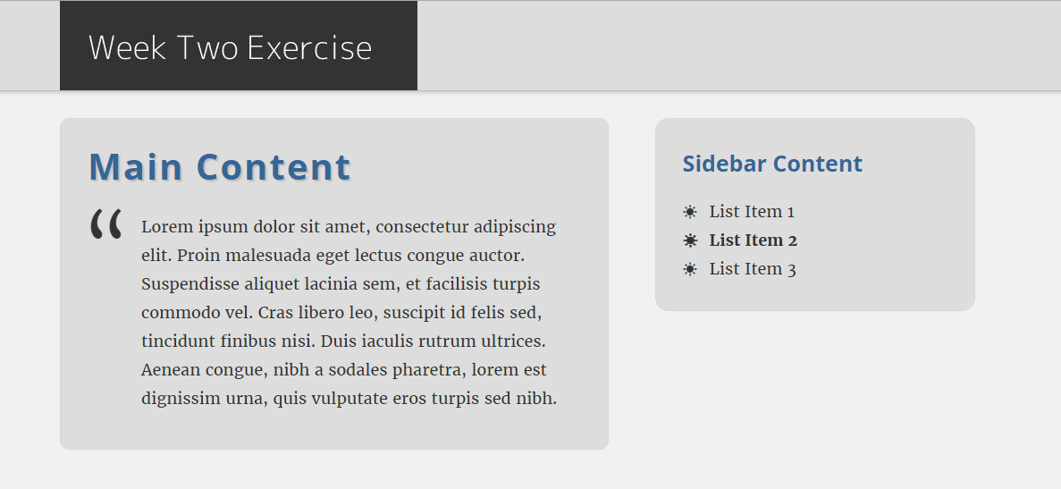
> YOUR TURN!!
© 2016 | RCB - All Rights Reserved
Notes:
Send snapshot from Git command line

Slide 28
> YOUR TURN!!
Assignment:
Make a new HTML document of your choosing (or use one you’ve generated before). Then modify its CSS to use at least 2 CSS pseudo-classes and 2 pseudo-elements in the style sheet.
Post this code to GitHub then slack a screenshot of your creation with a comment listing which pseudo-thingies you used.
© 2016 | RCB - All Rights Reserved
Notes:
Send snapshot from Git command line

Slide 29
Break
© 2016 | RCB - All Rights Reserved
Notes:
7:00 – 7:05

Slide 30
> YOUR TURN!!
Assignment:
Take the code you just posted to GitHub and share the git URL with a partner.
Have your partner modify at least one of the pseudo-elements (or create a new one). Then have your partner create a branch and submit a pull request.
Do the same for your partner’s code as well.
© 2016 | RCB - All Rights Reserved
Notes:
Send snapshot from Git command line

Slide 31
CSS3 Effects
© 2016 | RCB - All Rights Reserved
Notes:
7:00 – 7:05

Slide 32


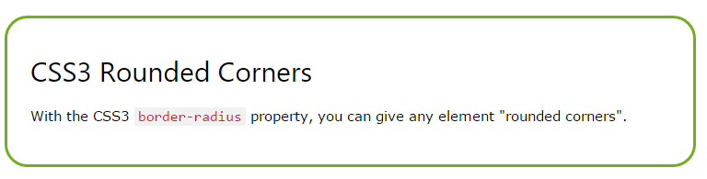
CSS3 Effects
Shadows text-shadow - can be applied to any text element on a page. box-shadow – can be applied to any border box on a page.
Rounded Corners – can be applied to make boxes have curved edges
© 2016 | RCB - All Rights Reserved
Notes:
7:00 – 7:05

Slide 33
> YOUR TURN!!
Assignment:
Take the code you’ve been working on with your partner and apply each of the following on the page:
Text-shadow
Box-shadow
A box with rounded corners
Create a branch and submit a pull-request to your partner when done.
© 2016 | RCB - All Rights Reserved
Notes:
Send snapshot from Git command line

Slide 34
Questions?
© 2016 | RCB - All Rights Reserved
Notes:
7:00 – 7:05

