Slide 1


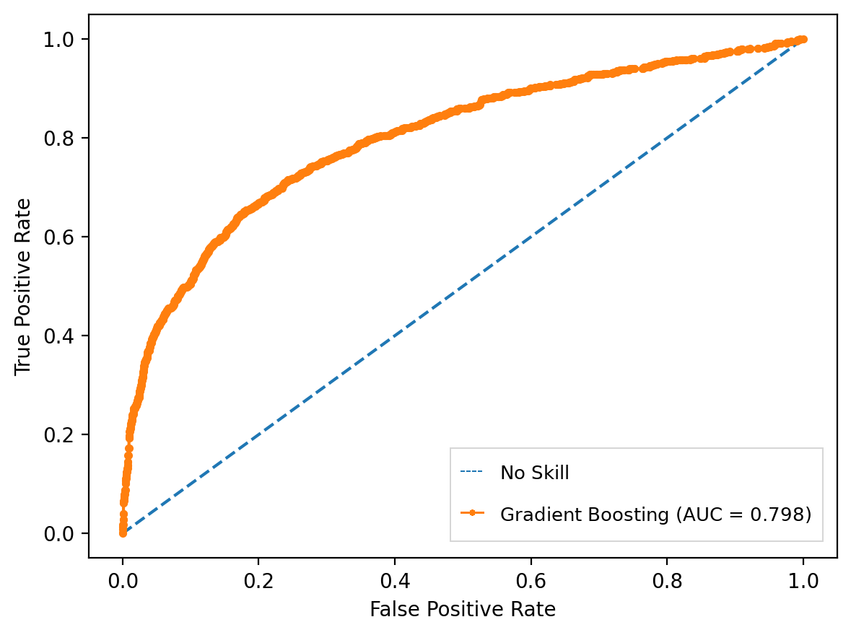
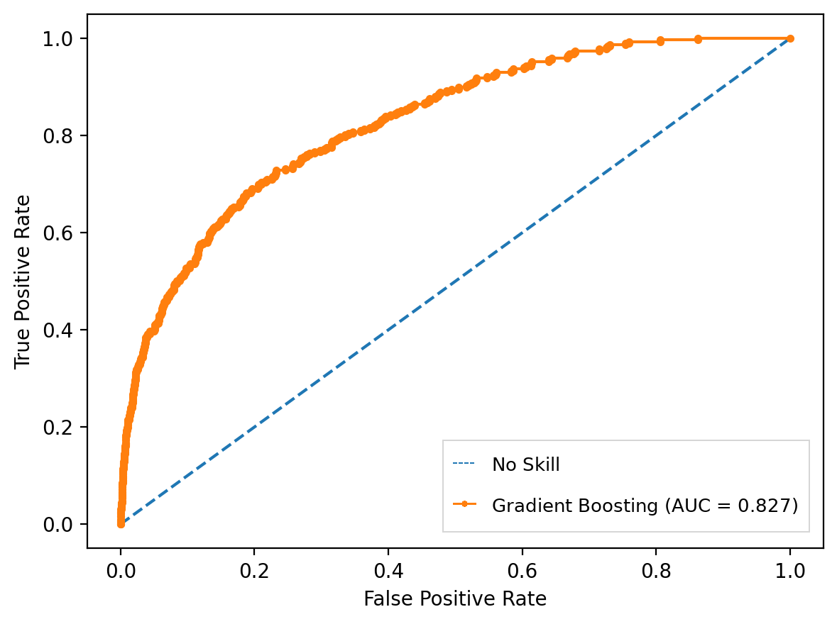
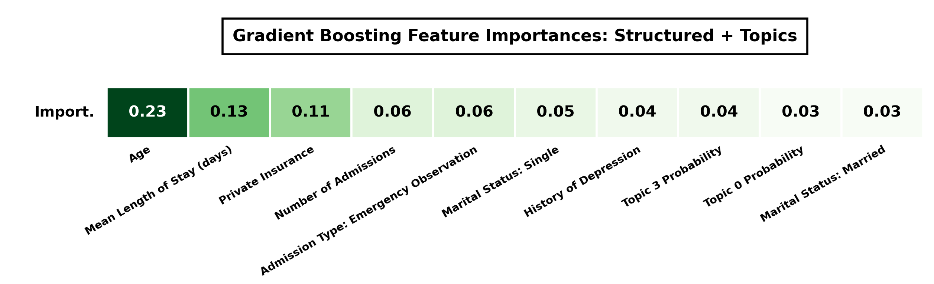
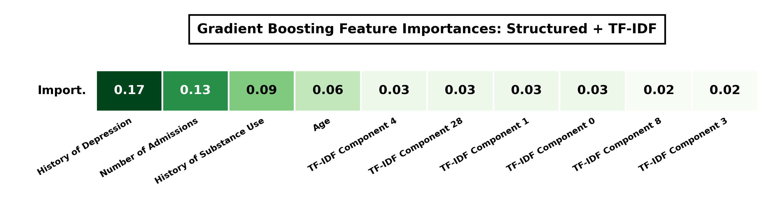
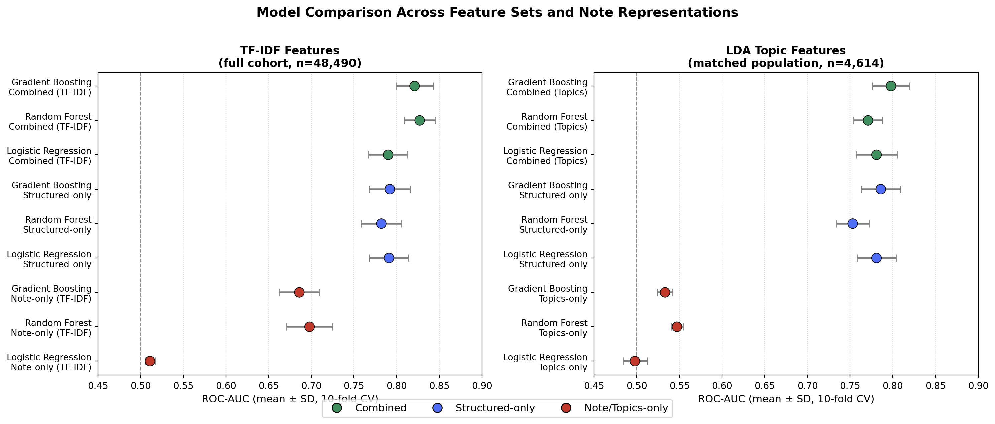
LLM-Based Extraction of Psychosocial Risk Factors in Clinical Notes for Suicide-Related Risk Prediction in Cancer Patients
Maximilian Wakefield
Introduction
Methods: LLM Filtering and Topic Modeling
Results: Model Accuracy Metrics
Cancer patients face elevated risk of suicidal ideation and self-harm, which are often documented only in free-text notes, not diagnosis codes.
LLM Filtering Pipeline
Topic Modeling: LDA vs. BERTopic
a) Gradient Boosting: Topics + Structured
b) Gradient Boosting: TF-IDF + Structured
Qwen2.5-32B-Instruct
LDA - Full Note
BERTopic - Full Note
Stage 1: Extract
Stage 2: Classify
Stage 3: Diagnosis-Link
Topics were:
Organ-system dominated
Medication dominated
Topics were:
Dosage and medication based
Pharmaceutical language dominated
List every sentence describing the patient's own negative mood, feelings, or coping difficulty.
(In list format)
Is this the patient’s own reported negative feeling?
(In Yes or No format)
Is this connected to the cancer diagnosis or treatment?
(In Yes, No, or Unclear format)
Past suicide risk prediction pipelines:
SELECTED
LDA - Evidence spans
BERTopic - Evidence spans
Discharge
Notes
LLM-Based
Filter
Risk
Model
Coherent topics
Clinically interpretable
Related to suicide risk
Only contained 2 topics
1 topic absorbed most of the notes
Not clinically interpretable
Figure 1: 3-stage LLM filtering pipeline overview. Extracts notes based on stage criteria (e.g., negative psychosocial factors, reactions to cancer diagnosis).
Topic count (k) selection (5-seed coherence comparison):
c)
Research Question & Hypothesis
200 / 1,177
877 / 10,627
Coherence Score
Can structured EHR data and clinical notes (individually and combined) identify patterns associated with documented suicide-related events among cancer patients? Hypothesis: Clinical notes can identify suicide-related events and provide significance in both note-only and combined machine learning models.
case notes kept (17.0%)
control notes kept (8.3%)
Index date & leakage: Index date = first qualifying event (cases) or a comparable reference admission (controls). Only notes charted before the index date are used as predictors.
Figure 2: Latent Dirichlet Allocation (LDA) k selection using coherence scores. LDA k=6 was chosen over the marginally more stable k=4 to isolate suicidal ideation as its own theme. Best coherence: 0.370; log-perplexity: -5.745 (train) / -9.380 (test).
d)
Results: LDA Topic Content & Case/Control Prevalence
Topic 0
Topic 1 Suicide/Ideation
Topic 2
Figure 5: (a-b) ROC-AUC curves and (c-d) Gini importance graphs for classification of cancer-related suicide risk and top feature contributions for the combined Gradient Boosting models. Structured features lead both models, with note-derived features contributing psychological significance.
Data & Cohorts
Cases: 13.5% Controls: 24.3%
Cases: 25.2% Controls: 22.5%
Cases: 16.2% Controls: 15.2%
Structured EHR
Longitudinal Evidence Trend
Structured EHR Tables from MIMIC-IV v3.1 Diagnosis codes, admissions, and demographics from the hospital record
(https://physionet.org/content/mimiciv/3.1/)
4,614 cancer patients:
769 with a documented suicide-related event
3,845 without a documented suicide-related event (matched controls)
28 features engineered from three tables:
Admissions: hospital visit history
Diagnosis codes: psychiatric, pain, substance-use history
Patients: demographics (age, sex, insurance, marital status)
Benefits: Clean clinical labels; well-defined structured variables
Drawbacks: Misses undocumented risk, weak correlation to real-life emotions
MIMIC-IV Database (PhysioNet, restricted access)
Topic 3
Topic 4
Topic 5
Cases: 10.8% Controls: 10%
Cases: 21.6% Controls: 17.2%
Cases: 12.6% Controls: 10.7%
Figure 6: Longitudinal graph showing increasing case prevalence over time. Cases nearly double approaching the event; controls stay flat (interaction p=0.0053, n=9,068).
Conclusions
1
Topics Help Tree Models
Figure 3: LDA six topics with the top five weighted words from each. The percentages show how often that topic was the main theme in a note.
Combining structured data with TF-IDF or LDA topics significantly improves reproducible Random Forest and Gradient Boosting (p<0.001) models, with a ROC-AUC of 0.827 and 0.798
Results: Predictive Value of Topic and Note Features
2
Structured Signal
AUC 0.792 structured-only, near state-of-the-art leakage-safe accuracy metrics
3
A Longitudinal Signal
Clinical Notes
Evidence in notes rises toward the event in cases, producing a significant signal (p=0.0053)
Discharge summaries from MIMIC-IV v2.2
Free-text discharge summaries from the same patients
(https://physionet.org/content/mimic-iv-note/2.2/)
11,804 notes screened:
1,177 from cancer patients with a documented suicide-related event (cases notes)
10,627 from cancer patients without a documented suicide-related event (control notes)
Benefits: Mimics real-life emotional signals in free text, heterogeneous data
Drawbacks: Contains many stop words, sparse data (~2 notes/patient), no predefined features
Limitations & Future Work
Limitations
MIMIC-IV v3.1 is ICU/ED-only, and has no psychotherapy notes Cancer-specific notes are sparse
Future Work
Pull broader cancer reports for the same cohort
Validate trajectory-based monitoring in oncology care
Acknowledgments
Dartmouth College / EDIT AI Joshua Levy — PI & Director, EDIT AI Louis Vaickus — Mentor, HPC & Data Infrastructure Alos Diallo — Mentor Benjamin Mattern, Matthew Hayden — EDIT AI Program VA Collaborators Monica Dimambro — Mentor Maxwell Levis — Mentor Data: MIMIC-IV & MIMIC-IV-Note (PhysioNet, restricted access). Prior work: Levis, Levy, Dimambro, Diallo, Gui, et al. LLM-based extraction of psychosocial risk factors for suicide-risk prediction in veterans. medRxiv, 2026 (preprint).
Figure 4: Model ROC-AUC for classification of cancer-related suicide risk. Error bars show mean ± SD across 10 cross-validation folds. The p-value compares Combined (structured + notes) vs. Structured-only on the same folds, isolating the added contribution of note features beyond structured data alone. Both TF-IDF and LDA topics significantly improve tree-based models (RF/GB) when added to structured data (paired t-test, p<0.001 for both), but not Logistic Regression.

