Slide 1
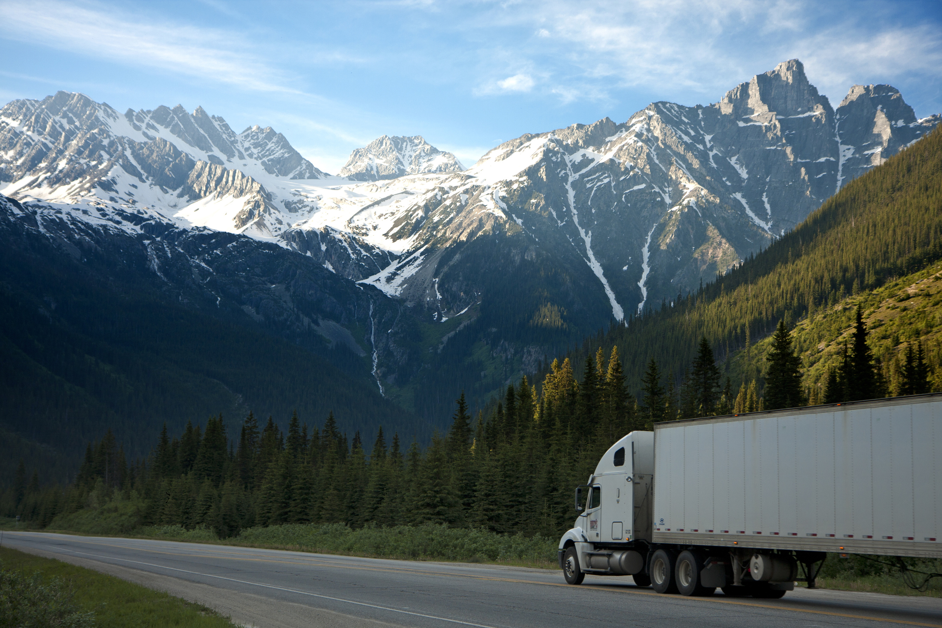
BUAN 6346.001 | Big Data
Risk Analytics:
Truck Operations
Ahead of the Curve: Steering Safety with Data-Driven Precision

Slide 2
Content Overview
Problem Statement
Data flow & Description
Insights
Conclusions
1.
2.
3.
4.

Slide 3





Problem
Statement
As the Fleet Manager of AZ National Trucking (ANT), our primary challenge is to ensure compliance with regulations and mitigate insurance risks associated with hazardous driving practices.
Objectives
  Understanding Risk Types and Risk Factor Calculation
  Highlight risk trends geographically
  Understand risk by model of truck
  Identify truck drivers with highest risk factors

Slide 4
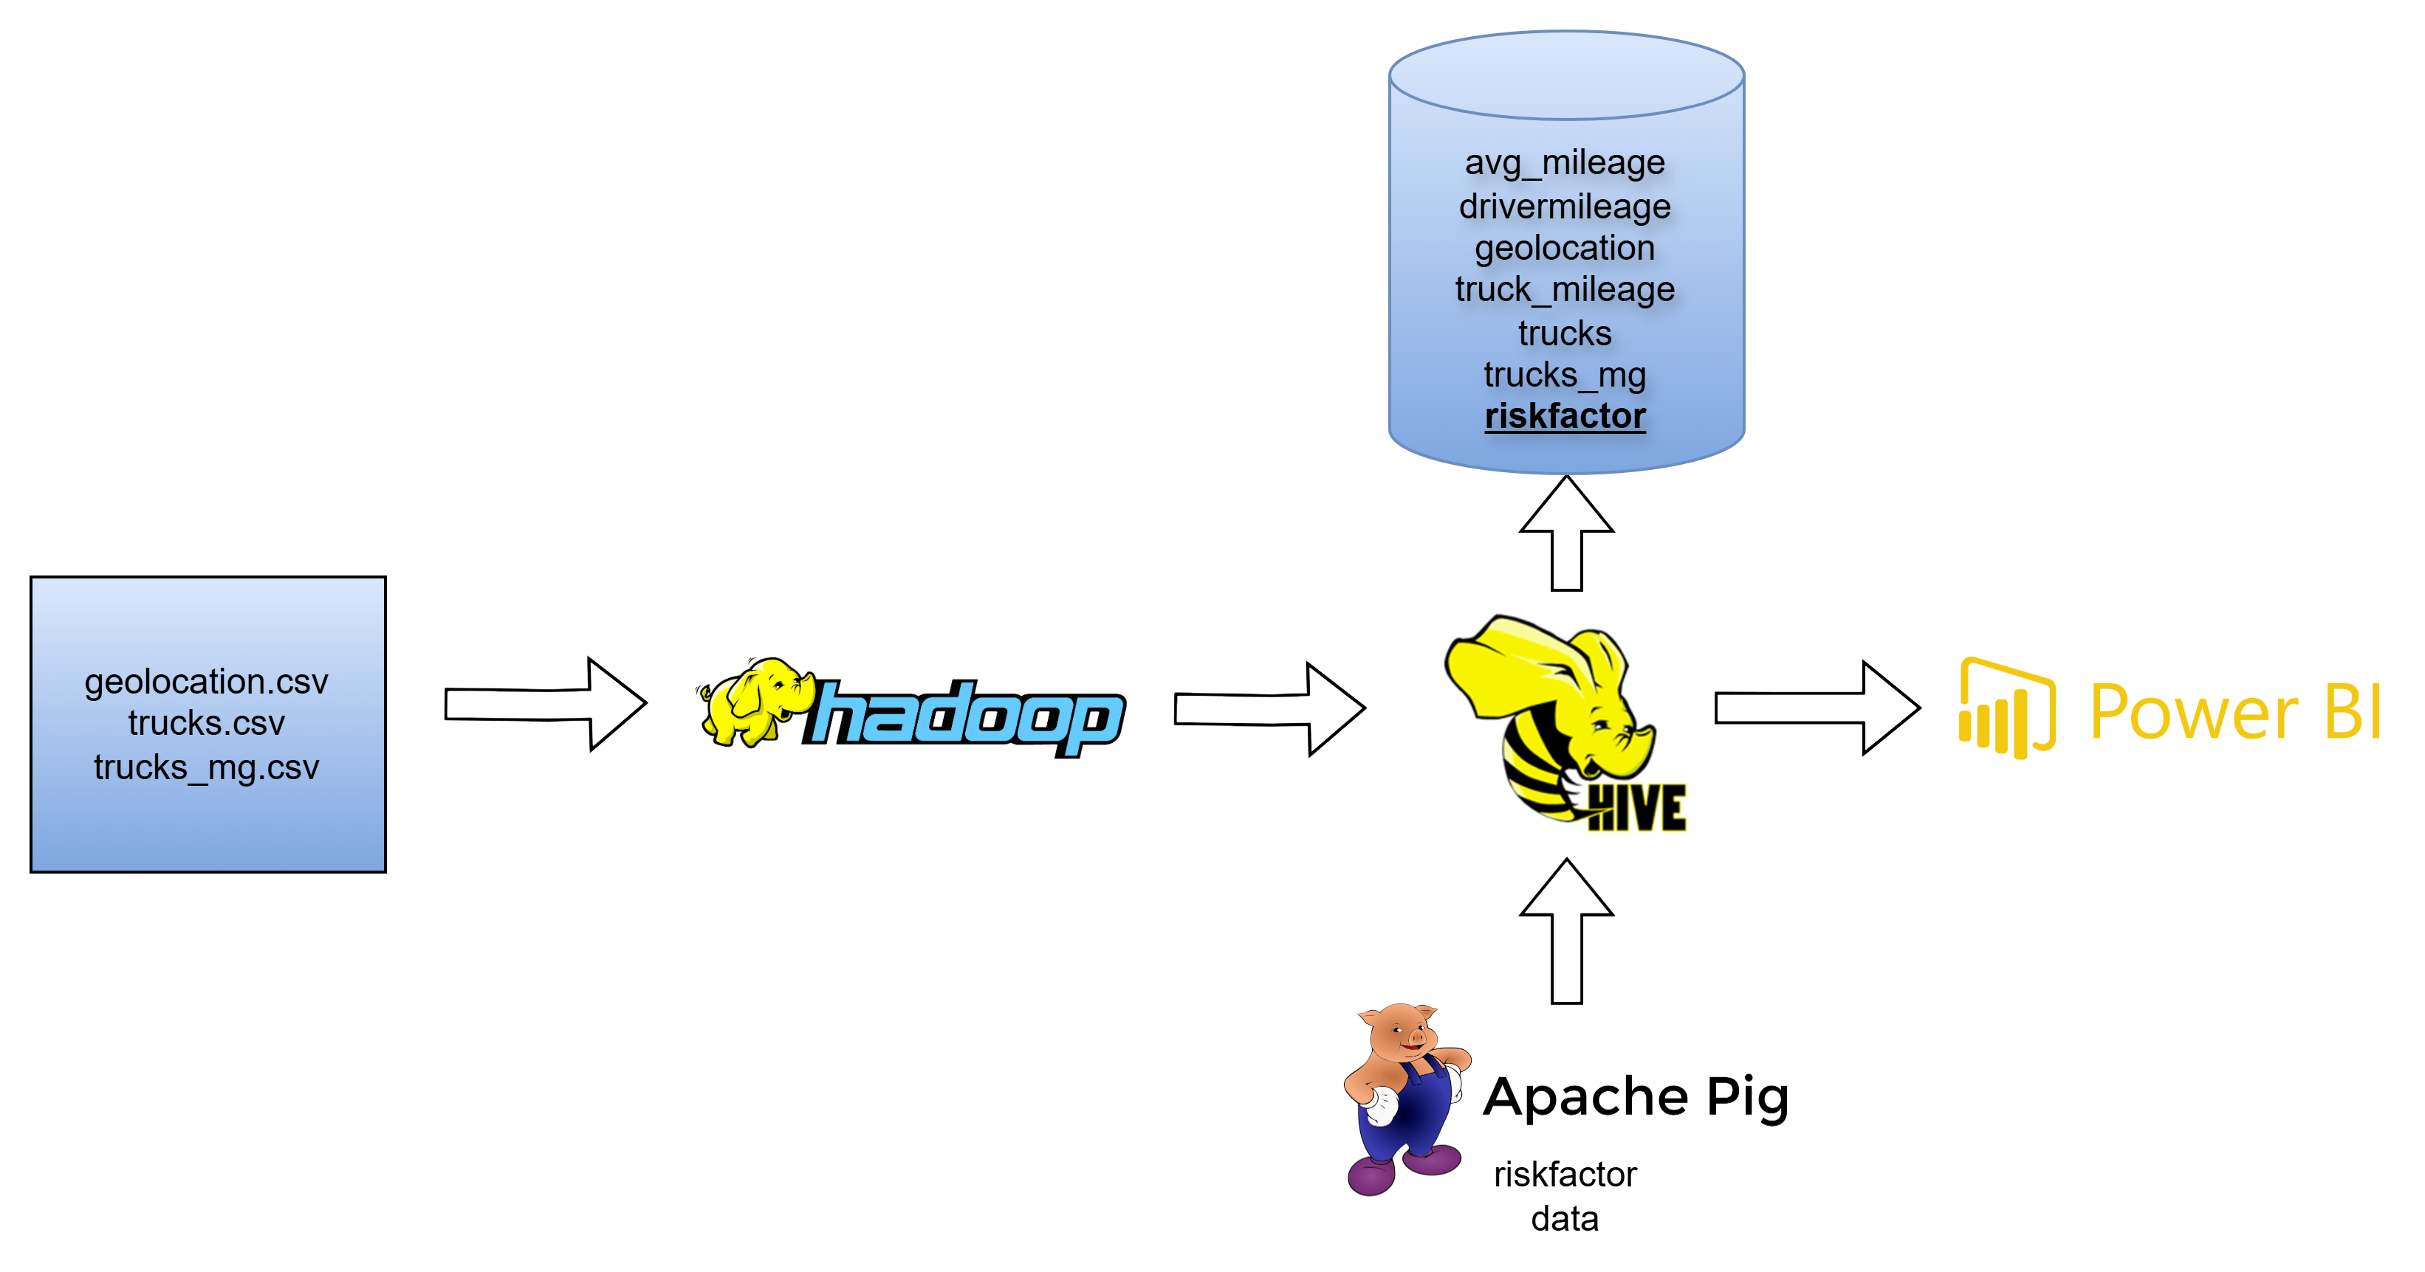
Data Flow &
Description

Slide 5
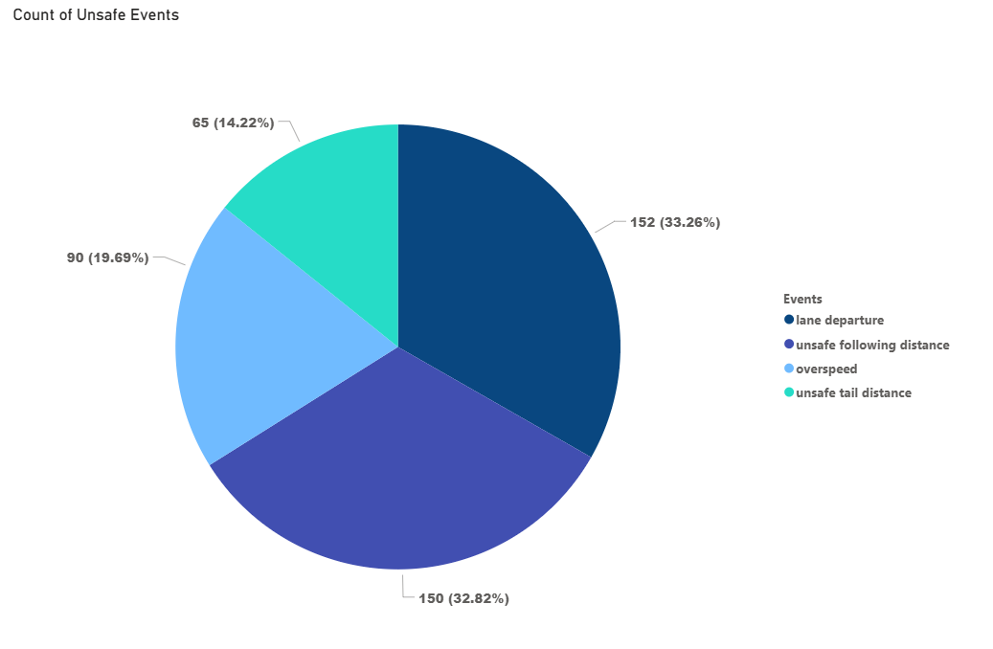
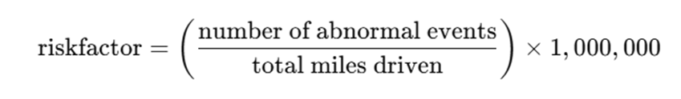
Insights : Events Analysis
Unsafe Driving Events Account for Nearly 6% of All Trips, Dominated by Lane and Distance Violations
Split of Unsafe Events
Risk is normalized per million miles to fairly compare drivers, with 7 events as the high-risk threshold
Lane departure and unsafe following distance alone contribute to over 66% of all unsafe events, signaling top focus areas for driver training and monitoring
Unsafe tail distance is the least frequent event but still accounts for over 14% of all incidents, showing that even lower-occurrence behaviors require attention
Understanding Risk Factor Calculation
Total Observations = 8000
Normal Observations = 7543
Unsafe Observations = 457
Abnormal events per million miles driven
Normalized risk across drivers
Acceptable risk threshold = 7

Slide 6
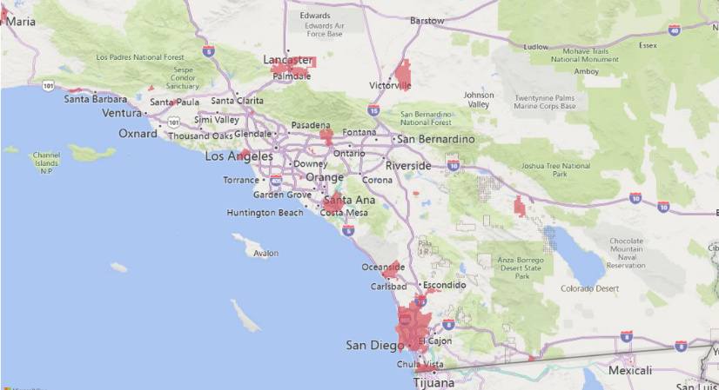
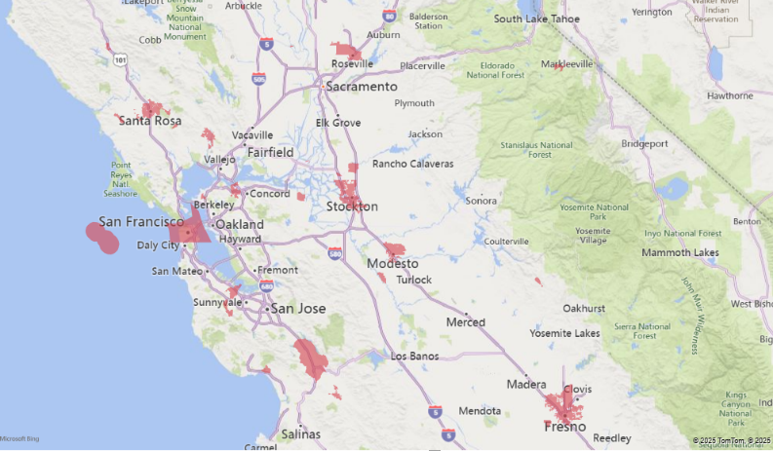
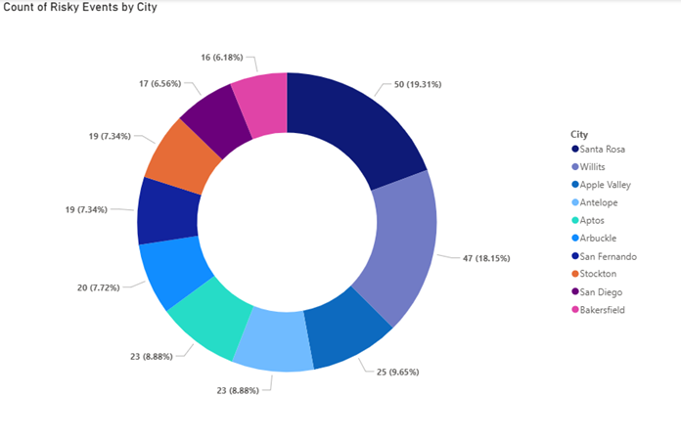
Insights : Risk by City
Risky driving events are primarily concentrated along NH5 indicating elevated risk zones along high-traffic corridors
Risk events are heavily concentrated near metropolitan zones, suggesting urban density and traffic volume are key drivers of risky behavior
Santa Rosa and Willits together account for over 38% of total risk events, indicating concentrated hotspots in Northern California
Geographic spread shows risk presence in both Northern and Southern California, suggesting a need for state-wide risk mitigation strategies, not just regional focus

Slide 7
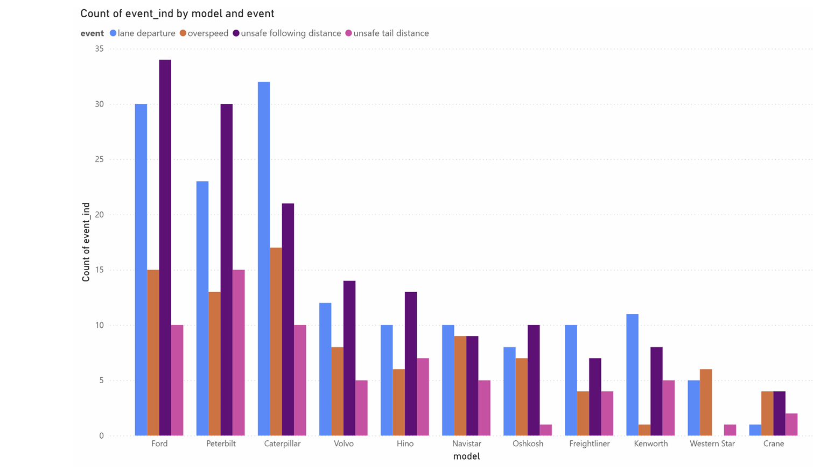
Insights : Truck Model Analysis
Lane Departure and Following Distance Emerge as Top Risk Patterns Across Truck Models
Unsafe driving behaviors are dominated by lane-related and distance-based violations, pointing to attention and spacing issues across the fleet
Risk patterns vary across models, likely due to operational roles (e.g., long-haul vs. local routes) rather than vehicle design
No causal link is observed between truck model and event type, suggesting driver behavior and route conditions are the more relevant risk factors
No : of Events
Truck Model

Slide 8
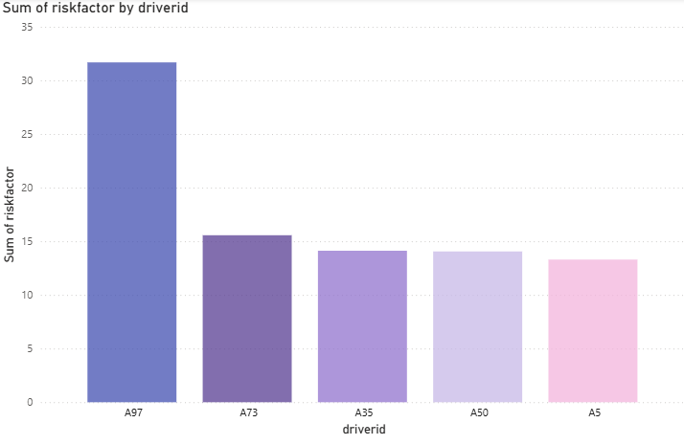
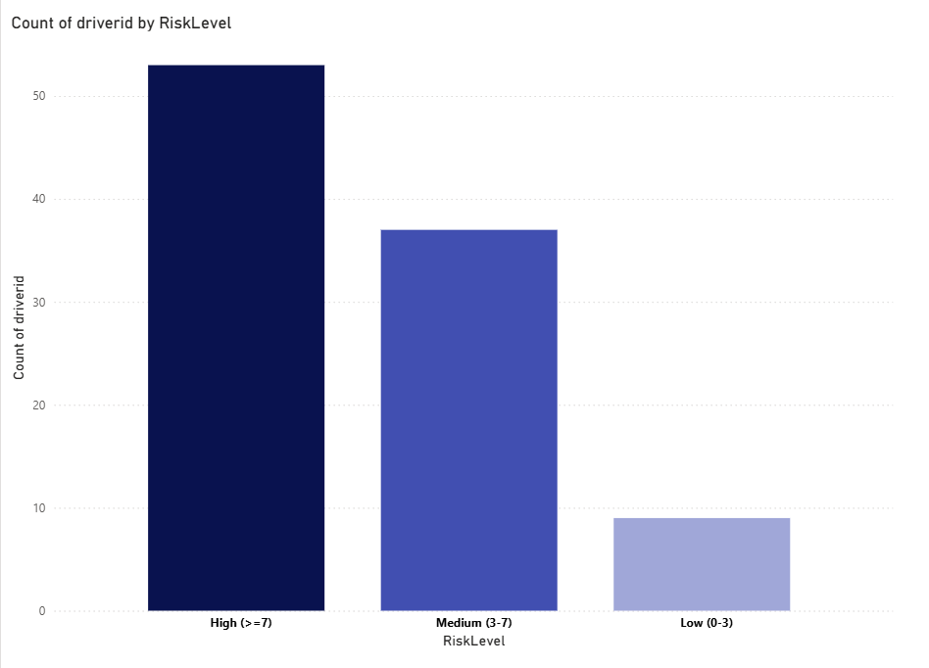
Insights : Risk by Drivers
66% of Drivers Exceed Risk Threshold — Key “Drivers” Identified
Driver A97 registers the highest cumulative risk factor, making them a clear priority for immediate review and coaching
Low-risk drivers form a small but valuable group that can serve as a benchmark for safer driving behavior across the fleet
High-risk drivers outnumber low-risk ones by nearly 6:1, highlighting the urgency for targeted safety interventions
Risk Factor
Driver ID
No : of Drivers
Risk Level

Slide 9
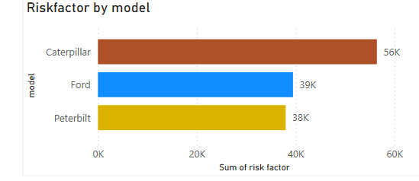
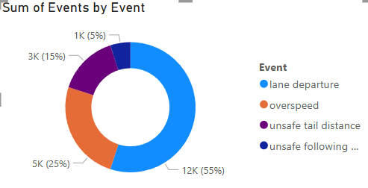
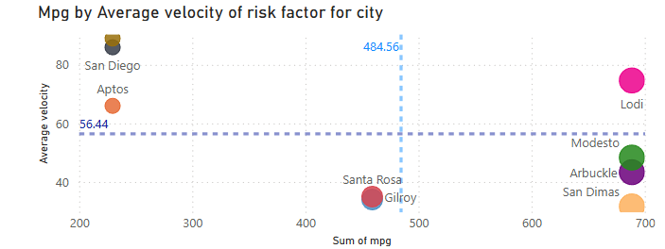
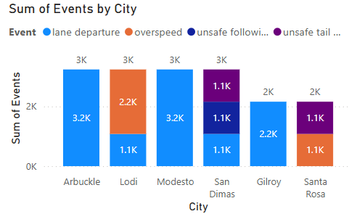
Insights :Outlier Study
The Caterpillar truck model shows the highest overall risk, primarily driven by driver A97
Lane departures are the most frequent event type, with Arbuckle recording the highest incidents involving A97
Lodi stands out as a city-level outlier due to elevated speeding events and unusually high MPG

Slide 10
Findings and Implementation Path
Conclusion
Lane Departure and Unsafe following distance are the most common risky events.
We observed high risk hotspots across NH5 and concentration in certain cities – Santa Rosa being the highest.
Truck model has no relation with risk factor.
Top 5 risky drivers identified.
Recommendations
Deploy dash-cams to detect lane drift and unsafe following distances, triggering alarms.
Introduce awards like “Safest Driver of the Month” or “Zero Violation Streak” bonuses.
Provide regular safety training for drivers like A97 on speed control, defensive driving, and lane discipline.

