Slide 1
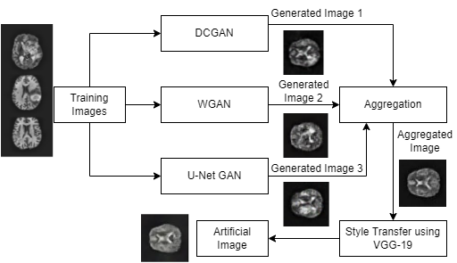
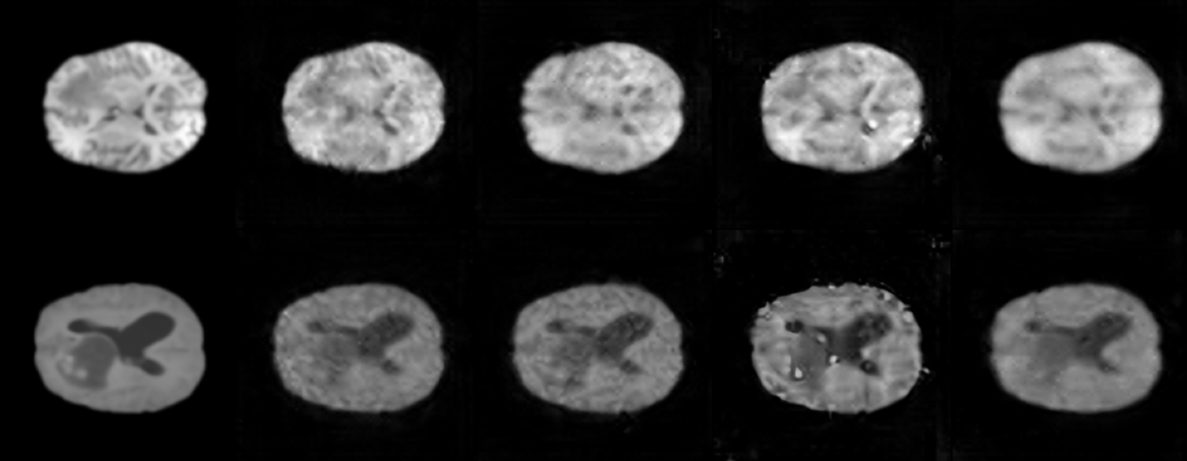
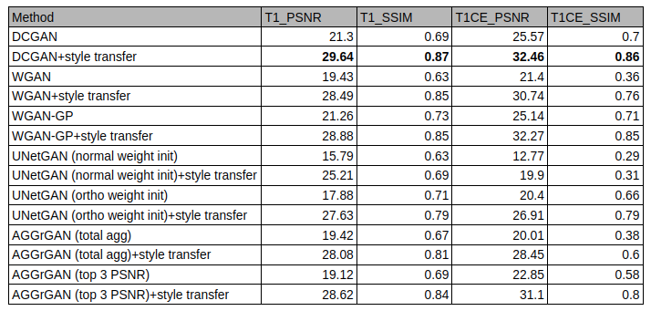
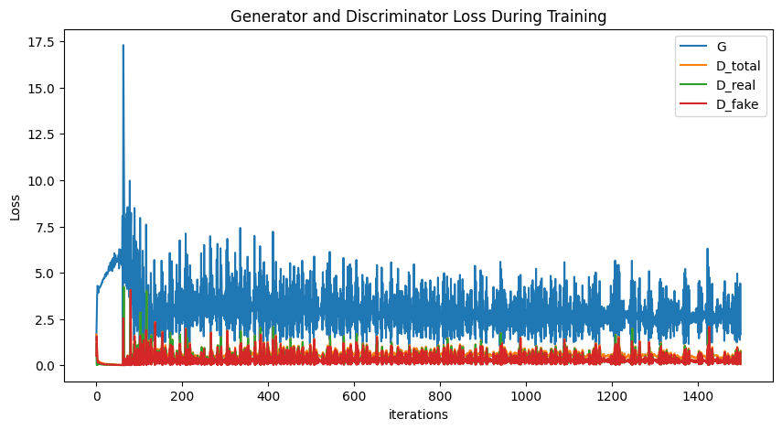
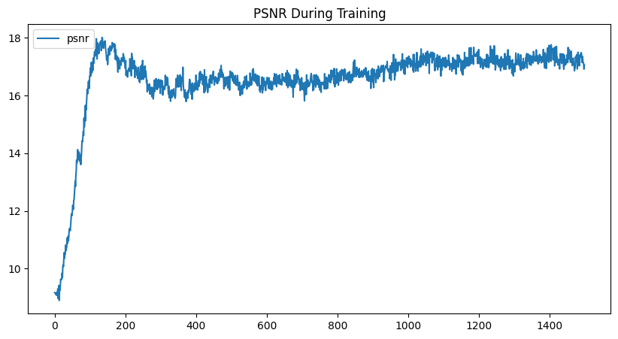
Brain tumor MRI synthesis using GAN aggregation
Sarah Hindawi, Sumant Bagri, Vignesh Edithal
University of Toronto
Motivation
New Technique
MRI is a powerful non-invasive tool for obtaining location and growth of tumor
Lack of medical imaging data along with high class imbalance due to resource constraints and privacy concerns
Traditional data augmentation generates highly correlated images with less variance resulting in poor generalization
Generative Adversarial Networks (GAN) have shown promising results with good generalization on a large variety of images. It serves as an anonymization tool and reduces data handling risks
We evaluate 5 GAN models individually, then run an aggregation algorithm followed by style transfer
This allows our model to capture both the unique and shared features in the latent representation. Style transfer allows us to capture localized information
We aim to perform an ablation study to measure the contribution of fake images produced by the Aggregate GAN (AGGrGAN) model [1] to a basic classification network
We added a UNet-GAN whose discriminator is a UNet. A UNet discriminator provides region-specific feedback to the generator for improved image synthesis.
UNet-GAN was added to the aggregation process of AGGrGAN in addition to DCGAN and WGAN
We also enhanced the aggregation logic to process all images instead of top 3 images based on PSNR/SSIM metric
We performed style transfer using three intermediate layers of VGG-19 and then used Adam optimizer on content + style loss
Flow chart of AGGrGAN model
Experimental Results
We present the images from individual GANs and the AGGrGAN followed by the PSNR and SSIM scores of both T1 and T1 ce modalities from the BraTS 2020 dataset
Real
DCGAN
WGAN-GP
UNET GAN
AGGR GAN
Related Work
T1
Debadyuti et al. proposed aggregation of GANs for medical image synthesis
Improved classification performance with augmented data on BraTS 2020 dataset
Han et al. applied DCGAN and WGAN separately on the BraTS 2016 dataset
Conducted visual turing test with 53% accuracy for WGAN
Shin et al., segmented images from ADNI and BraTS dataset into brain anatomy, tumor using pix2pix
Sarkar et al., created a CNN model to detect type of brain tumor using MRI scans to classify meningioma, glioma and pituitary tumors.
T1ce
Ablation study of GANs and style transfer
Training progress of DCGAN
References
[1] Mukherjee et al., Brain tumor image generation using aggregation of GAN, Scientific Reports, 2022
[2] Schonfeld, Schiele, Khoreva, U-Net based discriminator for GAN, CVPR, 2020
[3] Radford, Metz, Chintala, Deep Convolutional Generative Adversarial Network, ICLR 2016
Model losses decrease rapidly initially leading to a steady mean with high variance. PSNR increases rapidly followed by a steady increase.

