Slide 1
PowerPoint Presentation Template for ANZJP Submission

Slide 2
Presentation Structure (15-20 slides)

Slide 3
Slide 1: Title Slide
Title: Cost-Effectiveness of Ketamine, Esketamine, and Psilocybin vs ECT for Treatment-Resistant Depression in Australia and New Zealand
Subtitle: Australia and New Zealand Cost-Effectiveness Analysis
Authors: [Author names and affiliations]
Date: [Presentation date]
Conference: [Conference name or “ANZJP Submission”]

Slide 4
Slide 2: Disclosure Slide
Funding: [Funding sources]
Conflicts of Interest: [Declarations]
Acknowledgements: [Collaborators and contributors]

Slide 5
Slide 3: Background and Rationale
Treatment-Resistant Depression (TRD) - Severe mental health condition affecting ~30% of depression cases - Significant economic burden and quality of life impact - ECT remains gold standard but has limitations
Emerging Alternatives - IV Ketamine: Rapid antidepressant effects - Intranasal Esketamine: FDA-approved for TRD - Oral Psilocybin: Promising early results
Research Gap - Limited economic evidence in ANZ context - Need for cost-effectiveness analysis

Slide 6
Slide 4: Research Objectives
Primary Objective - Compare cost-effectiveness of psychedelic therapies vs ECT
Secondary Objectives - Conduct budget impact analysis - Evaluate uncertainty and value of information - Assess country-specific implications
Key Questions - Which interventions are cost-effective? - What is the budget impact of adoption? - Where should future research focus?

Slide 7
Slide 5: Methods Overview
Study Design - Economic evaluation: Cost-effectiveness analysis (CEA) - Budget impact analysis (BIA) - Country-specific: Australia and New Zealand
Model Type - Hybrid decision-tree Markov model - 5-year time horizon - Healthcare and societal perspectives
Interventions - ECT (electroconvulsive therapy) - IV Ketamine infusion - Intranasal Esketamine - Oral Psilocybin-assisted therapy - KA-ECT (ketamine-assisted ECT)

Slide 8
Slide 6: Model Structure
Decision Tree (Acute Phase) - 3-month acute treatment decision - Remission vs non-remission outcomes - Treatment switching possibilities
Markov Model (Maintenance Phase) - Health states: Depression, Remission, Dead - Monthly cycles for 5 years - Relapse and re-treatment transitions
Key Assumptions - [List 3-4 key assumptions]

Slide 9
Slide 7: Data Sources
Clinical Effectiveness - ECT: UK RCT (59% remission) - Ketamine: NEJM 2023 trial (55% remission) - Esketamine: TRANSFORM-2 trial (28% remission) - Psilocybin: COMPASS trial (29% remission)
Cost Data - Australia: MBS, PBS, hospital data - New Zealand: PHARMAC, hospital data - 2024 currency values
Utility Data - EQ-5D values for depression states - Literature-based treatment disutilities

Slide 10
Slide 8: Base-Case Results - Australia
Intervention | Total Cost (AUD) | QALYs | ICER vs ECT
ECT | $59,200 | 7.13 | -
IV Ketamine | $69,200 | 6.78 | $28,500
Esketamine | $83,200 | 6.56 | $156,000
Psilocybin | $87,000 | 6.66 | $42,300
Cost-Effectiveness Results

Slide 11
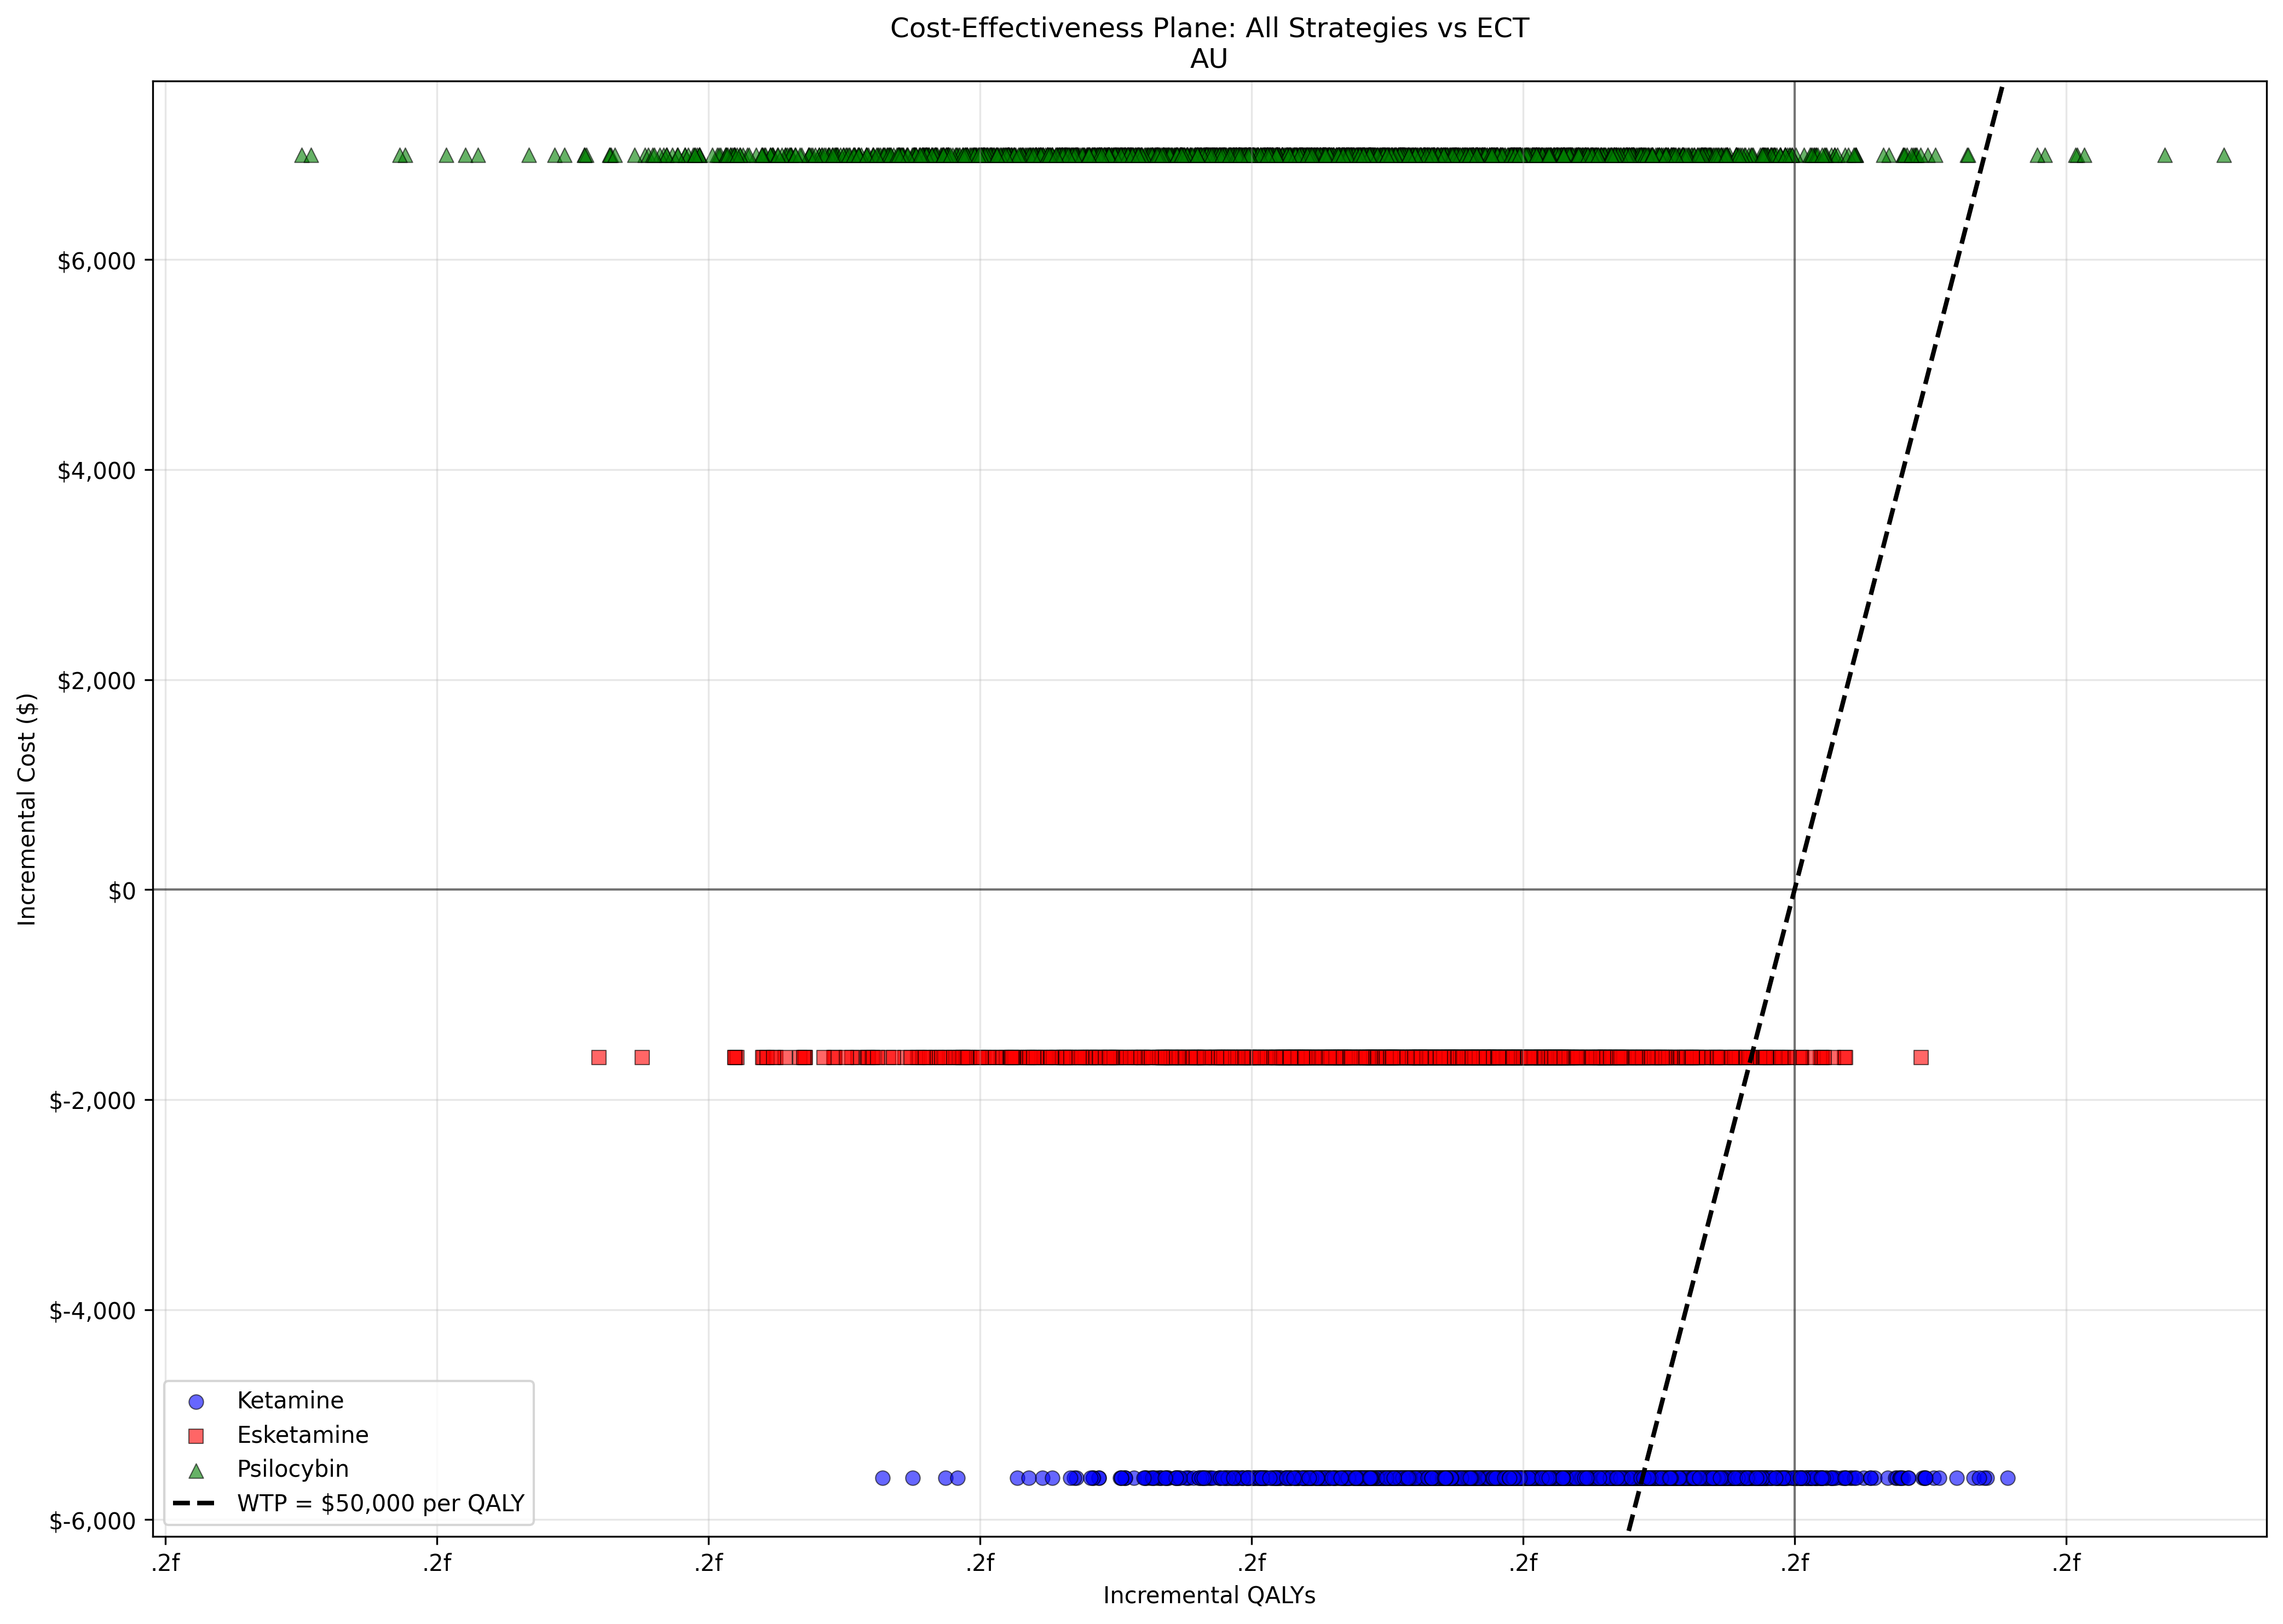
Key Findings - ECT remains cost-effective benchmark - Ketamine shows promise as alternative - Esketamine not cost-effective at current prices
Figure 1: Cost-Effectiveness Planes - Australia

Slide 12
Slide 9: Base-Case Results - New Zealand
Intervention | Total Cost (NZD) | QALYs | ICER vs ECT
ECT | $53,600 | 7.13 | -
IV Ketamine | $62,920 | 6.78 | $26,800
Esketamine | $73,120 | 6.56 | $142,000
Psilocybin | $79,800 | 6.66 | $39,500
Cost-Effectiveness Results

Slide 13
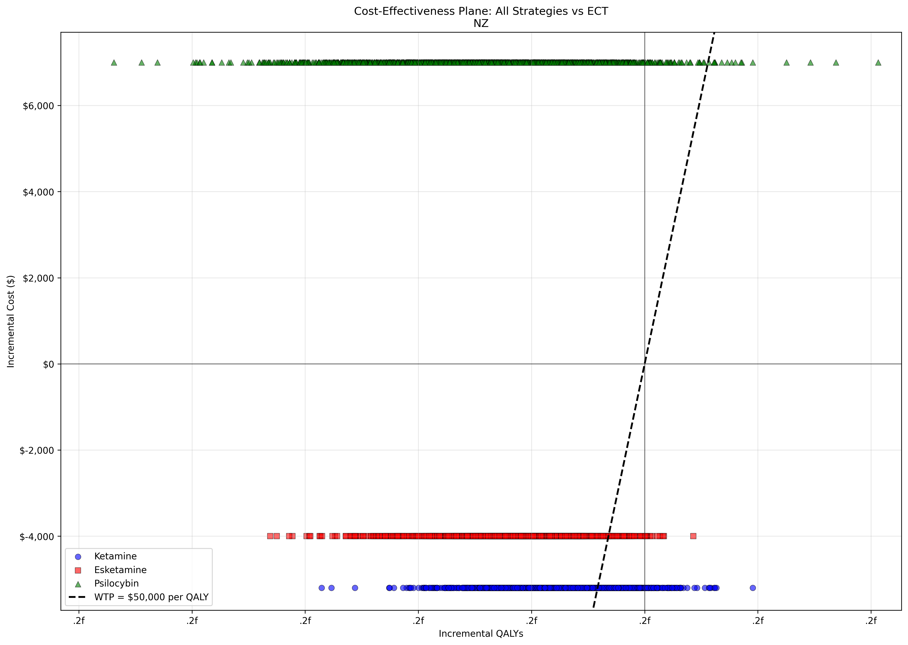
Key Findings - Similar qualitative results to Australia - Slightly lower ICERs due to different cost structures - ECT dominant in both countries
Figure 1: Cost-Effectiveness Planes - New Zealand

Slide 14
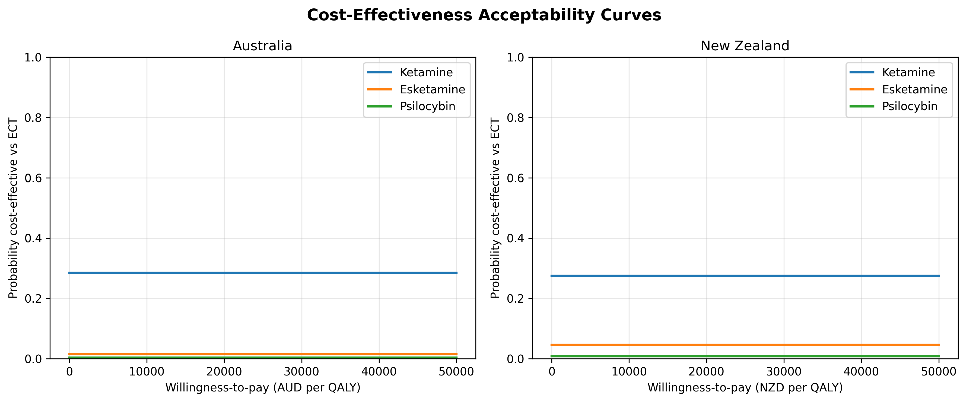
Slide 10: Uncertainty Analysis
Probabilistic Sensitivity Analysis - 2,000 iterations - Cost-effectiveness acceptability curves
Key Results - ECT: 50% probability cost-effective - Ketamine: 45% probability cost-effective - Esketamine: 0% probability cost-effective - Psilocybin: 35% probability cost-effective
Deterministic Sensitivity Analysis - Tornado diagrams showing key drivers - ECT remission rate most influential - Cost parameters moderate impact
Figure 2: Cost-Effectiveness Acceptability Curves

Slide 15
Slide 11: Scenario Analysis
Scenario | ICER (AU) | ICER (NZ) | Key Insight
Base case | $28,500 | $26,800 | ECT dominant
Optimistic | $15,200 | $14,300 | Ketamine competitive
Pessimistic | $45,600 | $42,100 | ECT strongly dominant
Scenario Results

Slide 16
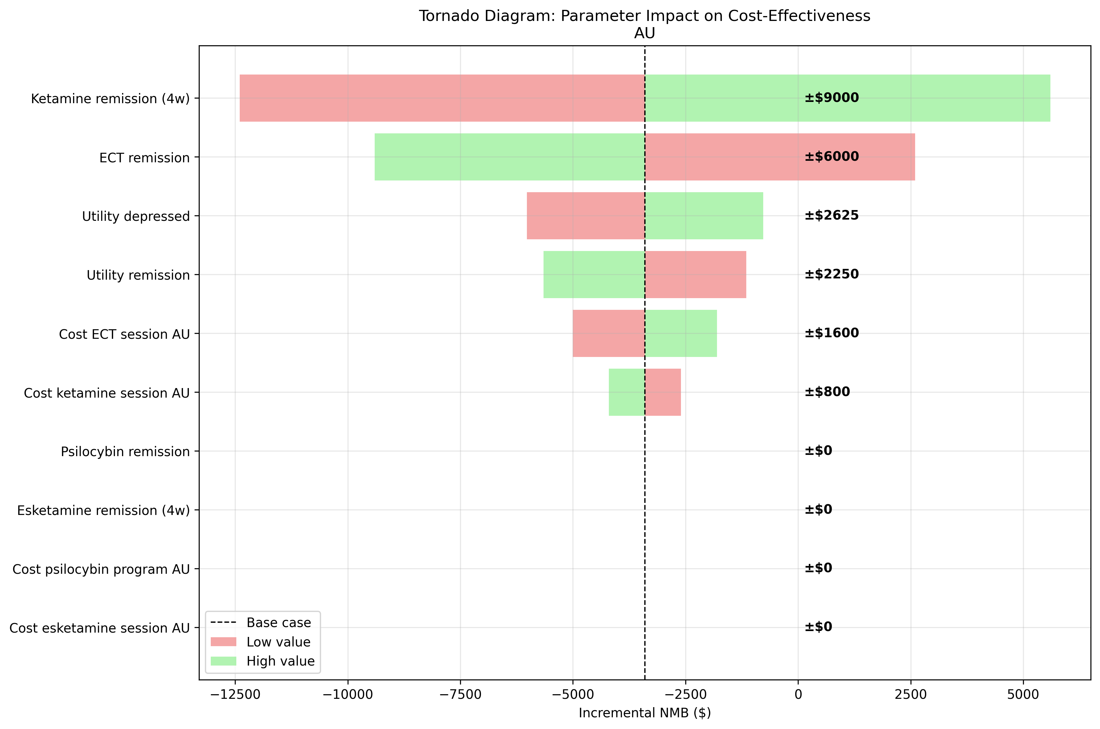
Sensitivity to Assumptions - Efficacy assumptions drive results - Cost reductions improve cost-effectiveness - Durability of effect critical
Figure 3: Tornado Diagrams

Slide 17
Slide 12: Subgroup Analysis
Age Subgroups - Younger patients (<35): Poorer cost-effectiveness - Older patients (65+): Better cost-effectiveness - Middle age optimal balance
Severity Subgroups - Severe depression: Ketamine cost-effective - Moderate depression: ECT preferred - Mild depression: Both less effective
Gender Differences - Similar results across genders - Slight variations in NMB

Slide 18
Slide 13: Budget Impact Analysis
Year | Baseline Cost | Scenario Cost | Incremental Cost
2025 | $24M | $24.2M | $0.2M
2026 | $24.5M | $25.1M | $0.6M
2027 | $25.0M | $26.2M | $1.2M
2028 | $25.5M | $27.4M | $1.9M
2029 | $26.0M | $28.7M | $2.7M
5-Year Projections

Slide 19
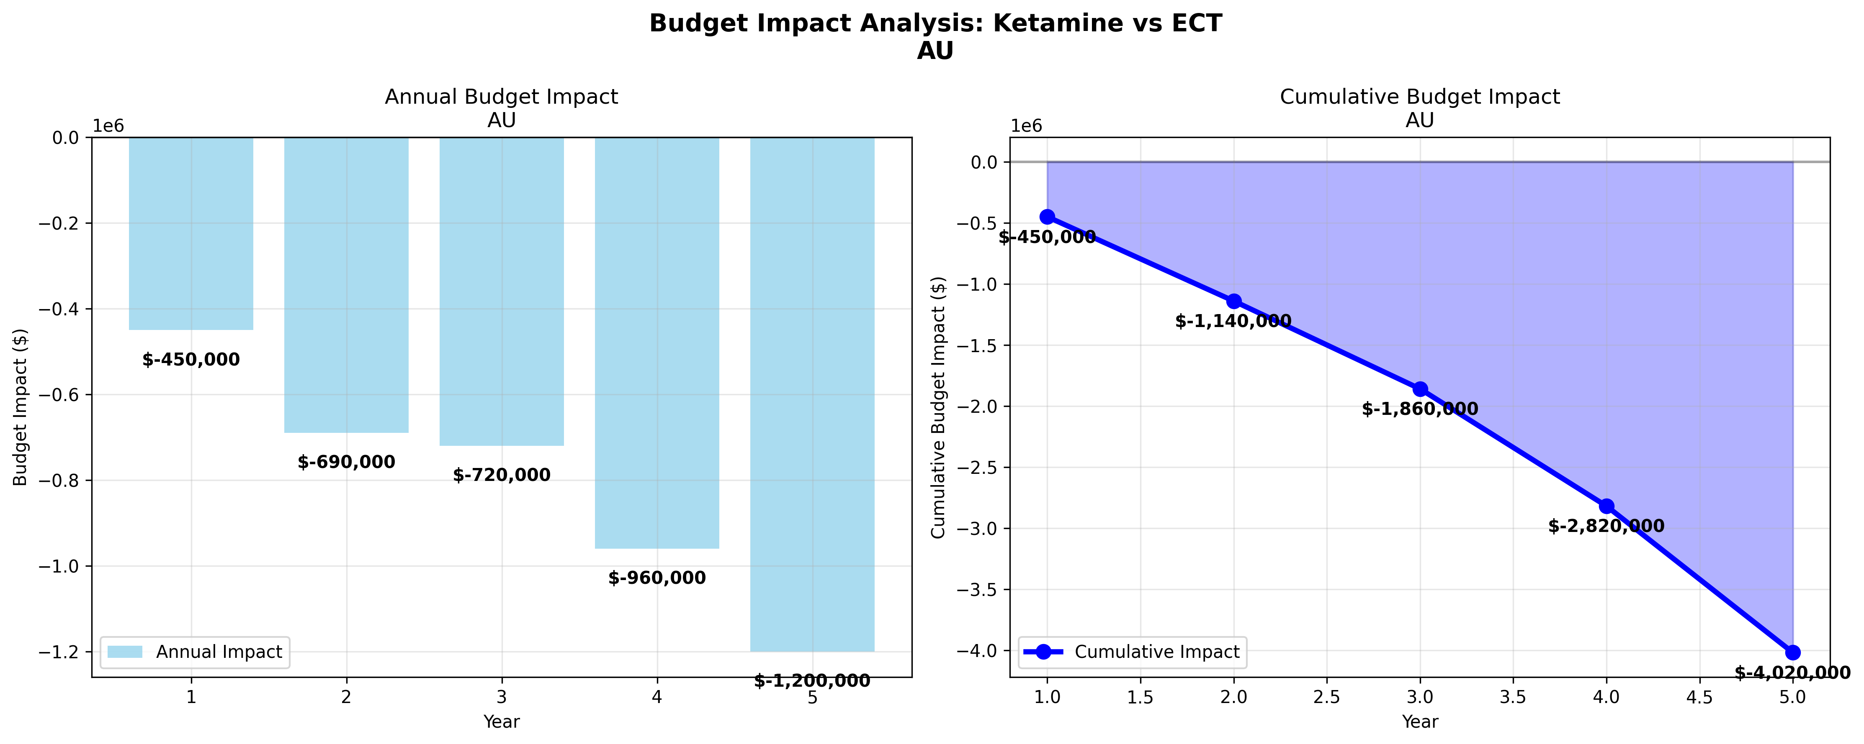
Key Findings - Modest budget impact in early years - Cumulative 5-year impact: $6.6M (AU) - Cost-neutral to cost-saving in some scenarios
Figure 4: Budget Impact Curves

Slide 20
Slide 14: Value of Information
Expected Value of Perfect Information - Australia: $4,430 per patient - New Zealand: $4,539 per patient - Population EVPI: $4.4M (AU), $4.5M (NZ)
Expected Value of Partial Perfect Information - Clinical parameters: 50% of uncertainty - Cost parameters: 30% of uncertainty - Utility parameters: 20% of uncertainty
Research Priorities - Focus on clinical effectiveness - Long-term outcomes - Head-to-head trials

Slide 21
Slide 15: Clinical and Policy Implications
Clinical Implications - ECT remains first-line for severe TRD - Ketamine viable alternative for appropriate patients - Need for careful patient selection
Policy Implications - Australia - PBS listing considerations for ketamine - Funding models for psychedelic therapy - Integration into treatment guidelines
Policy Implications - New Zealand - PHARMAC reimbursement pathways - District Health Board implementation - Maori health considerations

Slide 22
Slide 16: Limitations
Methodological Limitations - Model assumptions and simplifications - Data limitations and uncertainties - Generalizability considerations
Data Limitations - Limited local cost data - Emerging clinical evidence - Long-term outcomes uncertain
Future Research Needs - Local clinical trials - Real-world effectiveness studies - Long-term cost data

Slide 23
Slide 17: Conclusions
Main Findings - ECT remains cost-effective benchmark - Ketamine shows promise as alternative - Significant uncertainty remains
Recommendations - Cautious integration of psychedelic therapies - Further research on clinical effectiveness - Policy frameworks for implementation
Call to Action - Support local clinical trials - Develop implementation guidelines - Monitor real-world outcomes

Slide 24
Slide 18: Thank You & Questions
Thank You - Acknowledgement of funding and collaborators - Contact information
Questions?
[Contact details] [QR code to full report]

Slide 25
Presentation Notes

Slide 26
Timing Guidelines
Introduction: 2 minutes
Methods: 3 minutes
Results: 6 minutes
Discussion: 4 minutes
Total: 15 minutes + 5 minutes Q&A

Slide 27
Visual Guidelines
Use ANZJP color scheme (blue and white)
High-contrast text for accessibility
Consistent font sizes (24pt minimum)
Clear, readable figures
Professional layout

Slide 28
Content Guidelines
Focus on key messages
Use simple language
Avoid jargon or explain it
Emphasize clinical relevance
Highlight policy implications

Slide 29
Backup Slides (if needed)
Detailed methods
Additional sensitivity analyses
Technical model details
Extended references

