Slide 1
Panda Vision
Regional investment
and value of perspective
28 October 2026 | Model revision v7 | Discussion draft
Discussion draft | v7
Notes:
Original supplied CHHHS artwork. Simulated reviews are same-author role-based passes, not independent validation.

Slide 2
The regional decision is different from the state decision
Four portfolios share the same clinical uncertainty; they do not have the same utilisation.
Portfolio | Sites | Interpretation
Pilot | 3 | Atherton, Mareeba and Innisfail
CHHHS | 10 | Hospital/emergency readiness network
CHHHS + TCHHS | 14 | Add Cooktown, Weipa, Thursday Island and Bamaga
Illustrative Queensland | 33 | Historical non-hub spoke selection
Not every community clinic; not a certified installation list. Missing births are not observed zeros. Reopened and referral-only structures are tested separately.
outputs/v7/regional_roster.csv; historical birth tables and current service-directory notes.
Notes:
outputs/v7/regional_roster.csv; historical birth tables and current service-directory notes.
Discussion draft 28 October 2026. Sources and assumptions are documented in the v7 pathway supplement.

Slide 3
Separate resource value from financial transfers
One perspective must not borrow another organisation’s savings without an explicit allocation.
Perspective | Readout
Health system | Programme + local/receiving care + retrieval resources
Societal, bounded | Health resources plus family travel/time; wider effects unquantified
CHHHS provider | Regional resource exposure before unverified revenue settlements
Patient / family | Out-of-pocket travel after subsidy and opportunity time
State / Commonwealth | Conditional allocation and funding response, not actual entitlement
State + Commonwealth + patient/family = bounded societal cost. Subsidies reallocate burden; they do not create resources.
src/perspectives_v7.py; provider is nested in the health system, not an extra additive component.
Notes:
src/perspectives_v7.py; provider is nested in the health system, not an extra additive component.
Discussion draft 28 October 2026. Sources and assumptions are documented in the v7 pathway supplement.

Slide 4
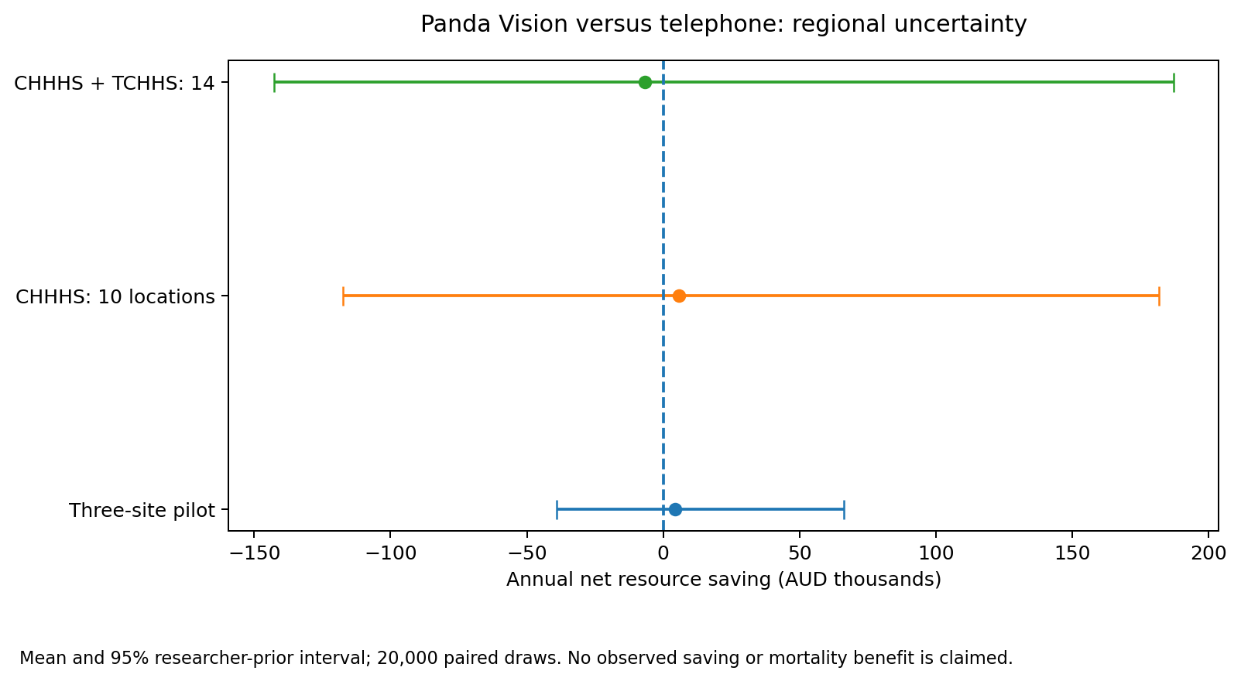
Panda’s regional financial result remains uncertain
20,000 paired draws; conditional on researcher priors, not measured programme effects.
50.5%
Pilot probability of saving
Three sites
39.2%
Combined regional probability
Fourteen readiness locations
Readiness at low volumes can add cost.
outputs/v7/psa_perspectives.csv; reference Panda versus telephone.
Notes:
outputs/v7/psa_perspectives.csv; reference Panda versus telephone.
Discussion draft 28 October 2026. Sources and assumptions are documented in the v7 pathway supplement.

Slide 5
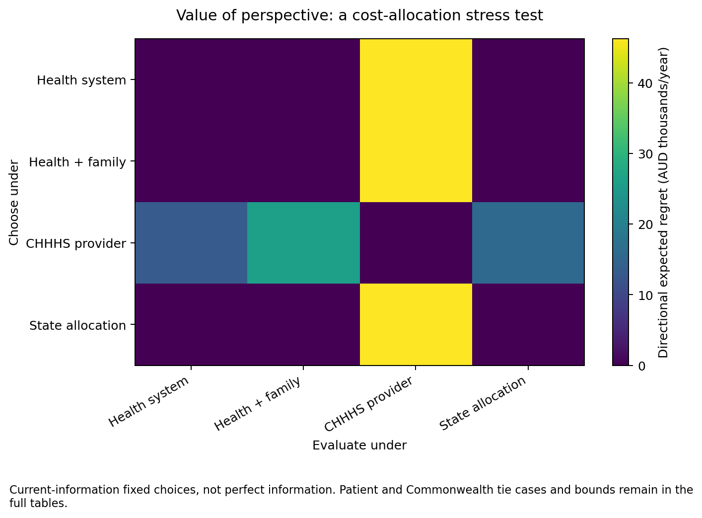
Perspective can change the investment decision
Use fixed expected-value choices, not per-draw perfect information.
Reference: no forced discordance
Provider and societal expected choices coincide in the reference comparison. Zero directional regret is retained.
Allocation stress test
When CHHHS bears local costs but no receiving/retrieval benefit, its telephone choice creates about $26.0k/year societal regret in the combined network.
vop_poc_nz perspective.py contract1.1.0; inspected pinned commit; own lightweight NumPy adapter.
Notes:
vop_poc_nz perspective.py contract1.1.0; inspected pinned commit; own lightweight NumPy adapter.
Discussion draft 28 October 2026. Sources and assumptions are documented in the v7 pathway supplement.

Slide 6
Health utilities are useful—but not a video-effect estimate
No mortality, QALY or DALY improvement is credited in the reference analysis.
Age-11 measure | Adjusted preterm utility decrement | Limitation
HUI2, UK SI | 0.13 (95% CI0.09–0.18) | Proxy childhood cohort, not intervention
HUI3, Canada | 0.28 (95% CI0.18–0.37) | Different instrument and preference tariff
Use as a bounded bridge
Keep metrics distinct
Test assumed fractions, duration and discounting from age 11; do not extrapolate these utilities to infancy. Video does not prevent prematurity.
QALYs need survival and utility; DALYs need YLL/YLD and disability weights. Do not use utility = 1 − disability weight.
Achana et al.2022; PMC9543967 Table4. Peart et al.2021 Australian cohort is a corroborative abstract-only lead.
Notes:
Achana et al.2022; PMC9543967 Table4. Peart et al.2021 Australian cohort is a corroborative abstract-only lead.
Discussion draft 28 October 2026. Sources and assumptions are documented in the v7 pathway supplement.

Slide 7
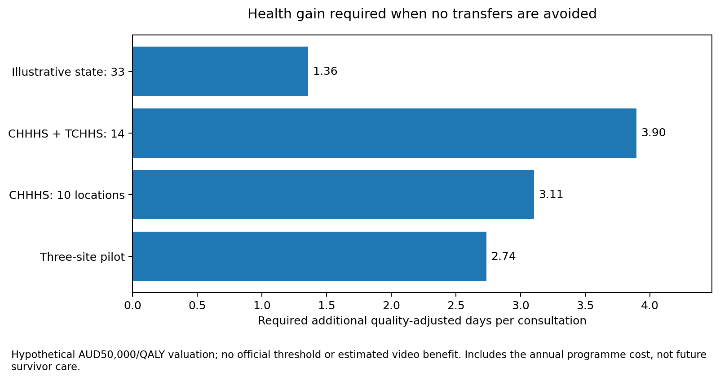
Ask how much health gain would justify the expenditure
A threshold is an answerable modelling question even when the causal effect is unknown.
No transfer benefit assumed
The threshold pays for the programme cost. Additional future costs among extra survivors would raise it.
Do not relabel it as benefit
These are required quality-adjusted days per consultation, not observed improvement.
outputs/v7/health_thresholds.csv; hypothetical AUD50,000/QALY, not an official Australian threshold.
Notes:
outputs/v7/health_thresholds.csv; hypothetical AUD50,000/QALY, not an official Australian threshold.
Discussion draft 28 October 2026. Sources and assumptions are documented in the v7 pathway supplement.

Slide 8
The audit produced specific repairs—not more infrastructure
Parameter audit, provenance and exact arithmetic remain more important than simulation volume.
Finding | Implemented response
Changed-mean beta clipping | Use mean/concentration parameters without boundary atoms
Statewide benefits assigned to CHHHS | Restrict receiving allocation to the regional origin catchment
Transfers mistaken for resource gains | Enforce exact payer/patient reconciliation
Historical evidence overwrite | Move current assurance output paths to v7
Potential source redirect escape | Validate HTTPS host before a redirect request
Synthetic panel independence | Label simulated roles as same-author self-review
evidence/v7/parameter_audit.csv; tests/test_v7_review_repairs.py; no local likelihood was fitted.
Notes:
evidence/v7/parameter_audit.csv; tests/test_v7_review_repairs.py; no local likelihood was fitted.
Discussion draft 28 October 2026. Sources and assumptions are documented in the v7 pathway supplement.

Slide 9
Source preservation is explicit—and incomplete
A numerical transcription is not the original source workbook.
Saved in the private project
Not yet acquired or certified
Supplied corporate originals; selected ELC pricing excerpt; IHACPA and NHRA transcriptions; HRQoL abstractions; source URLs, hashes and rights notes.
Public original PDF/XLSX downloads failed on DNS. Four core article full texts remain gaps. Gitleaks and the full pinned environment were not executed successfully.
No patient-level data added. Do not publish corporate artwork, the restricted ELC excerpt or other files without checking redistribution rights.
sources/source_register.csv; sources/manifest.json; sources/retrieval_receipts.json.
Notes:
sources/source_register.csv; sources/manifest.json; sources/retrieval_receipts.json.
Discussion draft 28 October 2026. Sources and assumptions are documented in the v7 pathway supplement.

Slide 10
Use v7 for conditional investment and evidence priorities
Simulation and software checks do not substitute for clinical validation.
Completed model questions
Still open
Regional scope; provider and payer allocation; fixed-decision VoP; null/alternative effects; prototype/retention; bounded health thresholds.
Current capability/routing; local marginal costs and QEP; core full texts; independent clinical/economic review; locked toolchain, Gitleaks and hosted CI.
Four simulated reviewer roles are documented. They are not independent subagents. Preserve the lean design and resolve decision-critical evidence before adding further complexity.
conductor/current-state.json; docs/validation/v7/simulated_panel.md; final actual assurance receipt.
Notes:
conductor/current-state.json; docs/validation/v7/simulated_panel.md; final actual assurance receipt.
Discussion draft 28 October 2026. Sources and assumptions are documented in the v7 pathway supplement.

