Slide 1
Neonatal teleconsultation
Choosing between five configurations
under substantial uncertainty
28 October 2026 | Comparative evaluation v5 | Discussion draft
CONDITIONAL MODEL | NOT PROCUREMENT APPROVAL
Notes:
Authentic supplied CHHHS artwork background. No approved procurement or comparative clinical trial is claimed.

Slide 2
Compare complete services—not camera retail prices
Telephone-supported consultation remains in all five options.
Configuration | Installed capital/site | Interpretation
Telephone | Incremental $0 | Existing advice is not zero healthcare cost
Mobile teleconference | $45,000 | ELC indicative system comparator
Panda Vision | $10,000 | ELC/user estimate; invoice unverified
Ceiling/wall PTZ | $47,000 | ELC; site/room suitability matters
Tablet + OBSBOT | $4,500 assumed | Complete kit; $7,500 and wider ranges tested
The $349 camera-only figure is not an equivalent installed service. Technical feasibility, power, mounting, cleaning and QH Portal control remain prerequisites.
ELC 21 October 2026, printed pp206–212. Complete kit price is an analyst assumption.
Notes:
ELC 21 October 2026, printed pp206–212. Complete kit price is an analyst assumption.
Discussion draft 28 October 2026. Sources and assumptions are documented in the v5 comparative supplement.

Slide 3
Three different investment decisions
A low-cost new option does not make replacing an existing system worthwhile.
Acquire new equipment
Retain installed equipment
Share equipment costs
Compare complete installation, recurrent costs and usable delivery. Do not infer clinical superiority from the camera specification.
Exclude sunk purchase expenditure only from the existing arm. The replacement still incurs a real purchase cost.
Attribute neonatal resources where cross-service use is defensible. Allocation does not reduce the full procurement payment.
All rankings are conditional on technical eligibility and the stated resource-cost objective.
v5 exact five-arm model. Equal clinical video effects are a reference hypothesis, not demonstrated equivalence.
Notes:
v5 exact five-arm model. Equal clinical video effects are a reference hypothesis, not demonstrated equivalence.
Discussion draft 28 October 2026. Sources and assumptions are documented in the v5 comparative supplement.

Slide 4
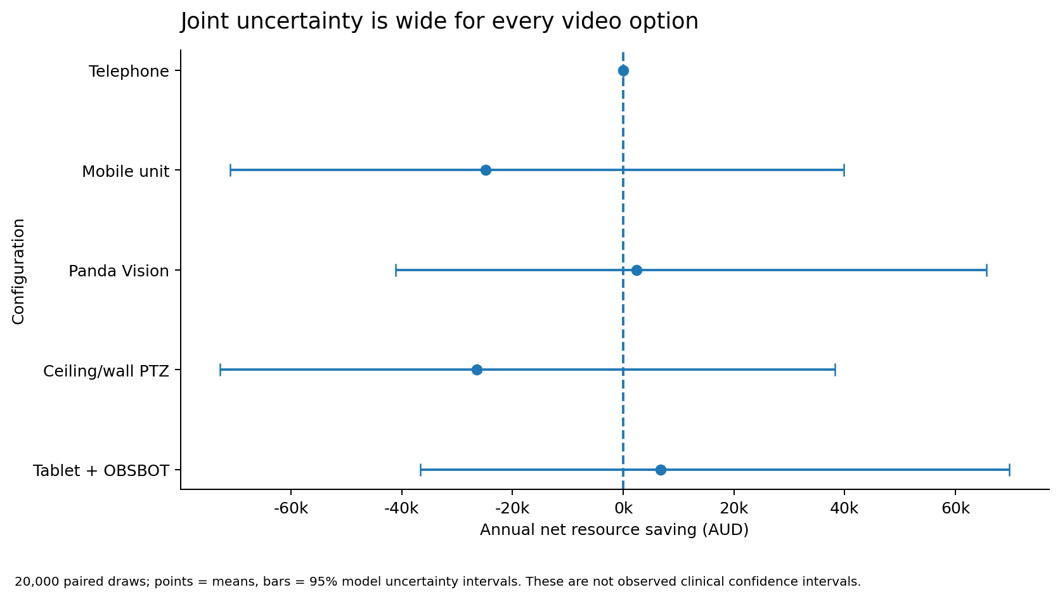
New-purchase reference results remain uncertain
Each arm uses the same uncertainty draw; correlations are preserved.
53.9%
kit is cost-optimal
Assumed equal video performance
46.0%
Panda saves vs phone
Different from probability best
outputs/v5/psa_strategy_summary.csv. Means and 95% model uncertainty intervals, not observed effects.
Notes:
outputs/v5/psa_strategy_summary.csv. Means and 95% model uncertainty intervals, not observed effects.
Discussion draft 28 October 2026. Sources and assumptions are documented in the v5 comparative supplement.

Slide 5
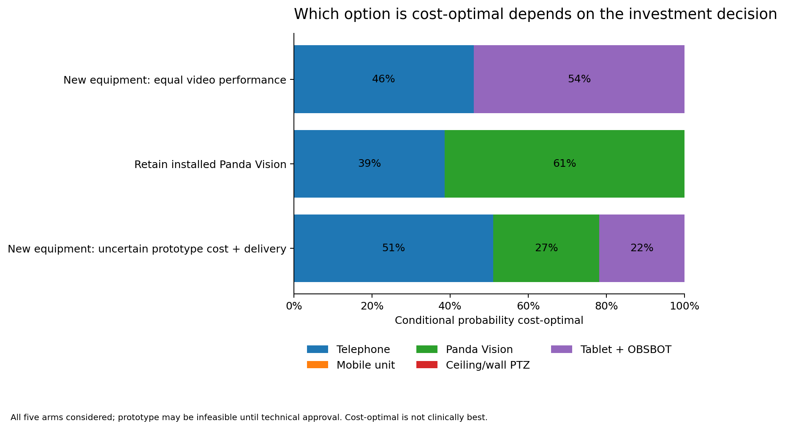
Incumbency and prototype uncertainty can change the answer
A conditionally attractive prototype is not a demonstrated clinical improvement.
Retain Panda
61.4% probability cost-optimal when existing Panda capital is sunk.
Prototype uncertain
Phone 51.0%
Panda 27.2%
Kit 21.8%
State expected-value choice switches to Panda.
v5 pilot paired PSA. Prototype uncertainty uses explicitly assumed complete cost and relative usable delivery.
Notes:
v5 pilot paired PSA. Prototype uncertainty uses explicitly assumed complete cost and relative usable delivery.
Discussion draft 28 October 2026. Sources and assumptions are documented in the v5 comparative supplement.

Slide 6
Sensitivity analysis is now explicitly multi-option
Broad within a declared scope—not every possible clinical pathway.
Method | Completed scope | Decision use
Paired PSA | 18 × 20,000 draws × 5 options | Probability best, pairwise value, regret
One-way | 12 dimensions, 21 values, pilot + state | Main drivers around a fixed reference
Two-way | 4 pairs, 31×31, pilot + state | Exact option-switching boundaries
k-way | 3,125 five-way + 2,401 four-way points | Joint assumptions and interactions
Global / explanatory | 12-D designs; Sobol; input clustering; classifier | Understand the exact model, not clinical causation
outputs/v5/results_v5.json and complete CSV design tables. Deterministic design frequencies are not probabilities.
Notes:
outputs/v5/results_v5.json and complete CSV design tables. Deterministic design frequencies are not probabilities.
Discussion draft 28 October 2026. Sources and assumptions are documented in the v5 comparative supplement.

Slide 7
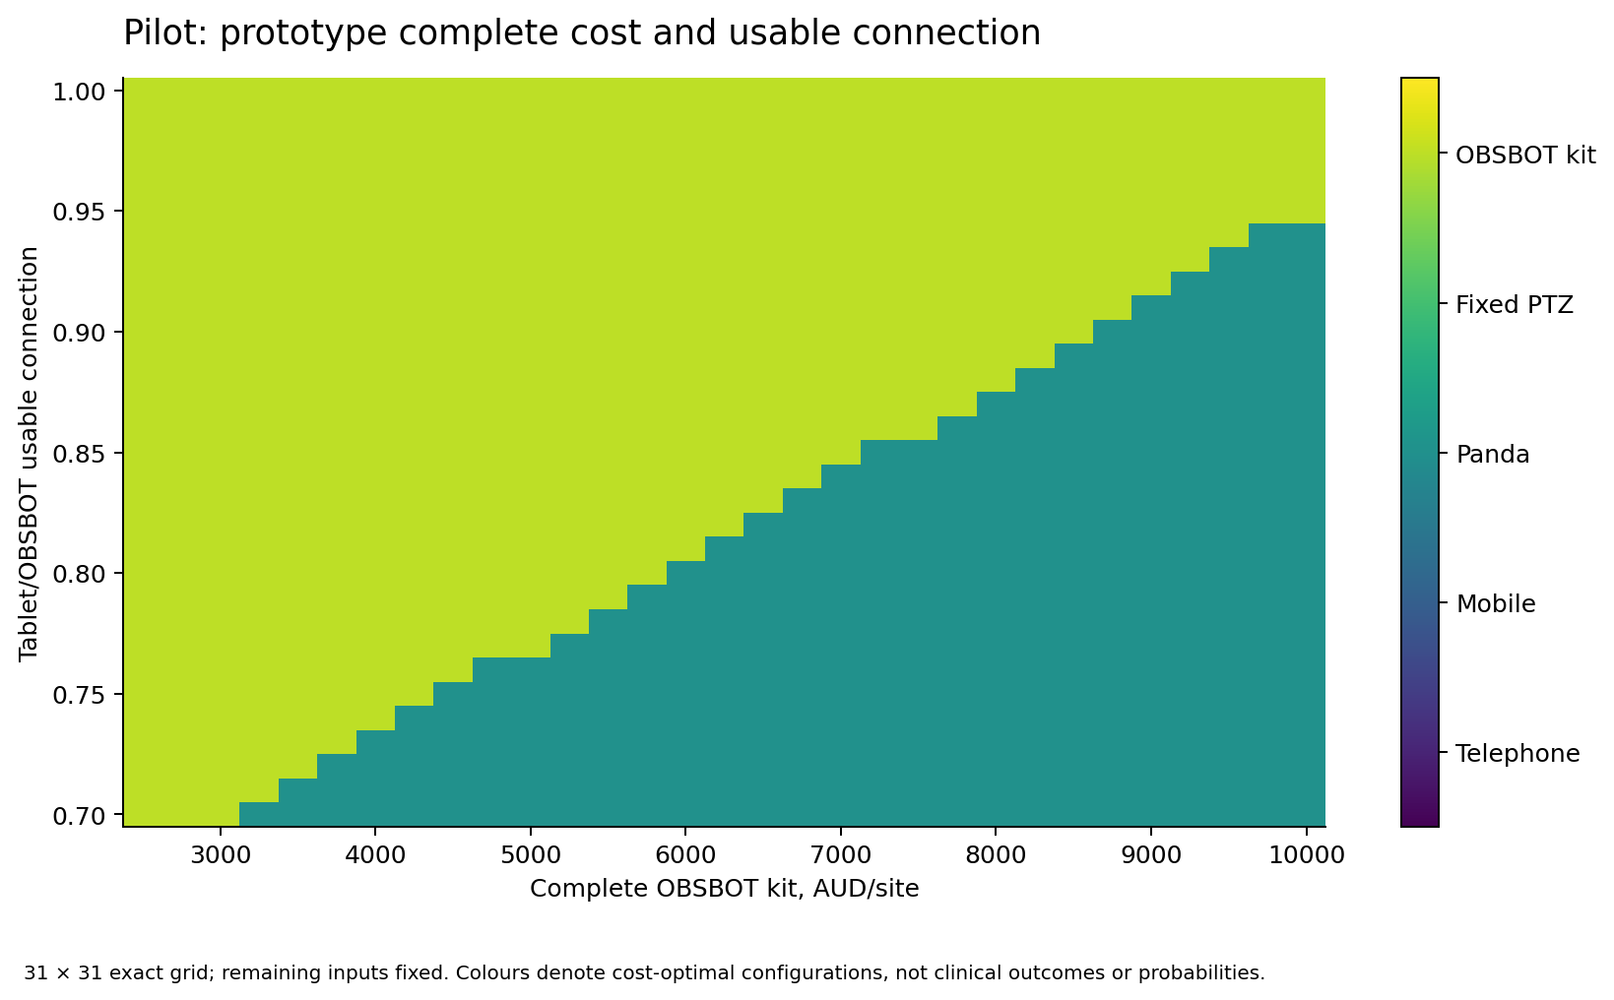
Prototype cost and usable delivery trade off
The map is exact-model output, not a machine-learning prediction.
What to verify
Installed-system cost
Usable connection and setup
Safe clinician control
Whether switching improves anything beyond convenience
Pilot two-way complete 31×31 grid. Complete kit price is unquoted; reliability is not comparative clinical efficacy.
Notes:
Pilot two-way complete 31×31 grid. Complete kit price is unquoted; reliability is not comparative clinical efficacy.
Discussion draft 28 October 2026. Sources and assumptions are documented in the v5 comparative supplement.

Slide 8
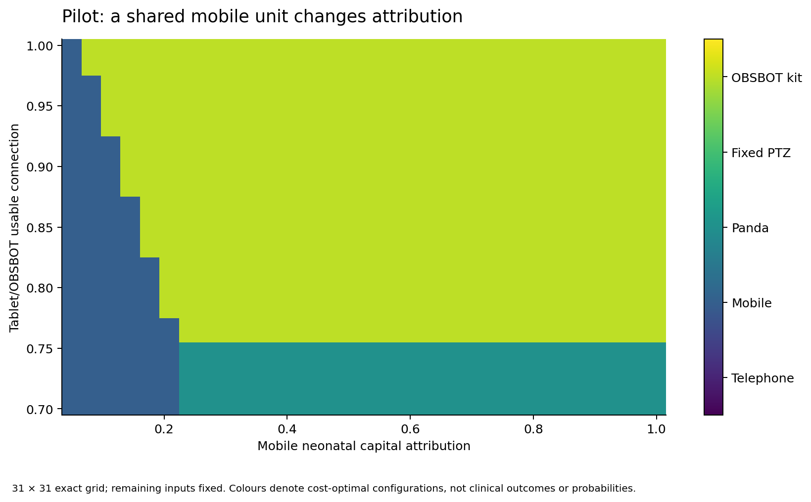
Shared use can favour a mobile unit
Resource attribution is not a procurement discount.
Separate the ledgers
Full purchase cash
Neonatal resource attribution
Existing/sunk capital
QWAU/QEP and NWAU/NEP
Clinical and family consequences
Pilot exact two-way grid. Cross-service allocation needs a defensible use denominator.
Notes:
Pilot exact two-way grid. Cross-service allocation needs a defensible use denominator.
Discussion draft 28 October 2026. Sources and assumptions are documented in the v5 comparative supplement.

Slide 9
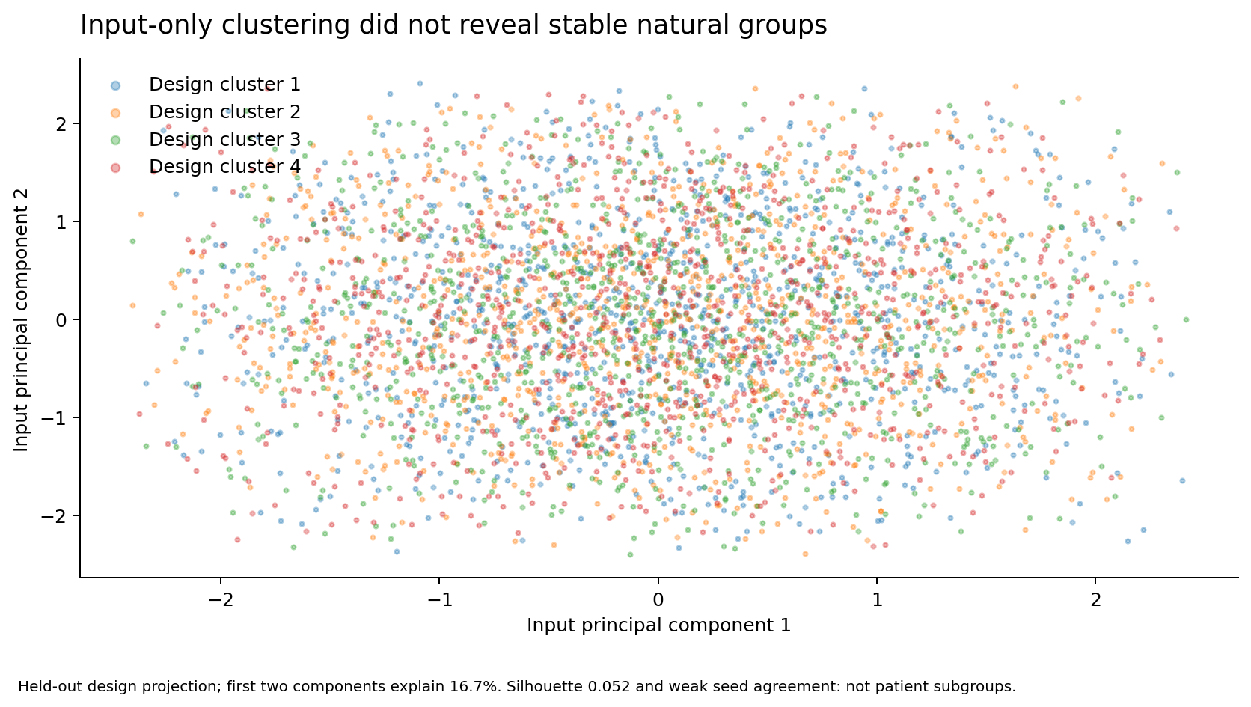
Unsupervised analysis did not discover natural clinical groups
Do not manufacture patient subgroups from a synthetic parameter design.
0.052
silhouette score
Weak separation
Interpretation
Seed agreement was also weak. The clusters are exploratory partitions only—not neonatal or hospital phenotypes.
Train-fitted input-only KMeans; all clusters retained; held-out design and seed-stability checks.
Notes:
Train-fitted input-only KMeans; all clusters retained; held-out design and seed-stability checks.
Discussion draft 28 October 2026. Sources and assumptions are documented in the v5 comparative supplement.

Slide 10
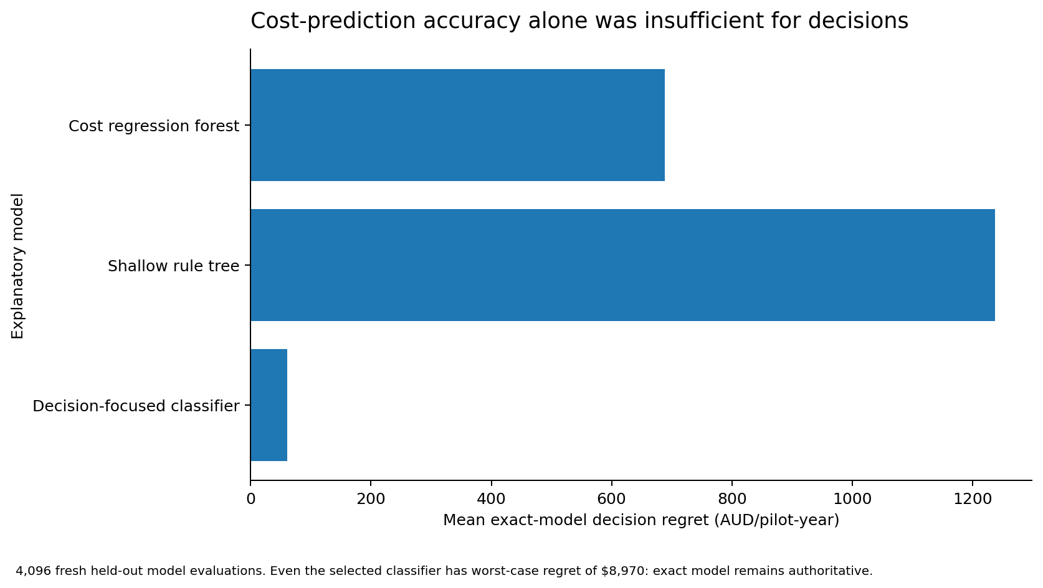
Predicting costs is not the same as choosing well
Every reported strategy ranking still comes from the exact model.
95.0%
classifier agreement
93.3% balanced accuracy
Still not a decision rule
Mean regret $60/year; worst $8,970. Importance is predictive, not causal and not EVPPI.
Fresh holdout n=4,096; selection sample separate; diagnostic holdout retired. outputs/v5/heldout_predictions.csv.
Notes:
Fresh holdout n=4,096; selection sample separate; diagnostic holdout retired. outputs/v5/heldout_predictions.csv.
Discussion draft 28 October 2026. Sources and assumptions are documented in the v5 comparative supplement.

Slide 11
Publication: lead with the investment decision
Suggested first target: Journal of Telemedicine and Telecare.
Journal | Best emphasis
Journal of Telemedicine and Telecare | Comparative economic analysis; generally 3,000 words
Telemedicine and e-Health | Quality, costs and access; prior neonatal model
Cost Effectiveness and Resource Allocation | Decision uncertainty and resource allocation methods
Australian Health Review | Queensland commissioning/funding; 2,500 words
Journal of Medical Internet Research | Stretch target: broader international digital-health relevance
Put machine-learning diagnostics and full sensitivity grids in the supplement. No head-to-head device trial, proven equivalence or QALY benefit is claimed.
Publisher guidelines checked 28 October 2026; full source/fee record in evidence/v5/journal_targets.csv.
Notes:
Publisher guidelines checked 28 October 2026; full source/fee record in evidence/v5/journal_targets.csv.
Discussion draft 28 October 2026. Sources and assumptions are documented in the v5 comparative supplement.

Slide 12
Next decision: review assumptions, not add complexity
Use the completed model to define the conditions for worthwhile investment.
For the pilot
For expansion
Retain installed Panda while examining technical usability and actual replacement costs. A cheaper component alone is not a reason to switch.
Compare technically eligible complete systems. Check common-effect assumptions and marginal resources; preserve uncertainty across sites.
Before publication: critical full-text source checks, independent clinical/economic review, governance and data-rights statements, and connected locked-toolchain verification. No new RCT or structured elicitation is required to undertake this model-based study.
Two-page CHHHS plan v5; comparative supplement; Conductor tracks and actual verification receipts.
Notes:
Two-page CHHHS plan v5; comparative supplement; Conductor tracks and actual verification receipts.
Discussion draft 28 October 2026. Sources and assumptions are documented in the v5 comparative supplement.

