Slide 1
Panda Vision
Evidence-informed economics
from the pilot to Queensland scenarios
28 October 2026 | Version 4 | Discussion draft
PRELIMINARY EVALUATION | V4
Notes:
Supplied CHHHS template background. Artwork retained from corporate source. Preliminary model, not an endorsement or procurement approval.

Slide 2
The question is the incremental value of video
Telephone consultation occurs in both arms. No new clinical study is a prerequisite.
3
pilot sites
Atherton • Mareeba • Innisfail
10–15
consultations/site/year
30–45 across the pilot network
4–5
episodes at Atherton
Not a rate or effect estimate
$10k
per installation
Invoice/components unverified
Primary consequences
Do not assume
Transfer decisions, procedural support, stabilisation, acute resource use and family burden.
Every retained baby represents an avoided retrieval, every transfer is undesirable, or every extra survivor saves money.
Local information: user corrections and CHHHS ELC Operational paper, 21 October 2026.
Notes:
Local information: user corrections and CHHHS ELC Operational paper, 21 October 2026.
Discussion draft 28 October 2026. Sources and assumptions are documented in the v4 analysis/evidence supplement.

Slide 3
Historical births make the extrapolation inspectable
Babies born, not mothers or registration transactions. Forecast consultations are not measured illness rates.
Pilot site | 2022 births | Forecast calls/year | Implied calls / birth
Atherton | 157 | 10–15 | 6.4–9.6%
Mareeba | 134 | 10–15 | 7.5–11.2%
Innisfail | 195 | 10–15 | 5.1–7.7%
State denominator
Scope limit
72 public rows → 65 co-located sites; 46,711 births preserved. Primary scenario: 33 non-hub sites, 28,276 births.
2022 is not a 2026 capability census. Private-facility detail, readiness locations and reopened Weipa are separate.
Source: Queensland Perinatal Data Collection 2022, table 8.09. https://www.health.qld.gov.au/__data/assets/pdf_file/0020/1378010/8-fac2022x.pdf
Notes:
Source: Queensland Perinatal Data Collection 2022, table 8.09. https://www.health.qld.gov.au/__data/assets/pdf_file/0020/1378010/8-fac2022x.pdf
Discussion draft 28 October 2026. Sources and assumptions are documented in the v4 analysis/evidence supplement.

Slide 4
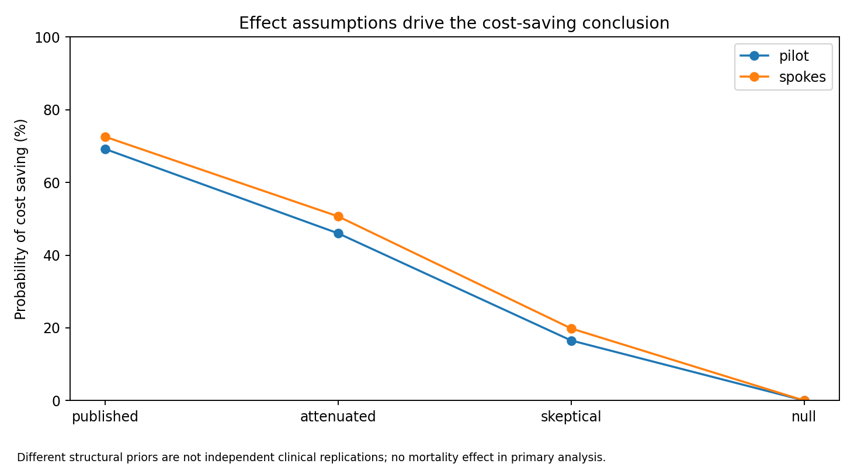
The literature supports uncertainty—not an imported effect
Clinical observational evidence, economic modelling and simulation have different evidentiary roles.
Relevant counter-evidence
2026 simulation: specialist support improved performance, but phone, video and AR did not differ. Null incremental-video effects remain plausible.
2012 Queensland and 2022 US economic studies inform structure and comparison. They are not independent replications of the local clinical effect.
Haynes 2020 PMID32081766; Lietz 2026 PMID42647428. Full mapping: evidence/literature_parameter_map.csv.
Notes:
Haynes 2020 PMID32081766; Lietz 2026 PMID42647428. Full mapping: evidence/literature_parameter_map.csv.
Discussion draft 28 October 2026. Sources and assumptions are documented in the v4 analysis/evidence supplement.

Slide 5
A public retrieval anchor replaces an unsupported air price
The distinction between allocated resource cost and avoidable cost can reverse the result.
$18,670
reported aeromedical cost
2018–19 Torres Strait study; all ages
$23,825
indexed reference cost
June 2026; 2019 price year assumed
50%
avoidable fraction
Assumption; broad PSA/scenarios
What is inferred
What is not claimed
Rotary/fixed multipliers, site transport mix and $4,000 road cost are explicit assumptions. NeoSTRESS is an outbound-leg convenience sample—not a service census.
No verified neonatal tariff, route-specific flight cost, or guaranteed cash release. CPI is not an aeromedical-specific cost index.
Fox et al. RRH 2024;24:8572. https://www.rrh.org.au/journal/article/8572/ | ABS CPI bridge and price-year rationale in supplement.
Notes:
Fox et al. RRH 2024;24:8572. https://www.rrh.org.au/journal/article/8572/ | ABS CPI bridge and price-year rationale in supplement.
Discussion draft 28 October 2026. Sources and assumptions are documented in the v4 analysis/evidence supplement.

Slide 6
QWAU/QEP and NWAU/NEP belong in separate ledgers
Do not combine funding benchmarks or equate revenue with the cost of caring for a baby.
Ledger | Calculation / treatment | Current status
Resource cost | Transport + care + programme differences | Primary economic result
National benchmark | NWAU(26) × NEP26 ($7,418) | Official price; episode data required
Queensland benchmark | QWAU × QEP | Current QEP/local weights unverified
Actual organisational budget | Contracts, allocations, caps, block funding | Not inferred from NWAU alone
Your mchs library is the relevant calculator. Its 2026 parity is explicitly unvalidated: this version uses a year guard and official-export pathway, not a claim of validated mchs execution.
IHACPA NEP26; Queensland HHS Funding/Purchasing Guidelines July2026; mchs versions/2026.md (not yet validated).
Notes:
IHACPA NEP26; Queensland HHS Funding/Purchasing Guidelines July2026; mchs versions/2026.md (not yet validated).
Discussion draft 28 October 2026. Sources and assumptions are documented in the v4 analysis/evidence supplement.

Slide 7
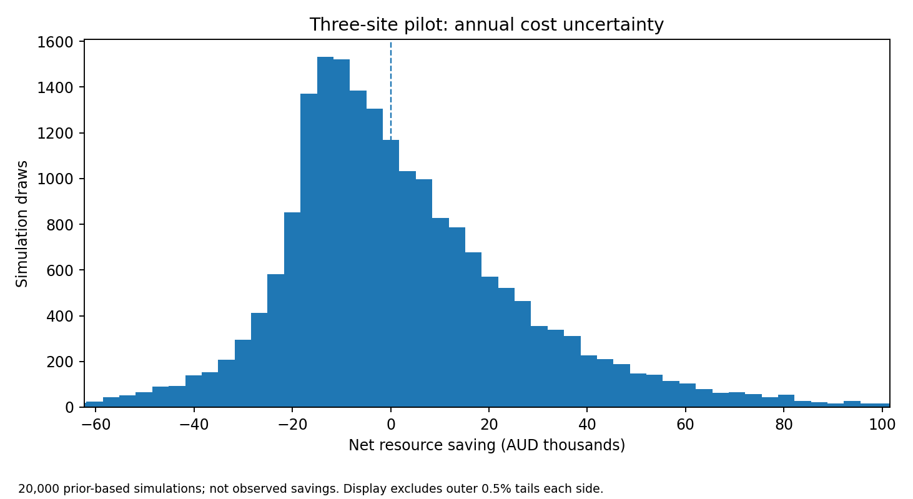
Pilot economics remain uncertain after the audit
No proven survival effect is monetised in this primary result. Positive saving means lower valued resource use.
46.0%
probability cost saving
Preserved from v2/v3 model
–$2,194
median annual net saving
95%: –$41,148 to +$65,642
Deterministic: $14,052 annual programme cost; $4,167 net resource saving. The probabilistic mean is +$2,428; a positive mean is not a robust investment verdict.
Model unchanged; v4 rerun: 20,000 fixed-seed researcher-prior draws. Results are conditional estimates, not observed CHHHS savings.
Notes:
Model unchanged; v4 rerun: 20,000 fixed-seed researcher-prior draws. Results are conditional estimates, not observed CHHHS savings.
Discussion draft 28 October 2026. Sources and assumptions are documented in the v4 analysis/evidence supplement.

Slide 8
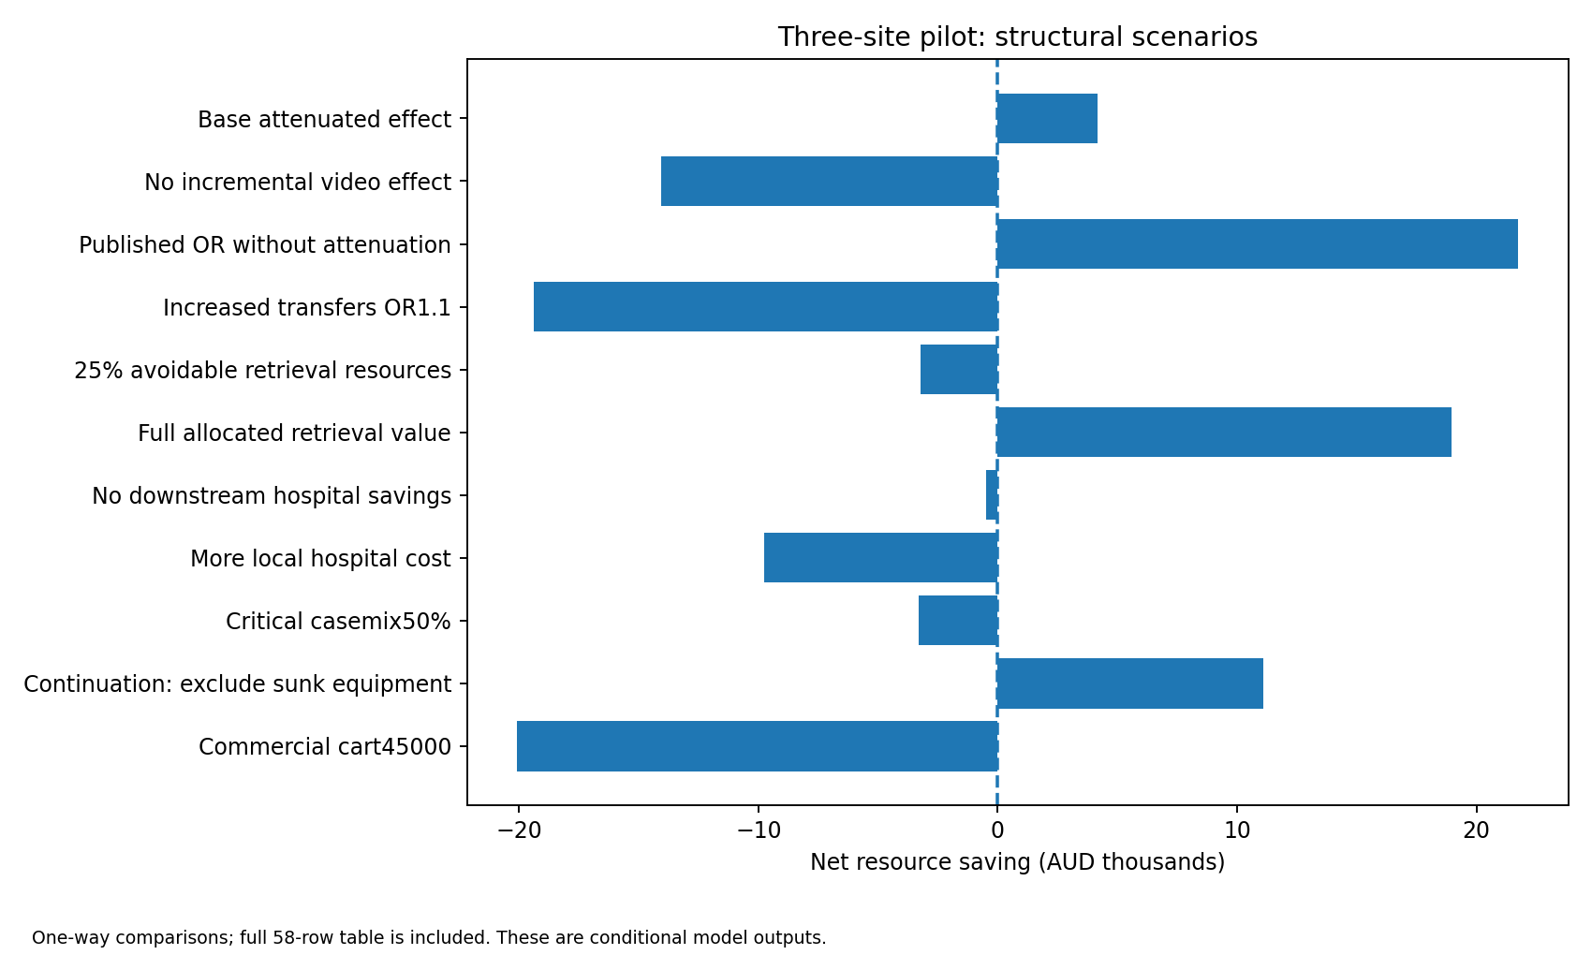
Scenario analysis exposes the decision-changing assumptions
58 deterministic comparisons across pilot and state portfolios; not 58 independent studies.
Included
Null / published / harmful transfer effects; critical-heavy cases; rescue; reliability; cash vs capital; transport mix; uptake; hub capacity; funding sensitivities.
Model unchanged; v4 rerun scenario_results.csv. Lower-cost tablet configurations remain hypothetical installed systems requiring approval.
Notes:
Model unchanged; v4 rerun scenario_results.csv. Lower-cost tablet configurations remain hypothetical installed systems requiring approval.
Discussion draft 28 October 2026. Sources and assumptions are documented in the v4 analysis/evidence supplement.

Slide 9
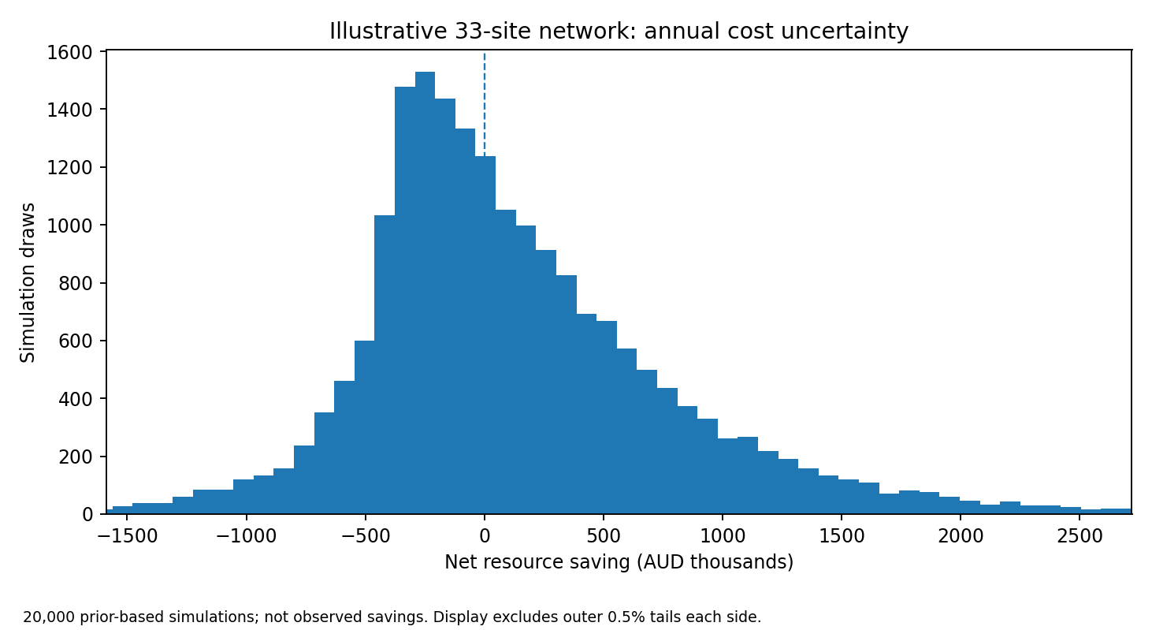
A statewide model is useful—but does not create evidence
Shared clinical-effect uncertainty remains correlated across sites; casemix coverage does not remove systematic bias.
50.7%
probability cost saving
Mean +$135,429/year
$9,692
median annual net saving
95%: –$1.012m to +$1.809m
~1,115 forecast consultations/year. Shared support and capacity steps are charged. This is a public-site scenario, not a complete 2026 statewide investment case.
Primary public-spoke scenario: historical 33-site roster, ANZNN-informed classification proxies, assumed uptake and geography.
Notes:
Primary public-spoke scenario: historical 33-site roster, ANZNN-informed classification proxies, assumed uptake and geography.
Discussion draft 28 October 2026. Sources and assumptions are documented in the v4 analysis/evidence supplement.

Slide 10
Survival with morbidity must remain in the model
Improved outcomes can justify extra spending; a cost-saving requirement alone is too narrow.
Implemented frontier
Not yet a lifetime CEA
Extra survival 0 / 0.1 / 0.5 / 1%; major-morbidity share 10 / 35 / 70%; discount 0 / 3 / 5%; illustrative willingness to pay $0 / $50k / $100k.
40-year constant survival and assumed utilities/costs are not calibrated trajectories. They expose the trade-off without asserting a mortality benefit or excluding disabled survivors.
Further structural priorities: antenatal transfer, repeated calls, origin–destination travel, common outages, hub delay, caregiver spillover and equity.
Exploratory survival_morbidity_frontier.csv: 108 combinations. All clinical effects, utilities and downstream costs are assumptions.
Notes:
Exploratory survival_morbidity_frontier.csv: 108 combinations. All clinical effects, utilities and downstream costs are assumptions.
Discussion draft 28 October 2026. Sources and assumptions are documented in the v4 analysis/evidence supplement.

Slide 11
Local checks pass; online assurance remains blocked
A configured workflow is not evidence that hosted CI, dependency audit or release has passed.
Gate | Actual status
Unit/data/model tests | 317 passed
Scoped model/harness coverage | 93.75%; numerical modules 100%
Latest dependency versions | Verified targets; not installed/resolved here
Full latest-toolchain acceptance | 6 passed; 22 blocked; 1 failed (missing lock)
Hosted Actions / Python version matrix | Not run
Conductor submodule working tree | Pinned gitlink; checkout blocked by DNS
SHA-pinned Actions, read-only permissions, frozen installation, SBOM/audit and separate PR/full profiles are configured. No public release or production-readiness claim.
Verification receipts in verification/v4/full/receipt.json. Conductor history records completed work and explicit blockers.
Notes:
Verification receipts in verification/v4/full/receipt.json. Conductor history records completed work and explicit blockers.
Discussion draft 28 October 2026. Sources and assumptions are documented in the v4 analysis/evidence supplement.

Slide 12
Use the model to define the investment conditions
The decision is where video offers sufficient clinical or economic value—not whether a favourable point estimate can be produced.
Ready now
Keep explicit
Compare pilot continuation, replacement and public-spoke portfolios. Examine no-benefit and higher-cost cases. Update ordinary invoices and public data when available.
Current capability/denominators; QEP/local weights; transport marginal costs; effectiveness transportability; clinical outcomes; and unexecuted online CI gates.
Do not wait for structured expert estimates. Do not treat uncertain clinical benefits as zero merely because they cannot yet be priced.
Decision inputs, evidence gaps and completion gates are tracked in the Conductor v4 project.
Notes:
Decision inputs, evidence gaps and completion gates are tracked in the Conductor v4 project.
Discussion draft 28 October 2026. Sources and assumptions are documented in the v4 analysis/evidence supplement.

Slide 13
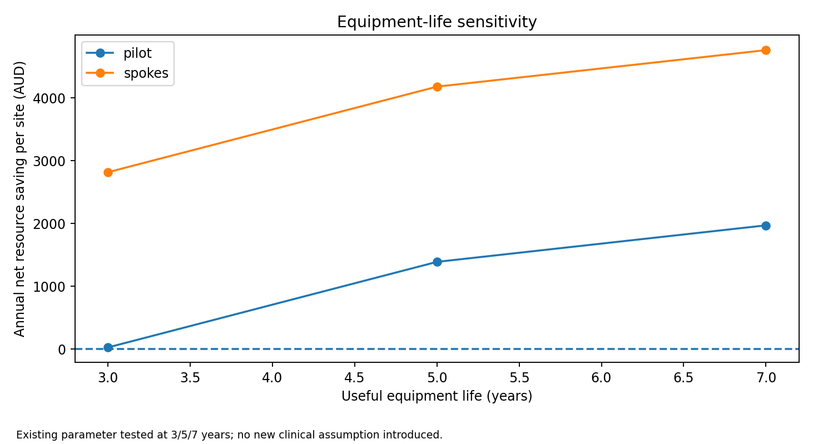
Equipment life changes the pilot financial case
No new clinical parameters; existing useful-life assumptions are tested explicitly.
Pilot net resource saving
3 years: about $80/year
5 years: $4,167/year
7 years: $5,912/year
Validate equipment life and replacement scope before interpreting savings.
outputs/v4/equipment_life_checks.csv and break_even_thresholds.csv. Conditional deterministic outputs.
Notes:
outputs/v4/equipment_life_checks.csv and break_even_thresholds.csv. Conditional deterministic outputs.
Discussion draft 28 October 2026. Sources and assumptions are documented in the v4 analysis/evidence supplement.

Slide 14
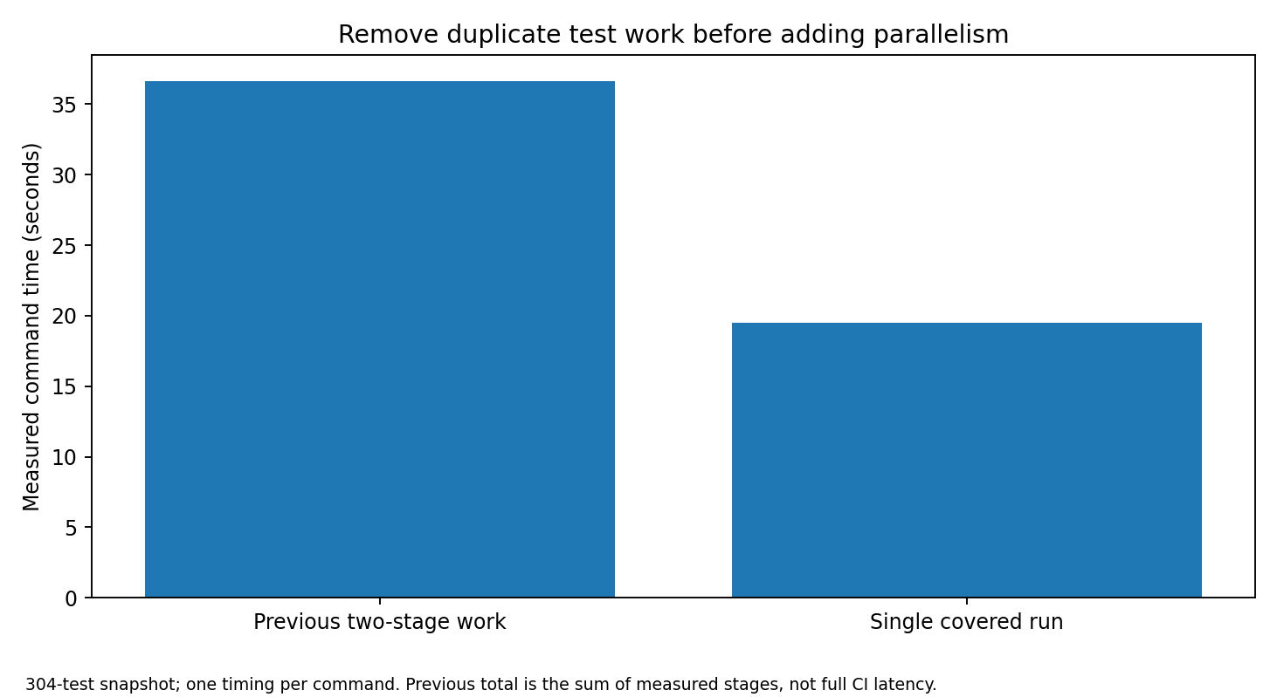
Reduce duplicate work without reducing acceptance
Local feedback, pull-request checks and full acceptance are different claims.
Implemented safeguards
One covered suite. Thin prek hooks. Guarded local caches. Workflow linters. One dependency updater.
Package installs, hosted CI and independent agent pressure testing remain unverified.
verification/v4/benchmarks/measured_work.json; portable skill in .agents/skills/maintaining-lean-ci.
Notes:
verification/v4/benchmarks/measured_work.json; portable skill in .agents/skills/maintaining-lean-ci.
Discussion draft 28 October 2026. Sources and assumptions are documented in the v4 analysis/evidence supplement.

