Slide 1

Neocam | decision-model consistency release
Existing evidence; five configurations; four regional portfolios.
Declared inputs now reach the calculations. One equipment estate aligns retention and cash budgets.
Current outputs are regenerated together. Uncertain clinical effects and incomplete validation remain explicit.

Slide 2
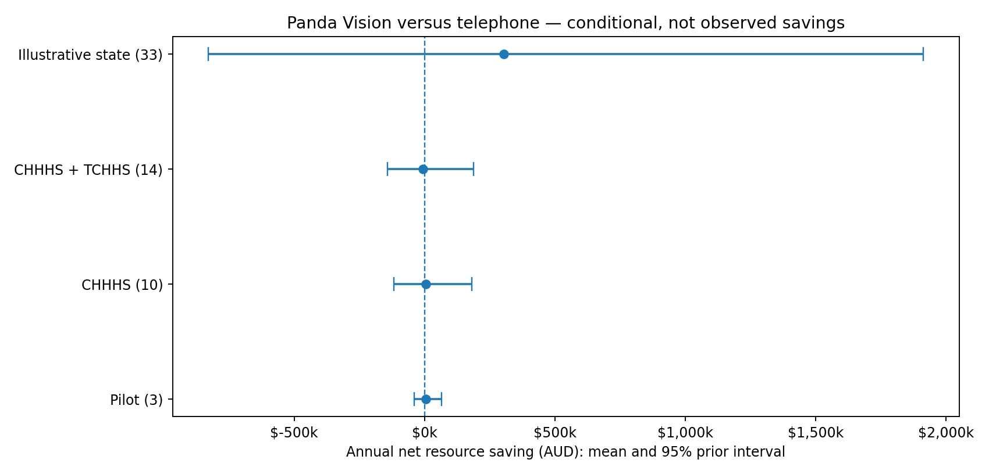
Conditional annual resource results

Slide 3
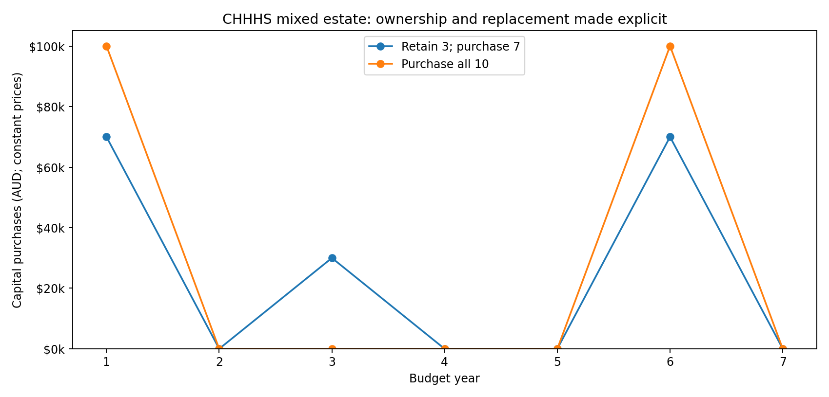
One estate, coherent purchases and replacements

Slide 4
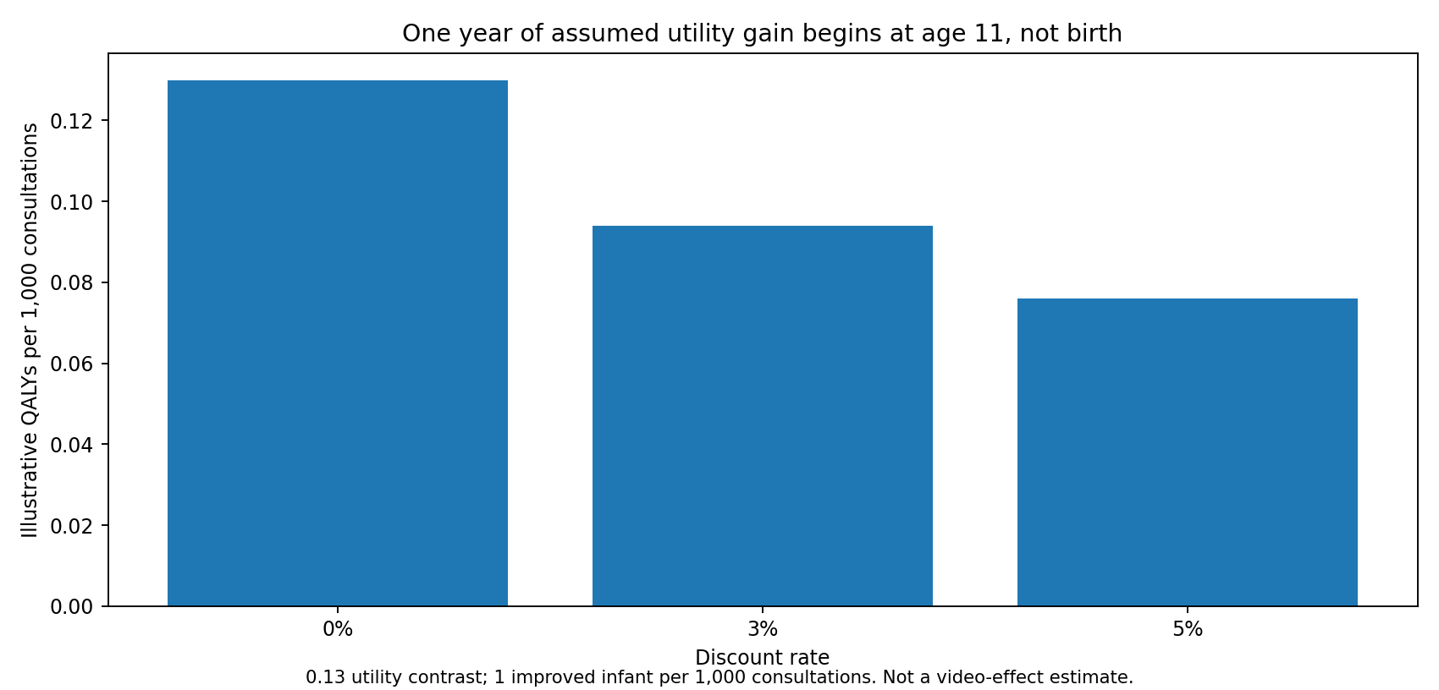
Corrected secondary health scenario

Slide 5
Interpret the results at the right level
Health-system resource value is not the same as CHHHS cash savings or Commonwealth/state funding.
Video may improve care without reducing transfers. No causal survival or QALY benefit is credited in the reference analysis.
Prototype equivalence, local eligibility, marginal retrieval costs and funding responses remain assumptions.

Slide 6
Work to finish before publication
Complete original-source and critical full-text verification; independent clinical/economic review.
Resolve the real environment lock; execute required security and quality tools, including Gitleaks.
Finish private repository/history transfer and reproduce from a fresh clone. No public release is authorised.

