Slide 1
Panda Vision
Explicit care pathways
and transparent investment decisions
28 October 2026 | Model revision v6 | Discussion draft
Notes:
Authentic supplied CHHHS template artwork; working evaluation, not procurement approval.

Slide 2
Three repairs—not new clinical evidence
Telephone consultation remains common care across all five configurations.
Workload-based hub
Explicit pathways
Hospital components
Remove the charge triggered by a fourth site. Cost only additional video time; distinguish resource hours from paid capacity.
Show immediate transfer, initially local care, delayed rescue and final local care in each arm. Do not count the same effect twice.
Price originating, receiving, local and extra pre-rescue care once each. Funding benchmarks are not actual marginal expenditure.
Five options remain: telephone, mobile unit, Panda Vision, ceiling/wall PTZ and a complete tablet/OBSBOT kit.
V6 methods supplement and source specification; all new assumptions separately registered.
Notes:
V6 methods supplement and source specification; all new assumptions separately registered.
Discussion draft 28 October 2026. Sources and assumptions are documented in the v6 pathway supplement.

Slide 3
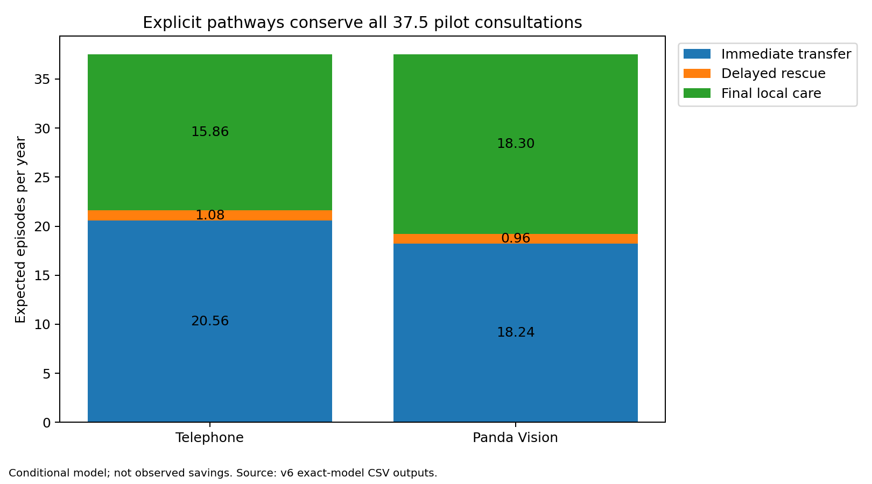
Every consultation ends in one of three pathways
Immediate transfer + delayed rescue + final local care = total consultations.
Reference endpoint
Apply the video effect to eventual transfer, then partition timing. Failed video follows telephone care.
Stress tests
Alternative initial-decision endpoint; more delay; excess rescue; unchanged effect for critical cases.
outputs/v6/pathways.csv. Timing shares are assumptions; no mortality improvement is credited.
Notes:
outputs/v6/pathways.csv. Timing shares are assumptions; no mortality improvement is credited.
Discussion draft 28 October 2026. Sources and assumptions are documented in the v6 pathway supplement.

Slide 4
Hospital costs are now auditable components
Clinical DRG assignment and full NWAU/QWAU calculation are not claimed.
Component | Charged to | Guard against double counting
Originating care | Immediate and rescued transfers | Origin included once per transferred episode
Receiving care | Immediate and rescued transfers | Receiving episode separate from origin
Final local care | Only final locally retained infants | Not added as a full episode before every rescue
Extra pre-rescue care | Delayed rescues only | Incremental observation/burden, not another full admission
Funding / resource fractions | Separate ledgers | NEP/QEP revenue is not added to healthcare costs
P68D / P68B / P60B / P60A / P06B are illustrative episode-price prototypes, not inferred patient codes. Local price burden and avoidable fractions remain uncertain.
IHACPA NEP26 Appendix A; provisional unadjusted price prototypes; current QEP/local weights unknown.
Notes:
IHACPA NEP26 Appendix A; provisional unadjusted price prototypes; current QEP/local weights unknown.
Discussion draft 28 October 2026. Sources and assumptions are documented in the v6 pathway supplement.

Slide 5
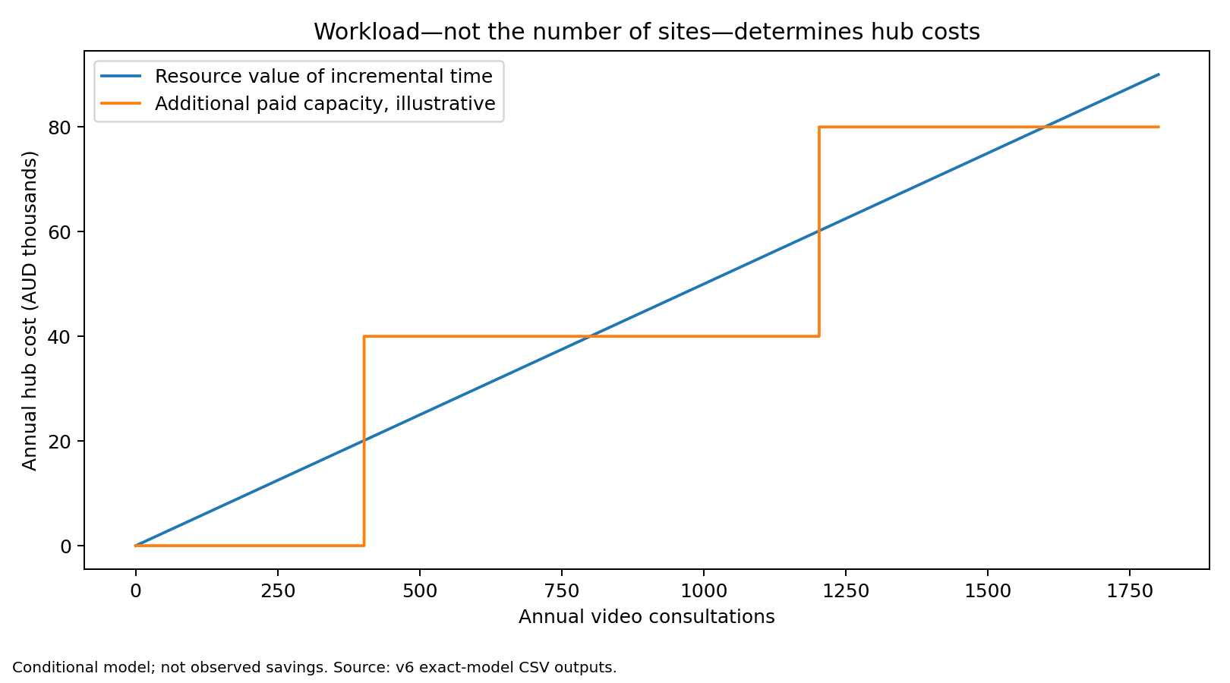
A fourth site no longer creates a hub-cost jump
Additional workload is compared with explicit spare capacity.
9.375 h
pilot extra video time
Resource $1,875; paid block $0
278.64 h
state extra video time
Resource $55,727; paid block $40,000
Do not add the two ledgers.
Reference assumptions: 15 extra minutes/call, $200/hour; 100 spare hours, 200-hour/$40,000 capacity blocks.
Notes:
Reference assumptions: 15 extra minutes/call, $200/hour; 100 spare hours, 200-hour/$40,000 capacity blocks.
Discussion draft 28 October 2026. Sources and assumptions are documented in the v6 pathway supplement.

Slide 6
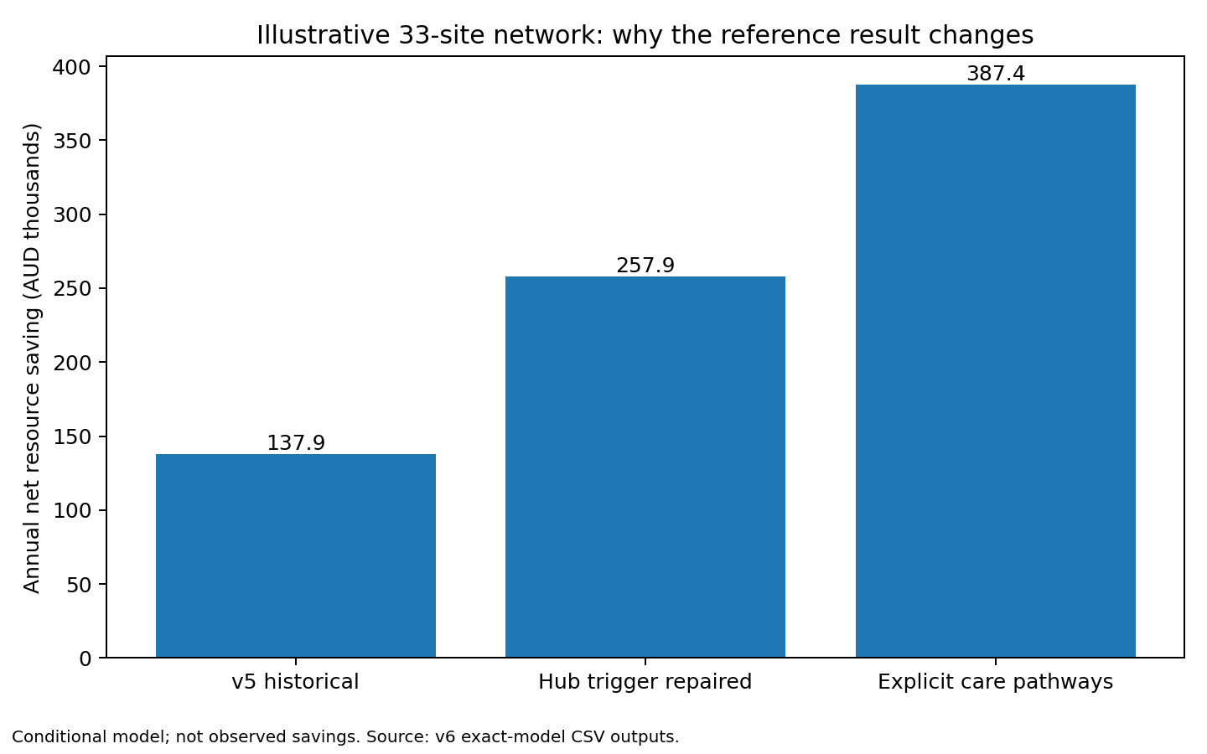
Why the statewide deterministic result changed
The bridge separates the accounting repair from pathway and price assumptions.
Remove arbitrary charge
+$120,000/year from removing the inherited hub/site-count rule.
Pathways and prototypes
A further +$129,514/year depends jointly on explicit timing and hospital-cost assumptions.
outputs/v6/v5_v6_bridge.csv. An improved model result is not new empirical effectiveness evidence.
Notes:
outputs/v6/v5_v6_bridge.csv. An improved model result is not new empirical effectiveness evidence.
Discussion draft 28 October 2026. Sources and assumptions are documented in the v6 pathway supplement.

Slide 7
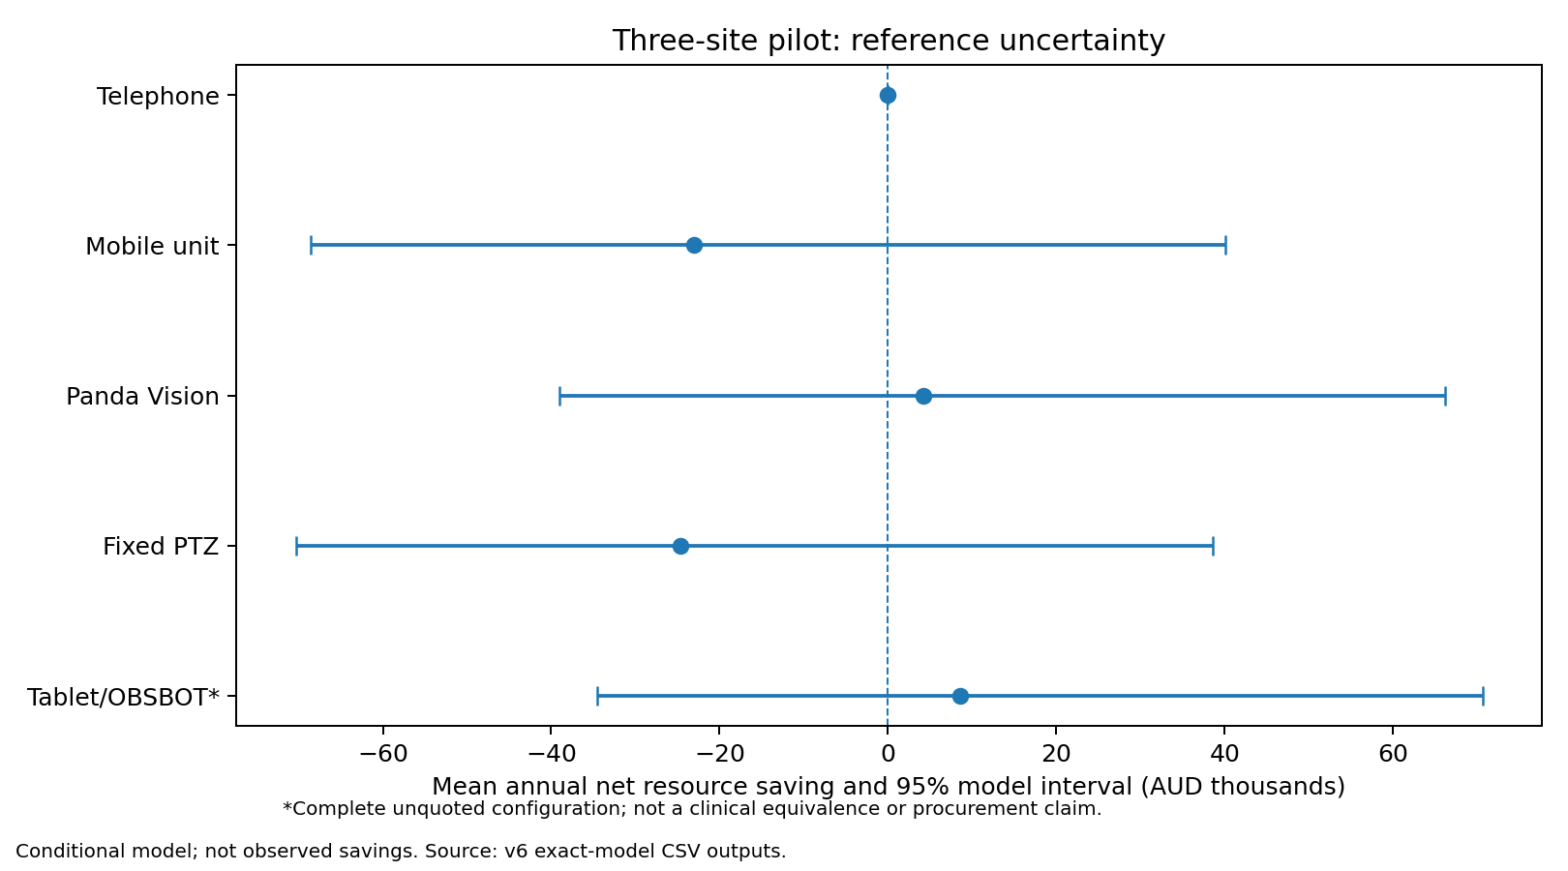
Uncertainty still spans added cost and resource saving
20,000 paired draws; systematic uncertainty is shared across sites and alternatives.
50.5%
pilot Panda saves vs phone
Mean +$4,252/year
65.6%
state Panda saves vs phone
Mean +$304,308/year
Mean and probability-best differ.
outputs/v6/psa_summary.csv. Probabilities are conditional model outputs, not measured clinical performance.
Notes:
outputs/v6/psa_summary.csv. Probabilities are conditional model outputs, not measured clinical performance.
Discussion draft 28 October 2026. Sources and assumptions are documented in the v6 pathway supplement.

Slide 8
Retain decision-relevant sensitivity analysis
Machine learning and uncalibrated lifetime results are no longer headline analyses.
Analysis | Completed v6 scope | Role
Paired probabilistic | 22 structures × 20,000 draws × 5 arms | Effect, costs, timing, reliability and incumbency
One-way | 12 dimensions × 21 values × 2 portfolios | Identify decision drivers
Two-way | 3 complete 21×21 grids × 2 portfolios | Joint assumptions and switching boundaries
Four-way | 625 exact pilot configurations | Joint effect/local burden/rescue/workload
Cash budget | 7 years for five options in two portfolios | Future replacement and extra paid capacity
scripts/analyse_v6.py; outputs/v6 tables and paired draw files. Historical v5 research remains archived.
Notes:
scripts/analyse_v6.py; outputs/v6 tables and paired draw files. Historical v5 research remains archived.
Discussion draft 28 October 2026. Sources and assumptions are documented in the v6 pathway supplement.

Slide 9
Full-text verification is partial—not complete
No abstract has been relabelled as a complete paper.
Actually reviewed | Still missing
Lietz: complete simulation article body | Haynes2020: core transfer-effect study
Maddox: complete implementation article body | Armfield2012: Queensland economic paper
Fox: complete transport-cost article text | Yoo2022: neonatal economic model
NEMO poster: complete extracted poster text | Thao2022: teleneonatology cost model
Maddox excluded deaths and mandatory transfers. Lietz does not establish device equivalence. The poster is not a substitute for Armfield’s economic paper.
evidence/v6/full_text_verification.csv. Full texts: Lietz2026 PMC13688369; Maddox2021 PMC8102672; Fox2024 RRH8572.
Notes:
evidence/v6/full_text_verification.csv. Full texts: Lietz2026 PMC13688369; Maddox2021 PMC8102672; Fox2024 RRH8572.
Discussion draft 28 October 2026. Sources and assumptions are documented in the v6 pathway supplement.

Slide 10
Technical verification is not independent validation
Requested subagent panel could not be executed in this environment.
Completed author checks
Explicitly still open
Separate scalar arithmetic; hand example; population conservation; failed-video/null/critical cases; hospital sums; workload thresholds; replacement schedule.
Independent clinical/economic/evidence/software reviews; four core full texts; clean locked toolchain; populated Conductor checkout; hosted CI.
Use as an early cost–consequence and investment-threshold analysis. Complete the stated review gates before manuscript submission; do not imply clinical validation, expenditure approval or a completed independent panel.
docs/validation/v6/panel_status.json and four reviewer briefs; actual verification receipts govern acceptance.
Notes:
docs/validation/v6/panel_status.json and four reviewer briefs; actual verification receipts govern acceptance.
Discussion draft 28 October 2026. Sources and assumptions are documented in the v6 pathway supplement.

