Slide 1
Health Economic Analysis: Policy Interventions
New Zealand Medical Journal Submission
Generated: 2025-11-27

Slide 2
Outline
1. Decision Model Structures
2. Cost-Effectiveness Analysis Results
3. Distributional Cost-Effectiveness Analysis (DCEA)
4. Value of Information Analysis
5. Budget Impact Analysis

Slide 4
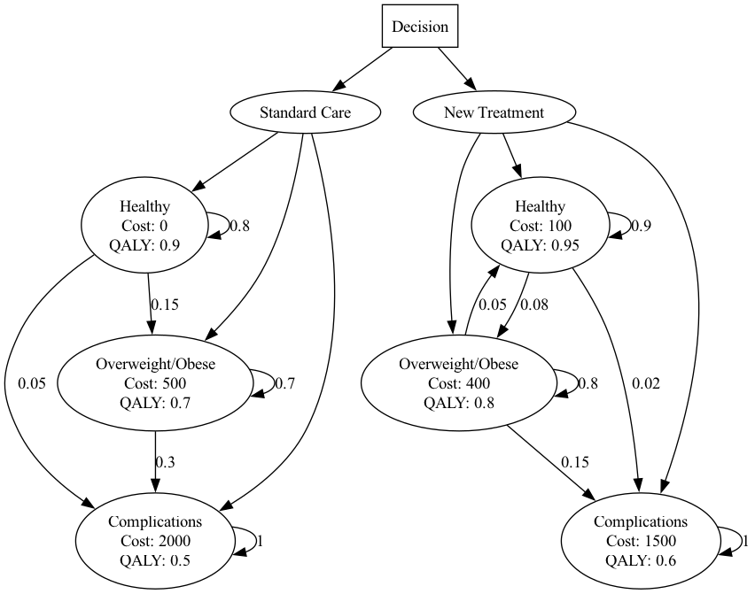
Model Structure: Childhood Obesity Prevention
Notes:
Decision tree structure for Childhood Obesity Prevention intervention.

Slide 6
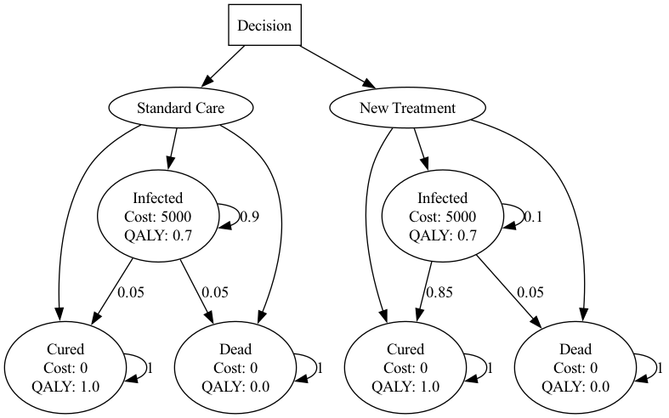
Model Structure: Hepatitis C Therapy
Notes:
Decision tree structure for Hepatitis C Therapy intervention.

Slide 8
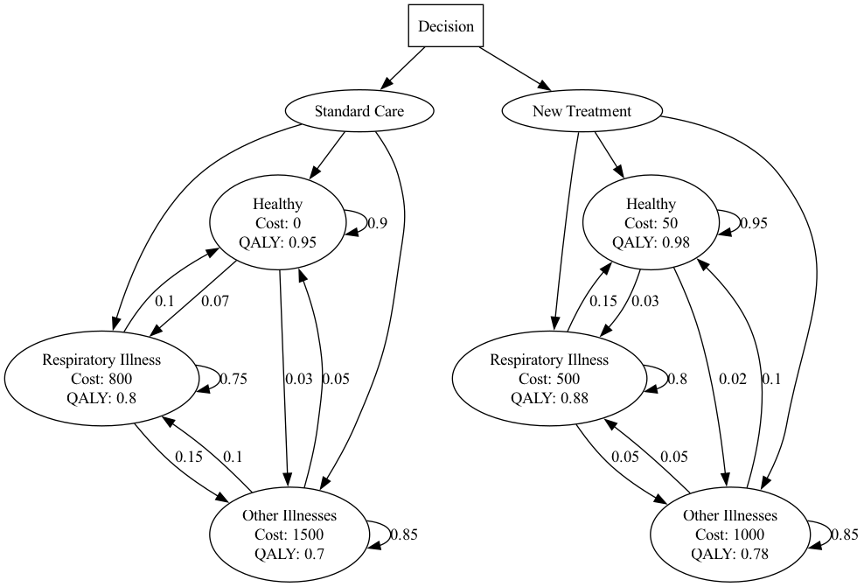
Model Structure: Housing Insulation
Notes:
Decision tree structure for Housing Insulation intervention.

Slide 10
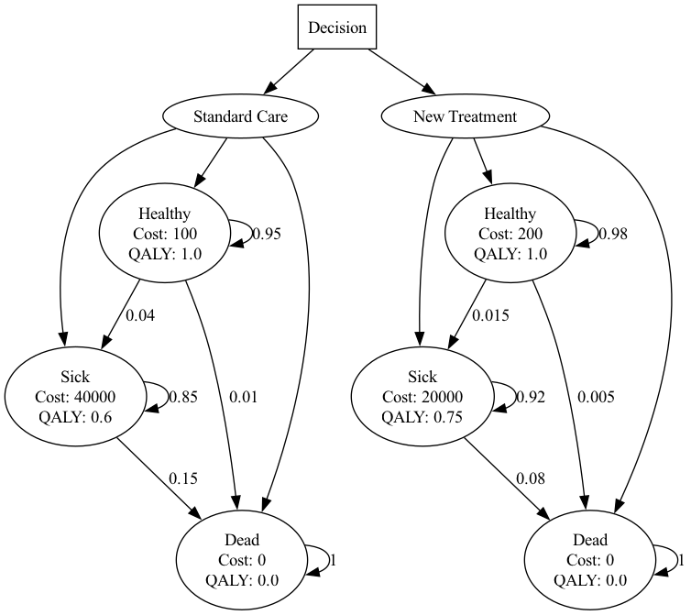
Model Structure: Hpv Vaccination
Notes:
Decision tree structure for Hpv Vaccination intervention.

Slide 12
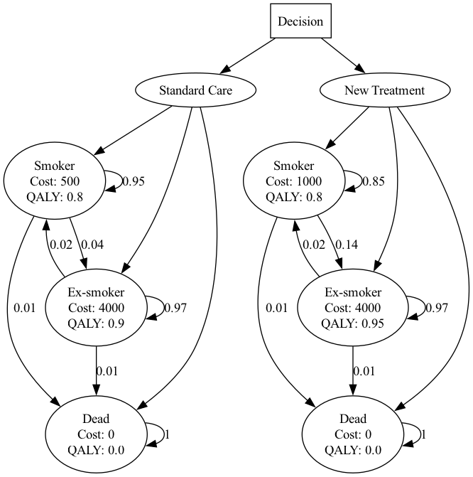
Model Structure: Smoking Cessation
Notes:
Decision tree structure for Smoking Cessation intervention.

Slide 14
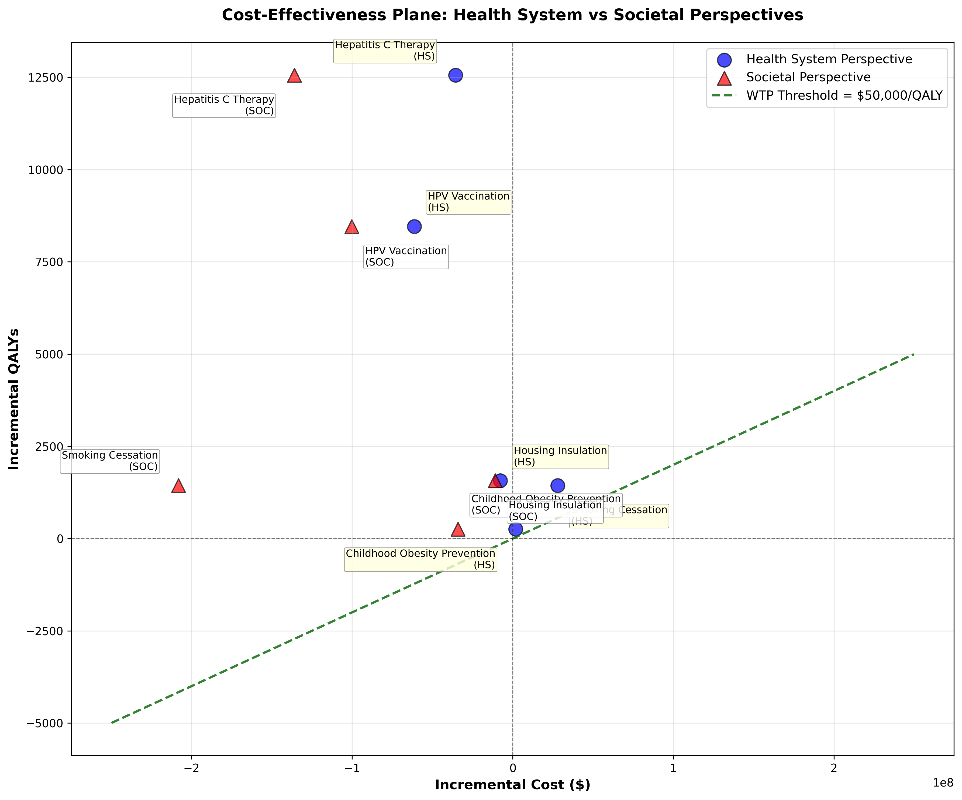
Cost-Effectiveness Plane: Both Perspectives Comparison
Notes:
Scatter plot of incremental costs vs incremental QALYs.

Slide 16
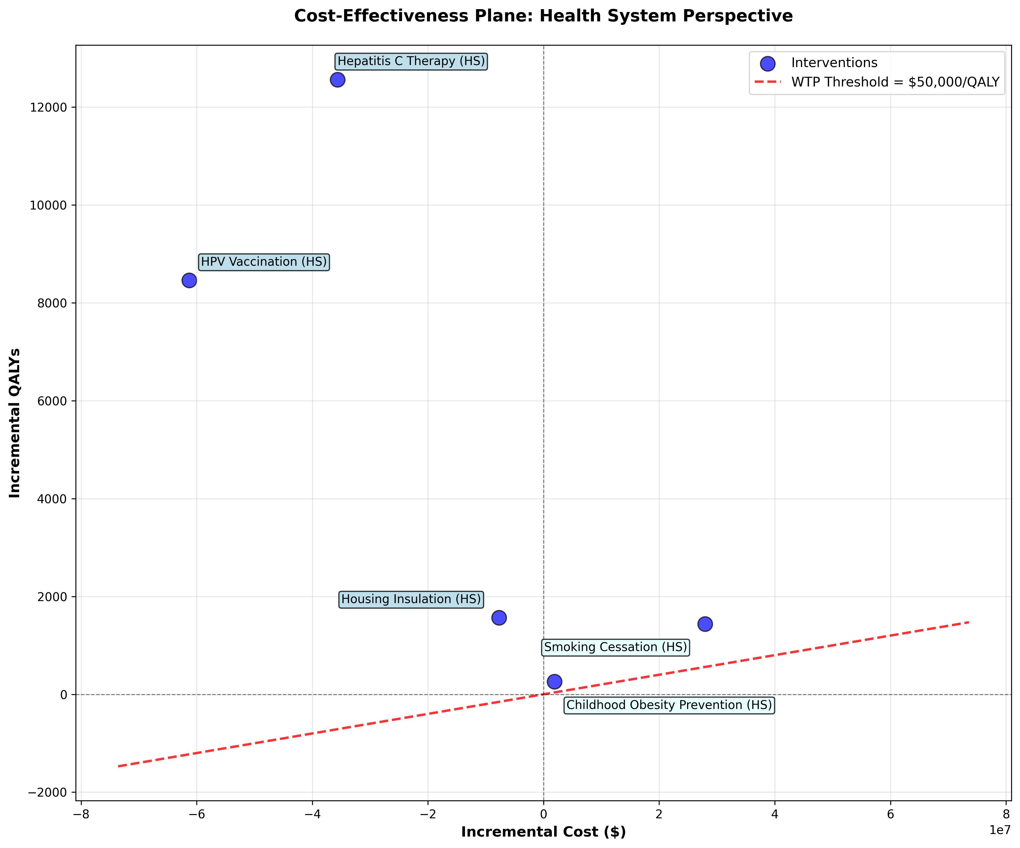
Cost-Effectiveness Plane: Health System Perspective
Notes:
Scatter plot of incremental costs vs incremental QALYs.

Slide 18
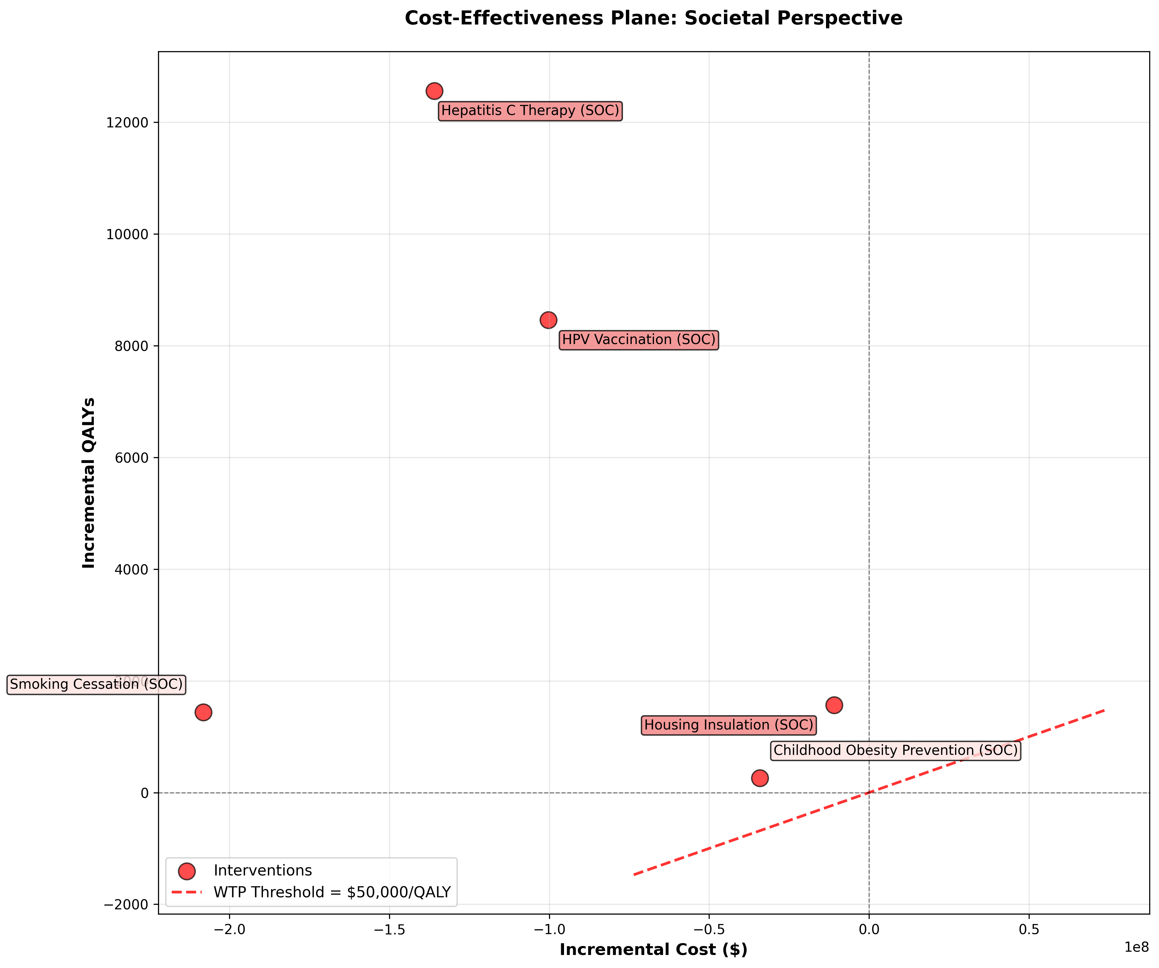
Cost-Effectiveness Plane: Societal Perspective
Notes:
Scatter plot of incremental costs vs incremental QALYs.

Slide 20
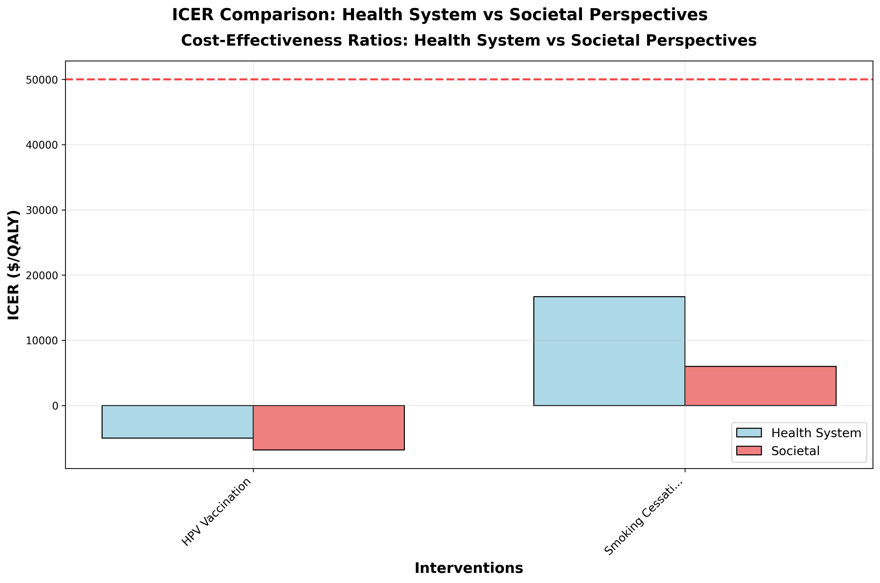
ICER Comparison
Notes:
Comparison of Incremental Cost-Effectiveness Ratios across perspectives.

Slide 22
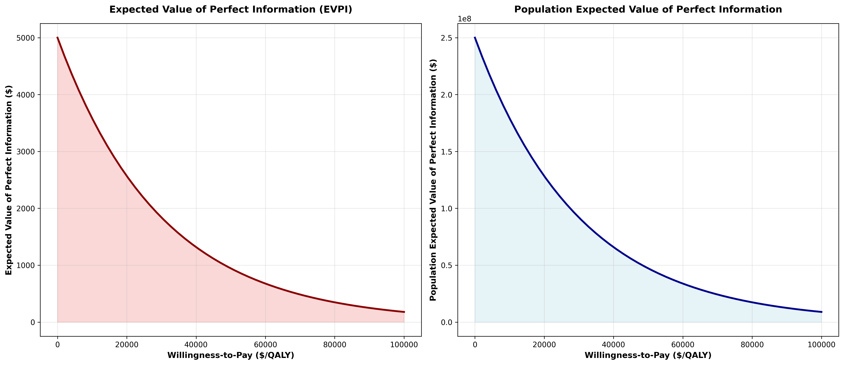
Value of Information: EVPI
Notes:
Expected Value of Perfect Information analysis.

Slide 24
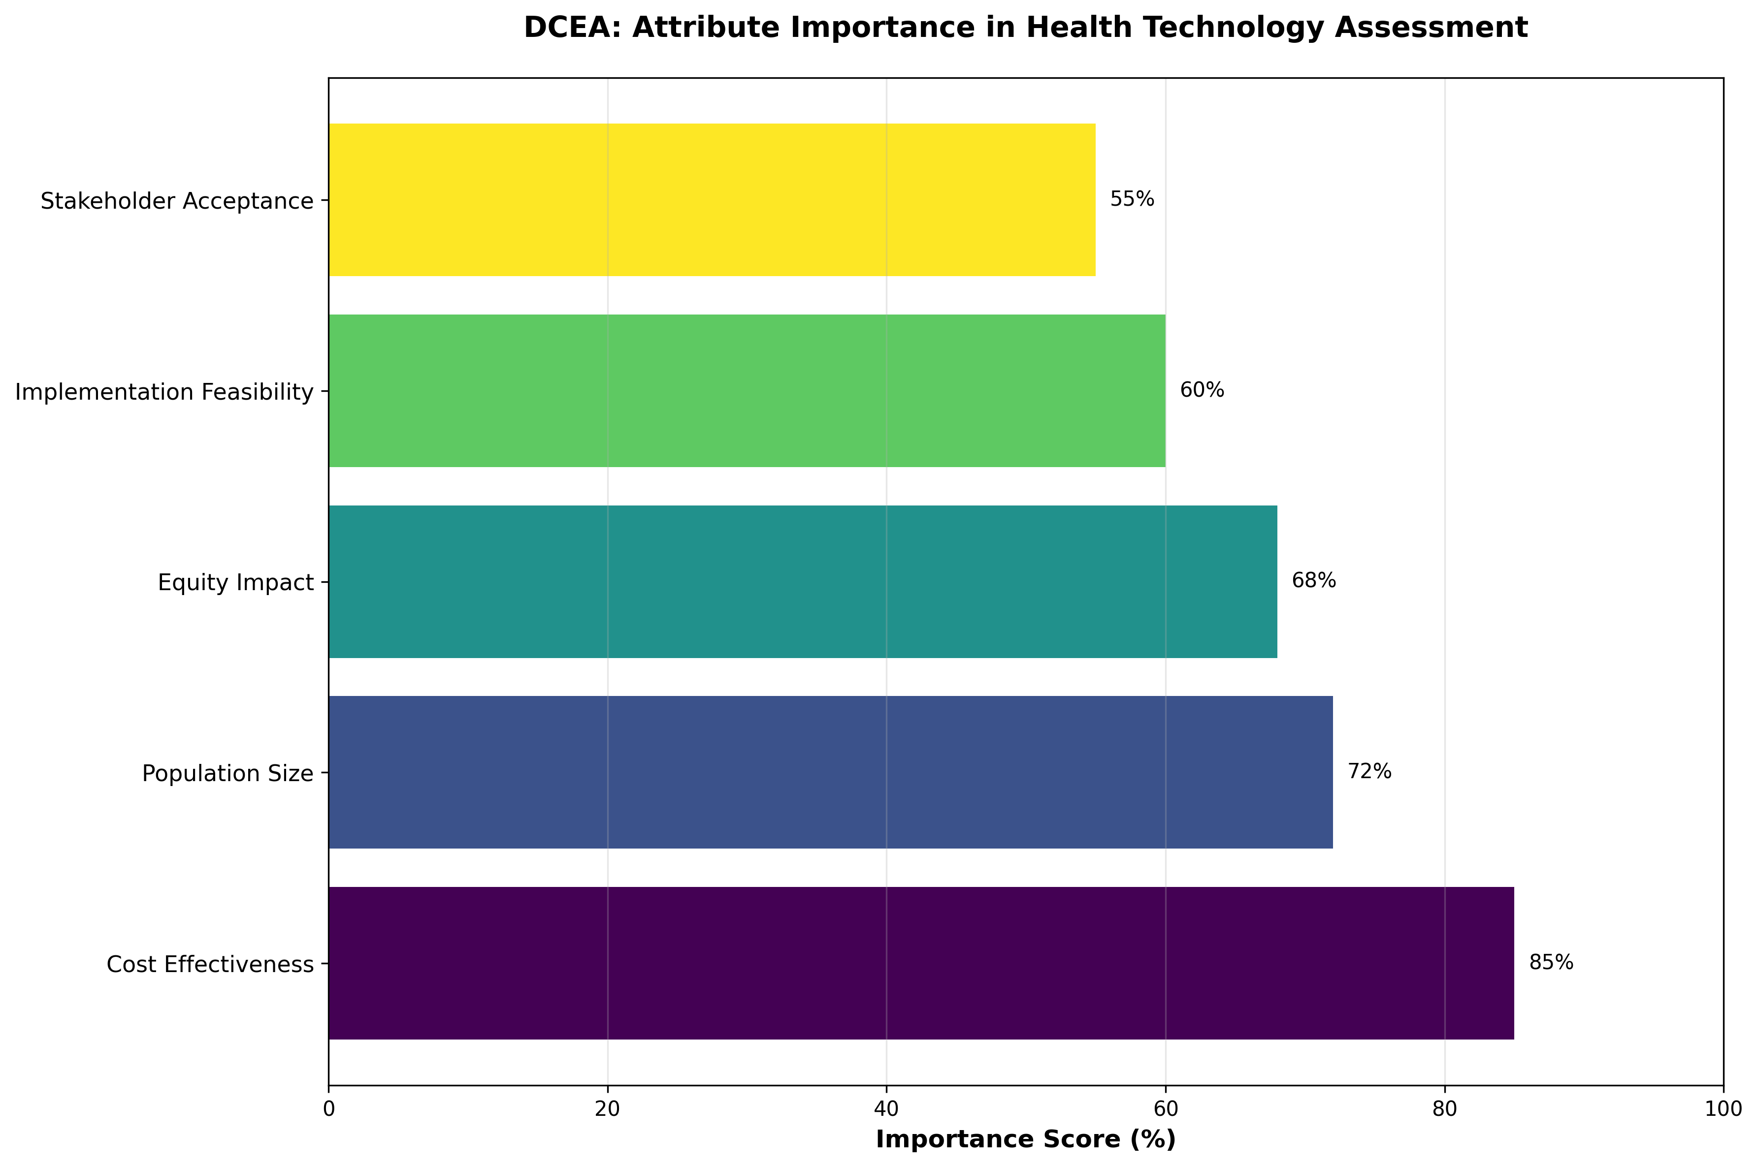
DCEA: Attribute Importance
Notes:
Relative importance of attributes in the Discrete Choice Experiment.

Slide 25
Questions & Discussion

