Slide 1
Health Economic Analysis: Policy Interventions
New Zealand Medical Journal Submission
Generated: 2025-11-27
Version: v3

Slide 2
Outline
1. Decision Model Structures
2. Cost-Effectiveness Analysis Results
3. Comparative ICER Summary
4. Probabilistic Sensitivity Analysis
5. Distributional Cost-Effectiveness Analysis (DCEA)
6. Budget Impact Analysis
7. Value of Information Analysis

Slide 3
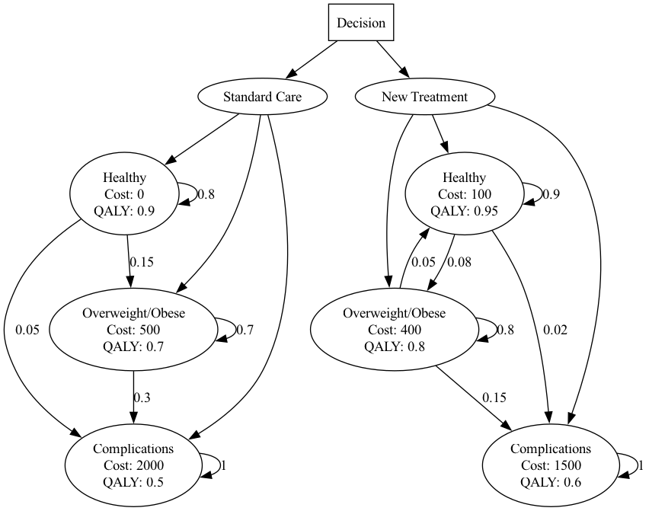
Model Structure: Childhood Obesity Prevention
Notes:
Decision tree structure for Childhood Obesity Prevention intervention.

Slide 4
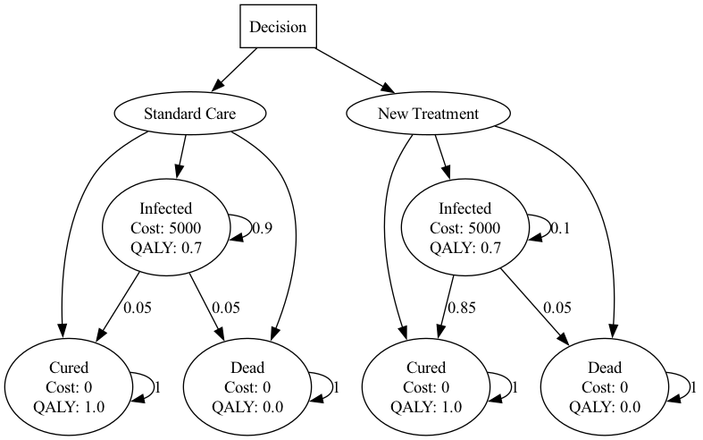
Model Structure: Hepatitis C Therapy
Notes:
Decision tree structure for Hepatitis C Therapy intervention.

Slide 5
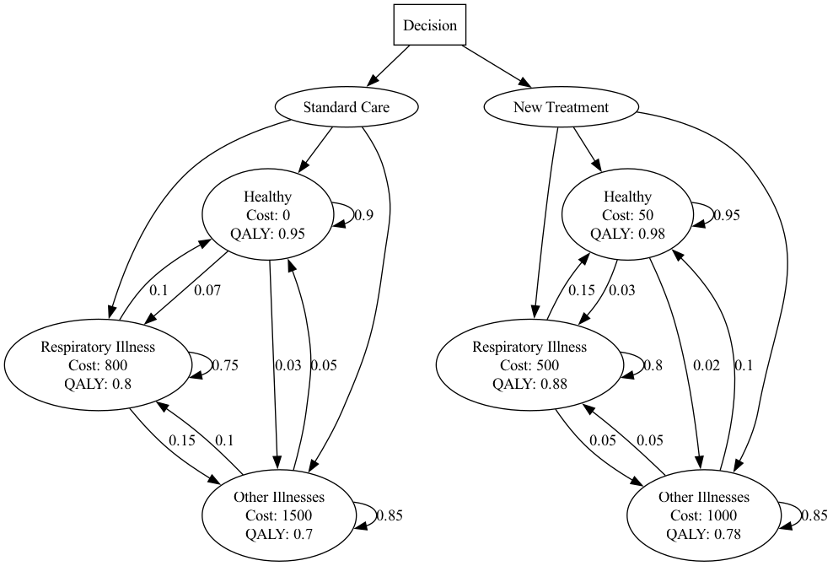
Model Structure: Housing Insulation
Notes:
Decision tree structure for Housing Insulation intervention.

Slide 6
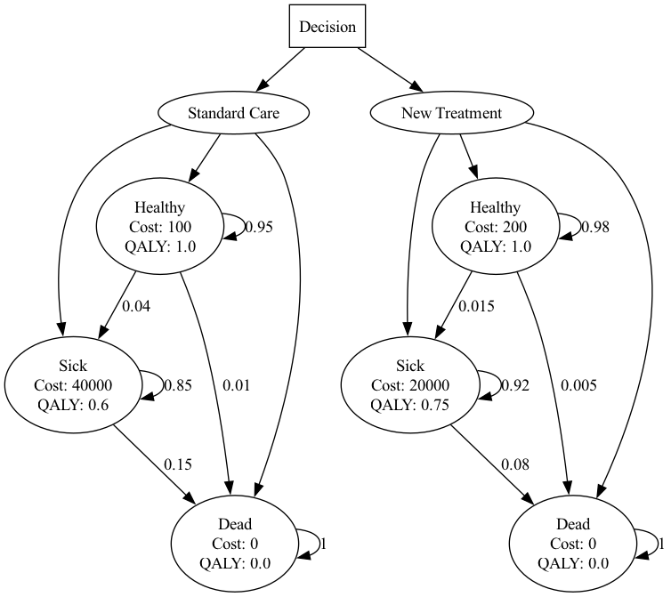
Model Structure: Hpv Vaccination
Notes:
Decision tree structure for Hpv Vaccination intervention.

Slide 7
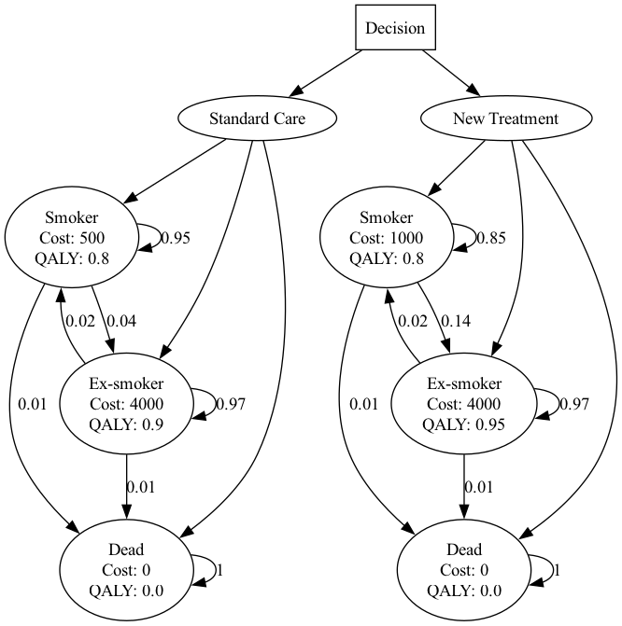
Model Structure: Smoking Cessation
Notes:
Decision tree structure for Smoking Cessation intervention.

Slide 8
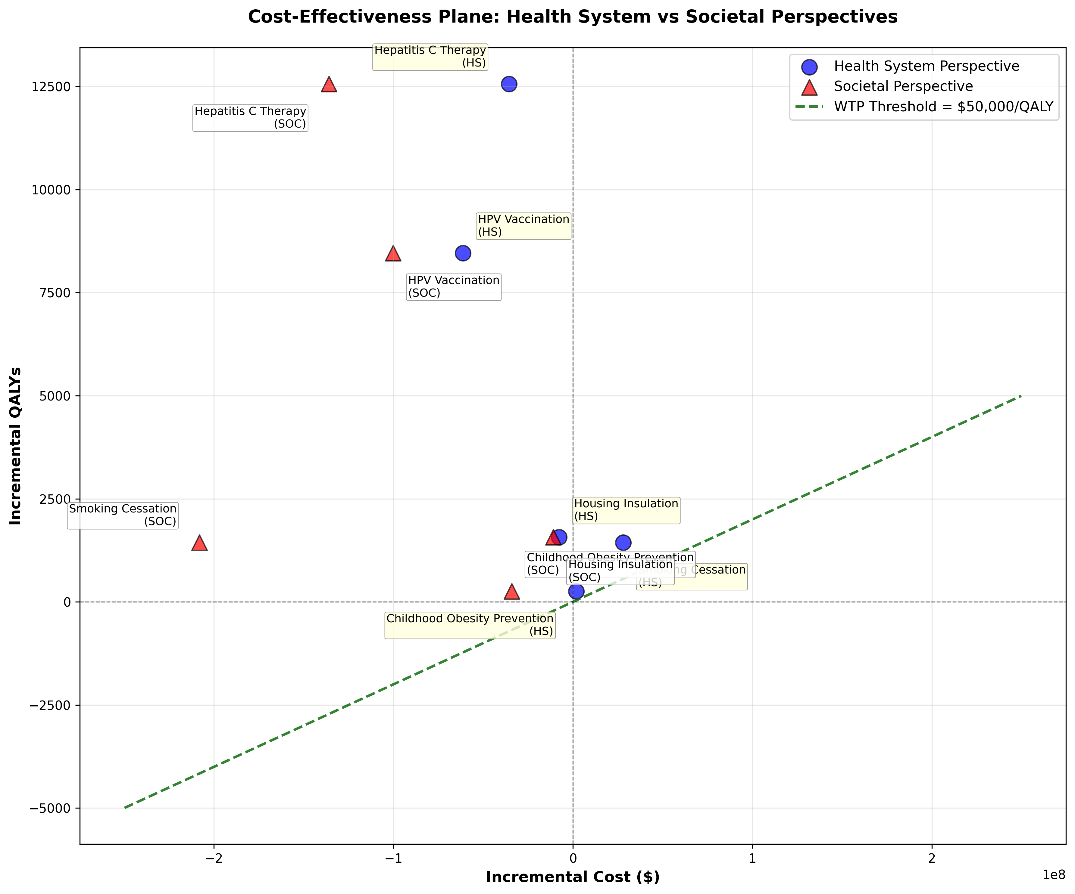
Cost-Effectiveness Plane: Both Perspectives Comparison
Notes:
Scatter plot of incremental costs vs incremental QALYs.

Slide 9
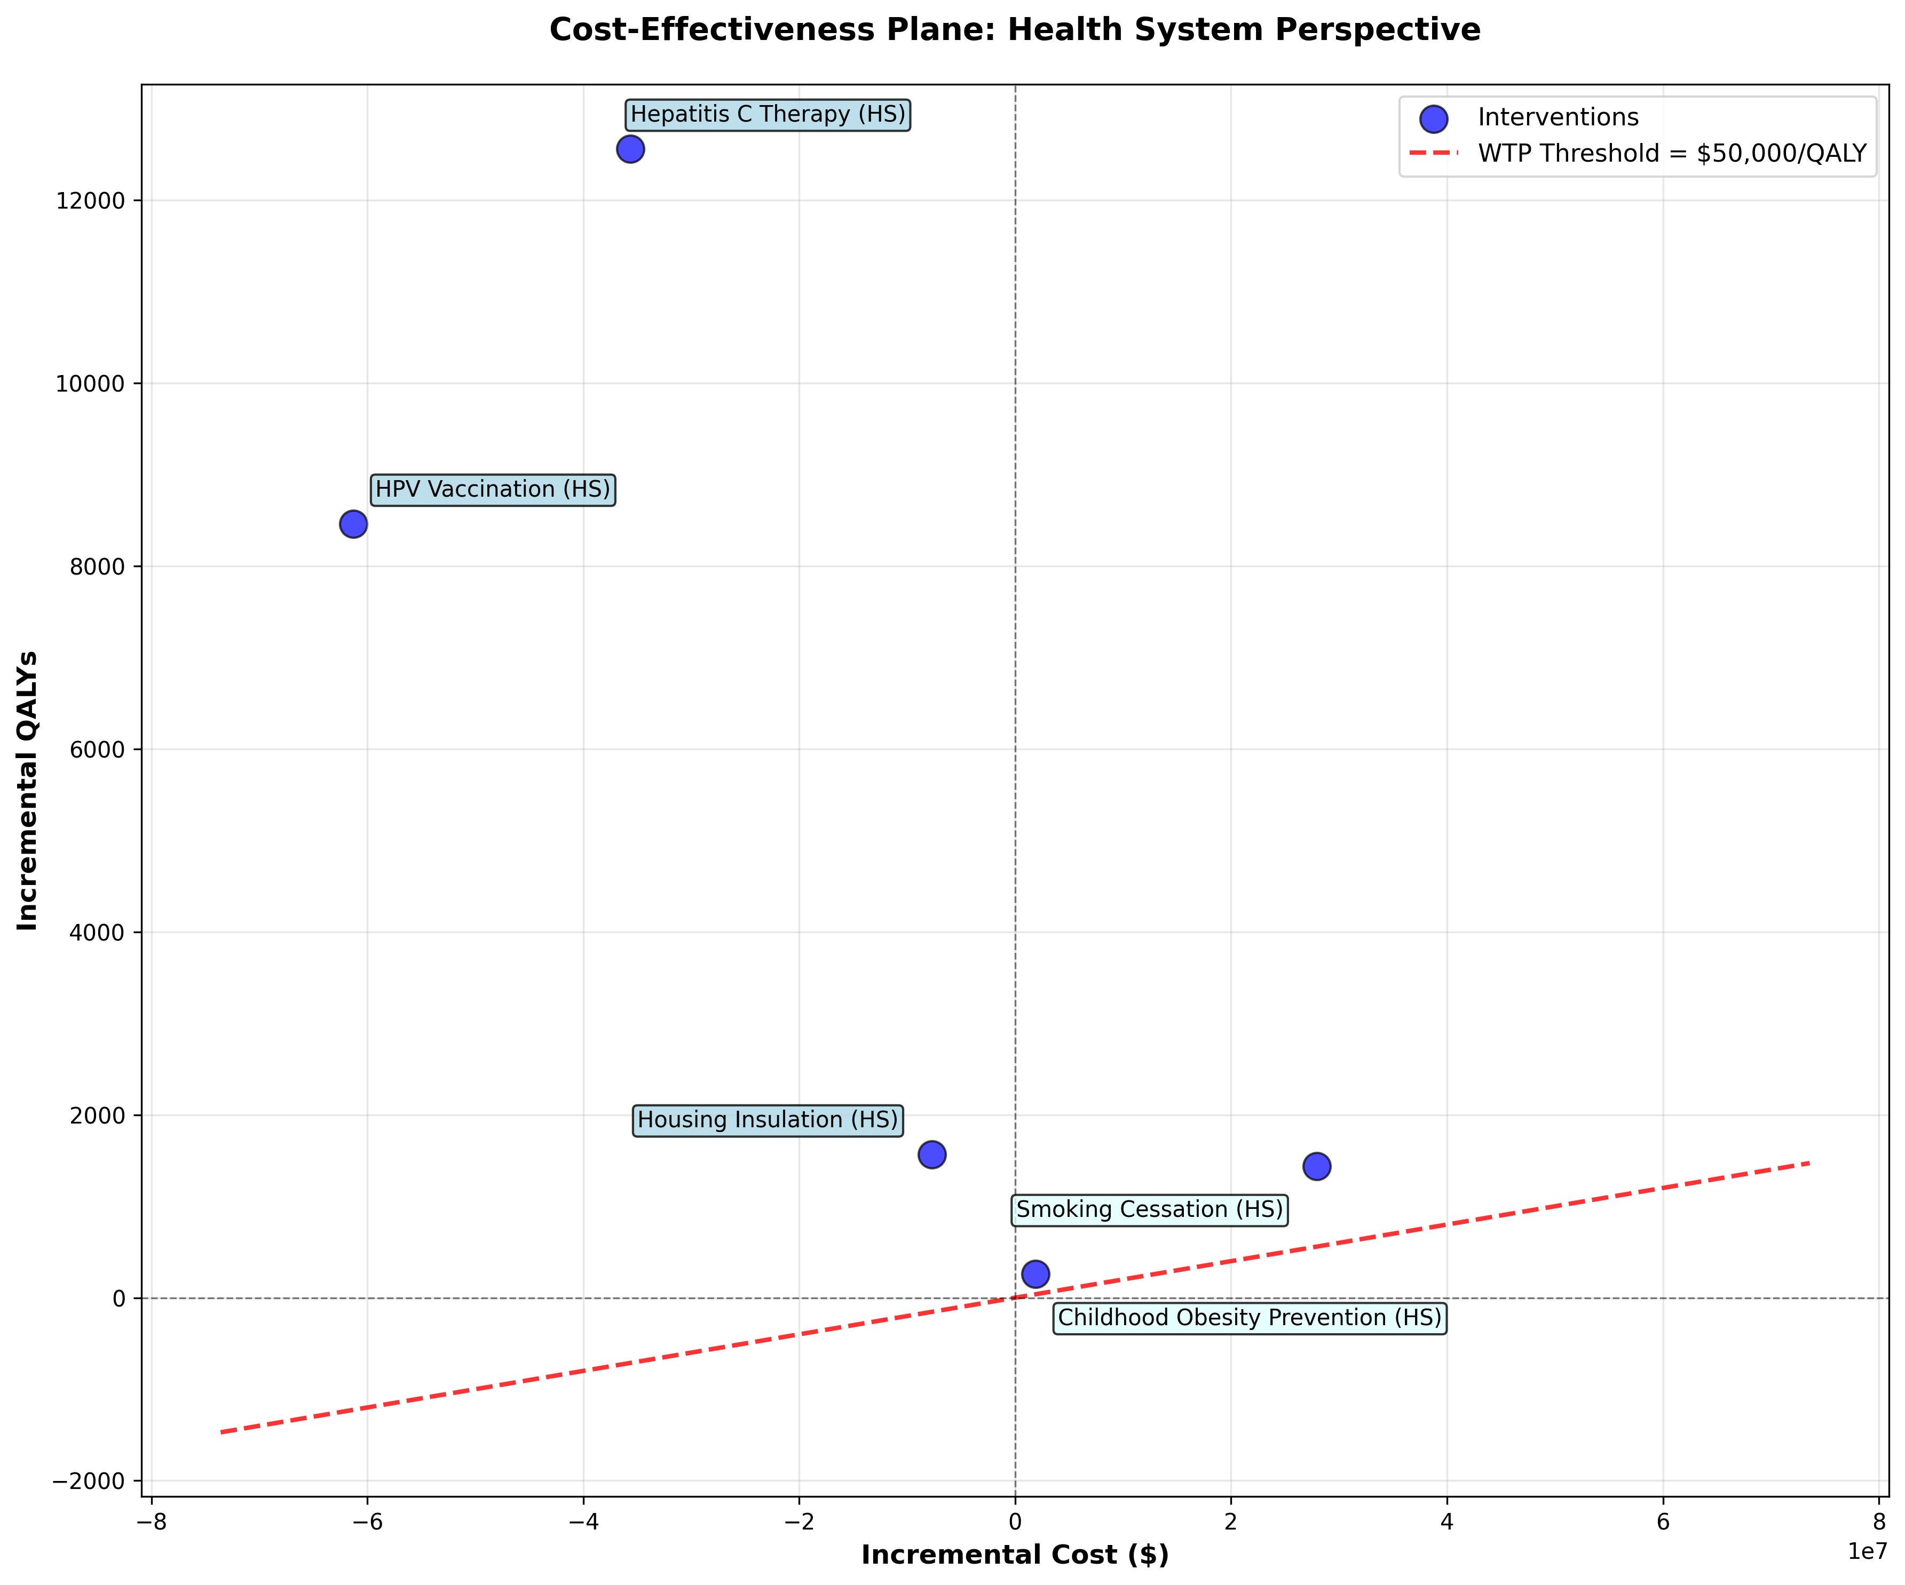
Cost-Effectiveness Plane: Health System Perspective
Notes:
Scatter plot of incremental costs vs incremental QALYs.

Slide 10
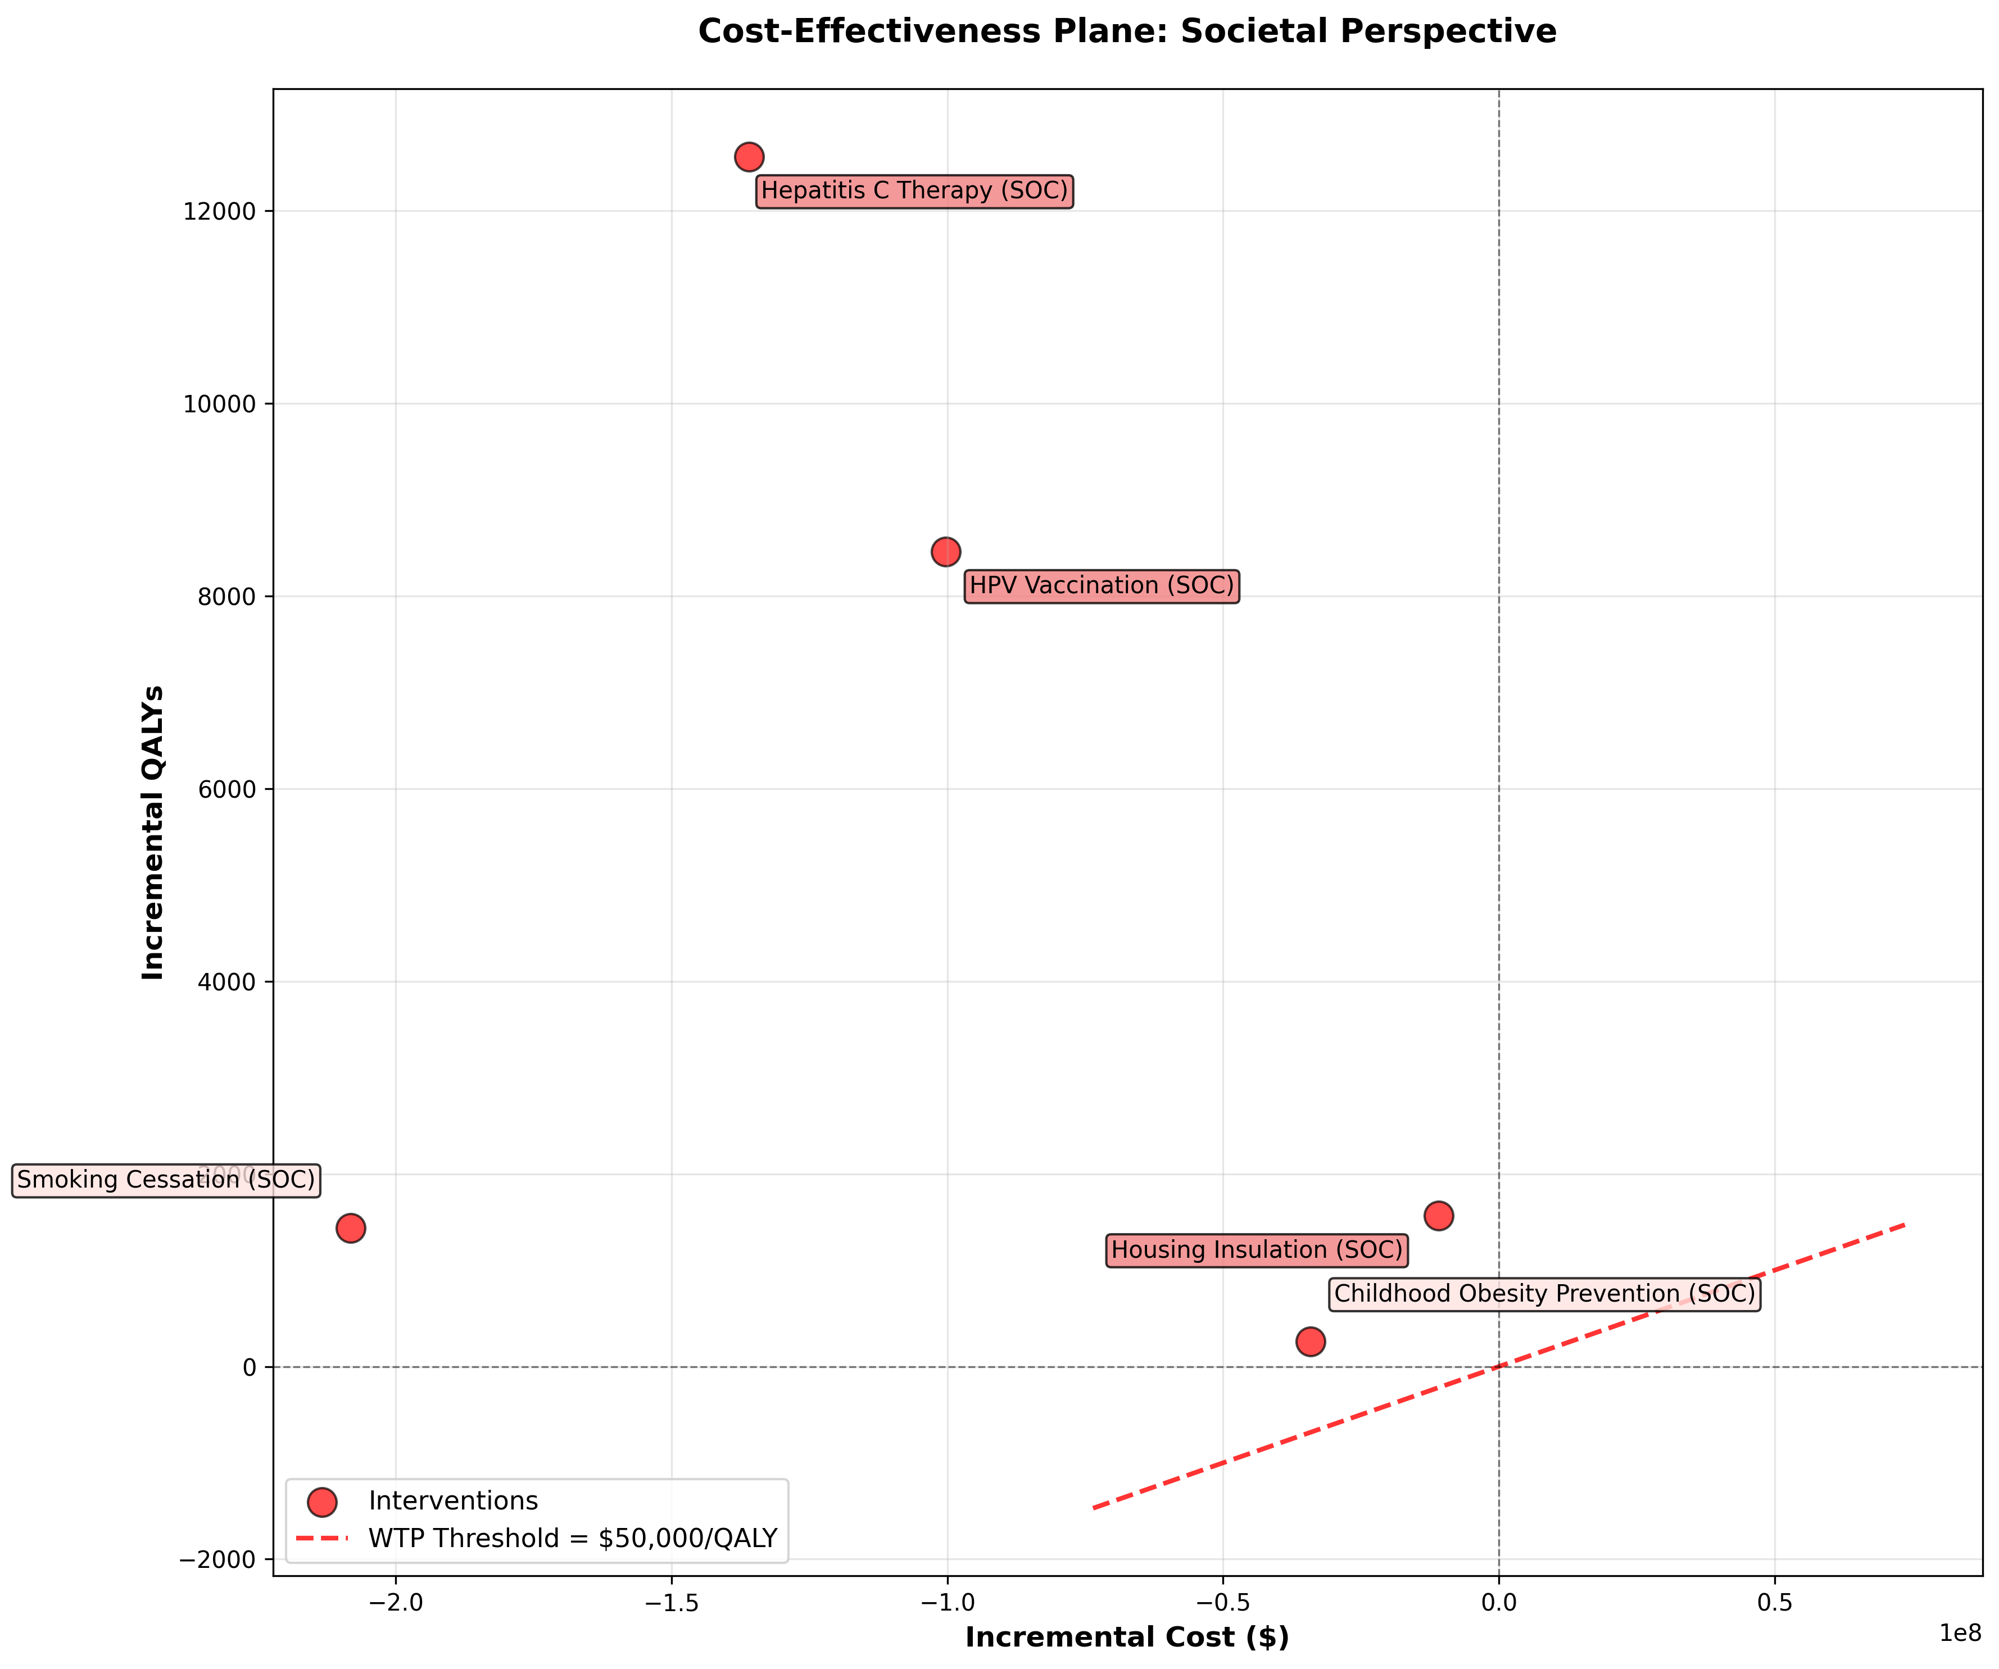
Cost-Effectiveness Plane: Societal Perspective
Notes:
Scatter plot of incremental costs vs incremental QALYs.

Slide 11
Comparative ICER Summary
Intervention | Perspective | ICER ($/QALY) | Cost-Effective (WTP=$50k)
HPV Vaccination (Human Capital) | Health System | $-7,247 | True
HPV Vaccination (Human Capital) | Societal | $-11,846 | True
HPV Vaccination (Friction Cost) | Health System | $-7,247 | True
HPV Vaccination (Friction Cost) | Societal | $-9,959 | True
Smoking Cessation (Human Capital) | Health System | $19,402 | True
Smoking Cessation (Human Capital) | Societal | $-144,537 | True
Smoking Cessation (Friction Cost) | Health System | $19,402 | True
Smoking Cessation (Friction Cost) | Societal | $-100,786 | True
Hepatitis C Therapy (Human Capital) | Health System | $-2,839 | True
Hepatitis C Therapy (Human Capital) | Societal | $-10,818 | True
Hepatitis C Therapy (Friction Cost) | Health System | $-2,839 | True
Hepatitis C Therapy (Friction Cost) | Societal | $-4,935 | True
Childhood Obesity Prevention (Human Capital) | Health System | $7,360 | True
Childhood Obesity Prevention (Human Capital) | Societal | $-132,199 | True
Childhood Obesity Prevention (Friction Cost) | Health System | $7,360 | True
Childhood Obesity Prevention (Friction Cost) | Societal | $-8,800 | True
Housing Insulation (Human Capital) | Health System | $-4,913 | True
Housing Insulation (Human Capital) | Societal | $-6,998 | True
Housing Insulation (Friction Cost) | Health System | $-4,913 | True
Housing Insulation (Friction Cost) | Societal | $-11,643 | True

Slide 12
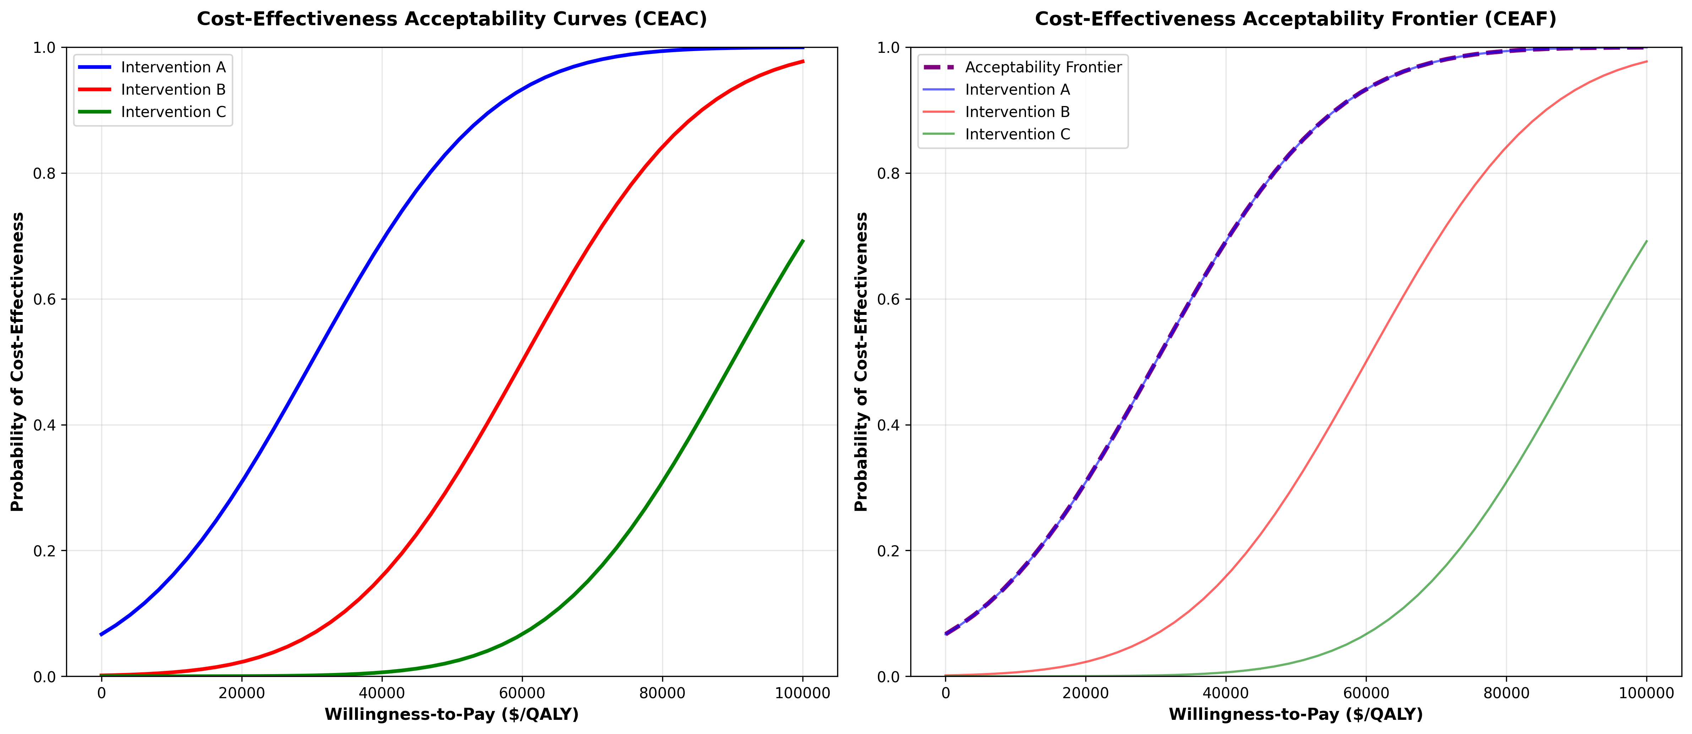
Probabilistic Sensitivity Analysis
Notes:
Cost-Effectiveness Acceptability Curve and Frontier.

Slide 13
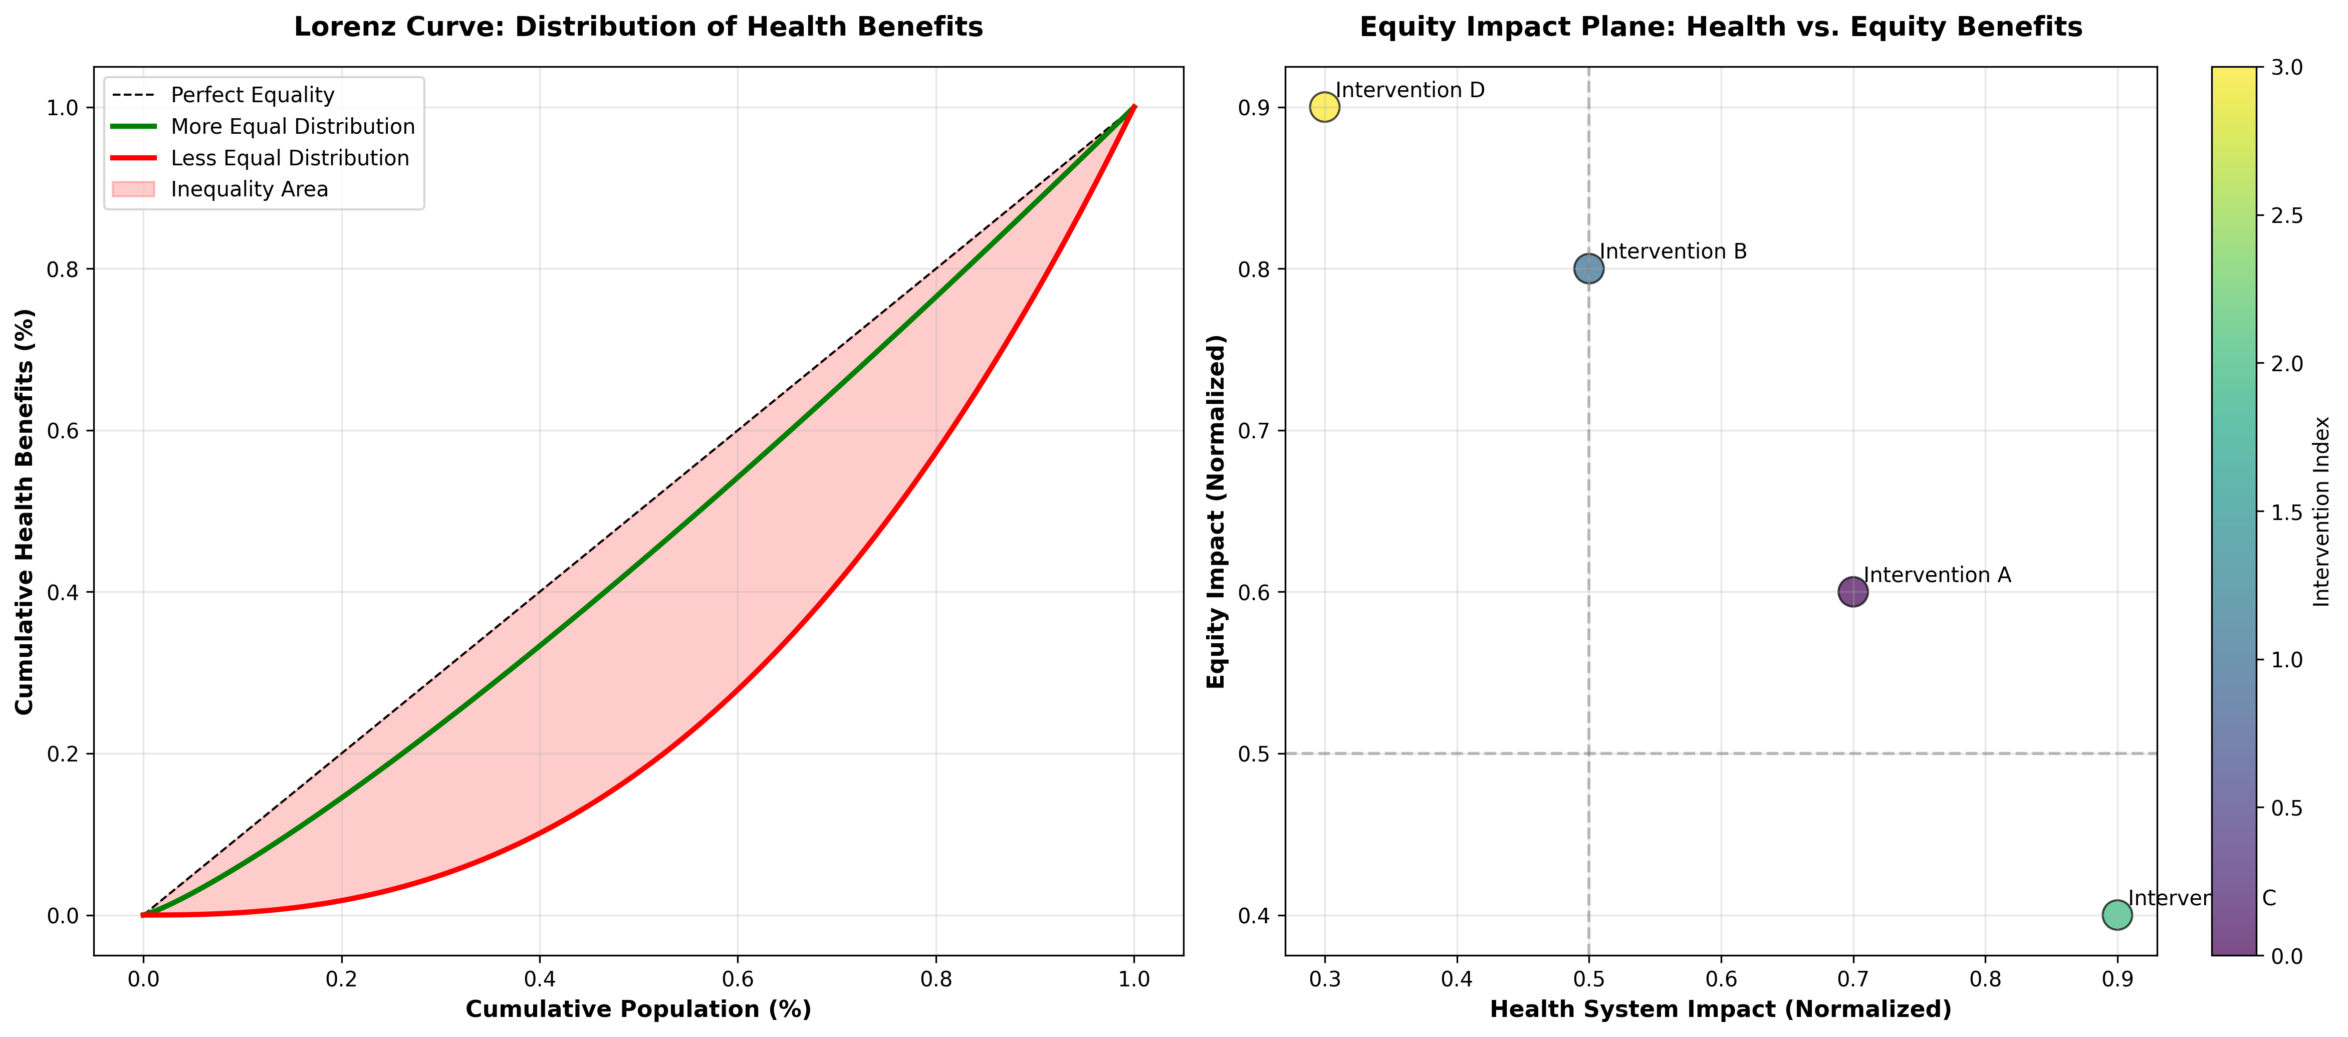
Equity Analysis
Notes:
Distributional impact of interventions across socioeconomic groups.

Slide 14
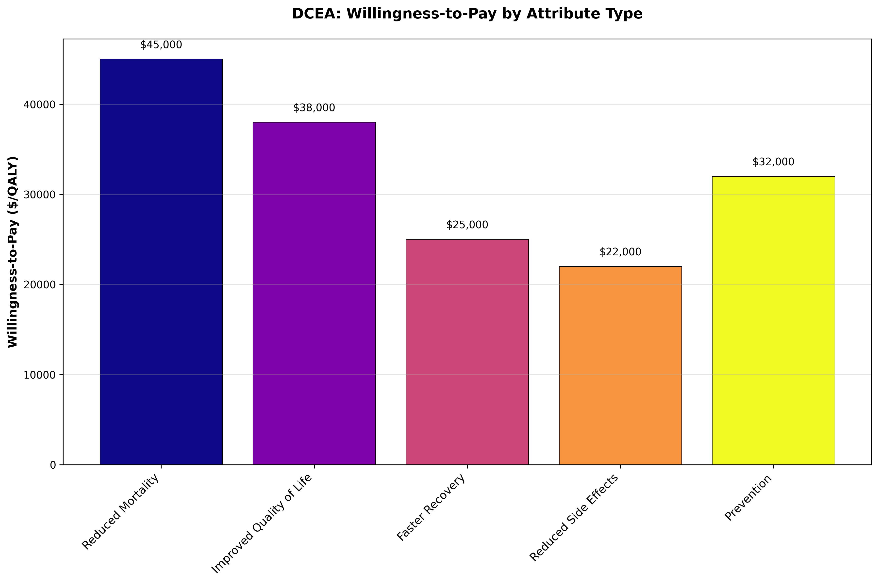
DCEA: Willingness to Pay
Notes:
Willingness to pay for equity-weighted health gains.

Slide 15
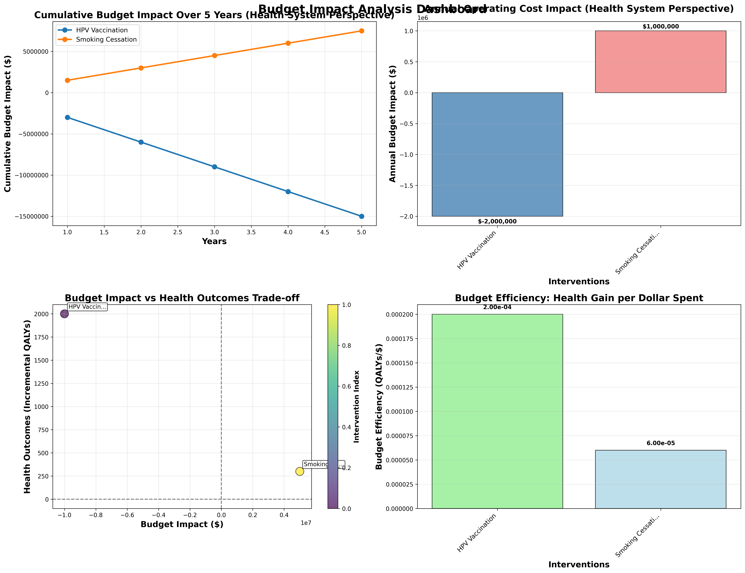
Budget Impact Analysis
Notes:
Financial implications of the interventions over time.

Slide 16
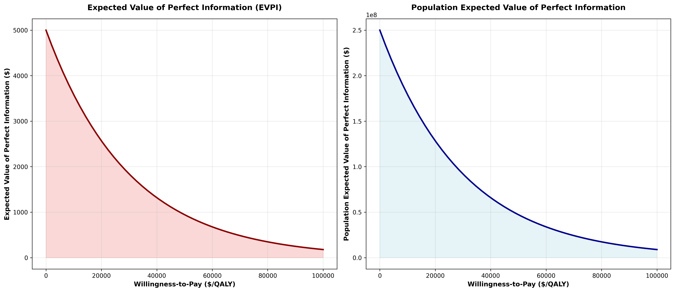
Value of Information: EVPI
Notes:
Expected Value of Perfect Information analysis.

Slide 17
Questions & Discussion

