Slide 1
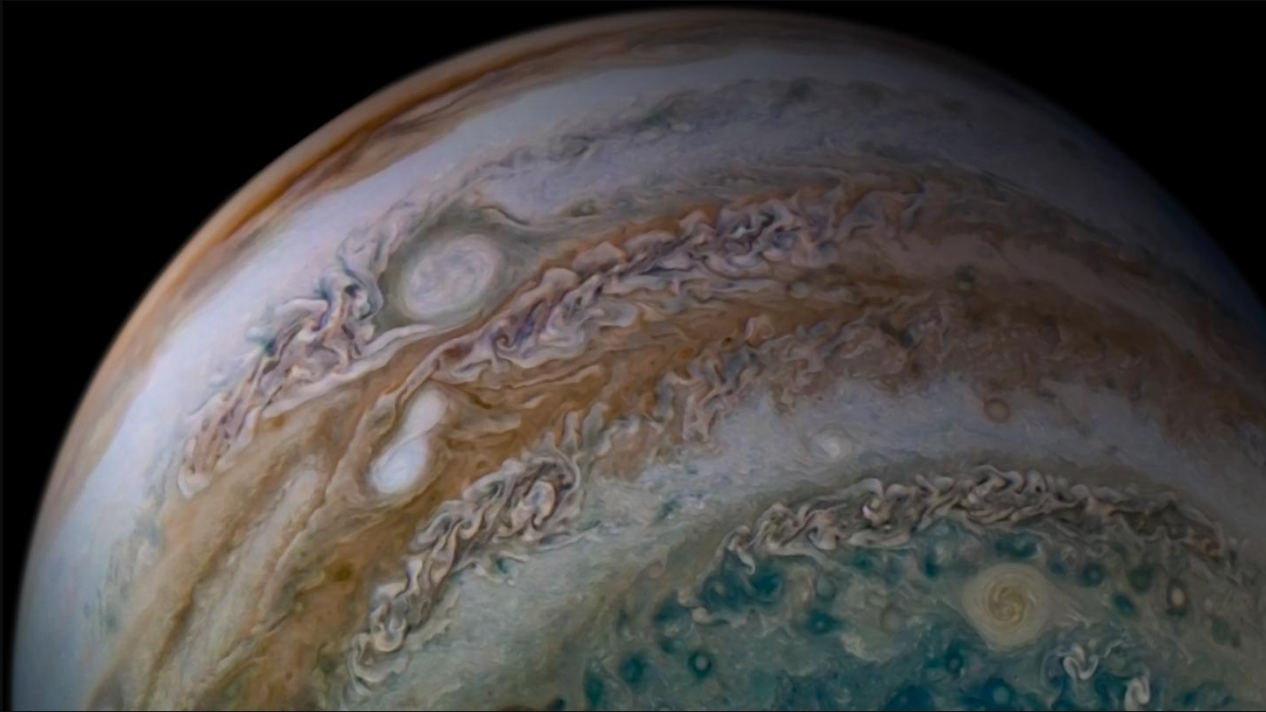
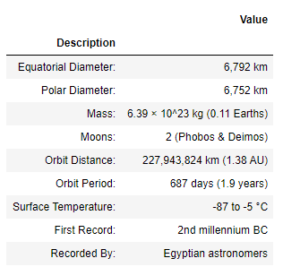
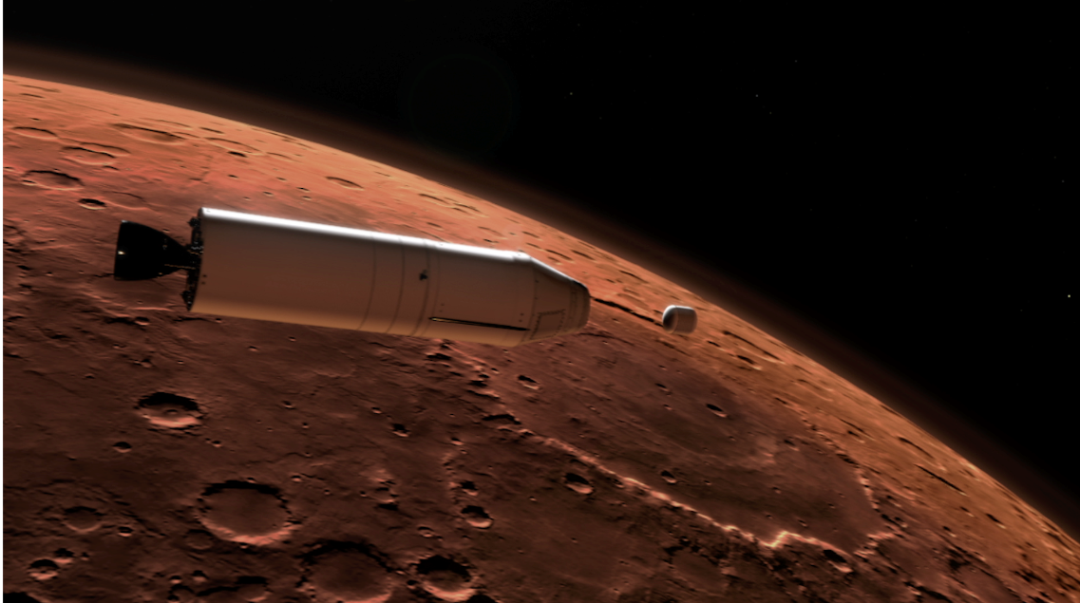
Mission to Mars
New Data
NASA Mars News
Mars Now
NASA chose a seventh-grader from Virginia as winner of the agency's "Name the Rover" essay contest. Alexander Mather's entry for "Perseverance" was voted tops among 28,000 entries.
JPL Mars Space Images - Featured Image
Mars Facts

Slide 2
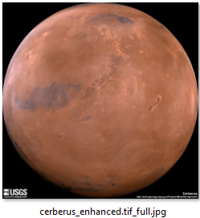
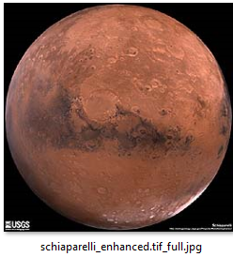
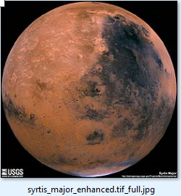
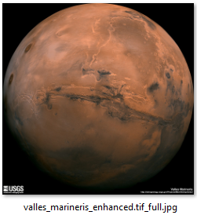
Mars Hemispheres
Mars Weather
InSight sol 448 (2020-02-29) low -94.1ºC (-137.3ºF) high -8.3ºC (17.0ºF) winds from the SSW at 5.5 m/s (12.4 mph) gusting to 19.9 m/s (44.6 mph) pressure at 6.30 hPa
Cerberus Hemisphere Enhanced'
Schiaparelli Hemisphere Enhanced’,
Syrtis Major Hemisphere Enhanced
Valles Marineris Hemisphere Enhanced’,

