Slide 1
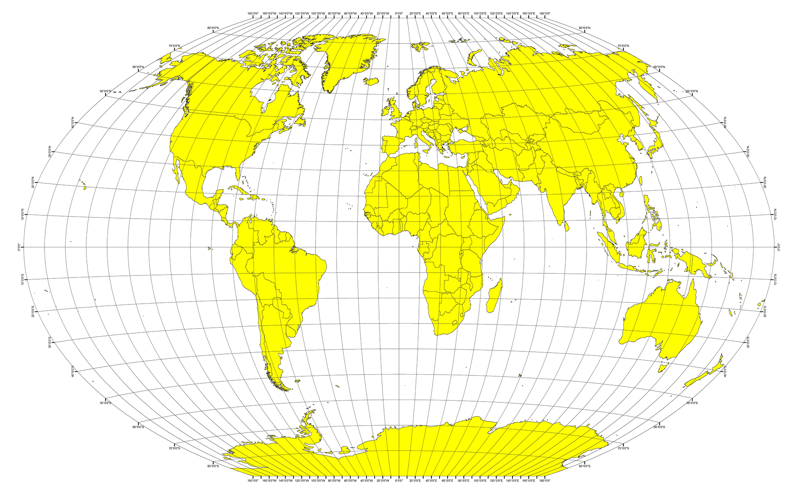
Weather Project – Web Design

Slide 2
Latitude - Latitude Analysis Dashboard with Attitude Scope
Create a visualization dashboard website using visualization created from Python-API’s assignment. The website must consist of 7 pages total, including:
A landing page containing:
An explanation of the project.
Links to each visualizations page.
Create Four individual visualization pages for each plot and their explanations
A descriptive title and heading tag.
The plot/visualization itself for the selected comparison.
A paragraph describing the plot and its significance.
Create a "Comparisons" page that contain:
Contains all of the visualizations on the same page so we can easily visually compare them.
Uses a bootstrap grid for the visualizations.
The grid must be two visualizations across on screens medium and larger, and 1 across on extra-small and small screens.
Create a "Data" page that displays a responsive table containing the data used in the visualizations.

Slide 3
Latitude - Latitude Analysis Dashboard with Attitude Headers – Landing Page
Header Navigation in large screen
Header Navigation Small Screen
Latitude
Plots
Data
Comparison
Cloudiness
Humidity
Wind Speed
Max Temperature
Latitude
Data
Comparison
Plots
Cloudiness
Humidity
Wind Speed
Max Temperature
Comparison
Data
Maximum Temperature

Slide 4

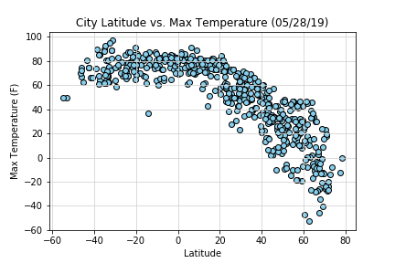
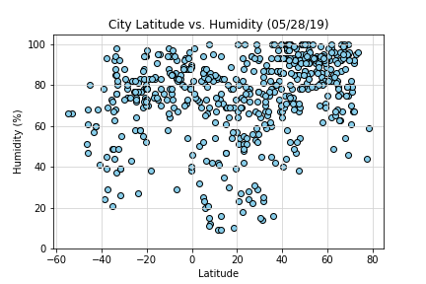
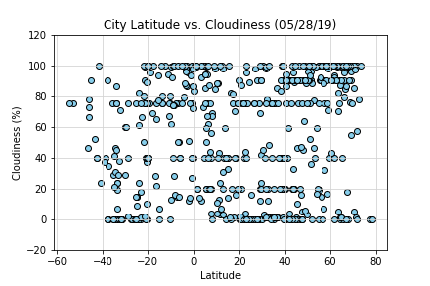
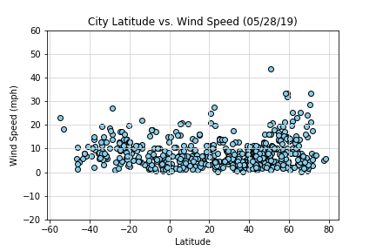
Latitude - Latitude Analysis Dashboard with Attitude Landing Page
Visualizations
Explanation of the Project
Latitude Analysis evaluate the behavior of the weather when a city is closed to the equator.
A random of 500 cities were selected to evaluate the weather pattern. The dataset was extracted from “OpenWeatherMap.org” website using Python-API (CityPy Python Library)
The dataset was analyzing using Pandas and Matplotlib Python libraries
Max Temperature, Humidity, Cloudiness, and Wind Speed variables were analyzed as well a comparison between Southern and Northern hemisphere.
Latitude with attitude dashboard shows
Dataset of 500 cities (source data)
Max Temperature, Humidity, Cloudiness, and Wind Speed visualization and results.
Cities on Southern and Northern hemisphere comparison.

Slide 5
Latitude - Latitude Analysis Dashboard with Attitude Landing Page
Explanation of the Project
Latitude Analysis evaluate the behauvior of the weather when a person travel close to the equator.
A random of 500 cities were selected to evaluate the weather pattern. The dataset was extracted from “OpenWeatherMap.org” website using Python-API (CityPy Python Library)
The dataset was analyzing using Pandas and Matplotlib Python libraries
Max Temperature, Humidity, Cloudiness, and Wind Speed variables were analyzed as well a comparison between Southern and Northern hemisphere.
Latitude with attitude dashboard shows
Dataset of 500 cities (source data)
Max Temperature, Humidity, Cloudiness, and Wind Speed visualization and results.
Cities on Southern and Northern hemisphere comparison.

Slide 6
Latitude - Latitude Analysis Dashboard with Attitude Headers – Plot 1 - Temperature
First Header is the landing page header
Second header is the plot header
Figure Text
Latitude
Plots
Data
Comparison
Cloudiness
Humidity
Wind Speed
Max Temperature
Maximum Temperature

Slide 7
Latitude - Latitude Analysis Dashboard with Attitude Visualization Temperature – Large Navigation
Maximum Temperature
Visualizations
Temperature has a strong correlation with latitude, the temperature is higher on the places near to the equator (latitude zero degree). On the data plot, I observed that North Hemisphere is lower than south. Temperature has a correlation with latitude, the temperature is higher on the places near to the equator. The cities locates far from the equator present lower temperature, these cities will be closer to the north pole or south pole

Slide 8
Latitude - Latitude Analysis Dashboard with Attitude Visualization Temperature – Small Navigation
Temperature
Temperature has a strong correlation with latitude, the temperature is higher on the places near to the equator (latitude zero degree). On the data plot, I observed that North Hemisphere is lower than south. Temperature has a correlation with latitude, the temperature is higher on the places near to the equator. The cities locates far from the equator present lower temperature, these cities will be closer to the north pole or south pole
Visualizations

Slide 9
Latitude - Latitude Analysis Dashboard with Attitude Headers – Plot 2 - Humidity
First Header is the landing page header
Second header is the plot header
Figure Text
Latitude
Plots
Data
Comparison
Cloudiness
Humidity
Wind Speed
Max Temperature
Humidity

Slide 10
Latitude - Latitude Analysis Dashboard with Attitude Visualization Humidity – Navigation Large
Humidity
Visualizations
There is no strong relationship between latitude and humidity.
On the Northern hemisphere cities, there is high number of cities with humidity greater than 50%.

Slide 11
Latitude - Latitude Analysis Dashboard with Attitude Visualization Humidity – Navigation Large
Humidity
There is no strong relationship between latitude and humidity.
On the Northern hemisphere cities, there is high number of cities with humidity greater than 50%.
Visualizations

Slide 12
Latitude - Latitude Analysis Dashboard with Attitude Headers – Plot 3 - Cloudiness
First Header is the landing page header
Second header is the plot header
Figure Text
Latitude
Plots
Data
Comparison
Cloudiness
Humidity
Wind Speed
Max Temperature
Cloudiness

Slide 13
Latitude - Latitude Analysis Dashboard with Attitude Visualization Cloudiness – Large Navigation
Cloudiness
Visualizations
There is not correlation between latitude and cloudiness, in one set of value of latiotude close to zero you can see value of cloudiness varies from 0 to 100. There is strong band of cities near 0, 20%, 75%, and 100% cloudiness.

Slide 14
Latitude - Latitude Analysis Dashboard with Attitude Visualization Cloudiness – Small Navigation
Cloudiness
There is not correlation between latitude and cloudiness, in one set of value of latitude close to zero you can see value of cloudiness varies from 0 to 100. There is strong band of cities near 0, 20%, 75%, and 100% cloudiness.
Visualizations

Slide 15
Latitude - Latitude Analysis Dashboard with Attitude Headers – Plot 4 – Wind Speed
First Header is the landing page header
Second header is the plot header
Figure
Text
Latitude
Plots
Data
Comparison
Cloudiness
Humidity
Wind Speed
Max Temperature
Wind Speed

Slide 16
Latitude - Latitude Analysis Dashboard with Attitude Visualization Wind Speed – Large Navigation
Wind Speed
Visualizations
There is no strong relationship between latitude and wind speed.
Wind speed tends to generally be between 0 and 15 mph regardless of latitude. In northern hemispheres, there are small amount of cities with wind speed over 20 mph. There is one city on the extreme south latitude with wind speed close to 45 mph

Slide 17
Latitude - Latitude Analysis Dashboard with Attitude Visualization Wind Speed – Small Navigation
Wind Speed
There is no strong relationship between latitude and wind speed.
Wind speed tends to generally be between 0 and 15 mph regardless of latitude. In northern hemispheres, there are small amount of cities with wind speed over 20 mph. There is one city on the extreme south latitude with wind speed close to 45 mph
Visualizations

Slide 18
Latitude - Latitude Analysis Dashboard with Attitude Headers – Plot 5 - Comparison
First Header is the landing page header
Second header is the plot header
Figure
Text
Latitude
Plots
Data
Comparison
Cloudiness
Humidity
Wind Speed
Max Temperature
Comparison Northern Hemisphere

Slide 19
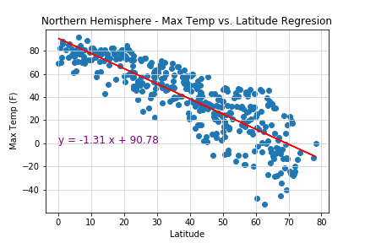
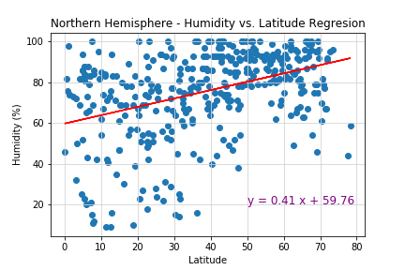
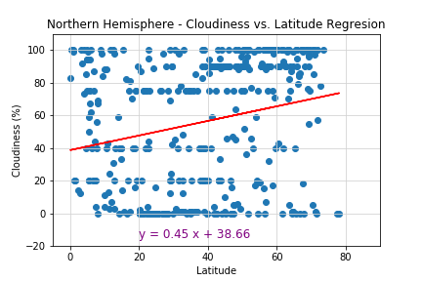
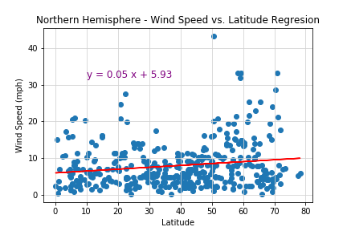
Latitude - Latitude Analysis Dashboard with Attitude Comparison Northern Hemisphere – Navigation Large/Medium
Picture aligned 2 horizontal
and text after last picture
Should be able to scroll down
The grid must be two visualizations across on screens medium and larger
This model show that there is a negative correlation between the Maximum Temperature and Latitude Regression in the Northern Hemisphere. A The temperature increase when the city get closer to the equator. On the other hand, the humidity and Latitude Regression in the Northern Hemisphere show a positive correlation. The humidity increase when the city get further from the equator but this correlation has not strong R-square (close to 100%).
Cloudiness and Latitude Regression in the Northern Hemisphere has a positive correlation. The cloudiness on the cities increase when the city get further from the equator. Similarly Wind Speed and Latitude Regression in the Northern hemisphere has a positive correlation. The wind speed slightly increase when the city get further from the equator.

Slide 20
Latitude - Latitude Analysis Dashboard with Attitude Comparison Northern Hemisphere – Navigation Small/Extra Small
This model show that there is a negative correlation between the Maximum Temperature and Latitude Regression in the Northern Hemisphere. A The temperature increase when the city get closer to the equator. On the other hand, the humidity and Latitude Regression in the Northern Hemisphere show a positive correlation. The humidity increase when the city get further from the equator but this correlation has not strong R-square (close to 100%).
Cloudiness and Latitude Regression in the Northern Hemisphere has a positive correlation. The cloudiness on the cities increase when the city get further from the equator. Similarly Wind Speed and Latitude Regression in the Northern hemisphere has a positive correlation. The wind speed slightly increase when the city get further from the equator.
Picture aligned vertical and text after last picture
Should be able to scroll down
The grid must be one visualizations across on screens extra-small and small screens

Slide 21
Latitude - Latitude Analysis Dashboard with Attitude Headers – Plot 6 - Comparison
First Header is the landing page header
Second header is the plot header
Figure
Text
Latitude
Plots
Data
Comparison
Cloudiness
Humidity
Wind Speed
Max Temperature
Comparison Northern Hemisphere

Slide 22
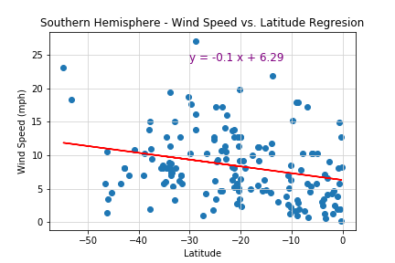
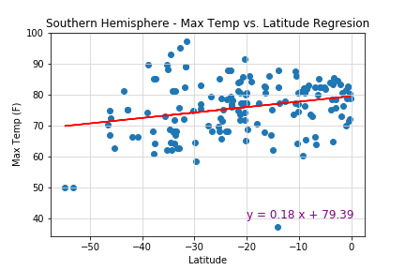
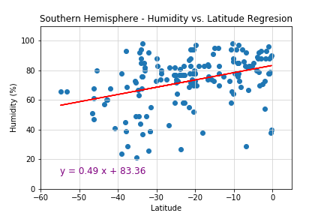
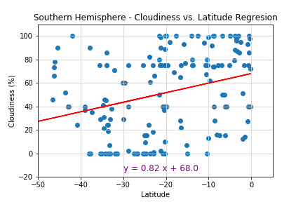
Latitude - Latitude Analysis Dashboard with Attitude Comparison Southern Hemisphere – Navigation Large
This model show that there is a positive correlation between Max Temp and Latitude Regression in the Southern Hemisphere. The maximum temperature increase when the city get closer to the equator. Similarly, there is a positive correlation between Humidity and Latitude Regression in the Southern Hemisphere. The humidity increases when the city get closer to the equator.
There is a positive correlation between Cloudiness and Latitude Regression in the Southern Hemisphere. The cloudiness increase when the city get closer to the equator
Wind Speed and Latitude Regression has a negative correlation in the Southern Hemisphere. The wind speed slightly increases when the city get further from the equator.

Slide 23
Latitude - Latitude Analysis Dashboard with Attitude Comparison Southern Hemisphere – Navigation Small
This model show that there is a positive correlation between Max Temp and Latitude Regression in the Southern Hemisphere. The maximum temperature increase when the city get closer to the equator. Similarly, there is a positive correlation between Humidity and Latitude Regression in the Southern Hemisphere. The humidity increases when the city get closer to the equator.
There is a positive correlation between Cloudiness and Latitude Regression in the Southern Hemisphere. The cloudiness increase when the city get closer to the equator
Wind Speed and Latitude Regression has a negative correlation in the Southern Hemisphere. The wind speed slightly increases when the city get further from the equator.
Picture aligned vertical and text after last picture
Should be able to scroll down

Slide 24
Latitude - Latitude Analysis Dashboard with Attitude Headers – Plot 6 - Comparison
First Header is the landing page header
Second header is the plot header
Figure
Text
Latitude
Plots
Data
Comparison
Cloudiness
Humidity
Wind Speed
Max Temperature
Data

Slide 25
Latitude - Latitude Analysis Dashboard with Attitude Data

