Slide 1
Business Analysis: AI Technology Trends
Comprehensive Analysis & Strategic Insights

Slide 2

AI Market Overview
Explosive Growth in AI Sector
• Global AI market: $150B in 2024, growing 35% annually • Enterprise adoption rate: 78% of Fortune 500 • Investment surge: $40B VC funding in 2024 • Key drivers: automation, data analytics, competitive advantage
Segment | Market Size | Growth Rate | Key Players
Machine Learning | $45B | 38% | Google, Microsoft
NLP | $25B | 42% | OpenAI, Anthropic
Computer Vision | $18B | 28% | NVIDIA, Intel
Robotics | $12B | 31% | Boston Dynamics, Tesla

Slide 3
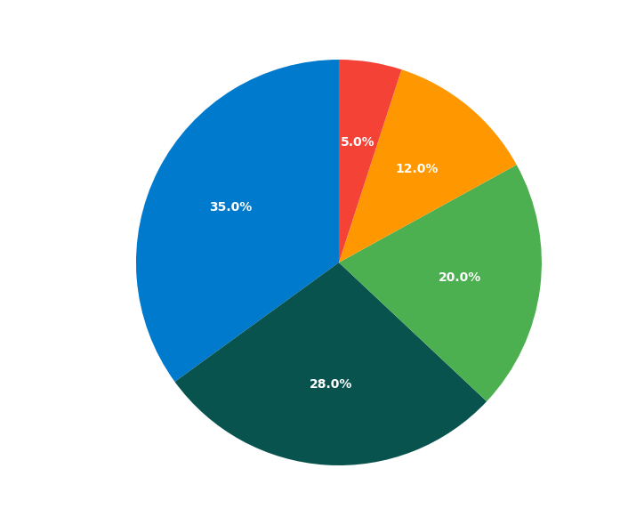
Technology Adoption Trends
Enterprise AI Implementation
• 65% of companies using AI for customer service • 58% implementing AI in operations • 45% using AI for data analytics • ROI average: 15-25% efficiency gains

Slide 4
Key Takeaways & Next Steps
Summary of Key Findings:
• AI Market Overview: Strategic importance for business growth
• Technology Adoption Trends: Strategic importance for business growth
Recommended Next Steps:
• Develop detailed implementation roadmap
• Allocate necessary resources and budget
• Establish key performance indicators
• Begin pilot program execution

