Slide 1
ESG Analysis Report
Comprehensive ESG Trends Analysis - September 2025

Slide 2
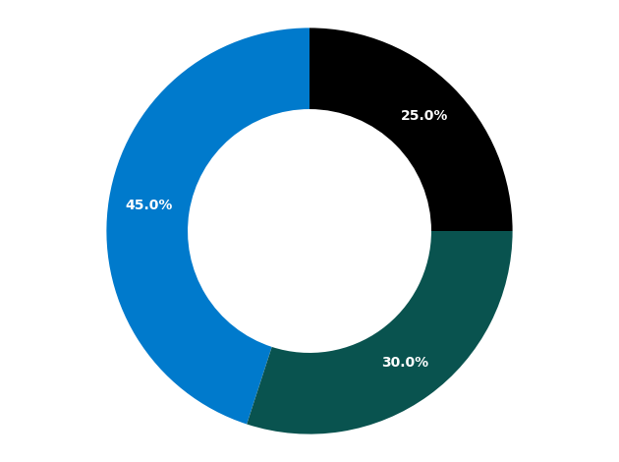
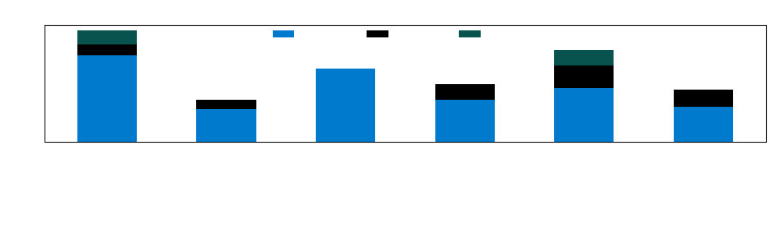
Executive Summary
This comprehensive ESG analysis examines sustainability trends across multiple regions, focusing on environmental, social, and governance factors. Key findings indicate strong positive sentiment toward renewable energy initiatives and corporate transparency measures, while regulatory compliance remains a challenge in emerging markets. The analysis reveals significant opportunities for financial institutions to enhance their ESG positioning through strategic partnerships and technology investments.

Slide 3
Potential Business Impact
Country | ESG Theme | Impact Area | Level | Rationale
United States | Renewable Energy Transition | Investment Banking | High | Significant opportunities in green bond issuance and renewable energy project financing
United States | Board Diversity | Corporate Banking | Medium | Enhanced due diligence requirements for governance assessment in lending decisions
United Kingdom | Net Zero Commitments | Asset Management | High | Growing demand for ESG-focused investment products and carbon-neutral portfolios
Germany | Circular Economy | Trade Finance | Medium | New financing products needed for circular economy business models
China | Green Technology Investment | Investment Banking | High | Major IPO and M&A opportunities in clean technology sector
China | Corporate Transparency | Risk Management | High | Enhanced due diligence and monitoring required for Chinese corporate exposures
Japan | Climate Adaptation | Project Finance | Medium | Infrastructure financing opportunities for climate resilience projects
Canada | Green Finance | Retail Banking | Medium | Consumer demand for green mortgages and sustainable banking products

Slide 4
Regional ESG & Sustainability Trends (Page 1 of 3)
Region | Country | Category | Theme
North America | United States | Environmental | Renewable Energy Transition
North America | United States | Environmental | Carbon Emissions Reduction
North America | United States | Social | Workforce Diversity
North America | United States | Social | Community Investment
North America | United States | Governance | Board Diversity
North America | United States | Governance | Executive Compensation
North America | Canada | Environmental | Green Finance
North America | Canada | Social | Indigenous Rights
North America | Canada | Governance | Climate Risk Disclosure
Europe | United Kingdom | Environmental | Net Zero Commitments

Slide 5
Regional ESG & Sustainability Trends (Page 2 of 3)
Region | Country | Category | Theme
Europe | United Kingdom | Environmental | Sustainable Finance Regulation
Europe | United Kingdom | Social | Living Wage Initiatives
Europe | United Kingdom | Governance | Anti-Corruption Measures
Europe | Germany | Environmental | Circular Economy
Europe | Germany | Social | Worker Rights
Europe | Germany | Governance | Supply Chain Transparency
Asia Pacific | China | Environmental | Green Technology Investment
Asia Pacific | China | Environmental | Air Quality Improvement
Asia Pacific | China | Social | Rural Development
Asia Pacific | China | Governance | Corporate Transparency

Slide 6
Regional ESG & Sustainability Trends (Page 3 of 3)
Region | Country | Category | Theme
Asia Pacific | Japan | Environmental | Climate Adaptation
Asia Pacific | Japan | Social | Aging Population Support
Asia Pacific | Japan | Governance | Corporate Governance Reform

Slide 7
Sentiment Justification (Page 1 of 3)
Country | Theme | Sentiment | Justification
United States | Renewable Energy Transition | Positive | Strong government incentives and corporate commitments to clean energy are driving positive sentiment
United States | Carbon Emissions Reduction | Positive | Major corporations setting aggressive carbon neutrality targets
United States | Workforce Diversity | Positive | Increased focus on inclusive hiring practices and equal opportunity initiatives
United States | Community Investment | Neutral | Mixed results in community development programs
United States | Board Diversity | Positive | SEC mandates and investor pressure driving board composition changes
United States | Executive Compensation | Negative | Continued shareholder concerns over pay equity and performance alignment
Canada | Green Finance | Positive | Strong regulatory framework supporting sustainable finance initiatives
Canada | Indigenous Rights | Neutral | Ongoing efforts to improve indigenous community relations with mixed outcomes
Canada | Climate Risk Disclosure | Positive | Mandatory climate risk reporting improving transparency
United Kingdom | Net Zero Commitments | Positive | Comprehensive net zero strategy with clear timelines and milestones

Slide 8
Sentiment Justification (Page 2 of 3)
Country | Theme | Sentiment | Justification
United Kingdom | Sustainable Finance Regulation | Positive | EU taxonomy and UK green finance framework providing clarity
United Kingdom | Living Wage Initiatives | Positive | Corporate adoption of living wage standards improving worker conditions
United Kingdom | Anti-Corruption Measures | Positive | Strengthened regulatory enforcement and corporate compliance programs
Germany | Circular Economy | Positive | Leading circular economy initiatives reducing waste and promoting recycling
Germany | Worker Rights | Positive | Strong labor protections and worker representation in corporate governance
Germany | Supply Chain Transparency | Neutral | New supply chain due diligence laws creating compliance challenges
China | Green Technology Investment | Positive | Massive state-led investments in renewable energy and clean technology
China | Air Quality Improvement | Neutral | Progress in major cities but challenges remain in industrial regions
China | Rural Development | Positive | Poverty alleviation programs showing measurable impact
China | Corporate Transparency | Negative | Limited disclosure requirements and enforcement mechanisms

Slide 9
Sentiment Justification (Page 3 of 3)
Country | Theme | Sentiment | Justification
Japan | Climate Adaptation | Positive | Innovative climate resilience technologies and infrastructure investments
Japan | Aging Population Support | Neutral | Corporate initiatives to support aging workforce with mixed effectiveness
Japan | Corporate Governance Reform | Positive | Tokyo Stock Exchange governance code improvements enhancing shareholder rights

Slide 10
Sources and Reliability
Source | Reliability Score | Justification
Bloomberg ESG Data https://www.bloomberg.com/esg | 9/10 | Comprehensive coverage with standardized methodology and regular updates
Reuters Sustainability Reports https://www.reuters.com/sustainability | 8/10 | Reliable financial news source with dedicated ESG reporting team
MSCI ESG Research https://www.msci.com/esg-research | 9/10 | Leading ESG rating provider with robust analytical framework
Sustainalytics https://www.sustainalytics.com | 8/10 | Independent ESG research with focus on material risk factors
CDP Climate Disclosures https://www.cdp.net | 9/10 | Direct corporate climate data with standardized reporting framework
Financial Times ESG Hub https://www.ft.com/esg | 7/10 | High-quality financial journalism with ESG focus but limited data depth
S&P Global ESG Scores https://www.spglobal.com/esg | 9/10 | Comprehensive ESG assessment with global coverage and detailed methodology
GRI Standards Database https://www.globalreporting.org | 8/10 | Widely adopted sustainability reporting standard with consistent framework

