Slide 1
Test Driven Development
Hannes Pétursson
Notes:
1

Slide 2
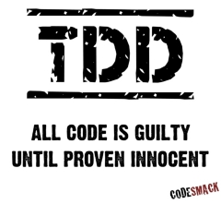

Slide 3
Test Driven Development
is the best thing I have learned as a developer
TDD has changed how I code and has helped me to produce better quality code

Slide 4
Different Types of Testing
Automated
Business Facing
Manual
Functional Tests (Virkniprófanir) | Usability and Exploratory Testing (Nytsemis og könnunar prófanir)
Unit Tests (Einingaprófanir) | Property Testing (Eiginleikaprófanir)
Support Programming (Drive/test to spec)
Critique Product ( Test to failure)
Automated
Tool-Based
Technology Facing

Slide 5
Different Types of Testing
Automated
Business Facing
Manual
Functional Tests (Virkniprófanir) | Usability and Exploratory Testing (Nytsemis og könnunar prófanir)
Unit Tests Einingaprófanir | Property Testing (Eiginleikaprófanir)
Support Programming (Drive/test to spec)
Critique Product ( Test to failure)
Automated
Tool-Based
Technology Facing

Slide 6
Unit Test
Aimed at smallest testable part of an application
Part of the source code
Run as part of build process
Run fast
Responsibility of the programmer

Slide 7
Benefits of Unit Tests
Facilitates changes
Gives the programmer more confidence to do changes.
Simplifies integration
Documentation
Show the programmer’s design intention
Always up to date (otherwise they would fail)
Loosely coupled code
Forces the programmer to write clear interfaces

Slide 8
Loose Coupling
Coupling is the degree to which each program module relies on each one of the other modules
Loose coupled code
One module interacts with another through a stable interface without concerning with the internal implementation
A change in one module will not require a change in the implementation of another module

Slide 9
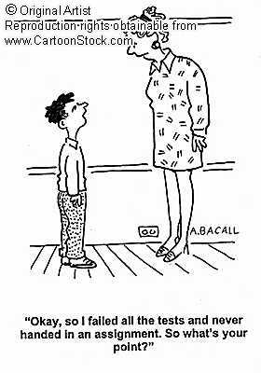
My first attempt
My first attempt to write unit test failed miserable
The code was not written with testing in mind, was not testable
Not testable, often means tight coupled

Slide 10
Two kinds of tests
Tests that find defects after they occur
Tests to prevent defects

Slide 11
Finding defects after they occur
Testing late is expensive
Context Switching
The root cause could be in the core design
You forget the details !!!!

Slide 12
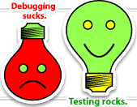
“The goal of lean software development is to prevent defects from getting into the code base in the first place, and the tool to do this is test-driven development.”
From “Lean Software Development”

Slide 13
“The act of writing a unit test is more an act of design than of verification” - Robert C. Martin

Slide 14
Test Driven Development
Is not only about Testing !!!!
Tool for develop better code
Design, coding and testing all at same time
Research show that TDD substantially reduces the incidence of defects
http://biblio.gdinwiddie.com/biblio/StudiesOfTestDrivenDevelopment

Slide 15
Classic development cycle
Design
Implement
Test

Slide 16
Test Driven Development
Design
Test
Implement

Slide 17
Test Driven Development
Design
Test
Implement
Test

Slide 18
Test Driven Development
Design
Test
Implement
Test

Slide 19
TDD Mantra
This cycle is called the TDD Mantra
Red (write test)
Green (write code)
Refactor
Repeat
Red
Green
Refactor
Repeat

Slide 20
TDD Mantra, details
First, write list of tests
Write failing test
Compile
Run test – red
Implement code – green
Refactor
Run all tests
Pick a test from the list

Slide 21
TDD how to start
Find tool (xUnit) for your programming language
Write all new code using TDD
Use helper classes
Mock/stub fake etc.
Use best practices
Inversion of Control (IoC), Dependency Injection
Test
Takes time to be an expert BUT easy to start

Slide 22
“Test driven development is the only realistic way to write good unit tests”
- Hannes
“Fewer defects, less debugging, more confidence, better design, and higher productivity in my programming practice”
- Kent Beck

