Slide 1
Twitter API
Calvin
09.21.2015

Slide 2
OUTLINES
API
Twitter API
Search API
Streaming API
Twitter API in HDMA Apps

Slide 3
api

Slide 4
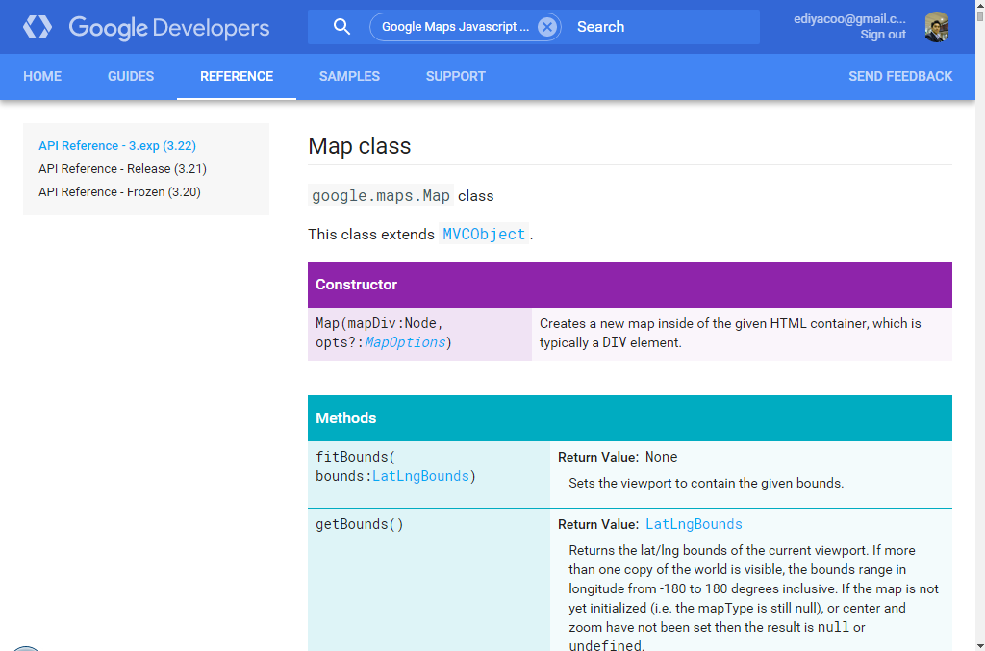

Slide 5
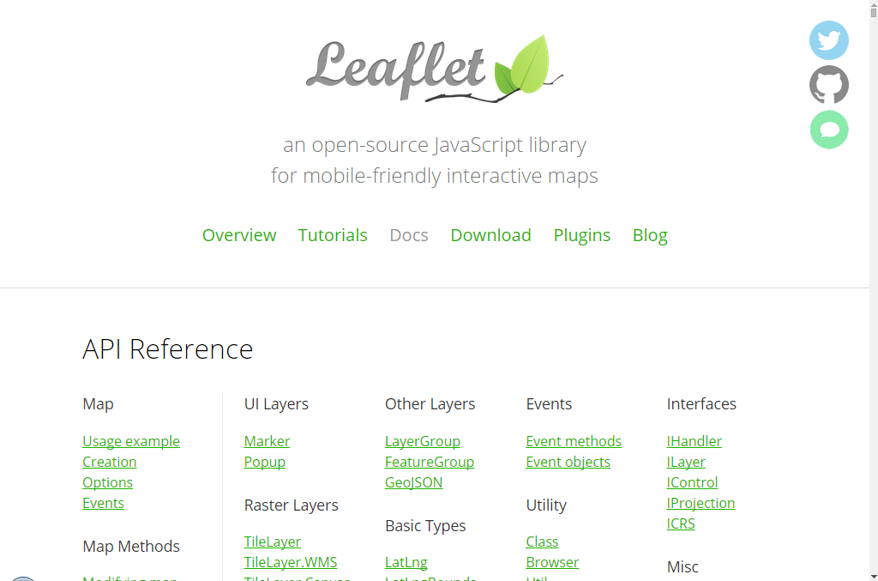

Slide 6


Slide 7
API
API (Application Programming Interface):
API is a set of tools and protocols for building software applications.
can be designed for
different languages (e.g. JavaScript, Python)
different protocol (e.g. SOAP, RESTful)
Easy to mashup if APIs are in the same language
jQuery + Leaflet API + Google Maps + D3

Slide 8
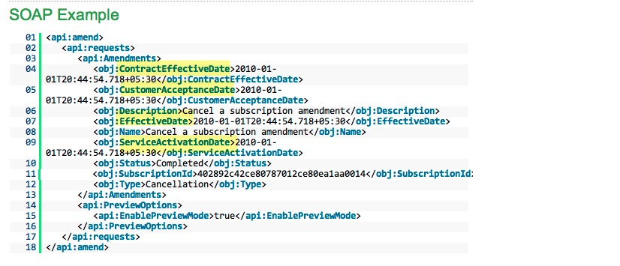
SOAP: Simple Object Architecture Protocol

Slide 9
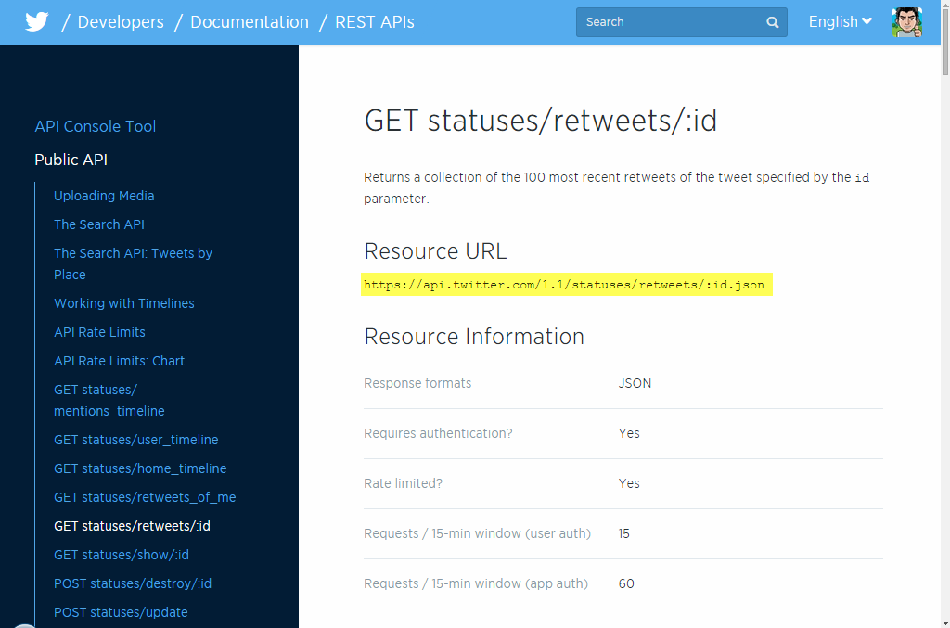
REST: REpresentational State Transfer

Slide 10
Twitter api

Slide 11
TWITTER API
Type | RESTful API | Streaming API
Feature | Read and write Twitter Data Author a new Tweet or Retweet Read User profile and follower data | Real-time Twitter Data
Query / Filter | Keyword / Geolocation / Time / Language | Keyword / Geolocation / User
Output Format | JSON | JSON
Historical data | Past 7 days | no
OAuth | Every request | Every request
Limit | 180 requests/queries per 15 minutes | 400 track keywords, 5,000 follow userids and 25 0.1-360 degree location boxes.

Slide 12
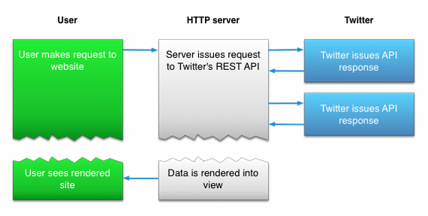
TWITTER SEARCH API

Slide 13
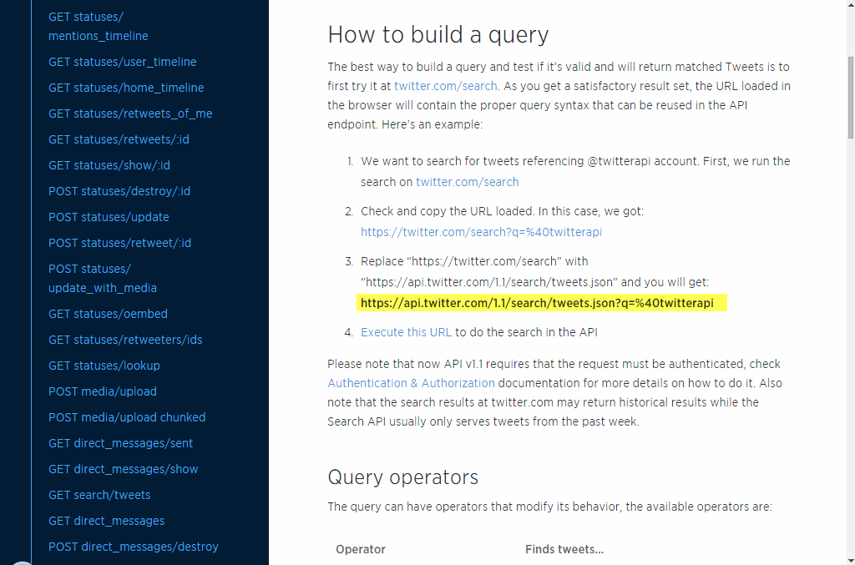
TWITTER SEARCH API

Slide 14
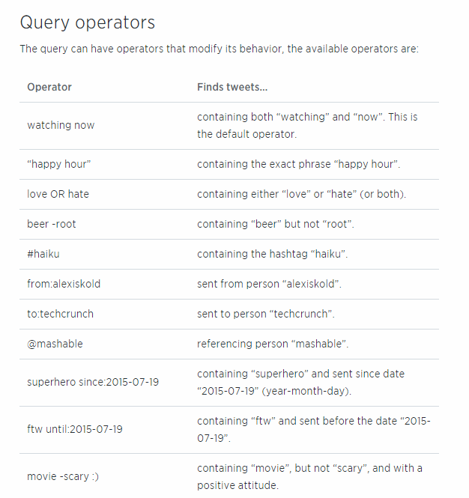
TWITTER SEARCH API

Slide 15
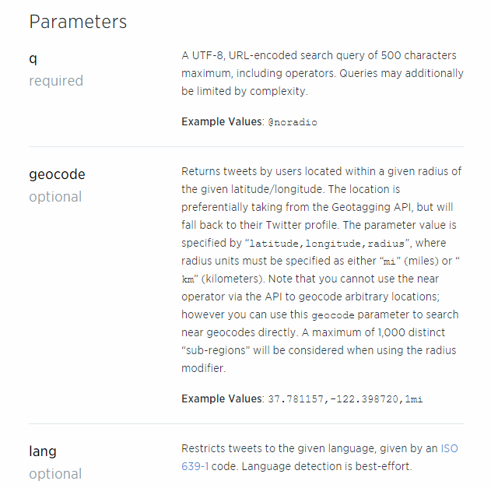
TWITTER SEARCH API

Slide 16
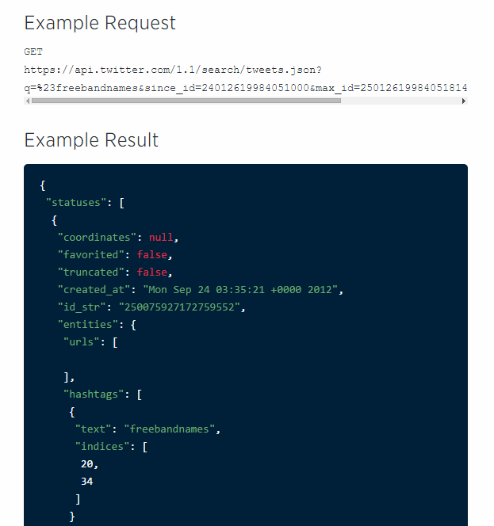
TWITTER SEARCH API

Slide 17
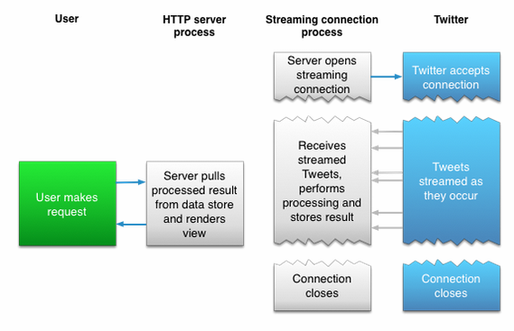
TWITTER STREAMING API

Slide 18
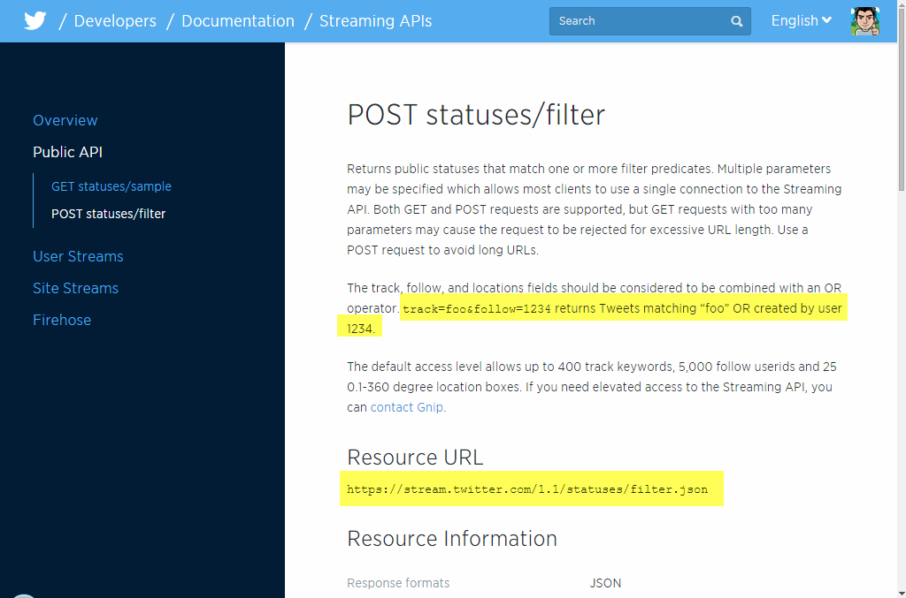
TWITTER STREAMING API

Slide 19
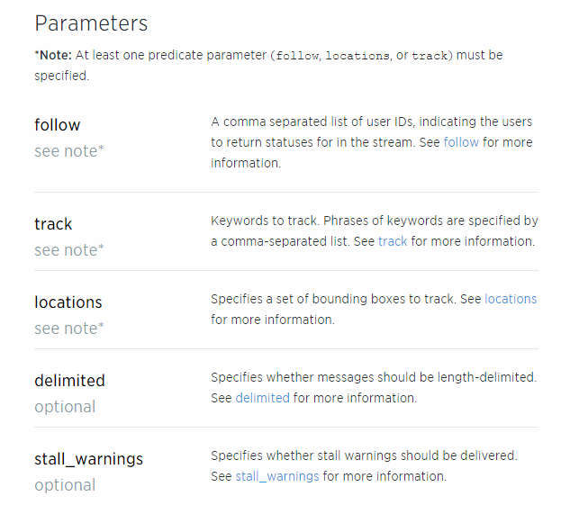
TWITTER STREAMING API

Slide 20
Twitter api IN hdma apps

Slide 21
HDMA Apps
SMART
Twitter Search API
Tweepy Python Library
Twitter Streaming API
NodeJS Twit module
Volunteer Mobile App
Twitter Streaming API
NodeJS Twit module
GeoViewer
Start searching at 2am

Slide 22
QUESTIONS?

