Slide 1
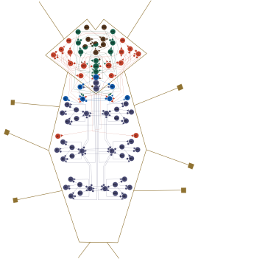
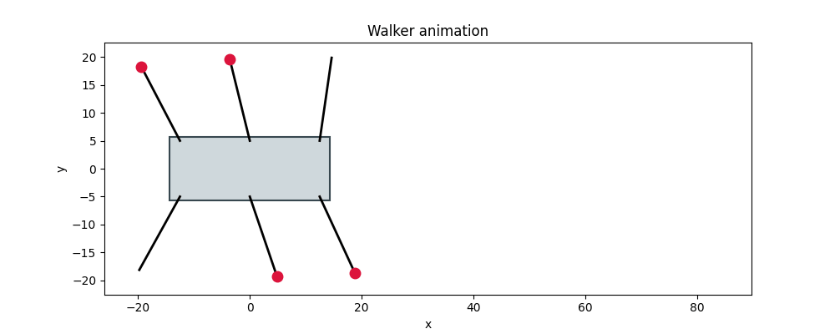
Six-Legged Walker: Brains with Their Own Rhythm
ECE497 Evolutionary Robotics ·
(Optional idea for a Project)

Slide 2
Every brain so far has been a function
Projects 3–4
Project 5
Optional Project
Feedforward network
Feedforward + a clock
CTRNN
Output depends only on the current input
No memory: same input, same output
Rhythm handed in from outside, as sin and cos inputs
The brain only shapes it
Internal state that changes in time
Makes its own rhythm, even with no input
Walking is rhythmic. Insects walk using central pattern generators: circuits of neurons that produce a rhythm on their own. Can evolution build one?

Slide 3
The task: make six legs walk
Six legs; each one swings forward and back, and puts its foot down or lifts it
A planted foot pushes the body; a lifted one swings back into place
The body only moves while the planted feet hold it up: a stable tripod
Fitness: average forward speed
Nobody tells it how to walk. Evolution has to find a leg-timing pattern, and a brain that produces it
An evolved CTRNN walking, seen from above, head to the right. Red dots: feet down.

Slide 4
The CTRNN
A neural network that is a dynamical system
1
3
2

Slide 5
One neuron, one equation
τ_{i} dy_{i}/dt = −y_{i} + Σ_{j} w_{ji} o_{j} + I_{i} o_{i} = σ(y_{i} + θ_{i})
y
state
τ
time constant
−y
leak
The neuron's internal activity. This is what carries over from one moment to the next.
How fast the state responds. Bigger τ, slower neuron.
With no input, the state decays back toward 0.
Σ w o
recurrent input
θ
bias
o = σ(·)
output
Weighted outputs of every neuron, including itself. w can be + or −.
Shifts where the neuron turns on.
Sigmoid of state + bias: always between 0 and 1. I is an external input, e.g. a sensor.

Slide 6
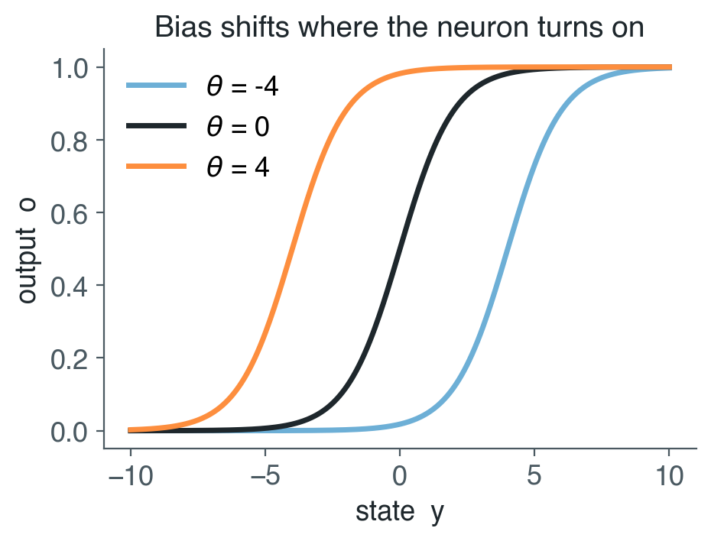
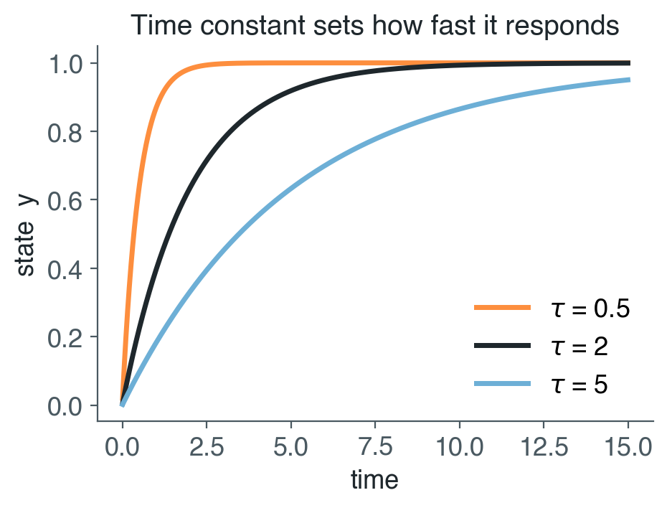
What the bias and the time constant do
θ moves the sigmoid left or right: a neuron with a large bias is on almost no matter what, a very negative one is off.
τ sets the speed: the same input, switched on at t = 0, reaches the same value, sooner or later.

Slide 7
Neurons talk to each other, in loops
Any neuron can connect to any other, and to itself
Feedforward: activity flows one way, through each layer once. Same input, same output.
Recurrent: activity keeps circulating. What the network does now depends on what it was doing a moment ago.
That's what lets it remember, and make its own rhythm.
1
3
2
In the code
Weights[j][i] = connection from neuron j to neuron i
Input to every neuron at once:
Weights.T @ Outputs

Slide 8
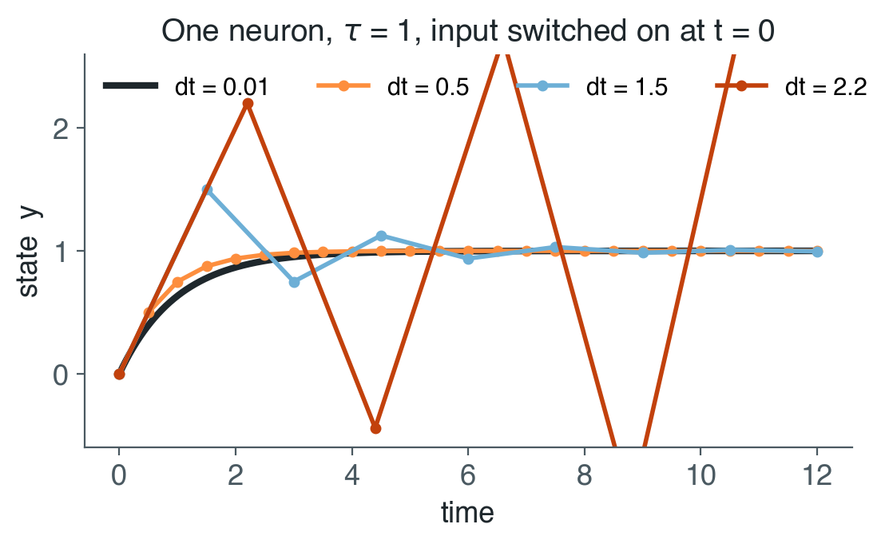
Simulating it: tiny steps forward in time
def step(self, dt):
netinput = self.Inputs + np.dot(self.Weights.T, self.Outputs)
self.States += dt * (self.invTimeConstants
* (-self.States + netinput))
self.Outputs = sigmoid(self.States + self.Biases)
Euler integration: y ← y + dt · dy/dt
Compute how fast every state is changing right now, take a small step in that direction, repeat
dt must be small compared to the smallest τ. Too big, and the simulation is wrong; bigger still (dt > 2τ) and it blows up
Unit 6: τ ≥ 0.1, dt = 0.01. Project 6: τ ≥ 1, dt = 0.1
The exact answer rises smoothly to 1. With bigger steps it overshoots; at dt = 2.2 it diverges.

Slide 9
Unit 6: a CTRNN in 60 lines of NumPy
import ctrnn
nn = ctrnn.CTRNN(3) # 3 neurons
nn.randomizeParameters() # random w, θ, τ
nn.setCenterCrossing() # optional (later)
nn.initializeState(np.random.uniform(-1, 1, 3))
for t in range(steps):
nn.step(dt)
outputs[t] = nn.Outputs
ctrnn.py
The network: states, weights, biases, time constants, step(dt)
sim.py
Simulate one circuit; plot each neuron over time, and neuron 1 vs. neuron 2
exp.py
Simulate hundreds of circuits; count how many oscillate
PythonBasics/Unit6: the same pieces as Project 6's controller, with nothing else attached. No body, no inputs: just the dynamics.

Slide 10
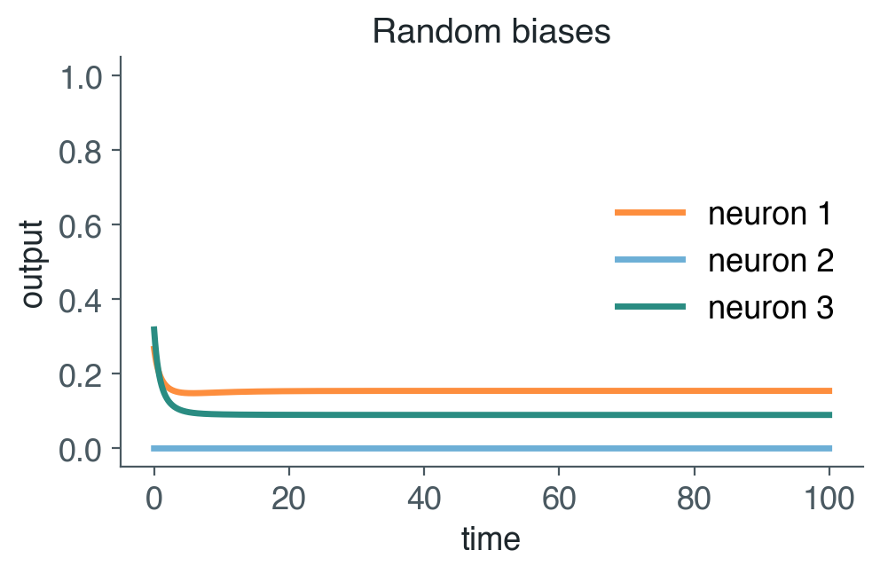
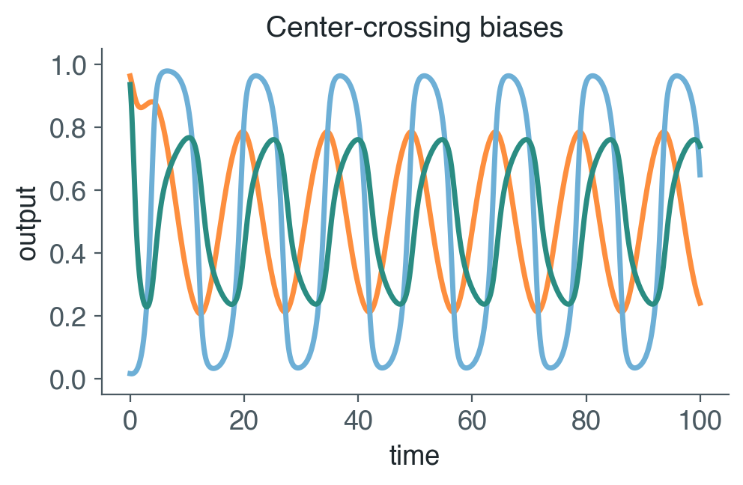
With no inputs at all, a CTRNN can...
Settle down
Oscillate
All activity dies into a fixed point and stays there. The most common outcome for a random circuit.
Activity repeats forever, with its own period: a rhythm nobody put in from outside.
They can also switch between several resting states, or behave chaotically. Which you get depends on the parameters, and sometimes on where you start.

Slide 11
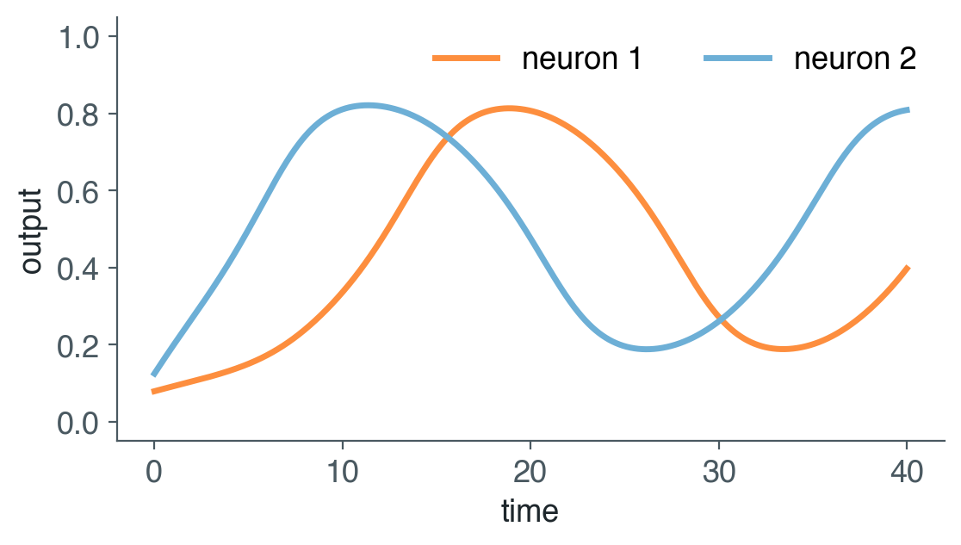
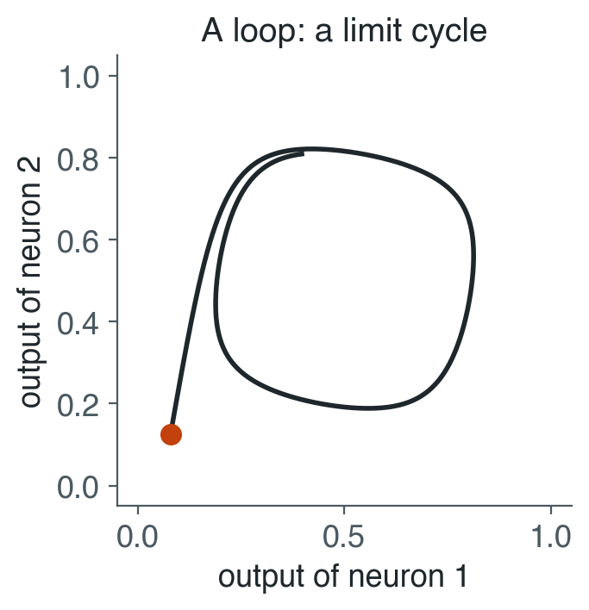
A two-neuron oscillator
2 turns 1 on; 1 turns 2 off; 2 off lets 1 fall; 1 off lets 2 rise... Each neuron excites itself (+4.5), so it tends to stay on or off; the cross connections keep pushing them over the edge. In output space the trajectory ends in a loop: a limit cycle.
−1
1
2
+1
sim.py with circuit = "oscillator" (θ = −2.75, −1.75; τ = 1)

Slide 12
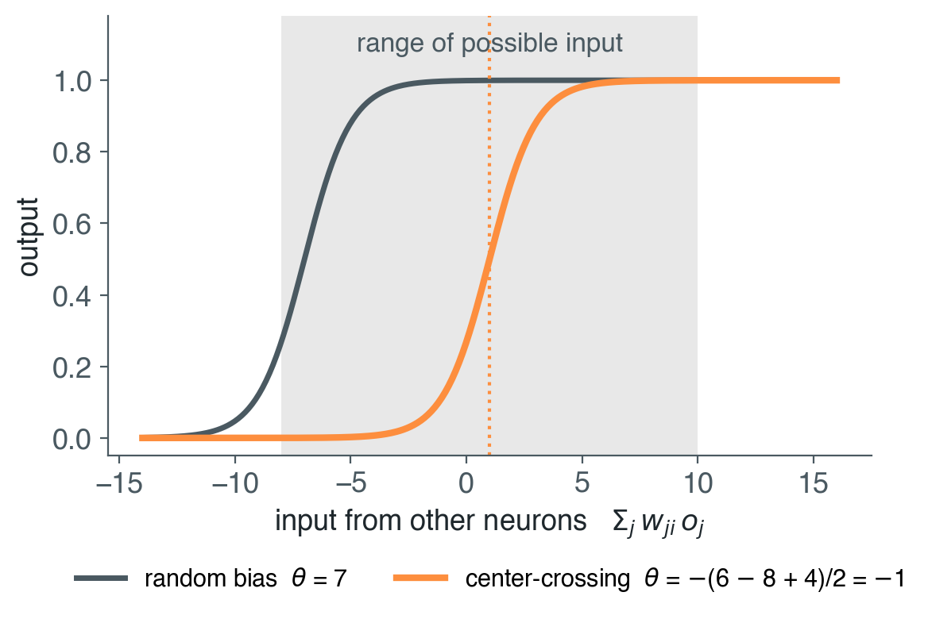
Center-crossing: put every neuron where it's sensitive
Random weights and biases push most neurons fully on or fully off. A saturated neuron ignores its inputs, so activity freezes
A neuron's input from the others always lies between the sum of its negative weights and the sum of its positive ones
Center-crossing: set each bias so the middle of that range lands on the steepest part of the sigmoid
θ_{i} = −Σ_{j} w_{ji} / 2
nn.setCenterCrossing() Mathayomchan & Beer (2002)

Slide 13
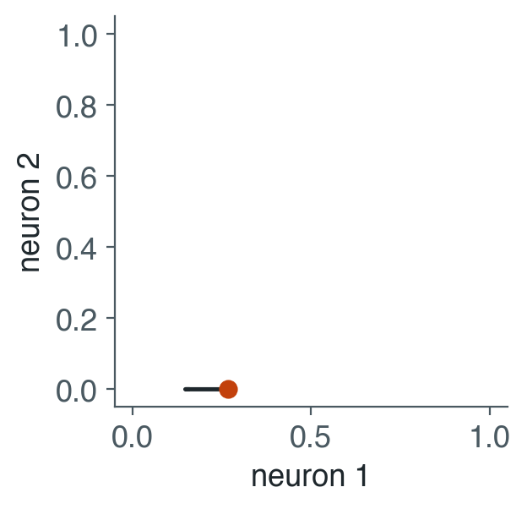
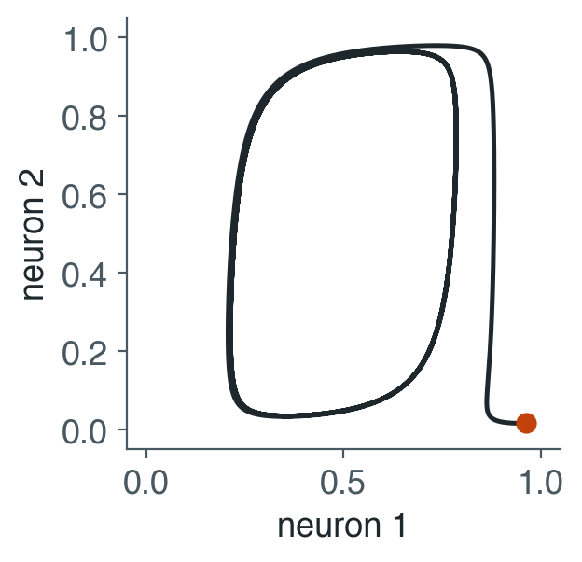
Same weights and time constants, different biases
# sim.py
size = 3
seed = 3
circuit = "random"
# or "centercrossing"
Same seed: same weights and time constants, only the biases change
Random: neuron 2 is pinned at 0, the others freeze within a few time units
Center-crossing: all three neurons cycle, forever

Slide 14
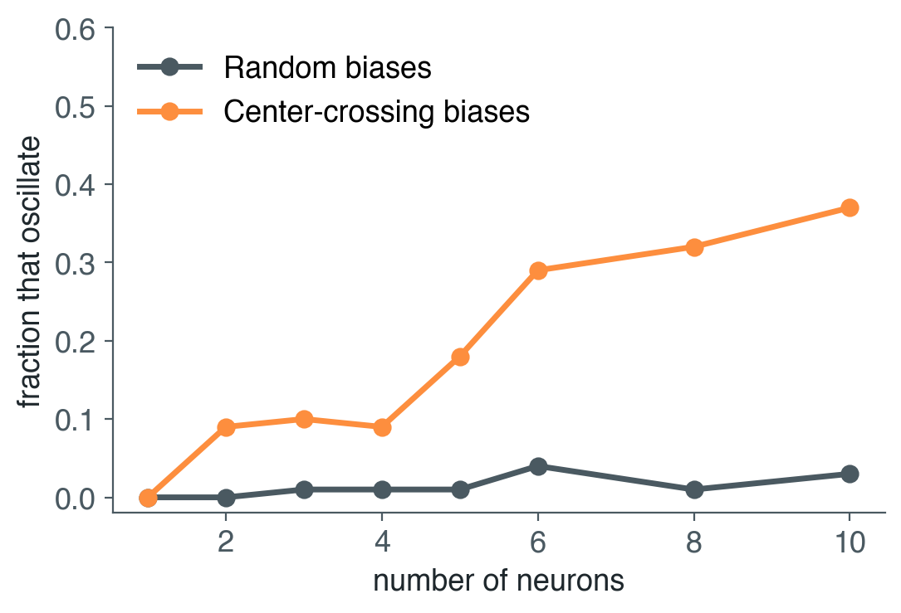
How common is rhythm?
exp.py
100 random circuits per size, each with random and with center-crossing biases
Throw away the first 100 time units; count it as rhythmic if a neuron keeps swinging (2+ full cycles)
Random: 0–4%. Center-crossing: up to 37%, and more with more neurons
Why does one neuron never oscillate?
About 1 minute. Change sizes, samples, or the parameter ranges, and run it again.

Slide 15
Try it: Unit 6
# sim.py: change these, run it again
size = 3
duration = 100.0
dt = 0.01
circuit = "random"
seed = None
Seed 3: random vs. center-crossing, same weights
Oscillator: what changes if you flip the sign of one cross connection?
dt: make it bigger until the plots change. When, and why?
Size: what do 10 center-crossing neurons do?
Duration: some circuits take a long time to settle. How long is long enough?
Output space: a point, a loop, or a tangle?
python3 sim.py
python3 exp.py

Slide 16
From Unit 6 to the walker
L3
L2
L1
Same equations, now wired to a body
R3
R2
R1

Slide 17
The walker body
Top-down; head to the right. Orange: foot down (L1, R2, L3: a tripod)
Senses: each leg's angle (6 numbers)
Acts: forward, backward, and foot for each leg (18 numbers in [0, 1])
foot > 0.5: planted. A planted leg pushes the body; a lifted leg swings
Balance: the body moves only while the planted feet hold it up: 3 or more, on both sides, around its center
Fitness: average forward speed, at most 1.0
L3
L2
L1
R3
R2
R1

Slide 18
Things to know about the simulator
0.1 s
220 s
3
1.0
per tick. One CTRNN step per tick of the body (dt = 0.1)
per episode: 2,200 ticks, each from random starting leg angles
episodes averaged for every fitness evaluation
maximum speed. Fitness near 0: the body never got off the ground
Setup: a fresh virtual environment, then pip install -r requirements.txt
NumPy, Matplotlib, PyTorch, EvoTorch; plus Gymnasium and MuJoCo for the optional part. No special Python version this time.
The physics is idealized: no mass, friction or contact forces. That's what makes it fast, and what the optional MuJoCo part is about.

Slide 19
Same CTRNN, wired to a body
Unit 6
Project 6
CTRNN.step(dt)
WalkerCTRNNController.act(observation)
netinput = Inputs + W.T @ Outputs
States += dt/τ * (-States + netinput)
Outputs = sigmoid(States + Biases)
inputs = WS * angle[leg] # sensors in
netinput = inputs + W.T @ Outputs
States += dt/τ * (-States + netinput)
Outputs = sigmoid(States + Biases)
return Outputs[command_idx] # 18 actions out
18 command neurons: forward, backward, and foot for each leg. Their outputs are the actions
Sensors: each command neuron hears its own leg's angle, through an evolved weight WS
The genome: numbers in [0, 1], decoded to weights and biases in [−16, 16] and time constants in [1, 20]
reset_state() randomizes the states at the start of every episode; act() is one Euler step

Slide 20
One leg circuit, copied six times
Every leg runs the same 3-neuron circuit (same weights): like an insect's segmental ganglia
A few connections between neighboring legs, also shared
24 genes build an 18-neuron network
L3
L2
L1
Genome (module size 3)
W
WS
CBW
ISW
τ
θ
R3
R2
R1
--module_size adds free interneurons to every leg's circuit
■ across the body (CBW) ■ along each side (ISW) ● fwd, bwd ● foot

Slide 21
Or one big network: choosing a topology
--topology | Settings | Neurons | Genome | Weight sharing
modular | --module_size 3 (default) | 18 | 24 | yes
modular | --module_size 5 | 30 | 50 | yes
modular | --module_size 8 | 48 | 104 | yes
fully_connected | --interneurons 0 | 18 | 378 | no
fully_connected | --interneurons 6 | 24 | 642 | no
Fully connected: every connection is its own gene. Nothing is assumed about legs or symmetry, and the genome is 16× bigger
Bigger isn't free: more genes, same budget of evaluations

Slide 22
Where does the rhythm come from?
--mode cpg
--mode rpg
--mode mpg
Central pattern generator
Reflexive pattern generator
Mixed
brain
body
brain
body
brain
body
Sensors off. The rhythm has to come from the circuit alone.
Sensors on (default). The rhythm can come from the circuit, the body, or both.
Episodes alternate between sensors off and on. Fitness is the average: it has to walk either way.
Beer & Gallagher (1992). Try a walker in the mode it wasn't evolved in: sim.py --mode cpg

Slide 23
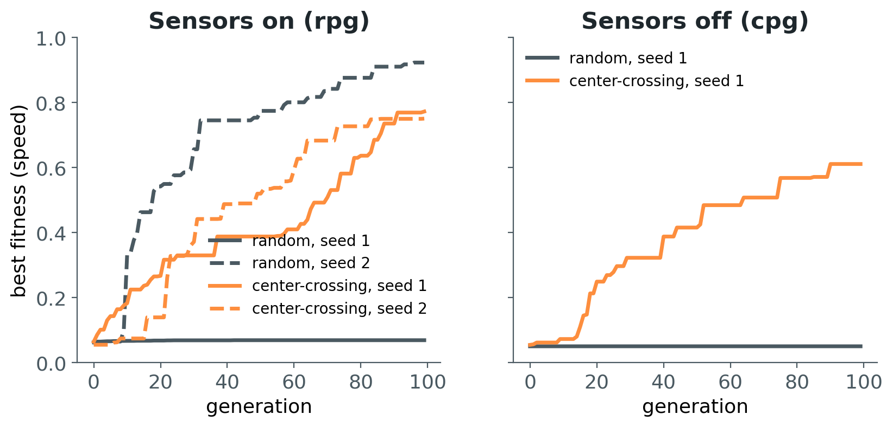
Center-crossing, in the walker
--center_crossing seeds the first generation with center-crossing biases (including the sensory and inter-leg weights)
Only the starting population: evolution can move the biases anywhere afterward
Center-crossing walked in 3 of 3 runs. Random biases got stuck skating in 2 of 3
But the fastest walker of all (0.92) came from random biases
Three runs is an anecdote, not an answer. How would you find out?

Slide 24
Evolving it
Running, watching, and reading what evolution built

Slide 25
Running it
# evolve a CTRNN (about 3 minutes on a 16-core laptop)
python evolve.py --controller ctrnn --center_crossing --seed 1 --verbose --vizperf \
--output walker.npy --fitness_output walker_fit.npz
# score it; then again with its sensors cut
python sim.py --controller ctrnn --genome walker.npy --scores
python sim.py --controller ctrnn --genome walker.npy --mode cpg --scores
# gait diagram, neuron outputs, and an animation
python sim.py --controller ctrnn --genome walker.npy --trace walk.dat
python visualize_walker.py walk.dat --out_prefix walk --topology modular --module_size 3
Pass sim.py the same controller settings you evolved with. --algorithm es swaps the GA for CMA-ES.
Save --output and --fitness_output for every run you might want to plot later.

Slide 26
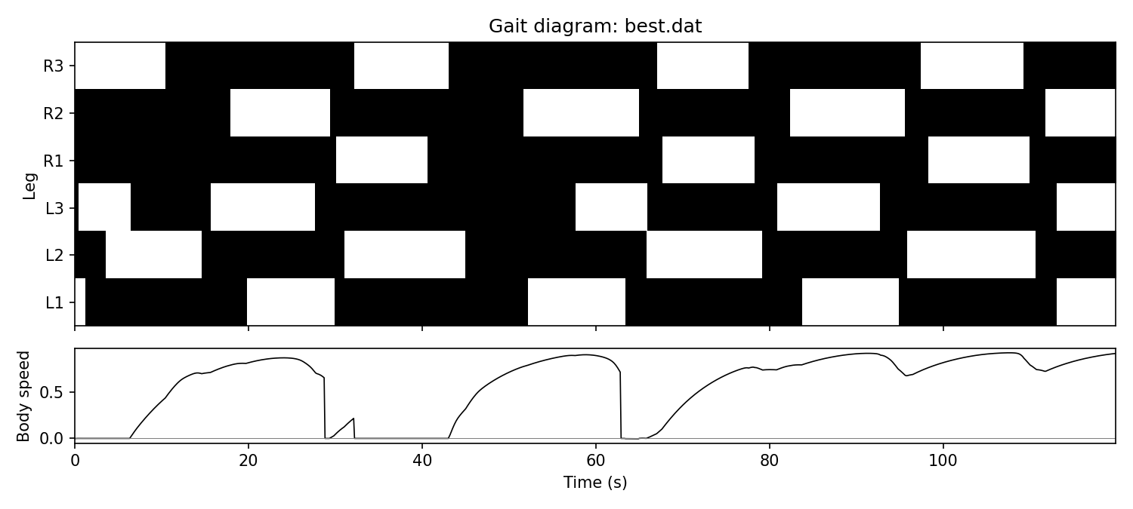
Reading a gait diagram
One row per leg. Black: foot down. White: swinging
Bottom: body speed. It drops to 0 whenever the planted feet stop holding it up
Look for the pattern: one or two legs lifted at a time, in a repeating order: a slow wave-like gait, not a tripod. It stumbles twice before it settles in

Slide 27
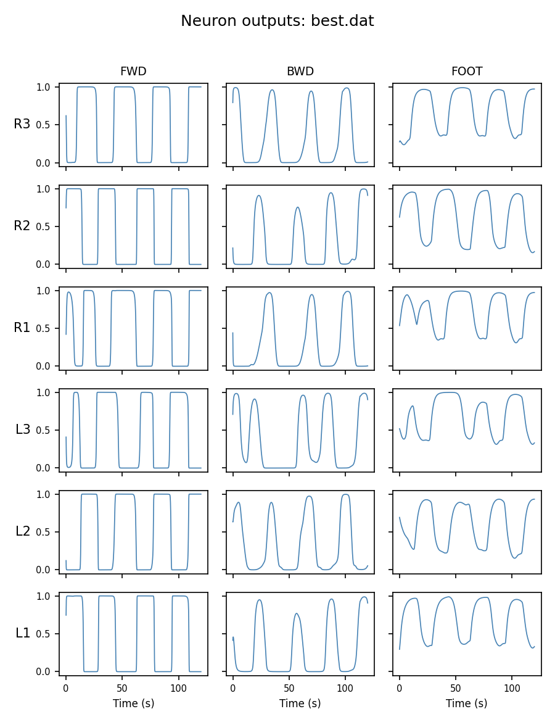
Inside the circuit
Every neuron's output over time, one row per leg: forward, backward, foot
Which neurons oscillate? Which just follow along?
Same circuit on every leg, but different timing: where do the phase differences come from?
Cut the sensors, remove a neuron, freeze an output: what breaks?

Slide 28
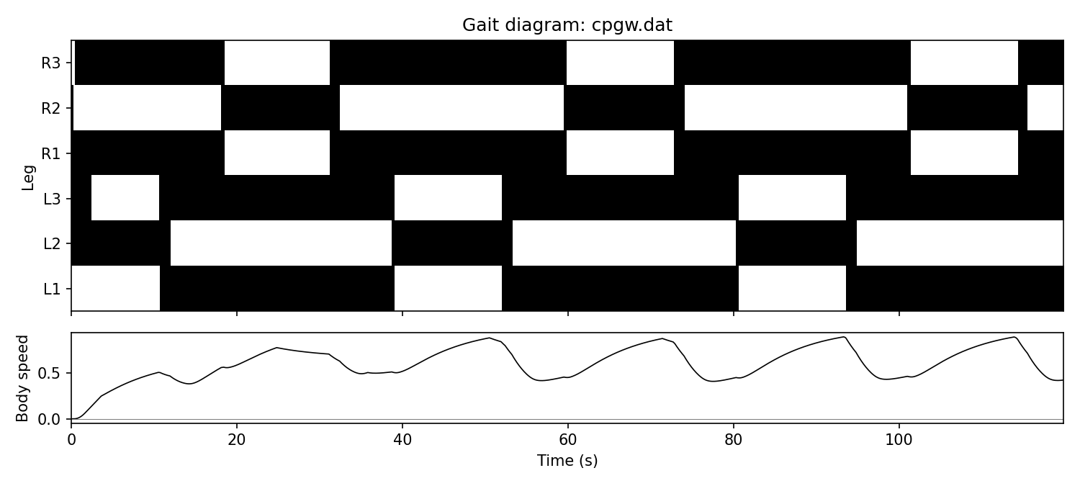
Two walkers, two sources of rhythm
Evolved in | Sensors on | Sensors off
rpg | 0.77 | 0.04
cpg | 0.03 | 0.61
Average speed, 5 episodes, run under each condition
Each walker only works the way it evolved
The rpg walker needs its sensors: its rhythm runs through the body
The cpg walker makes its own rhythm, and live sensory input throws it off
Could one walker do both? --mode mpg
The walker evolved with its sensors off (cpg, center-crossing): a steady rhythm, never stalls

Slide 29
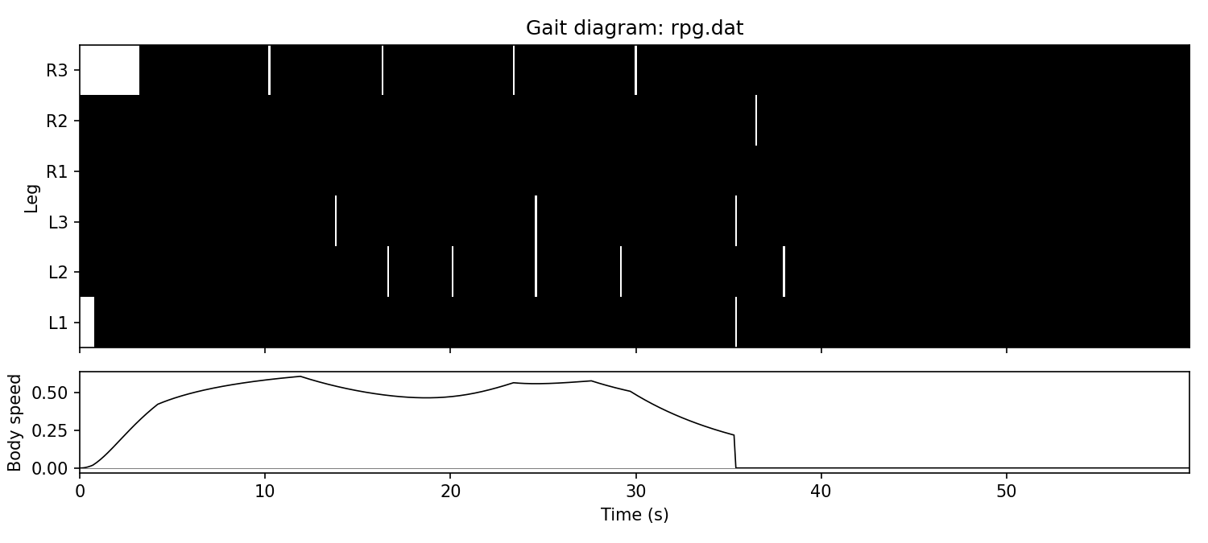
Watch out: walking vs. skating
Fitness 0.07, and it plateaued there
All six feet down, pushing: the body glides forward
Until the feet are dragged too far behind, and it's stuck for good
Easy to find, better than standing still, a dead end
A fitness number tells you how far, not how. Look at the gait.

Slide 30
How long it takes
3 min
15,000
0
per run on a 16-core laptop (50 genomes × 100 generations)
episodes per run: 50 × 100 × 3, each 2,200 ticks of physics
GPUs needed: the cost is the physics loop, spread across CPU cores
Time a short run on your own machine first: --popsize 20 --gens 20
Fewer cores, proportionally longer. Start early, and let runs work while you analyze others
Evolution is stochastic: one run is an anecdote. Use --seed, and several seeds before you trust a conclusion

Slide 31
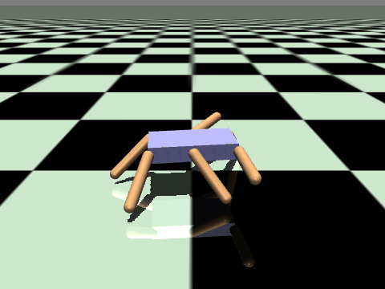
Optional: real physics
Does a walker evolved here walk in MuJoCo?

Slide 32
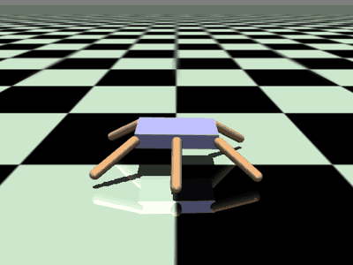
Same genome, more realistic physics
 | walker.py | hexapod (MuJoCo)
Physics | idealized | mass, friction, contact
Senses | 6 leg angles | 35 values
Acts | 18 values in [0, 1] | 12 torques: sweep, lift
Time step | 0.1 s | 0.05 s
hexapod_bridge.py: sweep torque = forward − backward; foot sets a target lift angle
--timescale (CTRNN speed vs. body) and --lift_gain matter, and interact
Expect it to fail at first. That gap is the challenge
The walker from the previous slides, on the MuJoCo hexapod: it stays upright, but moves only about 1.2 units in 50 s.

Slide 33
The assignment
how much is up to you
The most open-ended project yet
P1
P2
P3
P4
P5
P6

Slide 34
Two required parts, one optional
Required 1
Required 2
Optional · +1 extra credit
Evolve a CTRNN that walks
An experiment of your own
Walk in MuJoCo
Transfer a walker to the realistic body
Close the gap any way you like
A careful attempt counts, even if it never walks
Really walks: stepping, not skating
Show it: fitness, gait diagram, animation
Explain how it walks: what are the neurons doing? Where does the rhythm come from?
Ask a question about this world
Predict, vary one thing, enough seeds
What did you learn?
Any settings, any topology, any mode. Say what you chose, and why.
Checkpoint: TBA (Part 1, demo) Report due: TBA Presentations: TBA

Slide 35
Ideas for your experiment
A
B
C
D
E
Where's the rhythm?
Inside the circuit
Center-crossing
Structure
Time
cpg vs. rpg vs. mpg. Cut a walker's sensors
Lesion neurons or connections. Does one leg oscillate alone?
Faster evolution? Better walkers?
Modular vs. fully connected, module size, interneurons
What do evolved time constants do? Speed the circuit up
F
G
H
I
J
Robustness
Diversity
Fitness
Search
No memory
A broken leg, noisy sensors, a push, a longer walk
Same gait, same frequency, every seed?
Penalize effort; make skating impossible
GA vs. CMA-ES; population size; mutation
A feedforward walker: what can't it do?
Or something completely different. Details in the README.

Slide 36
Let's demo
Unit 6: one circuit, seed 3, random vs. center-crossing.
Then: evolve a walker, and watch it.

