Slide 1
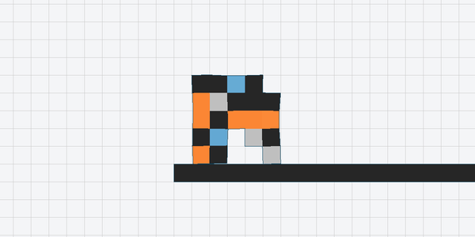
Soft Robots: Evolving Bodies, Not Just Brains
ECE497 Evolutionary Robotics · Project 5
Peer-review tomorrow Tuesday Oct 13 (10mins)
Select advanced topic lecture Thurs Oct 15 (10mins in class too)
Checkpoint Fri Oct 16 (10mins in class)
Reading & Discussion Fri Oct 16 (rest of class)
Report and presentations Mon Oct 19 (all class)
Notes:
This robot's body and brain were both designed by evolution, in about three and a half minutes on a laptop. Nobody drew this shape. By the end of the project, every one of you will have evolved creatures like this, and you'll be asking where its walking actually comes from: the brain, or the body.

Slide 2
So far, we have used evolution to only ever build brains..
Project 1
Projects 3–4
Project 5
Braitenberg vehicle
Neuroevolution
Soft robots
Brain: wired by hand
Body: designed by hand
Brain: evolved
Body: designed by hand
Brain: evolved
Body: evolved
If behavior comes from body, brain, and environment together, why keep the body fixed?
Notes:
Recap the arc. In Project 1 you designed both the brain and the body by hand. In Projects 3 and 4, evolution took over the brain, but the body was still ours. The lesson of Project 1 was that behavior emerges from body, brain, and environment together, so it's a strange choice to let evolution optimize only one of the three. In this project the body goes into the genome too. Karl Sims did this in 1994 with his Evolved Virtual Creatures; it's been an active research area ever since.

Slide 3
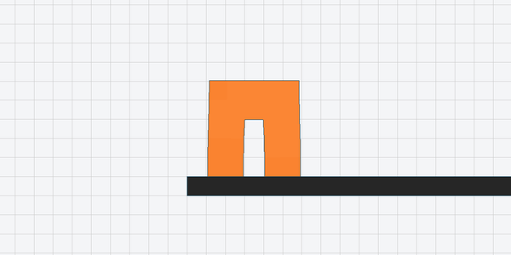
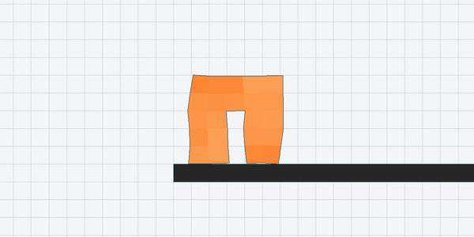
Same body, different brain
Random brain: goes nowhere (fitness 0.0)
Evolved brain: walks 70 voxels in 300 steps (fitness 7.2)
Neural controller (the brain)
The brain matters.
This project asks how much the body matters too, and what happens when evolution gets to design both.
clock +
sensing
muscles
Notes:
Both robots have exactly the same body, the biped preset. The left one has a random, unevolved brain: it twitches in place. The right one has a brain evolved for 50 generations. So the brain clearly matters. The question this project keeps returning to is the other half: how much of a good gait is really in the body? You'll answer it two ways: by designing bodies yourself, and by letting evolution design them.

Slide 4
Two problems, one pipeline
(a) Evolve the brain for a fixed body
(b) Co-design: evolve body and brain together
The body is given: one of ours, one you design by hand. Evolution searches only for the brain.
Evolution searches for a body and the brain that drives it, in a single genome.
Genome
Genome
brain
body
brain
Everything else is what you already know: a flat genome, EvoTorch's GeneticAlgorithm, evolve → simulate → analyze.
Notes:
The whole project is organized around these two problems. In (a), it's Project 4 again with a new kind of body: the body is fixed and only the brain's weights are in the genome. In (b), the genome gets a second part that describes the body. The evolutionary algorithm doesn't know or care: it still just sees a vector of numbers. What changes is how we decode that vector into a robot.

Slide 5
The soft robot platform
Evolution Gym: robots made of voxels
Notes:
First, the platform: what a soft robot is in EvoGym, how its muscles are driven, and the few facts about the simulator you need before running anything. The robot on this slide is the example body that ships with the project.

Slide 6
A robot is a grid of voxels
1 Rigid
Each voxel is point masses at its corners, joined by springs
Muscles are springs whose rest length the brain sets
Row 0 is the top; the last row rests on the ground
stiff, passive
2 Soft
squishy, passive
3 Horizontal muscle
stretches and squeezes left–right
4 Vertical muscle
stretches and squeezes up–down
0 Empty
no voxel
The task (Walker-v0): walk to the right, as far as possible.
Notes:
EvoGym is a soft-body physics simulator from MIT, used in research and published at NeurIPS 2021. A robot is a small 2D grid of voxels, each made of one of five materials. Under the hood, each voxel is four point masses at its corners connected by springs. Rigid voxels have stiff springs, soft ones compliant springs, and muscle voxels have springs whose rest length the brain controls. The colors here are the colors you'll see in every animation. The task for the whole project is Walker-v0: walk right on flat ground.

Slide 7
A robot is a grid of voxels
1 Rigid
Each voxel is point masses at its corners, joined by springs
Muscles are springs whose rest length the brain sets
Row 0 is the top; the last row rests on the ground
stiff, passive
2 Soft
squishy, passive
3 Horizontal muscle
stretches and squeezes left–right
4 Vertical muscle
stretches and squeezes up–down
0 Empty
point mass
spring
no voxel
The task (Walker-v0): walk to the right, as far as possible.

Slide 8
A muscle gets a target length every step
Horizontal muscles change width
One number per muscle, every simulation step
Always in [0.6, 1.6]: a fraction of the muscle's rest length
The brain's whole job: turn its inputs into these numbers
Walking happens only if the muscles are coordinated in time and across the body
0.6 squeeze
1.0 rest
1.6 stretch
Vertical muscles change height
0.6 squeeze
1.0 rest
1.6 stretch
Notes:
This is the robot's whole interface with its brain. Every simulation step, each muscle voxel gets one number: its target length, as a fraction of its rest length, between 0.6 (squeeze) and 1.6 (stretch). Horizontal muscles get narrower or wider; vertical ones get shorter or taller. Everything a gait is, is the pattern of these numbers over time and across the body.

Slide 9
Things to know about the simulator
300
1.0
−1
0
simulation steps per episode. The brain's clock repeats every 25 steps, so that's about 12 beats of its rhythm.
fitness = 10 voxel widths walked to the right
fitness of a body that can't be built: in pieces, or no muscles
noise: the same robot always does exactly the same thing
Setup: EvoGym needs Python 3.10 exactly (precompiled C++). Make a fresh conda env:
conda create -n evogym python=3.10
Unlike Project 4, there's no need to average episodes or re-evaluate: the fitness evolve.py reports is the fitness.
Notes:
Four numbers to remember. Episodes are 300 simulation steps. The brain gets a clock input, a sine and cosine that repeat every 25 steps, which gives it a built-in rhythm. So in one episode the robot gets about 12 cycles of that rhythm, roughly 12 chances to repeat a stride. Fitness is the distance the center of mass moves right, where 1.0 means ten voxel widths, about two body lengths. Bodies that fall apart or have no muscles can't be simulated, so they get minus one and selection removes them. And the physics is deterministic, which is a nice change from Project 4: no noisy fitness, no re-evaluation. The one setup trap: EvoGym only installs on Python 3.10, so you need a separate environment for this project.

Slide 10
Bodies
Start from one of ours, or build your own
Notes:
Next, bodies. Part 1 uses two kinds: one of the four presets we provide, and one you design yourself. This one is the tripod preset.

Slide 11
Four bodies to start from
--body biped
--body worm
--body block
--body tripod
Two legs and a torso, all horizontal muscle
A flat strip: vertical muscles over horizontal
Soft block, rigid top, muscles along the bottom
Three legs from a rigid back, mixed muscles
Preview any body with a random brain:
python sim.py --body worm --showbody --gif worm.gif
Notes:
These are the four preset bodies, all 5 by 5. Biped has two legs and is entirely horizontal muscle. Worm is a two-row strip. Block is a mostly passive soft block with muscles only along the bottom. Tripod hangs three mixed-muscle legs from a rigid back. In Part 1 you'll pick one of these and evolve a brain for it. sim.py with no genome runs a body with a random brain, which is a quick way to see what a body does before evolution touches it.

Slide 12
Or design your own body
# my_body.txt: one row per line,
# row 0 = top
1 1 1 1 1
2 3 3 3 2
2 4 0 4 2
2 4 0 4 2
3 3 0 3 3
Two rules
Connected: every voxel touches another edge to edge
At least one muscle (3 or 4)
Any size works; it doesn't have to be 5×5.
python sim.py --body my_body.txt --showbody --gif my_body.gif
Notes:
Designing a body is just writing a text file of material codes: 0 empty, 1 rigid, 2 soft, 3 horizontal muscle, 4 vertical muscle. This one is example_body.txt in the project folder; copy it and edit. There are only two rules: the body must be one connected piece, and it needs at least one muscle. Preview it with sim.py before evolving anything. Part 1 asks you to design one and compare it against a preset, so think about what you want your body to do before you draw it.

Slide 13
Brains
Four ways to drive any body, from simplest to most complex
Notes:
Now the brains. This is the part of the project that is genuinely new: brains designed so they keep working while evolution changes the body underneath them. We'll go from the simplest to the most complex.

Slide 14
The brain has to fit whatever body evolution builds
The obvious brain (Project 4 style)
Two ways around it
Input: the simulator's observation of the whole body
Output: one command per muscle
Both sizes depend on the body
Local: one small network, copied into every muscle. More muscles just means more copies.
Global: one network wired to the grid, not the body. Output k always drives cell k, whatever is in it.
Add a muscle, and the network no longer fits. It can't be co-evolved with a changing body.
Notes:
Here's the new problem co-design creates. The brain you'd naturally write, the Project 4 way, takes the whole body's observation in and gives one command per muscle out. But those sizes depend on the body. Mutate a voxel into a muscle and the network suddenly needs another output; its genome no longer fits. So it can't be evolved together with a body that keeps changing. There are two ways around this, and the project gives you both. Local: a single small network copied into every muscle. Global: one network, but wired to the grid instead of to the body.

Slide 15
Four brains, two choices
Open-loop: can't feel the body
Closed-loop: + senses strain
Local
one copy per muscle
1
clock + own position
2
+ own and neighbors' strain
49 genes on a 5×5 grid
129 genes on a 5×5 grid
Global
one network, whole body
3
clock only
4
+ every cell's strain
473 genes on a 5×5 grid
1,273 genes on a 5×5 grid
--controller local | global --loop open | closed
Notes:
Every brain in the project is a small feedforward network, and they differ along two independent choices. Rows: local, one copy per muscle, versus global, one network for the whole body. Columns: open-loop, which can't feel the body at all, versus closed-loop, which also senses how stretched the voxels are. That gives four brains, numbered here from simplest to most complex, with genome sizes from 49 to almost 1,300. All four get a shared clock as a source of rhythm. You pick one with two flags. The next four slides walk through them in order.

Slide 16
1. Local, open-loop
clock: sin, cos (2)
network
8 hidden
1 command, own muscle
own position: x, y (2)
weights + biases
in → hidden: 4×8 + 8 = 40
hidden → out: 8×1 + 1 = 9
total = 49
49
4 inputs
8 hidden
1 output
Every muscle runs the same function of time and position. Muscles only do different things because they sit in different places, so commands vary smoothly across the body.
One copy per muscle; it knows only where it is
genes on a 5×5 grid
Notes:
The simplest brain, and the one from PythonBasics Unit 5. One tiny network, copied into every muscle with identical weights. Each copy gets four numbers: the clock, sine and cosine of time, and where its muscle sits in the body, x and y scaled to 0 to 1. It outputs one command for its own muscle. That's the whole brain: 49 genes, whatever the body. Add a muscle and you just add a copy. Ask students: what can't this brain do? Two muscles right next to each other will always do nearly the same thing. Where 49 comes from: 4 inputs into 8 hidden neurons is 4×8 weights plus 8 biases, 40; 8 hidden into 1 output is 8 weights plus 1 bias, 9. Total 49.

Slide 17
2. Local, closed-loop
clock: sin, cos (2)
own position: x, y (2)
network
8 hidden
1 command, own muscle
own strain: width, height (2)
neighbors' strain: 4 × 2 (8)
weights + biases
in → hidden: 14×8 + 8 = 120
hidden → out: 8×1 + 1 = 9
total = 129
⋮
129
One copy per muscle; it sees its own voxel and four neighbors
14 inputs
8 hidden
1 output
genes on a 5×5 grid
Each muscle can now react to what its own neighborhood is doing: stretched, squeezed, pushed by the ground. Still the same weights everywhere, still any body.
Notes:
Same idea, plus sensing. Strain is how stretched a voxel is compared to rest: zero at rest, positive when stretched, negative when squeezed, separately for width and height. Each copy now also sees its own voxel's strain and that of the four voxels around it, zero where there's no voxel. So muscles can react locally: to being squashed against the ground, or pulled by a neighbor. 129 genes, still independent of the body. Same 8 hidden neurons, but now 14 inputs: 14×8 + 8 = 120, plus 8 + 1 = 9 for the output, 129.

Slide 18
3. Global, open-loop
network
16 hidden
clock: sin, cos (2)
1 command per grid cell
weights + biases
in → hidden: 2×16 + 16 = 48
hidden → out: 16×25 + 25 = 425
total = 473
⋮
⋮
473
2 inputs
16 hidden
25 outputs
Every cell has its own output weights, so neighboring muscles can do completely different things. Outputs for cells that aren't muscles are simply ignored.
One network drives every cell
genes on a 5×5 grid
Notes:
Now one network for the whole body. Its only input is the clock, and it has one output per cell of the grid: 25 on a 5 by 5 grid. Each muscle takes the output for the cell it sits in; the rest are ignored. Because it's wired to the grid rather than the body, it still fits any body on that grid. And since every cell has its own output weights, it can give every muscle its own behavior, which the local brains can't. The price is a bigger genome: 473 genes. Global networks get 16 hidden neurons. 2 inputs: 2×16 + 16 = 48. But 25 outputs, one per grid cell: 16×25 + 25 = 425. Almost all of the 473 genes are output weights.

Slide 19
4. Global, closed-loop
clock: sin, cos (2)
network
16 hidden
1 command per grid cell
every cell's strain: 25 × 2 (50)
weights + biases
in → hidden: 52×16 + 16 = 848
hidden → out: 16×25 + 25 = 425
total = 1,273
⋮
⋮
⋮
1,273
52 inputs
16 hidden
25 outputs
Sees the whole body's shape at once, and can coordinate every muscle with everything else. The most expressive brain, and by far the biggest genome to search.
One network sees every cell and drives every cell
genes on a 5×5 grid
Notes:
The most complex brain. The global network now also gets the strain of every cell in the grid, two numbers per cell, zero for empty cells: 52 inputs on a 5 by 5 grid. It sees the whole body's shape at once and can coordinate everything with everything. But it has almost 1,300 genes, and in co-design, another 125 for the body. Whether that expressiveness pays off within 50 generations is exactly the kind of question students can explore in Part 3. 52 inputs (clock plus 25 cells × 2 strains): 52×16 + 16 = 848, plus the same 425 output genes, 1,273. This is the one that grows fastest with body size.

Slide 20
Choosing a brain
Brain | Flags | Inputs | Outputs | Genes (5×5)
1. Local, open-loop | --controller local --loop open | clock + position | 1 per copy | 49
2. Local, closed-loop | --controller local --loop closed | + own and neighbors' strain | 1 per copy | 129
3. Global, open-loop | --controller global --loop open | clock | 1 per grid cell | 473
4. Global, closed-loop | --controller global --loop closed | + every cell's strain | 1 per grid cell | 1,273
All four fit any body on the grid, so all four work for a fixed body and for co-design
All four share a clock (one cycle every 25 steps, --period) as a source of rhythm
For Parts 1 and 2: pick one, or compare several, and say why
Notes:
Here's the summary to keep handy. The defaults are local and closed-loop, but for Parts 1 and 2 students can choose any brain, or compare several, as long as they justify the choice. Option B in Part 3 is a deliberate exploration of this whole grid, including what the clock is really contributing.

Slide 21
You choose the network's shape
Any of the four brains can be wider or deeper. Shown for brain 2 (local, closed-loop): 14 inputs, 1 output.
Default
Wider
Deeper
--hidden 8
--hidden 32
--hidden 8 8
⋮
⋮
⋮
⋮
14 in
8
1 out
14 in
32
1 out
14 in
8
8
1 out
129 genes
513 genes
201 genes
120 + 9 (one term per layer)
480 + 33 (one term per layer)
120 + 72 + 9 (one term per layer)
One number per hidden layer, any size: --hidden 32, --hidden 16 16. Defaults: 8 (local), 16 (global)
--activation tanh | relu | sigmoid sets the hidden layers; the output is always tanh
Bigger isn't free: more genes is a bigger space to search with the same 50 × 50 budget
Notes:
The hidden layers aren't fixed. --hidden takes one number per hidden layer, so --hidden 32 is one wider layer and --hidden 8 8 is two layers of 8. The genome is just every weight and bias, one term per layer: the wider network is 480 + 33 = 513 genes, the deeper one 120 + 72 + 9 = 201. --activation picks tanh, relu or sigmoid for the hidden layers; the output layer is always tanh. These flags are on evolve.py; the shape is saved in the .json next to the genome, so sim.py rebuilds the right network on its own. Ask students: does a bigger brain walk better, or does evolution just have more to search?

Slide 22
Evolving it
Body genes, brain genes, and how long it all takes
Notes:
Putting it together: how a body is written into a genome, how to run evolution, how long it takes, and some real results. The body on this slide was designed by evolution.

Slide 23
How a body becomes genes
Each voxel gets five genes, one per material. The largest gene wins.
A small mutation usually leaves a voxel unchanged
Only when two genes swap order does the material flip
5×5 grid: 125 body genes, then the brain's genes
horizontal muscle
empty
rigid
soft
H
V
Modes: control (fixed body) · codesign (body + brain) · morphology (body only, fixed brain)
Notes:
The body encoding is simple. Every voxel gets five genes, one per material, and becomes whichever material's gene is largest. That's an argmax, and it has a nice property: small mutations usually don't change anything, and material flips happen only when two genes swap order. So the body evolves in occasional jumps while the brain evolves smoothly. On a 5 by 5 grid that's 125 body genes, followed by the brain's genes. There's also a third mode, morphology, which evolves only the body under a fixed brain; it's one of the Part 3 options.

Slide 24
Running it
# (a) a fixed body: a preset, or your own
python evolve.py --mode control --body biped \
--controller local --loop closed --verbose --vizperf --output biped.npy
# (b) co-design on a 5x5 grid
python evolve.py --mode codesign --controller global --loop open \
--seed 1 --output codesign.npy --fitness_output codesign.npz
# watch what evolution built
python sim.py --genome codesign.npy --showbody --viztraces --gif codesign.gif
--output also saves a .json of every setting: sim.py rebuilds the robot by itself
Save --fitness_output for every run you might plot later
Notes:
The commands look like Project 4's. Two habits save a lot of time: always pass --output, which also writes a json file so sim.py can rebuild the exact robot without retyping flags; and always pass --fitness_output, so you can plot curves later without re-running evolution. The GIF from sim.py is the single most useful output: watch every robot you report on.

Slide 25
How long it takes
3.5 min
10–15 min
15 runs
per run, 16-core laptop
(50 robots × 50 generations)
per run, typical i7 laptop (e.g. a 2024 ThinkPad, plugged in); an estimate
for Parts 1 and 2: about 1 hour on 16 cores, 3–4 hours on an i7 laptop
Start early, and let runs work in the background while you analyze earlier ones
Time your own machine first, then multiply by about 25:
macOS / Linux: time python evolve.py --gens 2
Windows (PowerShell): Measure-Command { python evolve.py --gens 2 }
Use --gens 10 while getting a feel for things
Fitness curves are usually still rising at generation 50: more generations help if you have the time
Physics dominates the cost, so all four brains take about the same time
Notes:
Real numbers from test runs: a default run, 50 robots for 50 generations, takes about three and a half minutes on a 16-core laptop, about twice that on 8 cores. On a typical Intel i7 laptop, like a 2024 ThinkPad with a low-power U-series chip, expect roughly 10 to 15 minutes per run, so 3 to 4 hours for Parts 1 and 2. That's an estimate scaled from benchmarks, not a timed run; a Core Ultra H-series chip should be closer to 6 to 9 minutes. Plug the laptop in. Best advice: time two generations on your own machine and multiply by about 25. On macOS or Linux: time python evolve.py --gens 2. On Windows, in PowerShell: Measure-Command { python evolve.py --gens 2 }, and read the TotalMinutes line. Measure-Command hides the program's output, which is fine here because we only want the time. Parts 1 and 2 need 15 runs, so budget one to two hours of computer time on a fast machine, and three to four on a typical laptop. Don't leave it to the night before the checkpoint. And note that curves are generally still climbing at generation 50.

Slide 26
Evolution at work
The winner after 50 generations: about 53 voxels in 300 steps
Notes:
One real co-design run, using the simplest brain: local, open-loop. Orange is the best robot in each generation, blue the population average. Notice the jumps in the best curve: those are often body mutations, a voxel flipping material, rather than smooth changes to the brain. On the right is the final robot and its body. Nobody designed that shape.

Slide 27
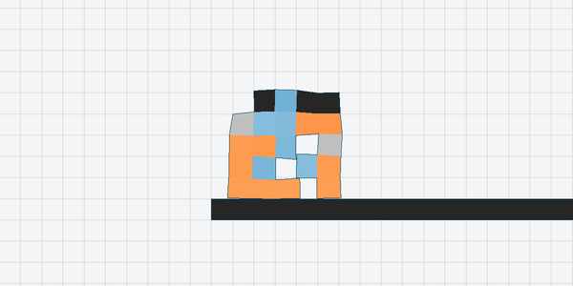
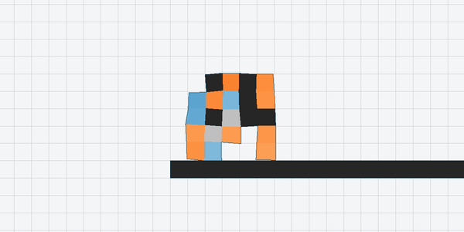
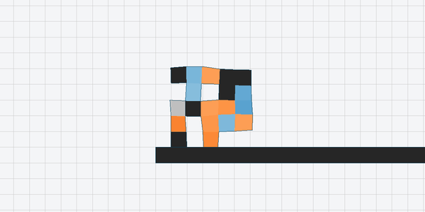
Four robots evolution designed
Brain 1
Brain 2
Brain 3
Brain 4
Notes:
Four co-design runs, one with each brain, all at default settings. Look how different the bodies are: there's no single right answer, and different brains seem to favor different bodies. Which brain does best in co-design, and why, is something we deliberately leave for students to find out. Part 2 asks them to run co-design five times and compare what comes out.

Slide 28
The assignment
Three required parts, open-ended by design
Notes:
Finally, what you have to do. You've run this kind of project several times now, so the required parts are deliberately open-ended: the choices of what to run and compare are mostly yours.

Slide 29
Three required parts
Part 1
Part 2
Part 3
A brain for a fixed body
Brain and body together
Explore one aspect in depth
Pick a preset body, and design one of your own
5 runs (seeds) each, same settings
Compare progress and behavior: why did one body do better?
Co-design, at least 5 runs
Show the progress of all five, and an animation of each final design
Compare and discuss, including against Part 1
Pick an option (next slide) or your own idea
State a question and a prediction
Enough seeds to trust the answer
Any brain, in any part. Use one throughout, or compare several, and say why.
Checkpoint: Fri Oct 16, 2 PM (Parts 1–2, demo) Report due: Mon Oct 19, 2 PM Presentations: Mon Oct 19 in class
Notes:
The required parts are deliberately open-ended. Part 1: a brain for a fixed body, comparing one of our presets against a body you design, five runs each. Part 2: co-design, at least five runs, with fitness curves and an animation of every final design. Part 3: one direction in depth. The checkpoint on Friday the 16th is a demo of Parts 1 and 2; the report is due Monday the 19th at 2, and presentations are in class that day. Since PDFs can't hold animations, the report should include frames plus a link.

Slide 30
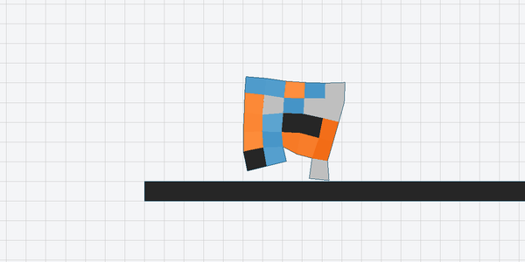
Ideas for Part 3
A
B
C
Body only
The four brains
Designer + evolution
A fixed traveling-wave brain: brain only vs. body only vs. both
Does sensing help? Does a bigger brain? What is the clock really doing?
Use what co-design found to design a better body by hand
B, a step further: no clock at all
A central network broadcasts a signal to every local copy instead. With memory, evolution found this: a robot that buzzes forward, its muscles slamming between squeeze and stretch every few steps.
D
E
F
New terrain
Material costs
Sweep a parameter
Stairs, rough ground, a soft bridge: which robots generalize?
Make muscles expensive: does evolution build passive bodies?
Grid size, clock period, or an EA parameter
Notes:
These are the Part 3 options from the README; students can also propose their own, as long as it's a genuine extension. Option B is the deepest: it's the whole grid of brains, plus the question of what the clock contributes. Its last step removes the clock entirely, replacing it with a small central network that broadcasts a signal to the local copies. When that central network has memory, evolution found a surprise: a robot that vibrates forward instead of walking, its muscles jumping between full squeeze and full stretch every few steps, with no clean rhythm. Whether that's a clever gait or a way of exploiting the simulator is a good discussion question. Encourage students to watch the animations frame by frame, because that's where results like this show up.

Slide 31
Required reading
R5A
R5B
Brains and bodies together
Soft robots made of voxels
Sims, K. (1994). Evolving Virtual Creatures. SIGGRAPH '94.
Cheney, N., MacCurdy, R., Clune, J., & Lipson, H. (2013). Unshackling Evolution. GECCO '13.
Bodies and neural controllers co-evolved in simulation: creatures that swim, walk, jump, and follow. Its genome builds the body, so the brain has to fit whatever body it builds, the same problem as this project. Watch the video too.
The closest ancestor of this project: voxel soft robots evolved to walk. Its brain is a single sine wave, so the gait comes almost entirely from the body. It also shows how much the body encoding matters.
Links are in the course reading list (Section 5), along with optional readings on morphological computation and on EvoGym itself.
Notes:
Two required readings for this project. Sims 1994 is the classic: bodies and brains co-evolved together, and the paper meets exactly the problem students face here, a brain that has to fit whatever body evolution builds. Make sure they watch the video. Cheney et al. 2013 is the closest ancestor of this project: soft robots made of voxels of stiff, soft and muscle materials, evolved to walk in simulation. Its brain is just a global sine wave, so whatever gait evolves comes almost entirely from the body, which is a good lead-in to the morphology option in Part 3. Its other point, that a generative body encoding beats a direct voxel-by-voxel one like ours, is a good discussion question.

Slide 32
Watch what evolution builds
A fitness number tells you how far, not how.
Predict before you run. Then look at the animations.
Notes:
Two habits to close on. First, write down a prediction before every experiment: that's what makes surprising results visible. Second, look at the robots. Evolution finds dragging, hopping, rolling, buzzing: gaits nobody would design, and you'll only understand your fitness curves once you've watched them.

