Slide 1
Ansible For Cisco Devices
Ed Jackson
Systems Engineer, Cisco Systems
March 2016

Slide 2
What are we trying to accomplish?
Monitor and manage Cisco devices through a programmatic method
Create re-usable actions that can be applied across a different groups or locations
What methods are available?
Scripting (API/rest, python, perl, bash, expect, etc.).
Configuration Management Tools (Ansible, Puppet, Chef, Salt)
Commercial Products (Prime, Solar Winds, etc.)

Slide 3
Why Ansible?
Agentless
Requires SSH only (and also API)
Large number of available modules to extend capabilities
Large support community
Alphabetically first.

Slide 4
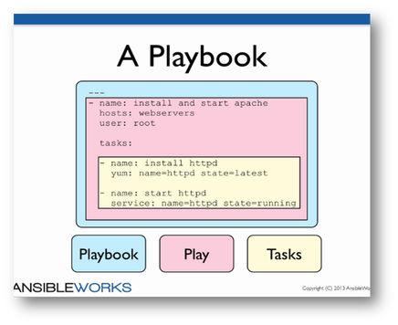
Parts of Ansible
Inventory
Connection Type
Playbooks
Plays
Modules
Templates
Roles

Slide 5
Examples
# Inventory File
[local]
localhost
[switches]
switch ansible_host=10.255.0.101
[ios]
ios-b ansible_host=10.255.0.98
ios-a ansible_host=10.255.0.99
[nxos]
nxos ansible_host=10.255.0.94
[cisco:children]
switches
ios
nxos
[switches:vars]
host_type=ios
[ios:vars]
host_type=ios
[nxos:vars]
host_type=nxos
---
# Playbook to get current timestamp from localhost
- hosts: localhost connection: local
# walk through plays for a given [group] in hosts file
- hosts: ios
gather_facts: no
connection: local
vars_files:
- secrets.yaml
- ios_command_sample_commands.yaml
tasks:
- name: Define Provider and Timestamp
set_fact:
provider:
host: "{{ hostvars[inventory_hostname].ansible_host|default(inventory_hostname) }}”
username: "{{ creds['username'] }}”
password: "{{ creds['password'] }}”
auth_pass: "{{ creds['auth_pass'] }}”
ts: "{{ hostvars['localhost'].ansible_date_time.iso8601_basic_short }}”
- name: Run Command From List In Playbook
ios_command:
provider: "{{ provider }}”
commands:
- show ip interface brief
register: output
- debug: var=output

Slide 6
Ansible Modules
Version 2.0 includes better networking support
IOS
ios_command
ios_config
ios_template
IOS-XR
iosxr_command
iosxr_config
iosxr_template
NXOS
nxos_command
nxos_config
nxos_api
nxos_template
command
copy
file
template
3rd Party modules:
https://github.com/jedelman8/aci-ansible
https://github.com/datacenter/nxos-ansible
https://github.com/joelwking/ansible-ios
https://github.com/networklore/ansible-cisco-snmp
etc...
https://docs.ansible.com/ansible/modules_by_category.html

Slide 7
On To The Demo...

Slide 8
Additional resources
https://docs.ansible.com
https://opennxos.cisco.com/public/api/ansible/
https://blogs.cisco.com/cloud/moving-to-the-devops-model-with-cisco-and-ansible
https://acidev.cisco.com/public/codeshop/ansible-aci/
http://www.packetgeek.net/2016/02/kicking-the-tires-with-the-new-ansible-network-modules/
https://pynet.twb-tech.com/
https://remote-lab.net/opsf-on-ios-with-ansible
http://jinja.pocoo.org/docs/dev/#

