Slide 1

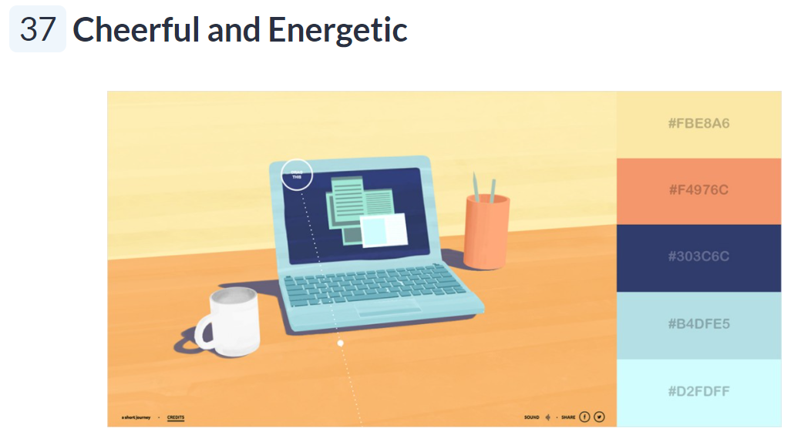
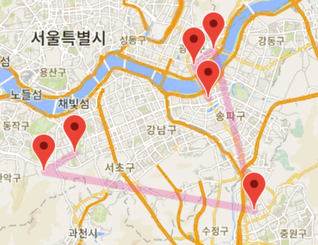


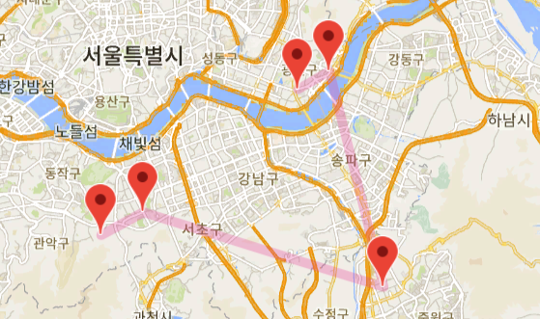
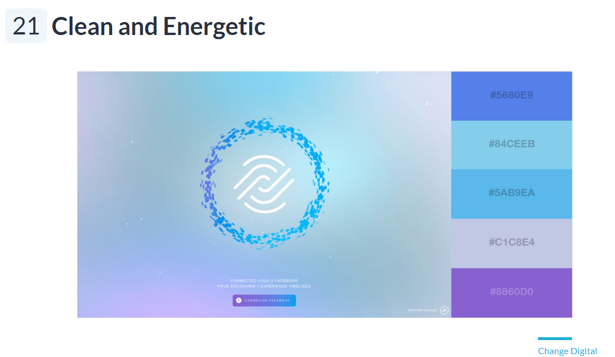

Routing
Star
Routing
Star

Slide 2





Slide 3


Slide 4

routing star
ROUTING STAR
ROUTING STAR

Slide 5


routing star
ROUTING STAR

Slide 6

ROUTING STAR
ROUTING STAR

Slide 7
ROUTING STAR

Slide 8
Routing
Routing
Star
Star
명조체

Slide 9
Routing
Routing Star
Star
Routing
Routing
Star
Star

Slide 10
Routing
Star

Slide 11
Routing
Star

Slide 12
routing star

Slide 13
ROUTING STAR

Slide 14

RS
ROUTING STAR
ROUTING STAR

Slide 15
routing star

Slide 16
ROUTING STAR

Slide 17
ROUTING STAR

Slide 18
ROUTING STAR

Slide 19
ROUTING STAR

Slide 20
routing star

Slide 21
routing star

Slide 22
Routing
Star

Slide 23
Routing
Star

Slide 24
ROUTING STAR

Slide 25
routing star

Slide 26
Routing Star

