Slide 1

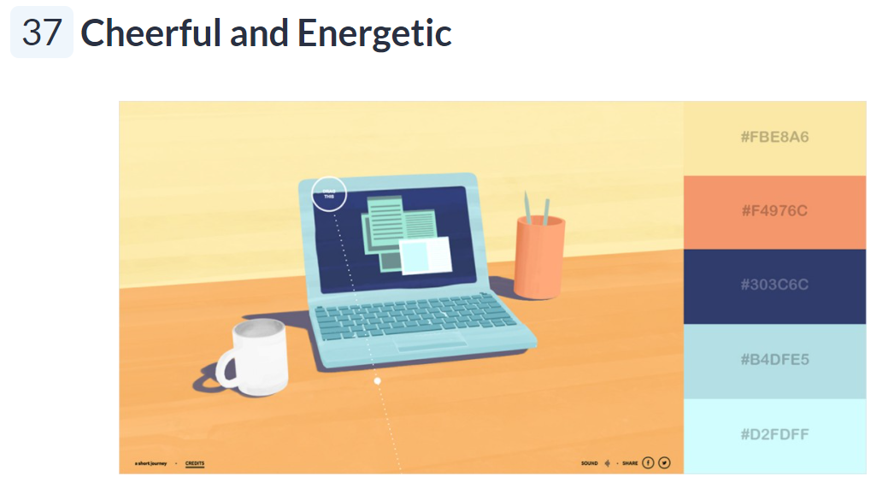
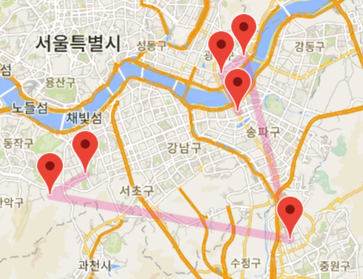


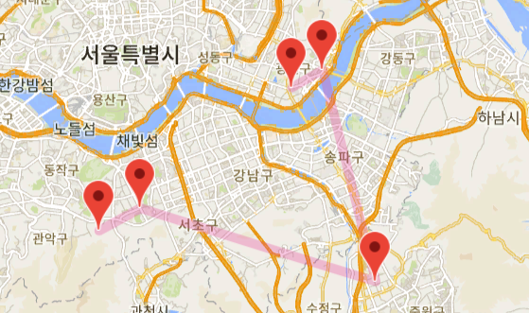
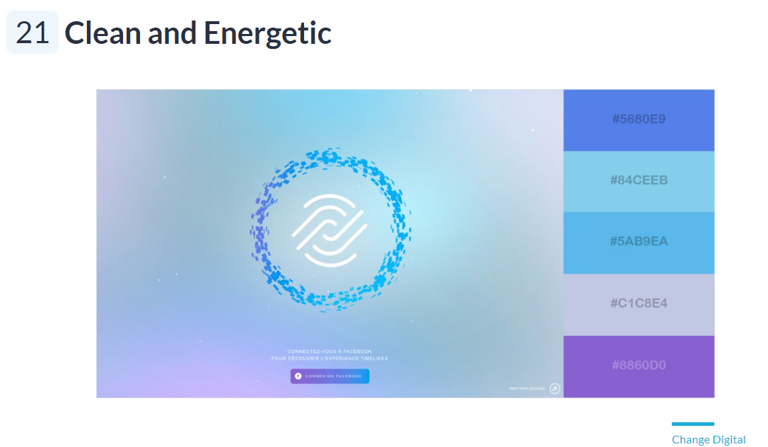

Routing
Star
Routing
Star

Slide 2





Slide 3


Slide 4

routing star
ROUTING STAR
ROUTING STAR

Slide 5


routing star
ROUTING STAR

Slide 6

ROUTING STAR
ROUTING STAR

Slide 7
ROUTING STAR

Slide 8
ROUTING STAR
ROUTING STAR
ROUTING STAR
ROUTING STAR
ROUTING STAR
ROUTING STAR
ROUTING STAR
ROUTING STAR
ROUTING STAR
ROUTING STAR
ROUTING STAR
ROUTING STAR
ROUTING STAR
ROUTING STAR

Slide 9
Routing Star

Slide 10
Routing
Routing
Star
Star
명조체

Slide 11
Routing
Routing Star
Star
Routing
Routing
Star
Star

Slide 12
Routing
Star

Slide 13
Routing
Star

Slide 14
routing star

Slide 15
ROUTING STAR

Slide 16
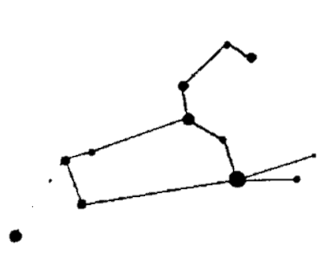
RS
ROUTING STAR
ROUTING STAR

Slide 17
routing star

Slide 18
ROUTING STAR

Slide 19
ROUTING STAR

Slide 20
ROUTING STAR

Slide 21
ROUTING STAR

Slide 22
routing star

Slide 23
routing star

Slide 24
Routing
Star

Slide 25
Routing
Star

Slide 26
ROUTING STAR

Slide 27
routing star

Slide 28
Routing Star

