Slide 1
The Hero’s Journey

Slide 2
The hero’s journey is a collection of tropes, patterns that occur in many different stories.

Slide 3
Call to adventure
Someone tells the hero that it’s time to go on a journey, or something happens and they decide to start an adventure.
Examples: Lord of the Rings: Gandalf tells Frodo that it’s time for an adventure.

Slide 4
Supernatural aid
a magical person or thing that helps the hero.
Examples: Sun Wukong’s staff, Harry Potter’s wand.

Slide 5
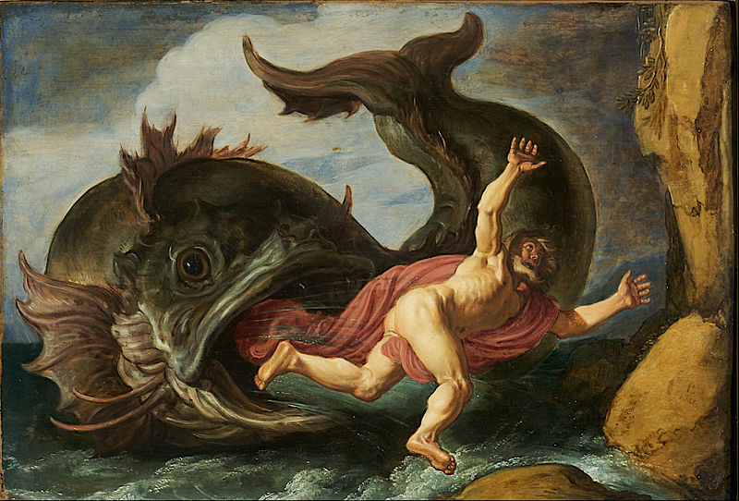
Belly of the Whale
the hero gets trapped in a difficult situation.
Examples: Jonah and the Whale (the Bible), Pinnochio

