Slide 1
Understanding Logical Fallacies

Slide 2
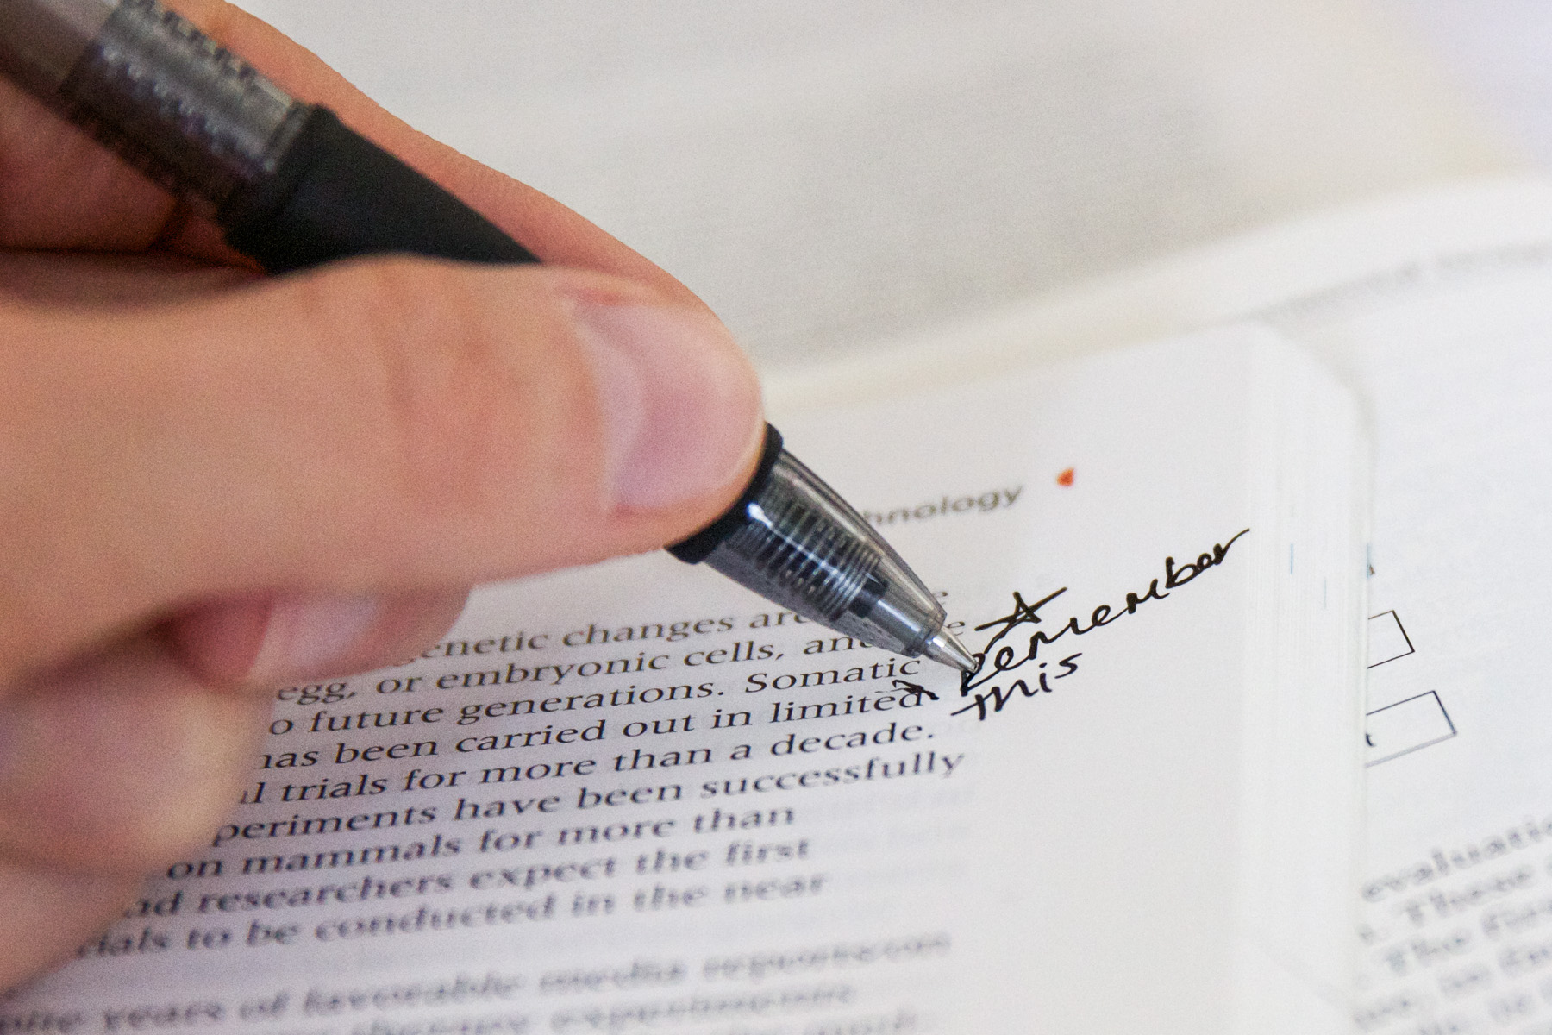
What is a fallacy?
A fallacy is an error in reasoning. Including fallacies in your writing weakens your argument.

Slide 3
Why is it important to know about logical fallacies?
If you know about fallacies and the different kinds of logical fallacies, you will be able to do two things:
You will be able to improve your own writing because you will be able to stay away from using fallacies in your arguments.
You will be able to recognize logical fallacies in other people’s writings.

Slide 4
Type of Logical Fallacies
Ad hominem
Ad populum
Begging the Question
Circular Reasoning
False Analogy
Hasty Generalizations
Non-Sequitur
Post hoc ergo propter hoc
Red Herring
Slippery Slope
Straw Man
These are just some of the many logical fallacies.

Slide 5
Ad hominem
An attack on the person, or the character of the person, rather than his or her arguments or opinions.
In Latin, ad hominem means, “against the man.”

Slide 6
Ad hominem
This is what an ad hominem can look like.
Person A makes claim X
Person B makes an attack on Person A
Therefore, A’s claim is not true

Slide 7
Ad hominem example
Michael Vick is not a good football player; he is a criminal who is cruel to animals.
Why is this an example of an ad hominem?
Claim
Supporting evidence

Slide 8
Ad hominem example
Michael Vick is not a good football player; he is a criminal who is cruel to animals.
While the claim may be true, the arguer does not support his or her claim with reason and logic. It is simply an attack on Michael Vick. Therefore, it is an ad hominem fallacy.
Claim
Supporting evidence

Slide 9
Ad populum
A fallacious argument that appeals to the popularity of the claim as a reason to accept it.
In Latin, ad populum means, “appeal to the people.”

Slide 10
Ad populum
This is what an ad populum can look like.
Person A makes claim X
Person A is popular and widely liked
Therefore, A’s claim is true because of his/her popularity.

Slide 11
Ad populum example
Most people think that Gatorade is better than Powerade, so Gatorade is the superior sports beverage.
Why is this an example of an ad populum?
Supporting evidence
Claim

Slide 12
Ad populum example
Most people think that Gatorade is better than Powerade, so Gatorade is the superior sports beverage.
While the claim may be true, all of the supporting evidence relies in its popularity, not on researched data.
Supporting evidence
Claim

Slide 13
Begging the Question
An argument that assumes that the premise of the claim is true.
This is a type of circular reasoning.

Slide 14
Begging the Question
This is what begging the question can look like.
Claim Z assumes that Z is true
Therefore, claim Z is true

Slide 15
Begging the Question example
Useless and wasteful plastic grocery bags should be banned.
Why is this an example of begging the question?
Supporting evidence
Claim

Slide 16
Begging the Question example
Useless and wasteful plastic grocery bags should be banned.
This is an example of begging the question because the person arguing the claim is assuming that the supporting evidence (that plastic grocery bags are useless and wasteful) is a valid claim in itself.
Supporting evidence
Claim

Slide 17
Circular Reasoning
A fallacious argument that restates the argument or claim rather than proving it.
The argument goes in a circle.
The arguer assumes what he or she is attempting to prove.

Slide 18
Circular Reasoning
This is what circular reasoning can look like.
Claim A is true because of claim B
B is true because of A

Slide 19
Circular Reasoning example
The president of the United States is a good leader because he is the leader of the country.
Why is this an example of circular reasoning?
Claim
Supporting evidence

Slide 20
Circular Reasoning example
The CEO of the company is a good leader because he is the CEO of the company.
This argument is an example of circular reasoning because the claim and the supporting evidence are nearly identical. The arguer simply restated the claim as the supporting evidence.
Claim
Supporting evidence

Slide 21
False Analogy
This is an argument that is based on a misleading comparison.

Slide 22
False Analogy
This is what false analogy can look like.
Item A and item B are similar
Item A likes Z
Therefore, B should like Z also

Slide 23
False Analogy example
Students should be able to use their notes and textbooks on exams because surgeons get to use X-ray and MRI images during surgery.
Why is this an example of a false analogy?
Claim
Supporting evidence

Slide 24
False Analogy example
Students should be able to use their notes and textbooks on exams because surgeons get to use X-ray and MRI images during surgery.
This is an example of false analogy because students and surgeons are not alike. During exams, students need to show what they have learned, whereas surgeons have already proven their knowledge and they are completing a task.
Claim
Supporting evidence

Slide 25
Hasty Generalizations
A conclusion, or a claim, that is based on insufficient evidence. This happens when the arguer rushes to a conclusion before having enough relevant facts.

Slide 26
Hasty Generalizations
This is what a hasty generalization can look like.
Z is true for A
Z is true for B
Z is true for C
Z is true for D
Therefore, Z must be true for E, F, G…..Y, Z

Slide 27
Hasty Generalizations example
Even though it is only the first day of school, I can already tell I’m going to hate this year.
Why is this an example of a hasty generalization?
Supporting evidence
Claim

Slide 28
Hasty Generalizations example
Even though it is only the first day of school, I can already tell I’m going to hate this year.
This argument is an example of a hasty generalization because the arguer is making a claim based on insufficient evidence. One day’s worth of evidence is not sufficient to make a claim for an entire year.
Supporting evidence
Claim

Slide 29
Non-Sequitur
This type of fallacy occurs when a conclusion does not follow from its premises.
In Latin non-sequitur means, “it does not follow.”

Slide 30
Non-Sequitur
This is what a non-sequitur can look like.
Person A makes claim 1
Person A provides support for claim 1
Therefore, claim 2 must be true

Slide 31
Non-Sequitur example
Students like to eat French fries. French fries are made from potatoes. Therefore, it is healthy to eat French fries everyday.
Why is this an example of a non-sequitur?
Supporting evidence
Claim

Slide 32
Non-Sequitur example
Students like to eat French fries. French fries are made from potatoes. Therefore, it is healthy to eat French fries everyday.
This is an example of a non-sequitur because the real claim in the argument (that it is healthy to eat French fries everyday) is not supported by any evidence or logic. The claim does not properly follow the premises of the argument.
Supporting evidence
Claim

Slide 33
Post hoc ergo propter hoc
This logical fallacy occurs when it is assumed that one thing caused another when the two events happen sequentially.
In Latin, post hoc ergo propter hoc means, “after this, therefore because of this.”
Shortened to “post hoc.”

Slide 34
Post hoc ergo propter hoc
This is what post hoc ergo propter hoc can look like.
Event A happens
Then, event B happens
Therefore, event A must have caused event B

Slide 35
Post hoc ergo propter hoc example
The stoplight always turns red right before I reach the intersection. Therefore, my car must be the reason why the stoplight always changes.
Why is this an example of post hoc?
Supporting evidence
Claim

Slide 36
Post hoc ergo propter hoc example
The stoplight always turns red right before I reach the intersection. Therefore, my car must be the reason why the stoplight always changes.
This is an example of post hoc because there are many reasons why the lights might turn red. However, my car is most likely not one of them.
Supporting evidence
Claim

Slide 37
Red Herring
This is a logical fallacy that is a diversion tactic that leads people away from the key or real issues.
To create a red herring, people will oppose arguments rather than addressing them.
Leads the reader or audience to a false conclusion.

Slide 38
Red Herring
This is what a red herring can look like.
Issue Y is being discussed
Issue Z is disguised to look relevant to Y
Issue Y is ignored/abandoned

Slide 39
Red Herring example
Energy drinks can be potentially very dangerous. However, the real danger society should be discussing is a generation of kids failing school because they are too tired to study.
Why is this an example of a red herring?
Claim
Supporting evidence

Slide 40
Red Herring example
Energy drinks can be potentially very dangerous. However, how else are students supposed to have enough energy to study and get good grades?
The highlighted portion of the argument is a red herring because it distracts the audience from the issue at hand (energy drinks can be potentially dangerous).
Claim
Supporting evidence

Slide 41
Slippery Slope
This fallacy occurs when a person argues that an event will inevitably happen without providing any examples that this may happen.
In most cases, a series of steps is intentionally left out.

Slide 42
Slippery Slope
This is what a slippery slope can look like.
Event A happens (or may happen)
Therefore, event Z will inevitably happen

Slide 43
Slippery Slope example
School districts have the ability to monitor student Internet use at school, therefore the districts will eventually monitor all student Internet activity.
Why is this an example of a slippery slope?
Supporting evidence
Claim

Slide 44
Slippery Slope example
School districts have the ability to monitor student Internet use at school, therefore the districts will eventually monitor all student Internet activity.
This is a slippery slope because there’s no logical evidence or reasoning that school districts will monitor all student Internet activity.
Supporting evidence
Claim

Slide 45
Straw Man
This logical fallacy happens when someone oversimplifies or misrepresents another person’s argument in order to make it easier to attack.

Slide 46
Straw Man
This is what a straw man can look like.
Person 1 believes A
Person 2 says B (which is a misrepresented version of A)
Person 2 attacks B
Therefore, A is wrong

Slide 47
Straw Man example
Person 1: I prefer rainy days to sunny days.
Person 2: Yes, but if it is never sunny out, people will suffer from Vitamin D deficiency, all of our crops will die, and we will die of starvation.
Why is this an example of a straw man?

Slide 48
Straw Man example
Person 1: I like the rain.
Person 2: Yes, but if it is never sunny out, people will suffer from Vitamin D deficiency, all of our crops will die, and we will die of starvation.
This is a straw man argument because Person 2 misrepresents Person 1’s argument to make it easier to attack. Person 1 never said that it shouldn’t ever be sunny.

