Slide 1

Xeno
The Premier Exotic Car Rental Service
Vesh Bhatt
Michael Bishoff
Edward LaFemina
Michael Lee
John Swank
Client: Shawn Squire

Slide 2
The Future of Luxury
Xeno is an exotic car rental service that allows users to experience the cars of their dreams. Through both the website and Twitter, registered users will be able to search for their desired car, reserve it, and interact with other users.

Slide 3
Technologies
Flask
Twitter API
HTML5 & CSS

Slide 4
Design
Sleek
Minimalist
Car of the Day
XENO

Slide 5
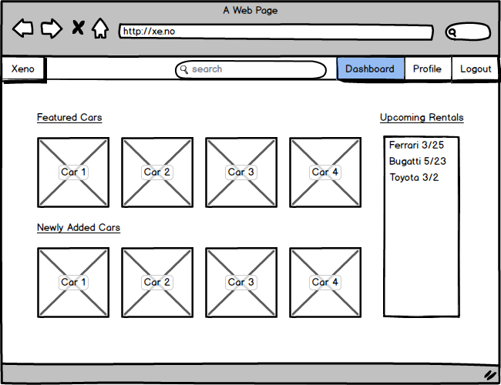
Mockups - Dashboard

Slide 6
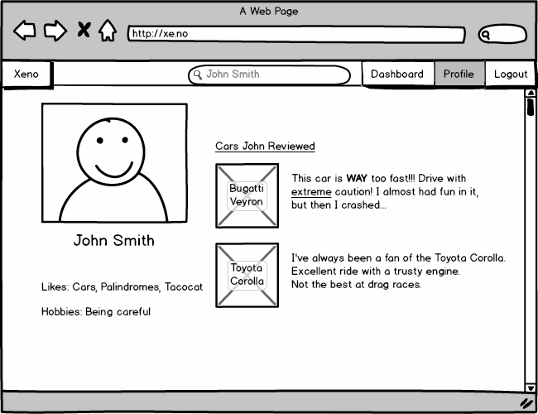
Mockups - User Profile

Slide 7
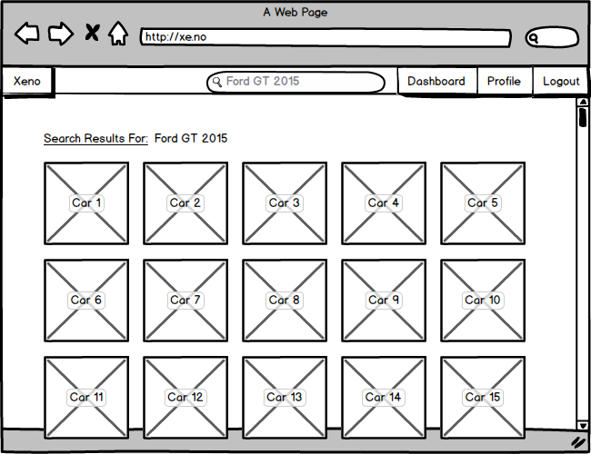
Mockups - Search Cars

Slide 8
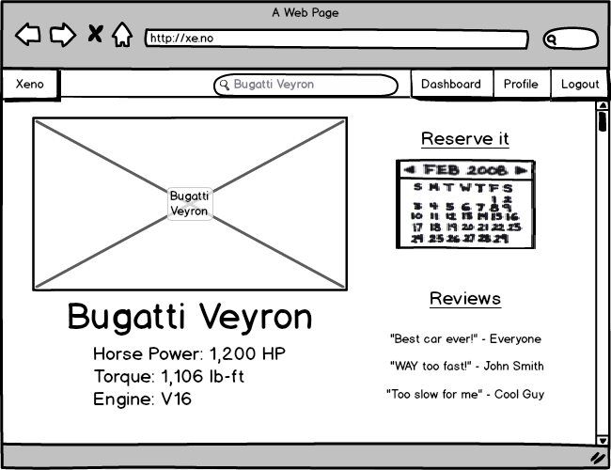
Mockups - Car Profile (User)

Slide 9
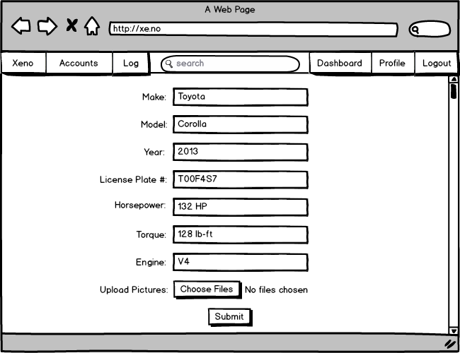
Mockups - Add Car

Slide 10
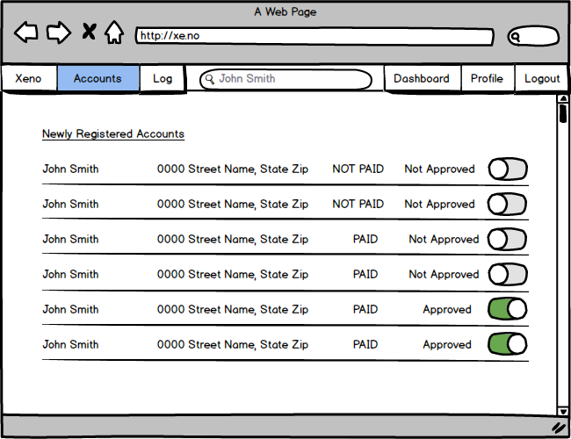
Mockups - Account Approval

Slide 11
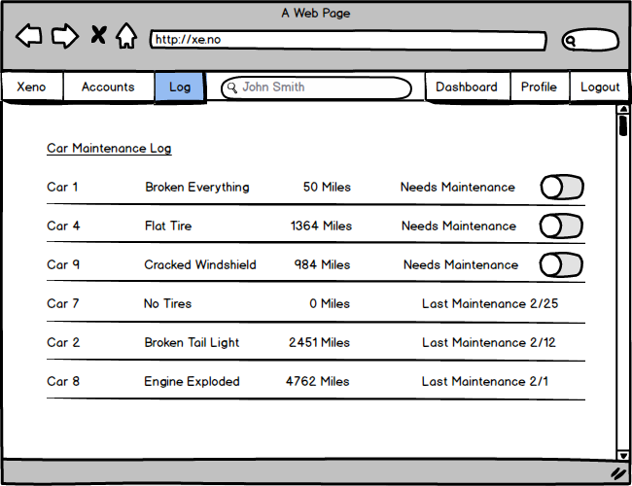
Mockups - Maintenance Log

Slide 12
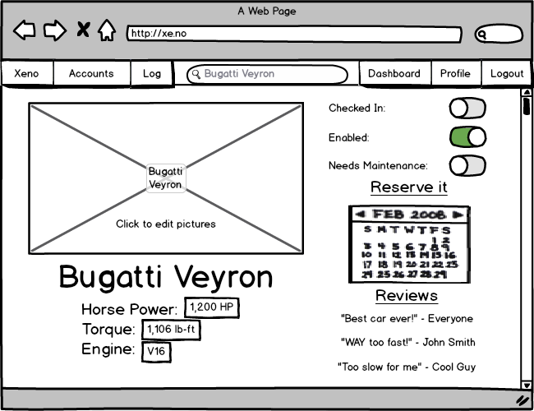
Mockups - Car Profile (Admin)

