Slide 2

XENO
The Premier Exotic Car Rental Service
Vesh Bhatt
Michael Bishoff
Edward LaFemina
Michael Lee
John Swank
Client: Shawn Squire

Slide 3
The Future of Luxury
XENO is an exotic car rental service that allows users to experience the cars of their dreams. Through both the website and Twitter, registered users will be able to search for their desired car, reserve it, and interact with other users.

Slide 4
Technologies
Flask
Maria DB
HTML5 & CSS
AngularJS
Twitter API

Slide 5
Design
Sleek
Minimalist
Car of the Day

Slide 6
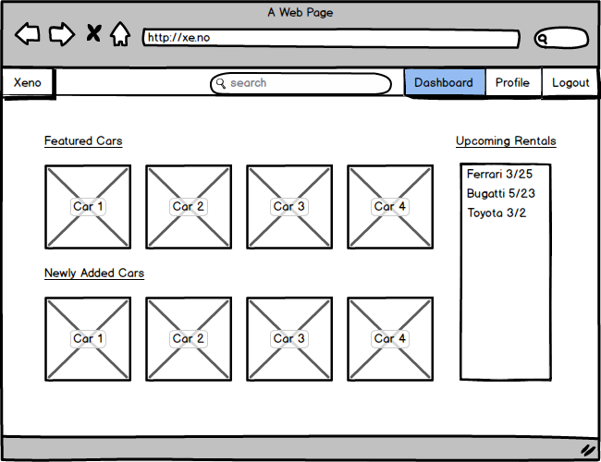
Mockups - Dashboard

Slide 7
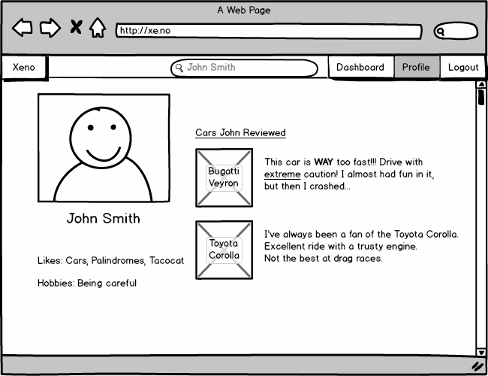
Mockups - User Profile

Slide 8
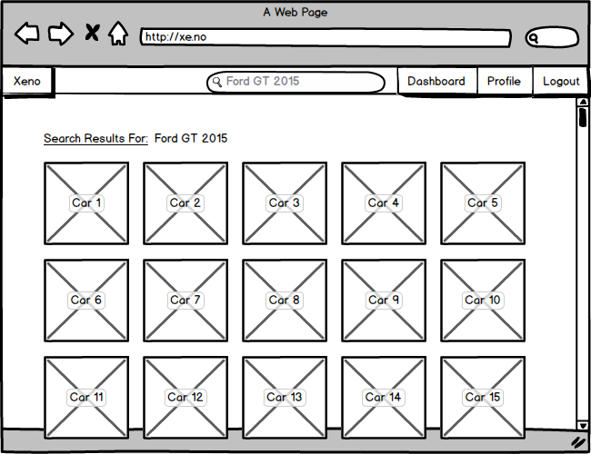
Mockups - Search Cars

Slide 9
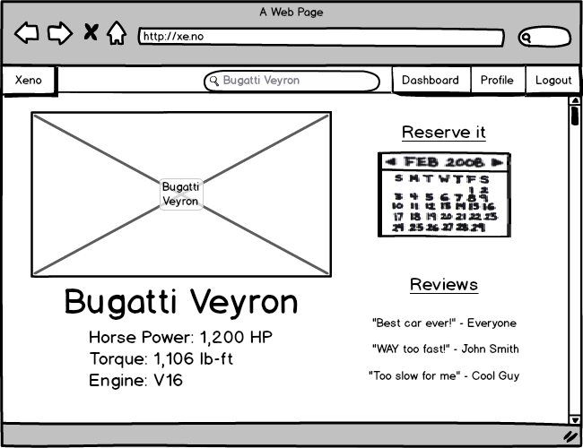
Mockups - Car Profile (User)

Slide 10
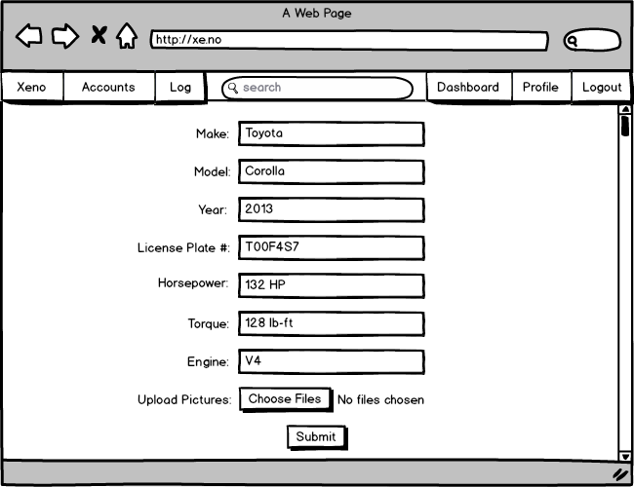
Mockups - Add Car

Slide 11
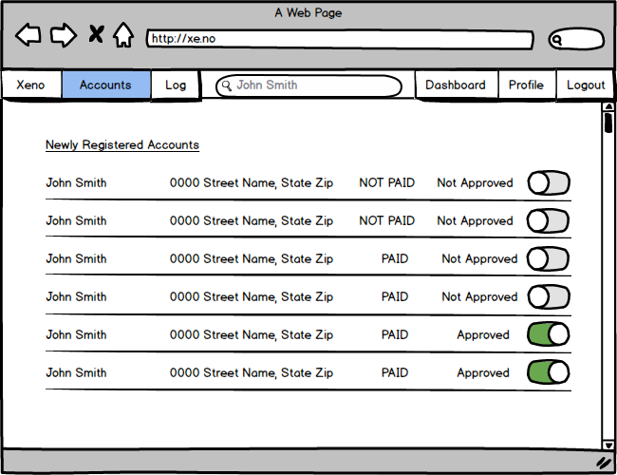
Mockups - Account Approval

Slide 12
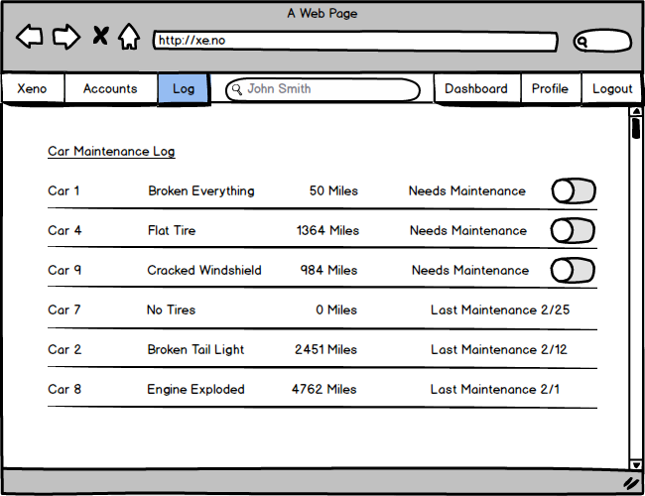
Mockups - Maintenance Log

Slide 13
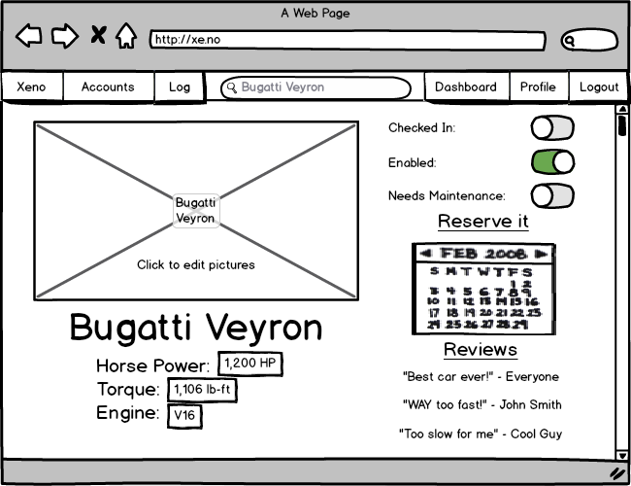
Mockups - Car Profile (Admin)

