Slide 1

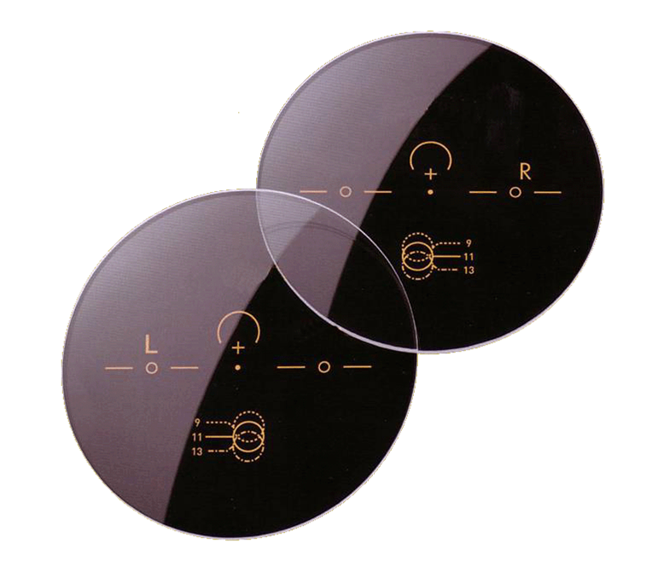


INNOVATIVE ® FREE FORM
Performance Overview

Slide 2
INNOVATIVE FF ®
A) Mono-Individual-single vision Digital lenses
These products are consequent derivatives of free form technology.
The combination of the most modern software and materials enables us to produce all prescription lenses in a much higher quality.
n= 1,50 - CR 39
n= 1,56 - Hi-Vex
n= 1,59 - Polycarbonate
n= 1,60 - MR 8
n= 1,67 - MR 10
n= 1,74 -
The lenses can optionally be produced in photochromic or polarized:
a.) Transition® (1.50, 1.60,1.67,polycarbonate)
b.) Photochromic (1.56)
c.) Polarized (1.50, 1.56, Polycarbonate,1.60)

Slide 3
INNOVATIVE FF ®
B) Progressive lenses
This product line is broadly based. Many different versions are available. Each version has different operating ranges, and price points.
The lenses are available in the following indexes / materials:
n= 1,50 - CR 39
n= 1,56 - Hi-Vex
n= 1,59 - Polycarbonate
n= 1,60 - MR 8
n= 1,67 - MR 10
n= 1,74 -
The lenses can optionally be produced in photochromic or polarized:
a.) Transition® (1.50, 1.60,1.67,polycarbonate)
b.) Photochromic (1.56)
c.) Polarized (1.50, 1.56, Polycarbonate)
Version 2011

Slide 4
INNOVATIVE FF ®
GERMAN OPTIVISION TECHNOLOGIES® This is actually one of the most efficient Software System for the calculation of freeform lenses.
By the modular assembly, it is possible to create a very wide range of products from “standard” to “high performance” lenses.
2 modules are available for the progressive lenses :
1) Standard Module: ( BASIC RX CUSTOMIZED LENS )
With this software, it is possible to calculate high precision “standard” freeform lenses, which are known since many years on the market as common lenses.
2) Premium Module:
This is an upgrade to the standard module.
The improvement is a much better overall vision (near, intermediate and far) due to enhanced canal width derived form a lower cylinder value (under 0.02 dpt).

Slide 5
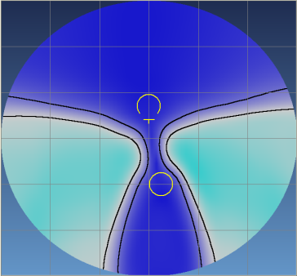
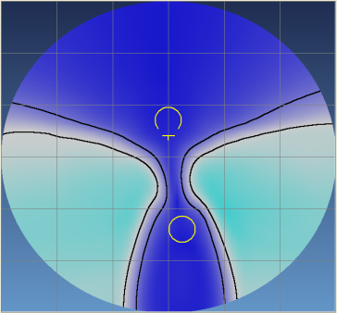
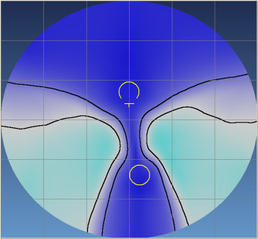
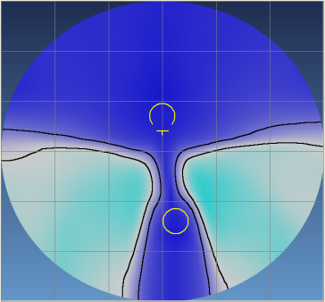
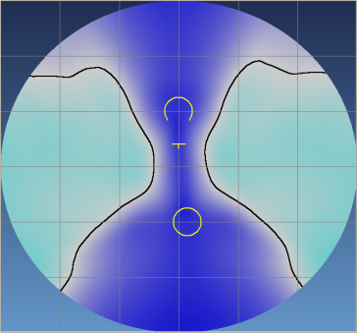
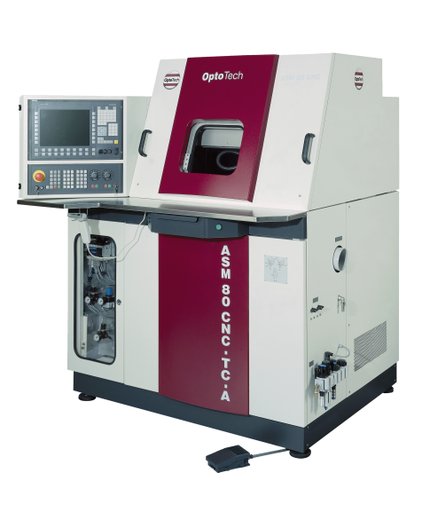
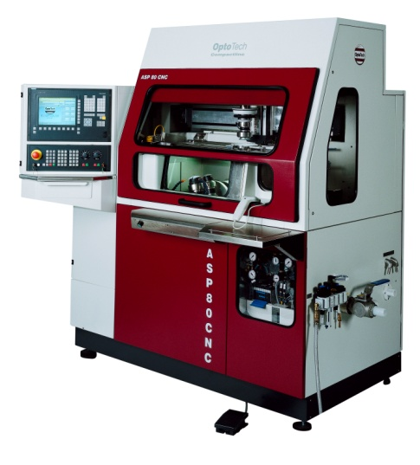
TUDOR®
DESIGN CONCEPTS
ACTIF-HD QUOTIDIEN-MD NEAR-SD
ULTRASHORT EXECUTIVES AT WORK

Slide 6
INNOVATIVE FF ®
The Freedom to See
Advances in manufacturing techniques in conjunction with ultra-modern computer technology make it possible to realize entirely new freedom in the manufacture of high quality lenses.
Lifestyle, Comfort, Weight Optimization
These are the basic milestones for the new INNOVATIVE FF® lenses.
Each lens is customized to give your customer the best possible visual comfort and clarity.
PERSONAL CUSTOMIZED – OPTIMIZED – PRODUCT

Slide 7


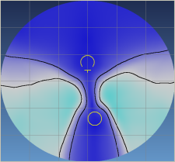

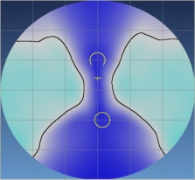
INNOVATIVE FF ®
The important parameters for the personalization
- Distance zone field of vision
- Near zone field of vision
- Thickness optimization (weight reduction)
- Fitting the field of vision to the selected frame
- Workplace-related power assignment
- Frame-related decentration in X and Y (adjustment to interpupillary distance and frame shapes)
- Special fitting needs for spectacles with a large horizontal inclination angle (sports eyewear)
- Lifestyle assignment
- Ease of wear for beginners
HD MD SD ULTRASHORT EXECUTIVE

Slide 8
INNOVATIVE FF ®
^{Lifestyle} ^{assignment}
HD
The Design HD is for use when distance view dominates into the visual part of the lens.
MD
The Design MD is optimized for the daily use and can be used universally.
SD
The Design SD is created mainly for the professional in the work place. The optics are designed for typical workstations and desk top settings.

Slide 9
INNOVATIVE FF ®
Fitting Recommendations for Progressive Lenses
Positioning of the glasses
1. Make sure that the patient is sitting at the same eye level as you
2. Before measuring, make sure that the glasses are sitting properly
3. Ensure that there is a pantoscopic angle of 9°-12°
Measure the pupillary distance
1. Position yourself so that you are exactly at eye level with the patient.
2. Mark the center of the pupil on the demo lens in the frame
3. Lay the demo lenses onto table A and measure the pupillary distance

Slide 10
INNOVATIVE FF ®
Fitting Recommendations for Progressive Lenses
Measure the pupillary height
1. Position yourself so that you are exactly at eye level with the patient
2. Mark the bottom edge of the pupil on the demo lenses in the spectacle frame
Select a lens (FH min.)
1. Lay the marking cross of the demo lenses onto Table B and determine the required diameter A and the necessary fitting height FH.
To reduce the diameter of the lenses, or to reduce the weight, a decentration in X can also be determined. The uncut diameter of the lenses is thus reduced
2. Check which corridor length is suitable for the selected spectacle frame.

Slide 11
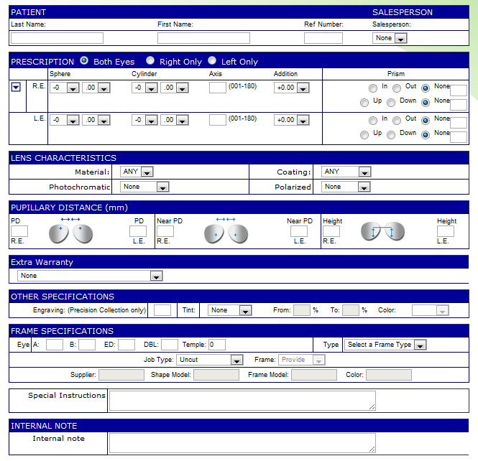
INNOVATIVE FF ®
^{Online order system}
Parameters Needed
1. Distance Prescription
2. ADD
3. Monocular Pupil Distance,
Fitting Height
4. Frame Size A-B-ED
5. Product Details

Slide 12
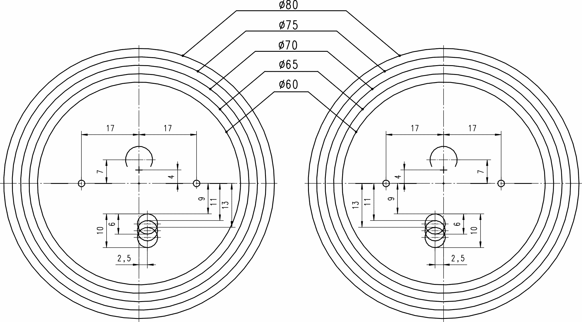
INNOVATIVE FF ®
HD MD SD
Near : 34% Near : 50% Near : 66%
Far : 66% Far : 50% Far : 34%

Slide 13

INNOVATIVE FF ®

