Slide 1

Linear Models
Machine Learning Workshop Series
Imperial College Data Science Society

Slide 2

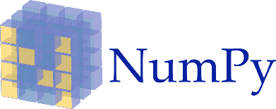

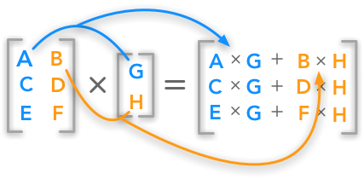
Prerequisite Knowledge

Slide 3
Table of Contents
Introduction to Data Science
Linear Regression and How it Works
Practice!
Multivariate Linear Regression
Practice!
Homework
1

Slide 4
Introduction to Data Science

Slide 5
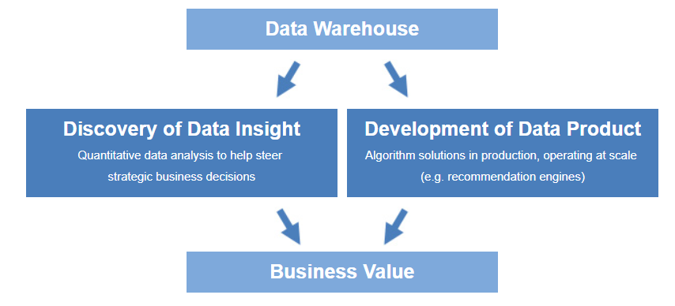
What is Data Science?
Data science is about using data in creative ways to generate business value

Slide 6
Data Science – Discovery of Data Insight
Uncovering findings, understanding complex behaviors, trends, and inferences to enable companies to make smarter business decisions.
For example:
Netflix data mines movie viewing patterns to understand what drives user interest
Target identifies what are major customer segments within it's base and the unique shopping behaviors within those segments
Proctor & Gamble utilizes time series models to more clearly understand future demand.

Slide 7
Data Science – Development of Data Products
A "data product" is a technical asset that:
utilizes data as input, and
processes that data to return algorithmically-generated results.
For example:
Amazon's recommendation engines suggest items for you to buy, determined by their algorithms.
Gmail's spam filter is an algorithm behind the scenes processes incoming mail and determines if a message is junk or not.
Computer vision used for self-driving cars is uses machine learning algorithms that are able to recognize traffic lights, other cars on the road, pedestrians, etc.

Slide 8
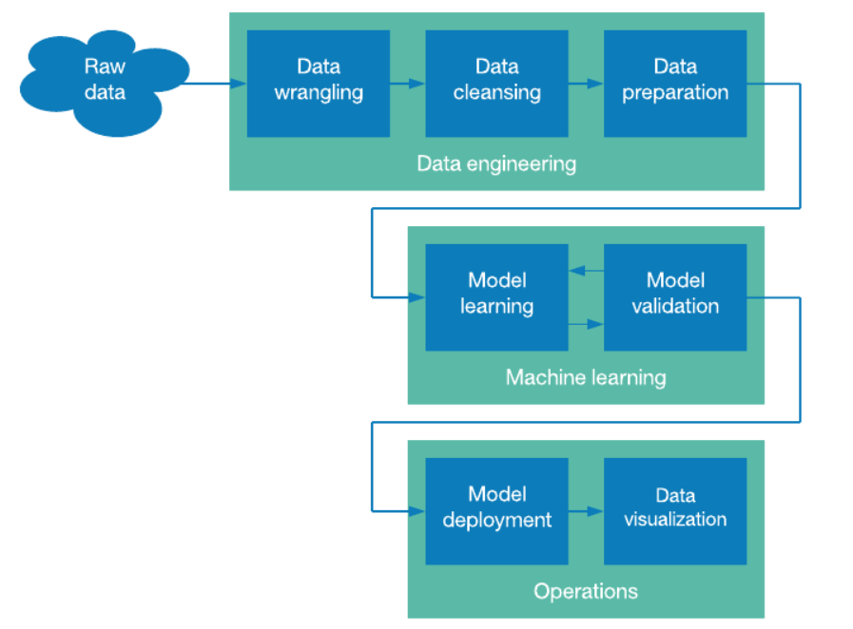
Data Science Pipeline

Slide 9
Course Overview
Include Slide that covers an overview of all the workshops ICDSS & MLsoc will be running and the topics covered

Slide 10
Machine Learning
Types of machine learning:
You have a target, a value or a class to predict. The model is trained on historical data and use them to forecast an output. Hence the model is supervised, it knows what to learn. Used in regression and classification problems.
You have unlabelled data and looks for patterns, groups in these data. Instead of doing it manually, unsupervised machine learning will automatically discriminate different classes. Used in clusterising and dimensionality reduction in data.
You want to attain an objective. For example, you want to find the best strategy to win a game with specified rules. Once these rules are specified, reinforcement learning techniques will play this game many times to find the best strategy.

Slide 11
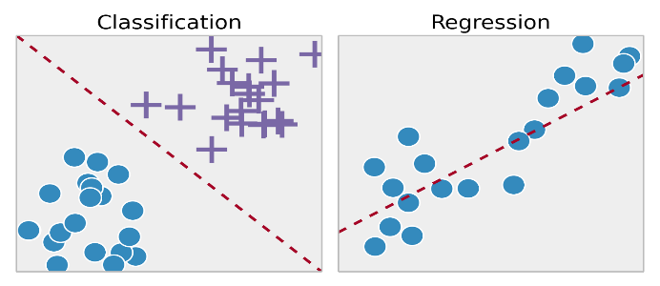
Supervised Learning
Supervised learning regroups different techniques which all share the same principles:
The training dataset contains inputs data (your predictors) and the value you want to predict (labels)
The model will use the training data to learn a link between the input and the outputs. Underlying idea is that the training data can be generalized and that the model can be used on new data with some accuracy.

Slide 12
Unsupervised Learning
Unsupervised learning does not use labelled output data. Unsupervised algorithms can be split into different categories:
Clustering algorithm, such as K-means, hierarchical clustering or mixture models. These algorithms try to discriminate and separate the observations in different groups.
Dimensionality reduction algorithms such as PCA, ICA or autoencoder. These algorithms find the best representation of the data with fewer dimensions.
Anomaly detections to find outliers in the data, i.e. observations which do not follow the data set patterns.
Most of the time unsupervised learning algorithms are used to pre-process the data, during the exploratory analysis or to pre-train supervised learning algorithms.

Slide 13
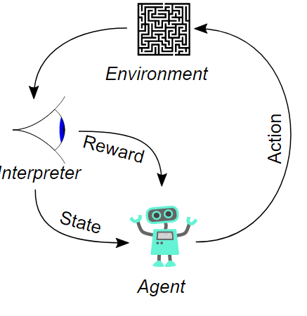
Reinforcement Learning
Reinforcement learning algorithms try to find the best ways to earn the greatest reward. Reinforcement learnings algorithms follow the different circular steps:
Given its and the environment’s states, the agent will choose the action which will maximize its reward or will explore a new possibility.
These actions will change the environment’s and the agent states.
They will also be interpreted to give a reward to the agent.
By performing this loop many times, the agents will improve its behavior.

Slide 14
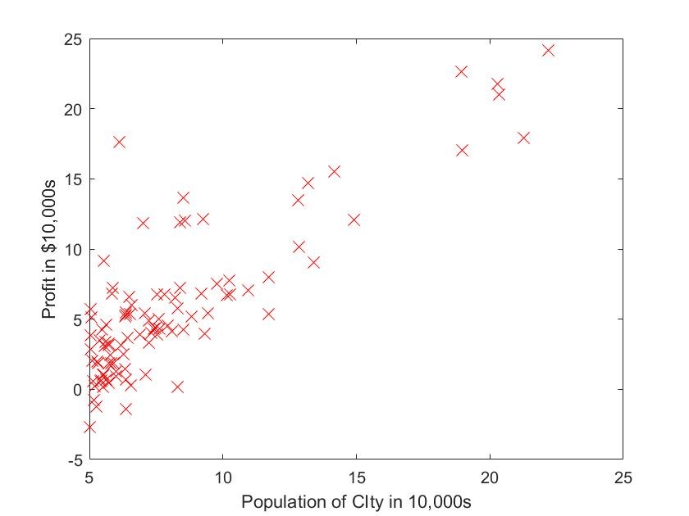
Supervised Learning – Linear Regression
Applications:
Studying engine data from test performance
Market research studies and customer survey analysis
Causal relationships in biological systems
And many more…
Notes:
Add Intro to Data Science Slides (terminology of data science)

Slide 15
Linear Regression and How it Works

Slide 16
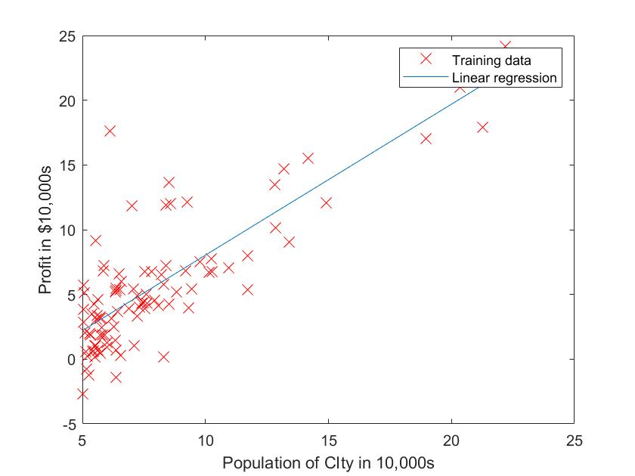
What is Linear Regression?
Supervised Learning | Data has an expected output for every input (y for every x)
Regression Problem | Predict the output for a given input
Notes:
Understand I choose linear regression as it is the simplest

Slide 17
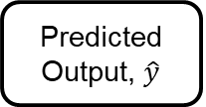
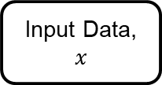
Model Training Pipeline
Training Data
Input Data, $x$
Model
Predicted Output, $\hat{y}$
Learning Algorithm
Model Training

Slide 18
Model Training Pipeline
Training Data
What we need
Model
What we want
Learning Algorithm
How we get it

Slide 19
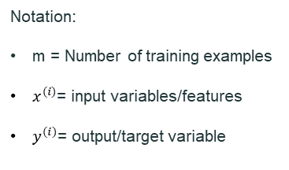
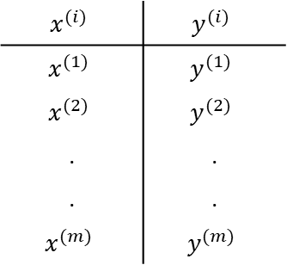
Training Data
$$x^{(i)}$$ | $$y^{(i)}$$
$$x^{(1)}$$ | $$y^{(1)}$$
$$x^{(2)}$$ | $$y^{(2)}$$
. | .
. | .
$$x^{(m)}$$ | $$y^{(m)}$$
Notation:
m = Number of training examples
$x^{(i)}$= input variables/features
$y^{(i)}$= output/target variable

Slide 20
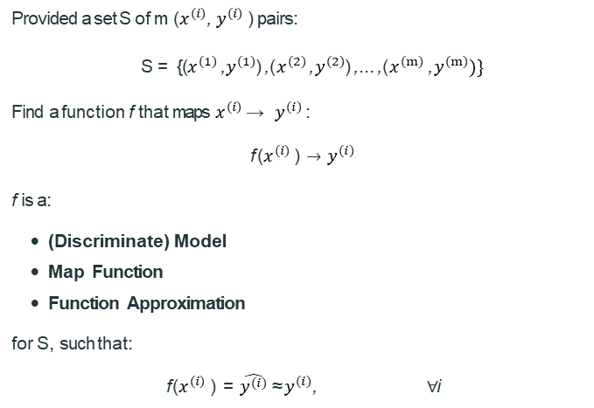
Model Representation
Provided a set S of m ($x^{(i)}$, $y^{(i)}$ ) pairs:
S = {($x^{(1)}$, $y^{(1)}$), ($x^{(2)}$, $y^{(2)}$), ..., ($x^{(m)}$ , $y^{(m)})\}$
Find a function f that maps $x^{(i)}$ → $y^{(i)}$ :
$\text{f} \text{(}x^{(i)} \text{)}→$ $y^{(i)}$
f is a:
(Discriminate) Model
Map Function
Function Approximation
for S, such that:
f ($x^{(i)}$ ) = $\hat{y^{(i)}}$≈ $y^{(i)}$, ∀i

Slide 21
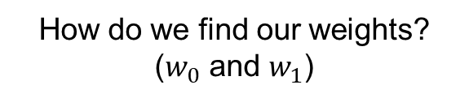
Linear Regression Model
Linear Regression Model with One Variable
Equation of a line :
$$f\left(x^{(i)}\right)=w_{0}+w_{1}∗x^{(i)}$$
$$\hat{y^{(i)}}=w_{0}+w_{1}∗x^{(i)}$$
How do we find our weights? ($w_{0}$ and $w_{1}$)

Slide 22
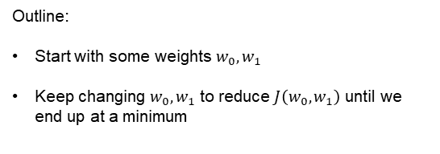
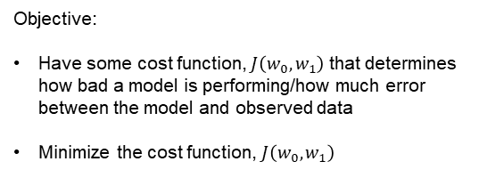
Cost Function Intuition
Objective:
Have some cost function, $J\left(w_{0},w_{1}\right)$ that determines how bad a model is performing/how much error between the model and observed data
Minimize the cost function, $J\left(w_{0},w_{1}\right)$
Outline:
Start with some weights $w_{0},w_{1}$
Keep changing $w_{0},w_{1}$ to reduce $J\left(w_{0},w_{1}\right)$ until we end up at a minimum

Slide 23

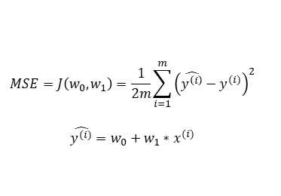
Cost Function
Linear regression graph
Use Mean Squared Error (MSE) as the cost function (denoted with $J\left(w_{0},w_{1}\right)$ in order to evaluate how good/bad the model f is, such that:
$$MSE=J\left(w_{0},w_{1}\right)=\frac{1}{2m}\sum_{i=1}^{m}{{\left(\hat{y^{\left(i\right)}}−y^{(i)}\right)}^{2}}$$
$$\hat{y^{(i)}}=w_{0}+w_{1}∗x^{(i)}$$
Notes:
Explain why MSE is chosen

Slide 24

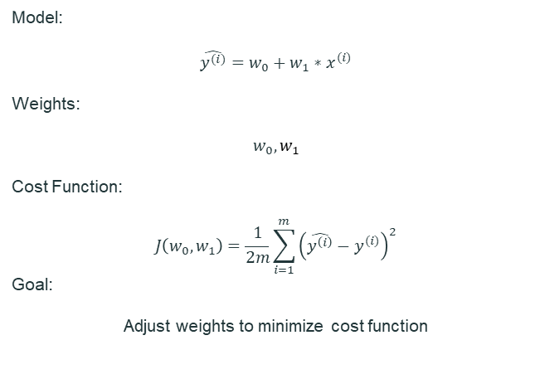

Cost Function Intuition
Model:
$$\hat{y^{(i)}}=w_{0}+w_{1}∗x^{(i)}$$
Weights:
$$w_{0},w_{1}$$
Cost Function:
$$J\left(w_{0},w_{1}\right)=\frac{1}{2m}\sum_{i=1}^{m}{{\left(\hat{y^{\left(i\right)}}−y^{(i)}\right)}^{2}}$$
Goal:
Adjust weights to minimize cost function
$w_{0}$ $w_{1}$
$J\left(w_{0},w_{1}\right)$

Slide 25
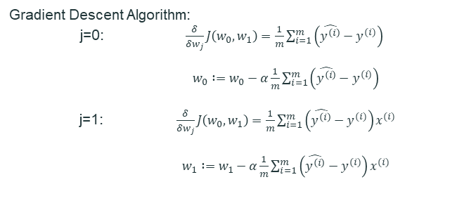
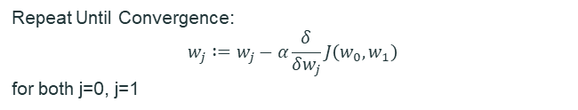
Gradient Descent Algorithm
Repeat Until Convergence:
$$w_{j} :=w_{j}−α\frac{δ}{δw_{j}}J\left(w_{0},w_{1}\right)$$
for both j=0, j=1
Learning Rate
Derivative of Cost Function
Gradient Descent Algorithm:
j=0: $\frac{δ}{δw_{j}}J\left(w_{0},w_{1}\right)=\frac{1}{m}\sum_{i=1}^{m}{\left(\hat{y^{\left(i\right)}}−y^{(i)}\right)}$
$w_{0} :=w_{0}−α\frac{1}{m}\sum_{i=1}^{m}{\left(\hat{y^{\left(i\right)}}−y^{(i)}\right)}$
j=1: $\frac{δ}{δw_{j}}J\left(w_{0},w_{1}\right)=\frac{1}{m}\sum_{i=1}^{m}{\left(\hat{y^{\left(i\right)}}−y^{(i)}\right)x^{(i)}}$
$w_{1} :=w_{1}−α\frac{1}{m}\sum_{i=1}^{m}{\left(\hat{y^{\left(i\right)}}−y^{(i)}\right)}x^{(i)}$

Slide 26






Gradient Descent – Why it works
$$w_{j} :=w_{j}−α\frac{δ}{δw_{j}}J\left(w_{0},w_{1}\right)$$
$$\frac{δ}{δw_{j}}J\left(w_{0},w_{1}\right)<0$$
$$\frac{δ}{δw_{j}}J\left(w_{0},w_{1}\right)>0$$
$$J\left(w_{j} \right)$$
$$J\left(w_{j} \right)$$
$$w_{j}$$
$$w_{j}$$

Slide 27





Learning Rate
$$J\left(w_{j} \right)$$
If $α$ is too small, gradient descent is slow
$$w_{j}$$
$$J\left(w_{j} \right)$$
If $α$ is too large, gradient descent can overshoot, and fail to converge.
$$w_{j}$$

Slide 28
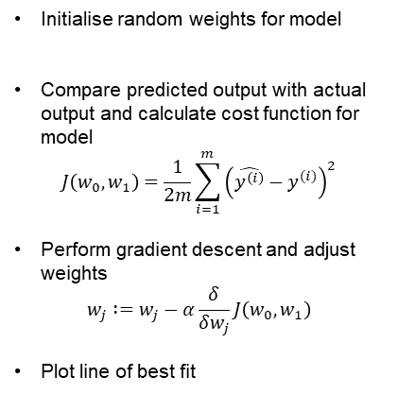
Summary
Step by Step:
Training Data
Initialise random weights for model
Compare predicted output with actual output and calculate cost function for model
$$J\left(w_{0},w_{1}\right)=\frac{1}{2m}\sum_{i=1}^{m}{{\left(\hat{y^{\left(i\right)}}−y^{(i)}\right)}^{2}}$$
Perform gradient descent and adjust weights
$$w_{j} :=w_{j}−α\frac{δ}{δw_{j}}J\left(w_{0},w_{1}\right)$$
Plot line of best fit
Model
Learning Algorithm

Slide 29
Practice! (Insert links and resources here

Slide 30
Multivariate Linear Regression

Slide 31

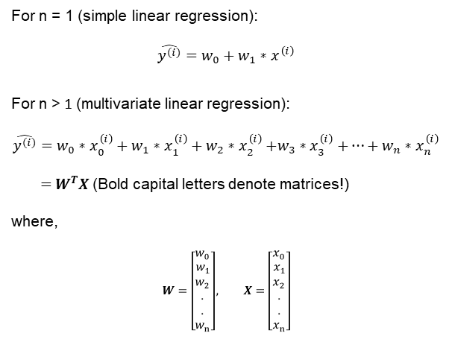
Multivariate Linear Regression Model
For n = 1 (simple linear regression):
$$\hat{y^{(i)}}=w_{0}+w_{1}∗x^{\left(i\right)}$$
For n > 1 (multivariate linear regression):
$$\hat{y^{(i)}}=w_{0}∗x_{0}^{\left(i\right)}+w_{1}∗x_{1}^{\left(i\right)}+w_{2}{∗x}_{2}^{\left(i\right)}+w_{3}{∗x}_{3}^{\left(i\right)}+…+w_{n}{∗x}_{n}^{\left(i\right)}$$
$=W^{T}X$(Bold capital letters denote matrices!)
where,
$$W=\left[\begin{aligned}w_{0} \\ w_{1} \\ w_{2} \\ . \\ . \\ w_{n}\end{aligned}\right], X=\left[\begin{aligned}x_{0} \\ x_{1} \\ x_{2} \\ . \\ . \\ x_{n}\end{aligned}\right]$$
$x_{0}$=1

Slide 32
Multivariate Model Training Pipeline
Training Data
What do we need?
Model
What do we want?
Learning Algorithm
How do we get what we want?
The process is the same!

Slide 33


Data with multiple features/variables
For $n$ number of features and $m$number of training examples:
$$X=\left[\begin{matrix}x_{1}^{(1)} & ⋯ & x_{n}^{(1)} \\ ⋮ & ⋱ & ⋮ \\ x_{1}^{(m)} & ⋯ & x_{n}^{(m)}\end{matrix}\right]$$
Training Data Number
$$x_{j}^{(i)}$$
Feature Number

Slide 34

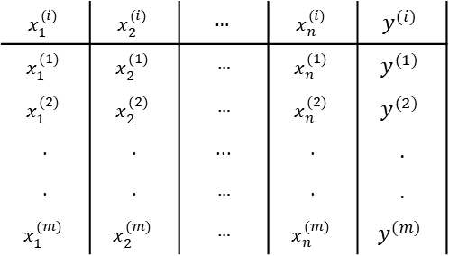

Data with multiple features/variables
$$x_{1}^{(i)}$$ | $$x_{2}^{(i)}$$ | $$…$$ | $$x_{n}^{(i)}$$ | $$y^{(i)}$$
$$x_{1}^{(1)}$$ | $$x_{2}^{(1)}$$ | … | $$x_{n}^{(1)}$$ | $$y^{(1)}$$
$$x_{1}^{(2)}$$ | $$x_{2}^{(2)}$$ | … | $$x_{n}^{(2)}$$ | $$y^{(2)}$$
. | . | ... | . | .
. | . | … | . | .
$$x_{1}^{(m)}$$ | $$x_{2}^{(m)}$$ | … | $$x_{n}^{(m)}$$ | $$y^{(m)}$$
Training Data Number
$$x_{n}^{(m)}$$
Feature Number
$n$ = Number of Features
$m$= Number of training examples

Slide 35
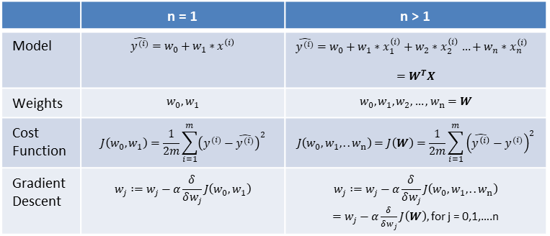
Multivariate Modelling
Equations for Multivariate Linear Regression
 | n = 1 | n > 1
Model | $$\hat{y^{(i)}}=w_{0}+w_{1}∗x^{\left(i\right)}$$ | $\hat{y^{(i)}}=w_{0}+w_{1}∗x_{1}^{\left(i\right)}+w_{2}{∗x}_{2}^{\left(i\right)}…+w_{n}{∗x}_{n}^{\left(i\right)}$ $$=W^{T}X$$
Weights | $$w_{0},w_{1}$$ | $$w_{0},w_{1},w_{2},…,w_{n}=W$$
Cost Function | $$J\left(w_{0},w_{1}\right)=\frac{1}{2m}\sum_{i=1}^{m}{{\left(y^{(i)}−\hat{y^{(i)}}\right)}^{2}}$$ | $$J\left(w_{0},w_{1},..w_{n}\right)=J\left(W\right)=\frac{1}{2m}\sum_{i=1}^{m}{{\left(\hat{y^{\left(i\right)}}−y^{(i)}\right)}^{2}}$$
Gradient Descent | $$w_{j} :=w_{j}−α\frac{δ}{δw_{j}}J\left(w_{0},w_{1}\right)$$ | $$w_{j} :=w_{j}−α\frac{δ}{δw_{j}}J\left(w_{0},w_{1},..w_{n}\right)$$ $=w_{j}−α\frac{δ}{δw_{j}}J\left(W\right),$for j = 0,1,….n

Slide 36
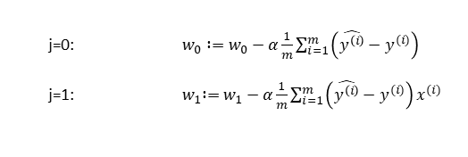

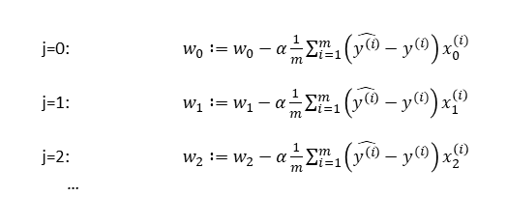
Gradient Descent
$$w_{j} :=w_{j}−α\frac{δ}{δw_{j}}J\left(W\right)$$
For n = 1:
j=0: $w_{0} :=w_{0}−α\frac{1}{m}\sum_{i=1}^{m}{\left(\hat{y^{\left(i\right)}}−y^{(i)}\right)}$
j=1: ${ w}_{1} :=w_{1}−α\frac{1}{m}\sum_{i=1}^{m}{\left(\hat{y^{\left(i\right)}}−y^{(i)}\right)}x^{(i)}$
For n > 1:
j=0: $w_{0} :=w_{0}−α\frac{1}{m}\sum_{i=1}^{m}{\left(\hat{y^{\left(i\right)}}−y^{(i)}\right)}x_{0}^{(i)}$
j=1: $w_{1} :=w_{1}−α\frac{1}{m}\sum_{i=1}^{m}{\left(\hat{y^{\left(i\right)}}−y^{(i)}\right)}x_{1}^{\left(i\right)}$
j=2: $w_{2} :=w_{2}−α\frac{1}{m}\sum_{i=1}^{m}{\left(\hat{y^{\left(i\right)}}−y^{(i)}\right)}x_{2}^{\left(i\right)}$
…

Slide 37
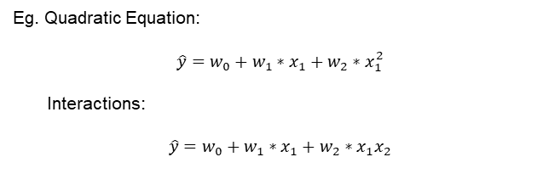
Polynomial Regression
Polynomial Regression is a case of multivariate linear regression
Eg. Quadratic Equation:
$$\hat{y}=w_{0}+w_{1}∗x_{1}+w_{2}{∗x}_{1}^{2}$$
Interactions:
$$\hat{y}=w_{0}+w_{1}∗x_{1}+w_{2}∗x_{1}x_{2}$$

Slide 38

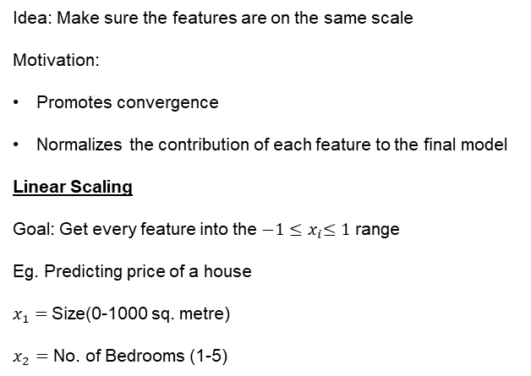
Feature Scaling
Idea: Make sure the features are on the same scale
Motivation:
Promotes convergence
Normalizes the contribution of each feature to the final model
Linear Scaling
Goal: Get every feature into the ${−1≤x}_{i}≤1$ range
Eg. Predicting price of a house
$x_{1}=$Size(0-1000 sq. metre)
$x_{2}=$ No. of Bedrooms (1-5)
$x_{1}$ = $\frac{Size}{1000}$
$x_{2}$= $\frac{No. of Bedrooms}{5}$

Slide 39

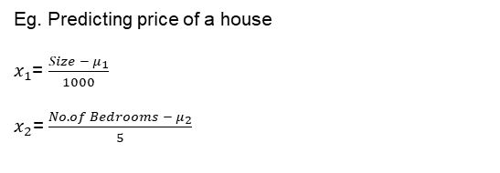
Feature Scaling
Mean Normalization
Goal: Make features have approximately 0 mean
$x_{i}$= $\frac{x_{i}− μ_{i}}{{range}_{i}}$
where $μ_{i}$ is the mean and ${range}_{i}$ is the range of feature $x_{i}$
Eg. Predicting price of a house
$x_{1}$= $\frac{Size − μ_{1}}{1000}$
$x_{2}$=$\frac{No. of Bedrooms − μ_{2}}{5}$

Slide 40
Model Evaluation

Slide 41
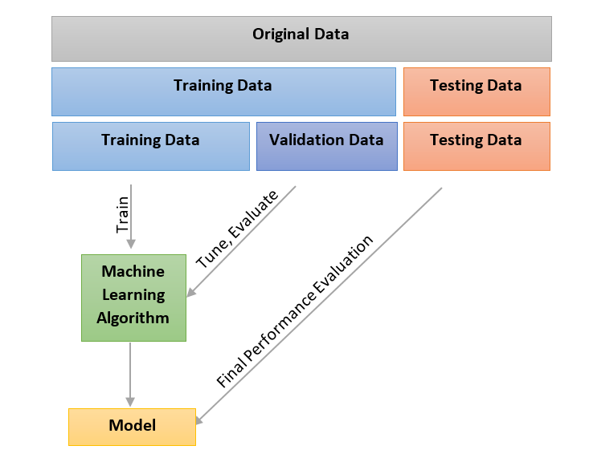
Model Evaluation Data Sets

Slide 42
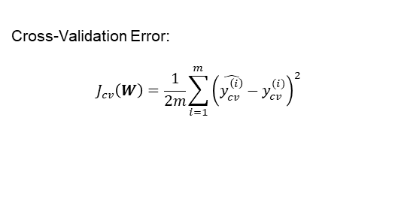
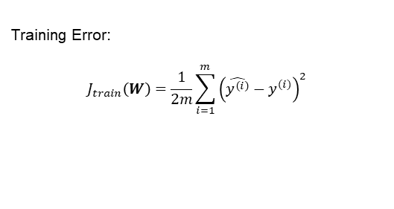
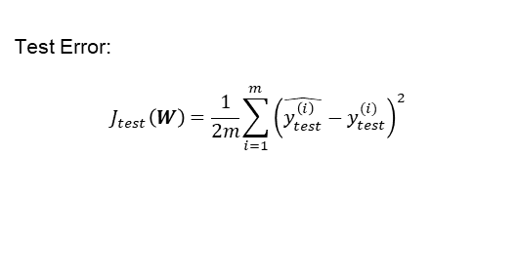
Train/Validation/Test Error
Training Error:
$$J_{train}\left(W\right)=\frac{1}{2m}\sum_{i=1}^{m}{{\left(\hat{y^{\left(i\right)}}−y^{(i)}\right)}^{2}}$$
Minimised to perform gradient descent during training
Cross-Validation Error:
$$J_{cv}\left(W\right)=\frac{1}{2m}\sum_{i=1}^{m}{{\left(\hat{y_{cv}^{\left(i\right)}}−y_{cv}^{(i)}\right)}^{2}}$$
Used to compare performance of different models
Test Error:
$$J_{test}\left(W\right)=\frac{1}{2m}\sum_{i=1}^{m}{{\left(\hat{y_{test}^{\left(i\right)}}−y_{test}^{(i)}\right)}^{2}}$$
Used to evaluate the accuracy of the chosen model with actual test data

Slide 43


Bias and Variance
Error
High Bias (Underfitting)
High Variance (Overfitting)
$$J_{cv}\left(W\right)$$
$$J_{train}\left(W\right)$$
Model Complexity

Slide 44
Putting Everything Together
Training Data
Validation Data
Model
Cross-Validation Error
Learning Algorithm
Improve Model
Model Training
Model Evaluation

Slide 45
Practice! (Insert links and resources here

Slide 46
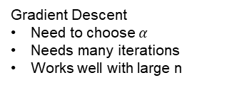
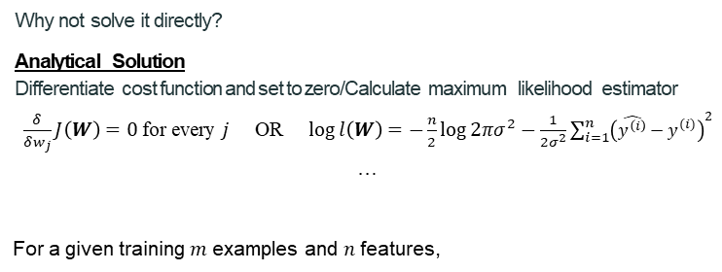

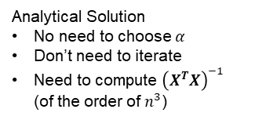
Solutions
Why not solve it directly?
Analytical Solution
Differentiate cost function and set to zero/Calculate maximum likelihood estimator
$\frac{δ}{δw_{j}}J\left(W\right)=0$ for every $j$ OR $\log{l\left(W\right)}=−\frac{n}{2}\log{2πσ^{2}−\frac{1}{2σ^{2}}\sum_{i=1}^{n}{{\left(\hat{y^{\left(i\right)}}−y^{(i)}\right)}^{2}}}$
…
For a given training$m$ examples and $n$ features,
$$W={\left(X^{T}X\right)}^{−1}X^{T}y$$
Gradient Descent
Need to choose $α$
Needs many iterations
Works well with large n
Analytical Solution
No need to choose $α$
Don’t need to iterate
Need to compute ${\left(X^{T}X\right)}^{−1}$ (of the order of $n^{3}$)

Slide 47
Homework/Project

Slide 48
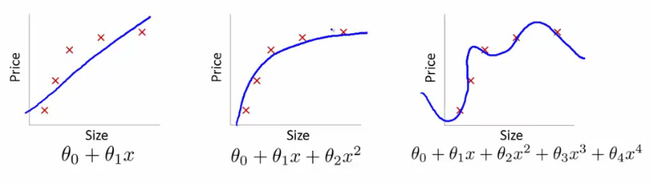
Overfitting vs Underfitting
Underfitting
Overfitting

Slide 49
Questions?

Slide 50
Setup
Create a Github account.
Sign-in cocalc using your Github credentials. 3.Create a new project in cocalc.
Clone (green button at top RHS) in zip format the Linear Models
repository.
Upload the zip file to newly created cocalc project. 6.Click on the zip file and extract the compressed files. 7.Navigate to the extracted folder
∼/Linear-Models-master/notebooks/Demo.ipynb.
8.Select from the menu bar:
Kernel → Change Kernel → Python 3 (Anaconda).

Slide 51
Challenges
Beta Hedging
Come up with a Beta Hedging strategy using Linear Models
Generic Machine Learning API for Linear Models
Create a generic API, encapsulating all the different implementations and exposing simple methods:
fit
predict

Slide 52
Disclaimer
Presentations are intended for educational purposes only and do not replace independent professional judgment. Statements of fact and opinions expressed are those of the participants individually and, unless expressly stated to the contrary, are not the opinion or position of the ICDSS, its cosponsors, or its committees. The ICDSS does not endorse or approve, and assumes no responsibility for, the content, accuracy or completeness of the information presented. Attendees should note that sessions are video-recorded and may be published in various media, including print, audio and video formats without further notice.

