Slide 1
goo.gl/eKxKZH

Slide 2

Linear Models
Machine Learning Workshop Series
Angelos Filos October 19, 2017
Imperial College Data Science Society

Slide 3
Table of Contents
Theory
Application
Codelab
1

Slide 4
Theory

Slide 5
Problem Definition
Provided a set S of (x_{i} , y_{i} ) pairs:
S = {(x₁, y₁), (x₂, y₂), ..., (x_{k} , y_{k} )}
Find a function f that maps x_{i} → y_{i} :
f : X → Y
f is a:
(Discriminate) Model
Map Function
Function Approximation
for S, such that:
f (x_{i} ) = yˆ_{i} ≈ y_{i} , ∀i

Slide 6
Linear Model
f is a Linear Model, iff:
f (x_{i} ) = w ∗ x_{i} , x_{i} ∈ R^{n} ; y_{i} ∈ R^{m} ; w ∈ R^{m×n}
For a finite S where |S| = k, we express (1) in matrix format as:
f (X) = ˆy = X ∗ w, X ∈ R^{k×n} ; y ∈ R^{k×m} ; w ∈ R^{n×m}
Matrices X and y are constructed by stacking the k pairs as row vectors.
(1)

Slide 7
Mini Demo

Slide 8
Metric
Use Mean Squared Error (MSE) as the metric function in order to evaluate how good/bad the model f is, such that:
Σ
Σ
1 2k
k
1 2k
k
MSE =
2
2
f
(y − yˆ ) =
(y − w ∗ x )
i i
i i
i
i =1
i =1
In matrix form:
1
T
MSE = (y − X ∗ w) (y − X ∗ w)
(2)
f
2k
Target: minimize MSE_{f} in order to increase accuracy! Apply optimization algorithms to achieve it.

Slide 9
Solutions
Minimize the metric (a.k.a error) function.
Analytic Solution
Maximum Likelihood Estimator: differentiate 2 and find its minimum. There is a global minimiser, since MSE_{f} is convex (quadratic).
w_{MLE} = (X^{T} X)⁻¹ ∗ X^{T} ∗ y
Computational Solution
Gradient Descent: make incremental updates, towards the correct solution, using the derivative of the error at each step.
w_{t+1} = w_{t} − η(y_{i} − yˆ)x_{i}

Slide 10
Application

Slide 11
Context
Factor models are a way of explaining the returns of one asset via a linear combination of the returns of other assets. The general form of a factor model is:
y = α + β₁x₁ + β₂x₂ + ... + β_{n}x_{n}
An asset’s β to another is just the β factor from (3). Look for:
(3)
Σ Σ
₁Σ
β
ystock = βxbenchmark + α = ^{Σ}x
benchmark
α

Slide 12
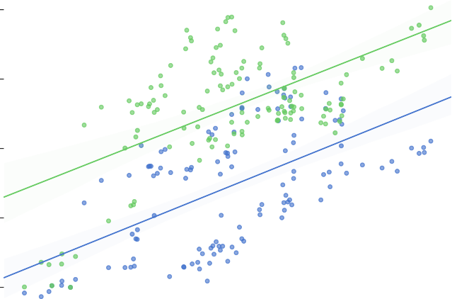
Results
Beta Exposure to S&P500
APPL GOOG
0.20
0.15
Stock Price Percentage Change
0.10
0.05
0.00
0.00
0.02
0.04
SPY Percentage Change
0.06
0.08

Slide 13
Questions?

Slide 14
Codelab

Slide 15
Setup
Create a Github account.
Sign-in cocalc using your Github credentials. 3.Create a new project in cocalc.
Clone (green button at top RHS) in zip format the Linear Models
repository.
Upload the zip file to newly created cocalc project. 6.Click on the zip file and extract the compressed files. 7.Navigate to the extracted folder
∼/Linear-Models-master/notebooks/Demo.ipynb.
8.Select from the menu bar:
Kernel → Change Kernel → Python 3 (Anaconda).

Slide 16
Challenges
Beta Hedging
Come up with a Beta Hedging strategy using Linear Models
Generic Machine Learning API for Linear Models
Create a generic API, encapsulating all the different implementations and exposing simple methods:
fit
predict

Slide 17
Disclaimer
Presentations are intended for educational purposes only and do not replace independent professional judgment. Statements of fact and opinions expressed are those of the participants individually and, unless expressly stated to the contrary, are not the opinion or position of the ICDSS, its cosponsors, or its committees. The ICDSS does not endorse or approve, and assumes no responsibility for, the content, accuracy or completeness of the information presented. Attendees should note that sessions are video-recorded and may be published in various media, including print, audio and video formats without further notice.

