Slide 1
Techfiction corp information security management system ad hoc Audit
APRIL 2026
EDMAN TANGJONG
edmantangjong@protonmail.com

Slide 2
A mid-sized it services company that manages
Cloud infrastructure
Customer data / PII (Personally Identifiable Information)
Financial systems
Internal HR systems.

Slide 3
Issues and requests​
Recent issues:
Delayed Patching
Incidents of unauthorized access​
Missing Audit logs
Vulnerable / Weak password policies.
Audit Committee has requested an internal ISMS audit to assess:
Compliance with ISO/IEC 27001 principles
Effectiveness of risk management
Internal controls.

Slide 4
Audit scope & objectives
Audit Objectives
Evaluate information security controls effectiveness
Assess compliance with policies
Identify security risks and vulnerabilities
Recommend corrective actions.
Audit Scope
Included:​
Data Security
Incident Management​
Network Security
User Access Management.
Excluded:​
Physical security (due to limited resources).

Slide 5

Definitions &​ Terms
Ad Hoc: Specific / Special time where immediate actions are taken.
Cloud: An online storage where virtual files are stored.
HR: Human Resource, section in an organization that deals with employment.
ISMS: Short for “Information Security Management System”.
ISO/IEC 27001: Global standards for Information Security Compliance.
Matrix: A structured table that shows relation between one or more values
MFA: Multi-factor Authentication, an extra layer of security other than password.
Patch: Small changes that fix errors and improve information system.
Sampling: Picking required data statistical / subjectively.
SLA: Short for “Service-level Agreement”, an agreement that external providers must maintain to protect organization’s assets.

Slide 6
METhodology​
I Planning
Define objectives
Identify risks
II Fieldwork
Control testing
Data analysis
III Reporting
Findings
Recommendations
Prepare audit checklist.
Sampling.
Risk rating.
IV Monitoring
Follow-up actions.

Slide 7
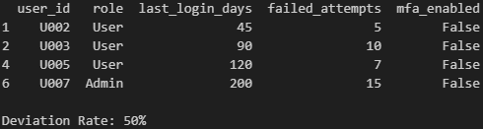
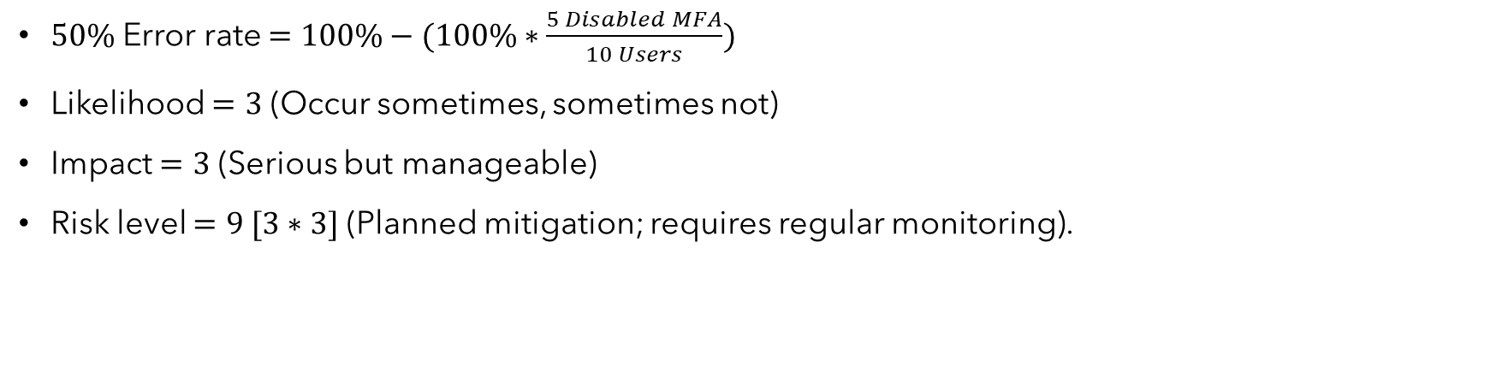
Unauthorized access ​
$50\%$ Error rate $=100\%−(100\%∗\frac{5 Disabled MFA}{10 Users})$
Likelihood $=3$ (Occur sometimes, sometimes not)
Impact $=3$ (Serious but manageable)
Risk level $=9 [3∗3]$ (Planned mitigation; requires regular monitoring).

Slide 8
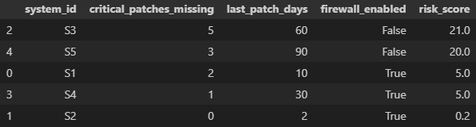
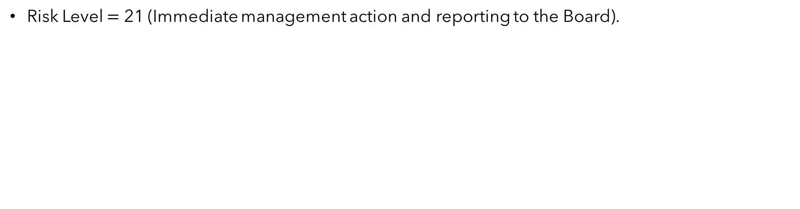
System patch failure​
Risk Level $=$ 21 (Immediate management action and reporting to the Board).

Slide 9
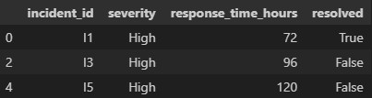
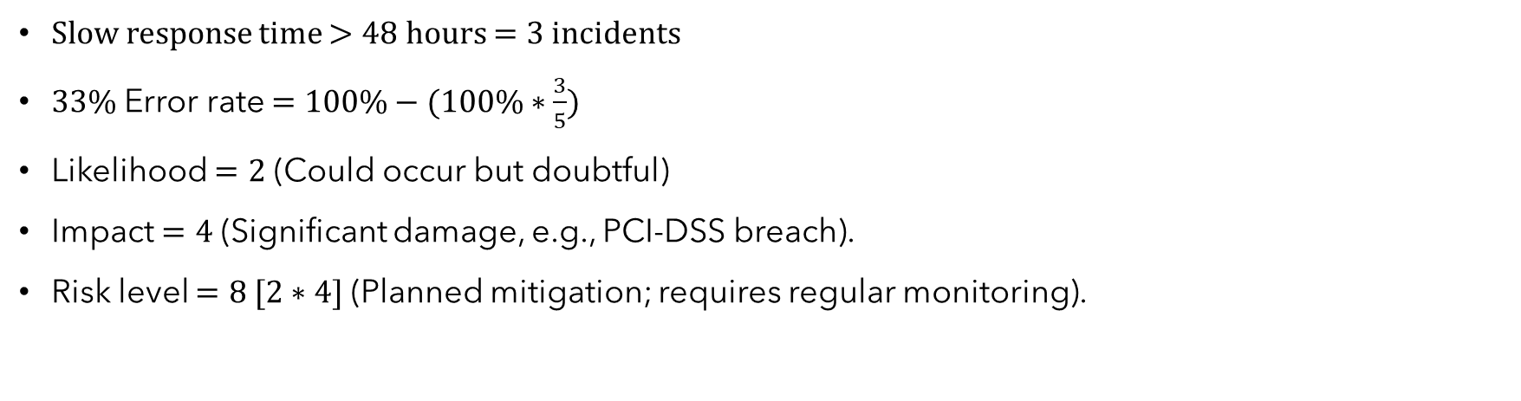
Incident report delay​
Slow response time $>48$ hours $=3$ incidents
$33\%$ Error rate $=100\%−(100\%∗\frac{3}{5})$
Likelihood $=2$ (Could occur but doubtful)
Impact $=4$ (Significant damage, e.g., PCI-DSS breach).
Risk level $=8 [2∗4]$ (Planned mitigation; requires regular monitoring).

Slide 10
RACM (Risk and control matrix)​
Risk | Control | Test
Data breach | Firewall | Verify firewall
Delayed patching​ | Patch policy | Check patch period​
Incident mismanagement​ | Response SLA (Service Level Agreement) | Analyze response time​
Unauthorized access | MFA (Multi-factor Authentication) | Check MFA status​

Slide 11
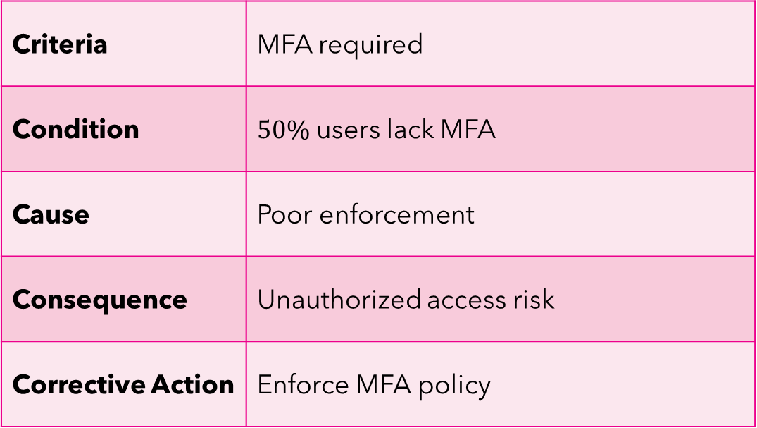
I Weak authentication
Criteria | MFA required
Condition | $50\%$ users lack MFA
Cause | Poor enforcement
Consequence​ | Unauthorized access risk
Corrective Action | Enforce MFA policy

Slide 12
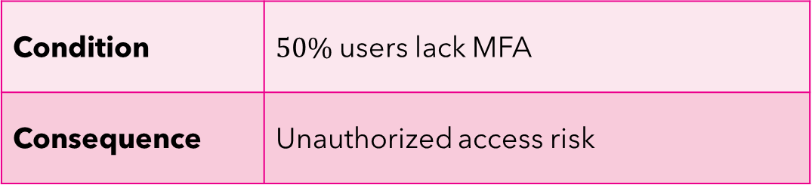
II Patch mismanagement
Condition | $50\%$ users lack MFA
Consequence​ | Unauthorized access risk

Slide 13
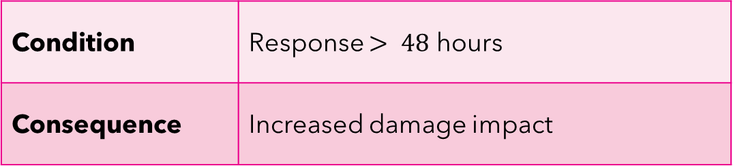
III incident response delay
Condition | Response $> 48$ hours
Consequence​ | Increased damage impact

Slide 14
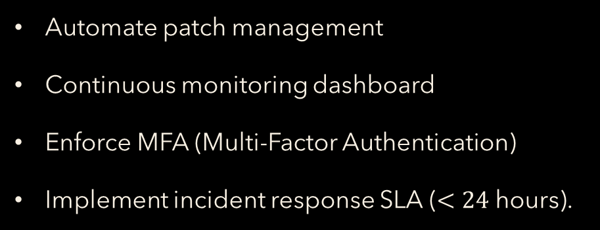
Recommendations
Automate patch management
Continuous monitoring dashboard
Enforce MFA (Multi-Factor Authentication)
Implement incident response SLA ($<24$ hours).

