Slide 1

LNHS Online Forum
Home
About
Disclaimer
Login Account
STUDENT
TEACHER

Slide 2
The Page
Developer
References

Slide 3
LNHS Online Forum
The Page: The LNHS online forum is a webpage where users can discuss reports and findings related to the LNHS e-library. It’s a space for sharing insights, exchanging ideas, and collaborating on projects.

Slide 4
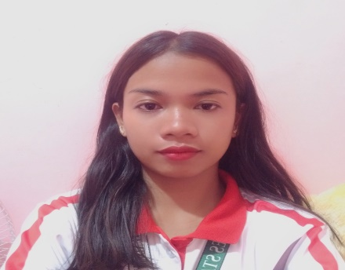
CURRICULUM VITAE
Daisy Mae S. Humpa
(Bachelor of Science Information Technology)
Purok Ghelenan Pob. Lapuyan ZDS.
Cell # 09658027148
daisymaehumpa785@gmail.com
PERSONAL DATA
Date of Birth: January 29 2000
Age: 24
Place of Birth: Pingolis,Pob.Lapuyan ZDS.
Father: Roberto L. Humpa Jr.
Mother: Daisy S. Humpa
Religion: Alliance
Civil Status: Single
Language/Dialect Spoken: Subanen
Experience: 3 years Filipino Club Officer At LNHS
Educational Background
TERTIARY: Undergraduate
SECONDARY: Lapuyan National High School
ELEMENTARY: AVASMCES

Slide 5
http://scholar.google.com/scholar?hl=en&as_sdt=0,5&qsp=3&q=online+information+public+libraries&qst=br#d=gs_qabs&t=170987695693&u%23p%3Dui1UzRFZxU4J

Slide 6
LNHS Online Forum
Disclaimer: The LNHS online forum serves as a platform for open discussion and exchange of ideas related to the LNHS. The views expressed by participants are their own and do not necessarily reflect the views of LNHS or its affiliated entities.While every effort is made to ensure the accuracy and reliability of information shared, users are encouraged to independently verify any information obtained from the forum.

Slide 7
LNHS Online Forum
Login Account
Username
Password
LOGIN
I Don’t have account
REGISTER

Slide 8

Student Account
Join Forum
View Topics
Ask Question
Logout

Slide 9
LNHS Online Forum
Login Account
Username
Password
LOGIN
I Don’t have account
REGISTER

Slide 10
LNHS E-Library Report Forum
Last Name
First Name
Middle Name
Birthdate
Email
Password
Role
Register Account
Register

Slide 11
Teacher’s Account
Start Forum
Topics
Reply Question
Logout

Slide 12
Teacher’s Account
General Discussion
Report Submission
View Feedback
Logout

Slide 13
Student Account
General Discussion
Report Submission
Give Feedback
Logout

Slide 14
LNHS Online Forum
Last Name
First Name
Middle Name
Birthdate
Email
Password
Role
Register Account
Register

