Slide 1
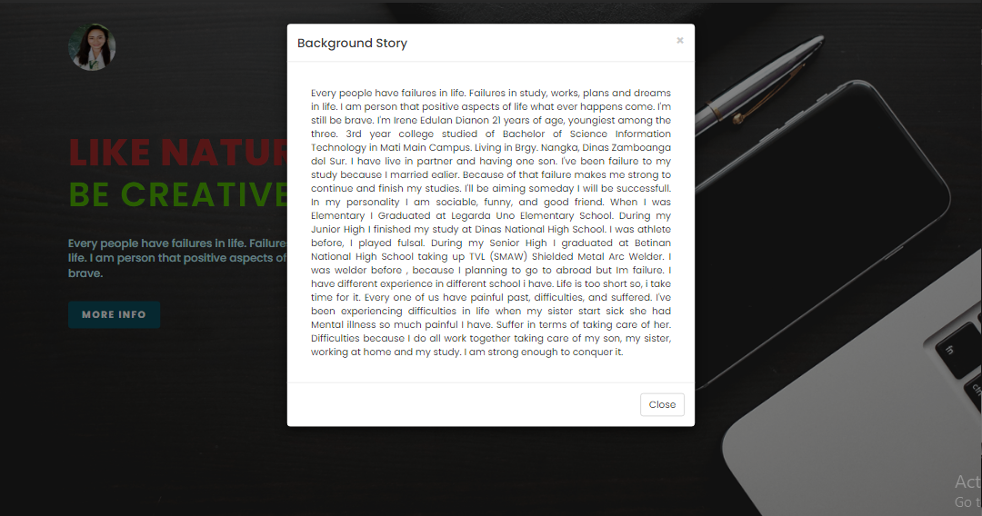


RESPONSIVE WEB
Desktop Screen
Tablet Screen
Mobile Screen

Slide 2
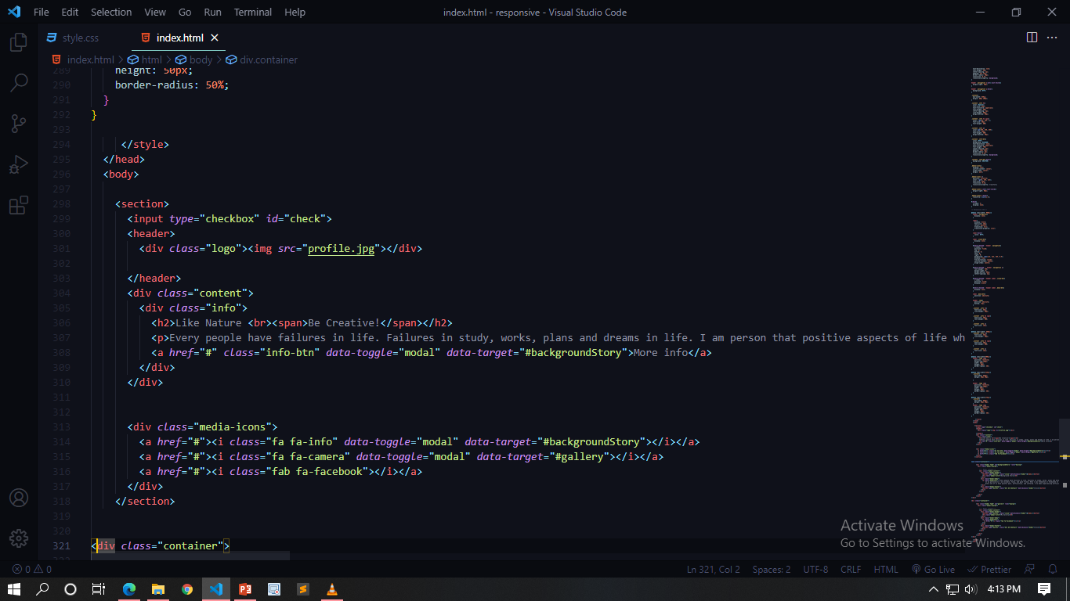
I make a responsive website by creating a <section> tag as a parent element to make it responsive. Inside the <section> tag there’s two <div> (content and media-icons) blocks that will separate them when the screen grows small.

Slide 3
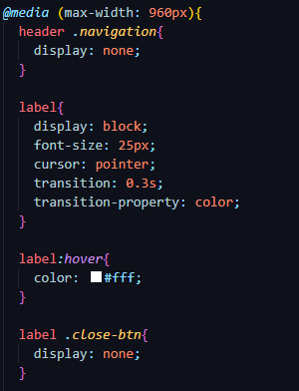
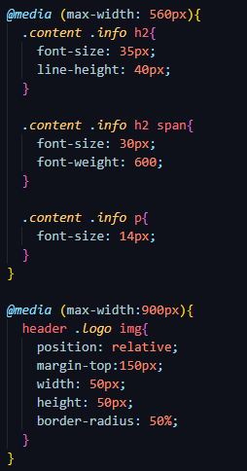
This makes the main part of the website that changes every sizes of the screen, this @media screen with specific width size, it will changes the size/positions/display of the property when the screen size met this condition inside @media screen.

