Slide 1
Abstraction Recovery for Scalable Static Binary Analysis
Edward J. Schwartz
Software Engineering Institute
Carnegie Mellon University

Slide 2
The Gap Between Binary and Source Code
push %ebp
mov %esp,%ebp
sub $0x10,%esp
movl $0x1,-0x4(%ebp)
jmp 1d <f+0x1d>
mov -0x4(%ebp),%eax
imul 0x8(%ebp),%eax
mov %eax,-0x4(%ebp)
subl $0x1,0x8(%ebp)
cmpl $0x1,0x8(%ebp)
jg f <f+0xf>
mov -0x4(%ebp),%eax
leave
ret
Functions
Types
Variables
int f(int c) {
int accum = 1;
for (; c > 1; c--) {
accum = accum * c;
}
return accum;
}
Control
Flow

Slide 3
Static Binary Analysis
Automatic extraction of facts about binary programs without executing them

Slide 4
Static Binary Analysis Strengths
High Coverage
Reason about most or all possible executions
Safe
Does not execute (possibly unsafe) code
Widely Applicable
Source code not needed
Useful for end-users, researchers, sysadmins

Slide 5
Primary Challenge: Scalability
Largest
Program
Largest Program
Static Binary Code
Analysis Tools
Static Source Code Analysis Tools

Slide 6
The Gap Between Binary and Source Code
push %ebp
mov %esp,%ebp
sub $0x10,%esp
movl $0x1,-0x4(%ebp)
jmp 1d <f+0x1d>
mov -0x4(%ebp),%eax
imul 0x8(%ebp),%eax
mov %eax,-0x4(%ebp)
subl $0x1,0x8(%ebp)
cmpl $0x1,0x8(%ebp)
jg f <f+0xf>
mov -0x4(%ebp),%eax
leave
ret
Functions
Types
Variables
int f(int c) {
int accum = 1;
for (; c > 1; c--) {
accum = accum * c;
}
return accum;
}
Control
Flow

Slide 7
Abstraction Recovery
int f (int x) {
int y = 1;
while (x > y) {
y++;
010100101010101001010110111010101001010101010
010100101010101
Choose abstractions
Recover abstractions
Scalable, high-level reasoning
Compiled C Programs
Decompilation
Functions
Types
Variables
Static Source Code Analysis

Slide 8
Reverse Engineering
“Reverse engineering is the process of analyzing a subject system to create representations of the system at a higher level of abstraction.”
Chikofsky and Cross
Software Reuse and Reverse Engineering in Practice

Slide 9
Reverse Engineering
Abstraction
Binary
More Abstract
Less Detail

Slide 10
Abstraction Recovery
int f (int x) {
int y = 1;
while (x > y) {
y++;
010100101010101001010110111010101001010101010
010100101010101
Choose abstractions
Recover abstractions
Scalable, high-level reasoning
Compiled C Programs
Decompilation
Functions
Types
Variables
Reverse Engineering
Static Source Code Analysis

Slide 11
Outline
Introduction
Recovering Abstractions
C abstractions (Phoenix Decompiler)
Gadget abstractions (Q ROP Compiler)
Future Work and Conclusions

Slide 12
int f (int x) {
int y = 1;
while (x > y) {
y++;
}
return y;
int f (int a) {
int v = 1;
while (a > v++) {}
return v;
Original
Source
Recovered
Source
Decompiler
Compiler
010100101010101001010110111010101001010101010101111100010100010101101001010100010010101101010101011010111
Compiled
Binary

Slide 13
The Phoenix Decompiler
Designed for abstraction recovery
Correctness (new)
Prior work: focus on manual reverse engineering
Effective abstraction recovery
Design: series of stages
Each stage recovers a different abstraction
Some are new; some are not

Slide 14
Phoenix Overview
010100101010101001010110111010101001010101010101111100010100010101101001010100010010101101010101011010111
CFG Recovery
Variable and Type Recovery
int f (int x) {
int y = 1;
while (x > y) {
y++;
}
return y;
Source-code Output or Analysis
Control
Flow
Structuring
New in Phoenix

Slide 15
Control Flow Structuring
if (e)
{…;}
else
{…;}
Compilation
e
¬e
if (e)
{…;}
else
{…;}
Control Flow Structuring
?
e
¬e

Slide 16
Structural Analysis
Iteratively match patterns to CFG
Collapse matching regions
B1
B1
B1
B2
B2
B2
If-then
While
Sequence

Slide 17
Structural Analysis Example
SEQ
WHILE
ITE 1
SEQ 1
...;
while (...) { if (...) {...} else {...} };
...; ...;

Slide 18
Structural Analysis Property Checklist
Correctness

Slide 19
Structural Analysis Property Checklist
Correctness
Not originally intended for decompilation
Structure can be incorrect for decompilation

Slide 20
Semantics Preservation
Reductions preserve meaning of program
NATURAL
LOOP
y≠2
x≠1
y=2
x=1
y=2
x=1
Non-determinism

Slide 21
Structural Analysis Property Checklist
Correctness
Not originally intended for decompilation
Structure can be incorrect for decompilation
Effective abstraction recovery

Slide 22
Structural Analysis Property Checklist
Correctness
Not originally intended for decompilation
Structure can be incorrect for decompilation
Effective abstraction recovery
Graceless failures for unstructured programs
break, continue, and gotos
Failures cascade to large subgraphs

Slide 23
Unrecovered Structure
s1;
while (e1) {
if (e2) { break; }
s2;
}
s3;
s1;
L1: if (e1) { goto L2; }
else { goto L4; }
L2: if (e2) { goto L4; }
L3: s2; goto L1;
L4: s3;
Original
Decompiled
SEQ
UNKNOWN
This break edge prevents progress

Slide 24
Iterative Refinement
Remove edges that are preventing a match
Represent in decompiled source as break, goto, continue
Run on remaining graph
Allows structuring algorithm to make more progress

Slide 25
Iterative Refinement
s1;
while (e1) {
if (e2) { break; }
s2;
}
s3;
s1;
while (e1) {
if (e2) { break; }
s2;
}
s3;
Original
Decompiled
SEQ
WHILE
BREAK
SEQ 1

Slide 26
Large Scale Experiment Details
How does Phoenix compare with state of the art?
Measure impact of:
Semantics preservation
Iterative refinement
Other decompilers
Hex-Rays (industry state of the art)
Boomerang (academic state of the art)

Slide 27
Large Scale Experiment Details
How does Phoenix compare with state of the art?
Measure impact of:
Semantics preservation
Iterative refinement
Other decompilers
Hex-Rays (industry state of the art)
Boomerang (academic state of the art)
Did not terminate in <1 hour for most programs

Slide 28
Large Scale Experiment Details
GNU coreutils 8.17, compiled with gcc
Programs of varying complexity
Test suite
Metrics
Correctness
Number of decompiled utilities that pass unit tests
Has not been done before on large scale!
Control-flow structure recovery
Count number of goto statements

Slide 29
Number of Correct Utilities

Slide 30
Number of Correct Utilities

Slide 31
Number of Correct Utilities
107
All Utilities

Slide 32
Correctness
Any incorrect abstraction can cause incorrect decompilation
Hex Rays
?
Phoenix
All (known) correctness errors attributed to type recovery
Undiscovered variables
No known problems in control flow structuring

Slide 33
Control Flow Structure: Gotos Emitted (Fewer is Better)

Slide 34
Control Flow Structure: Gotos Emitted (Fewer is Better)

Slide 35
Outline
Introduction
Recovering Abstractions
C abstractions (Phoenix Decompiler)
Gadget abstractions (Q ROP Compiler)
Future Work and Conclusions

Slide 36


OS Defenses
All major operating systems employ defenses
DEP: Data Execution Prevention
ASLR: Address Space Layout Randomization
Make reliable exploitation difficult
How difficult?

Slide 37
Simple Control-Flow Hijack Exploit
Exploit
Shellcode
Padding
Pointer
Computation
Control

Slide 38
Data Execution Prevention (DEP)
Exploit
Shellcode
Padding
Pointer
Crash
User input is non-executable
DEP: Buffers cannot be writable and executable

Slide 39
Bypassing DEP
Goal: Specify exploit computation even when DEP is enabled
Return-oriented Programming [Shacham 2007]
Use existing instructions from program it to create self-contained gadgets
Chain gadgets together to encode computation

Slide 40
Return-oriented Programming
Example: How can we write to memory without shellcode?

Slide 41
Return-oriented Programming
nextaddr
Exploit
addr3
eax
address
ebx
addr2
value
stack
Gadgets
addr1
pop %eax
ret
addr2
pop %ebx
ret
addr3
movl %eax, (%ebx)
ret

Slide 42

Gadgets as Abstractions
Gadgets are behavior specifications
Load constant
Store to memory
Don’t need to reason about low-level behavior to combine them
Load to register
Store to memory
Load from memory
Arithmetic

Slide 43
Address Space Layout Randomization (ASLR)
ASLR disabled
Exploit
Gadgets
ASLR enabled
Gadgets
Exploit
Crash
ASLR: Addresses are unpredictable

Slide 44
Return-oriented Programming + ASLR
Randomized code can’t be used for ROP
But ASLR implementations do not randomize all code…

Slide 45
(Typical) Randomized Code in Linux
Unrandomized
Randomized
Program Image
Libc
Stack
Heap
Executable

Slide 46
Modern Exploitation using ROP
Program image is often the only unrandomized code
Small
Program-specific
How much unrandomized code does an attacker need to use ROP?
We need a graduate student with a lot of free time
We need automatic ROP techniques that can work with the program image

Slide 47
Q: Automatic ROP System

Slide 48
Q: ROP Overview
Abstraction Recovery
Source P
Discovery
Assignment
Computation
Arrangement
High-level
Reasoning

Slide 49
Gadget Discovery
Discovery: Does instruction sequence do something we can use for our computation?
Fast randomized test for every program location (thousands or millions)
Vulnerable P
sbb %eax, %eax; neg %eax; ret

Slide 50
Randomized Testing
Before
EAX | 0x0298a7bc
CF | 0x1
ESP | 0x81e4f104
OutReg <- InReg
sbb %eax, %eax; neg %eax; ret
Semantic Definition
For Move
After
EAX | 0x1
ESP | 0x81e4f108
EBX | 0x0298a7bc

Slide 51
Q’s Semantic Definitions/ Gadget Types
Gadget Type | Semantic Definition | Real World Example
MoveRegG | Out <- In | xchg %eax, %ebp; ret
LoadConstG | Out <- Constant | pop %ebp; ret
ArithmeticG | Out <- In1 + In2 | add %edx, %eax; ret
LoadMemG | Out <- M[Addr + Offset] | movl 0x60(%eax), %eax; ret
StoreMemG | M[Addr + Offset] <- In | mov %dl, 0x13(%eax); ret
ArithmeticLoadG | Out +<- M[Addr + Offset] | add 0x1376dbe4(%ebx), %ecx; (…); ret
ArithmeticStoreG | M[Addr + Offset] +<- In | add %al, 0x5de474c0(%ebp); ret

Slide 52
Randomized Testing
Randomized testing quickly rules out non-gadgets
Fast
Enables more expensive second stage
Second stage: program verification

Slide 53
Connection to Program Verification
sum = 0
while (n > 0) {
sum += n;
n--;
}
sbb %eax, %eax
neg %eax; ret
EAX <- CF
sum =
Does the post-condition always hold after executing program?

Slide 54
Gadget Verification
Weakest Precondition
sbb %eax, %eax
neg %eax; ret
Θ
EAX <- CF
Validity Check
Valid (Gadget)
Invalid (not Gadget)
Θ

Slide 55
Semantic-based Gadget Discovery
Q is better at finding gadgets than I am!
imul $1, %eax, %ebx ret | Move %eax to %ebx
lea (%ebx,%ecx,1), %eax ret | Store %ebx+%ecx in %eax
sbb %eax, %eax; neg %eax ret | Move carry flag to %eax

Slide 56
Q: ROP Overview
Abstraction Recovery
Source P
Discovery
Assignment
Computation
Arrangement
High-level
Reasoning

Slide 57
Research Questions
How much unrandomized code is sufficient to create ROP payloads?
Detail: payloads call any functions in libc
system, execv, connect, mprotect

Slide 58
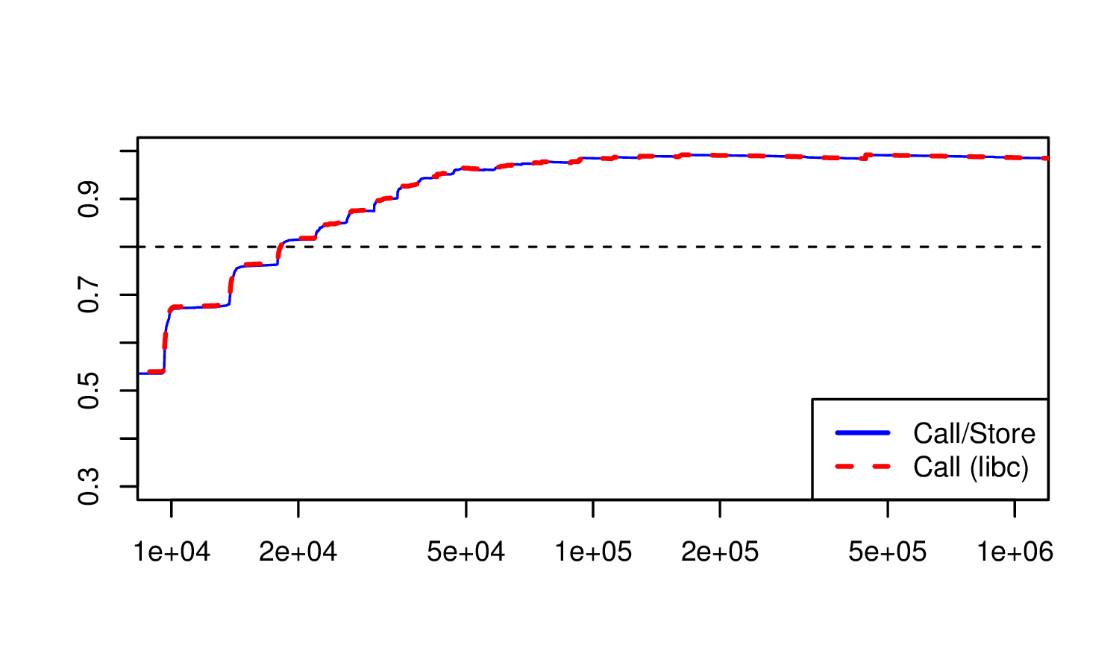
ROP Success Probability
Probability that attack works
Call libc functions in 80% of programs >= true (20KB)
Program Size (bytes)

Slide 59
Research Questions
Can Q automatically add ROP payloads to existing exploits for real programs?

Slide 60
Real Exploits
Q was able to automatically add ROP to nine exploits downloaded from exploit-db.com
Name | Total Time | OS
Free CD to MP3 Converter | 130s | Windows 7
Fatplayer | 133s | Windows 7
A-PDF Converter | 378s | Windows 7
A-PDF Converter (SEH exploit) | 357s | Windows 7
MP3 CD Converter Pro | 158s | Windows 7
rsync | 65s | Linux
opendchub | 225s | Linux
gv | 237s | Linux
Proftpd | 44s | Linux

Slide 61
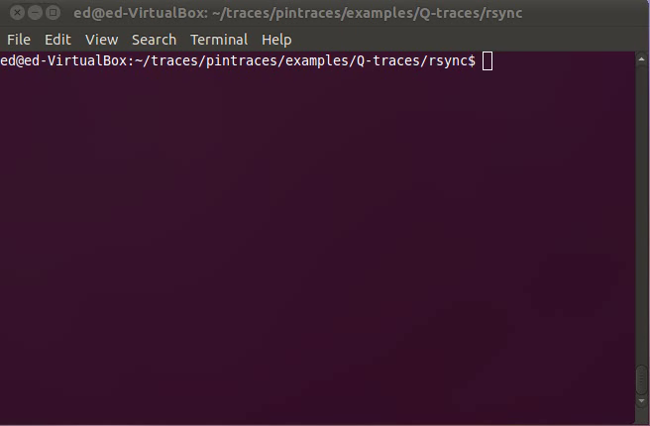
Demo!

Slide 62
Outline
Introduction
Recovering Abstractions
C abstractions (Phoenix Decompiler)
Gadget abstractions (Q ROP Compiler)
Future Work and Conclusions

Slide 63
Abstraction Recovery Questions
Systems: How do we build systems that
Recover abstractions?
Use abstractions?
Theory: When is it possible to recover abstractions?
Observable behaviors preserved by compilation
Scalability: How does recovering and utilizing abstractions improve scalability?
ROP (150x)
C verification (15x)

Slide 64

Future Work
Certified decompilation
Prove that binary → C translation is correct
Optimal abstraction recovery
Provably optimal algorithms (i.e., minimum gotos)
Additional abstractions & architectures
C++, ARM, Dalvik

Slide 65
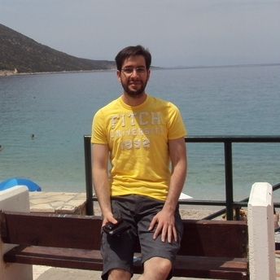
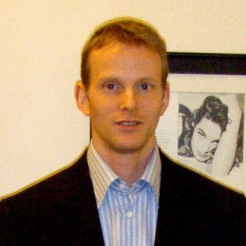
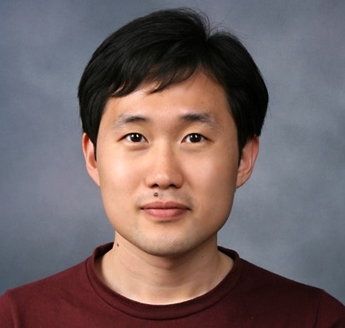
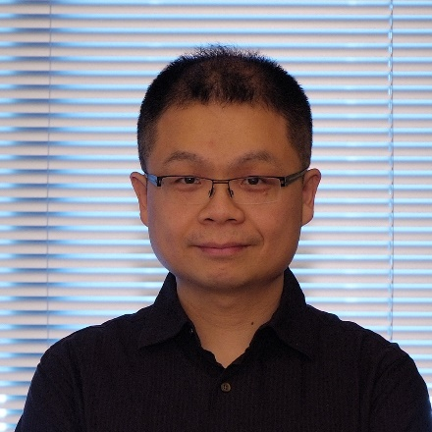
Thanks to My Great Co-authors
Thanassis Avgerinos
David Brumley
JongHyup Lee
Maverick Woo

Slide 66
Conclusion
Abstraction Recovery
Recovering abstractions helps static binary analysis
Phoenix decompiler
Goal: Correct, effective decompilation
New control-flow structuring algorithm
Q ROP Compiler
Takeaway: Unrandomized code is dangerous
20KB makes DEP+ASLR ineffective

Slide 67
Thanks ☺
Questions?
Edward J. Schwartz
eschwartz@cert.org
http://www.ece.cmu.edu/~ejschwar

