Slide 1
Q: Exploit Hardening Made Easy
Edward J. Schwartz, Thanassis Avgerinos, and David Brumley
Carnegie Mellon University

Slide 2


Downloading Exploits
I found a control flow hijack exploit online!
Exploit
Evil Ed
Windows 7

Slide 3
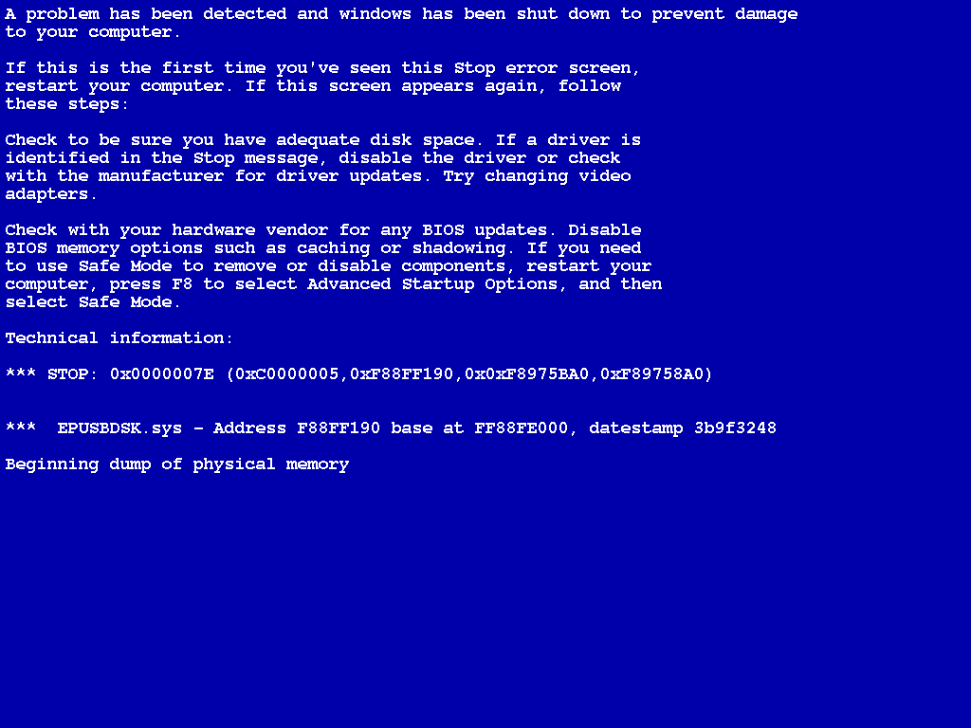

Slide 4
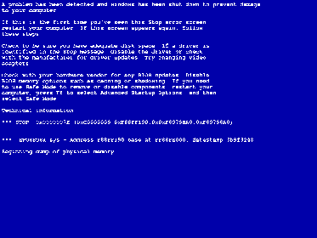
Downloading Exploits
Why didn’t the exploit work?
Evil Ed
Windows 7

Slide 5
Causes of Broken Exploits
Exploit used OS/binary-specific tricks/features
OS Defenses

Slide 6
OS Defenses
Modern OS defenses are designed to make exploiting difficult
ASLR: Address Space Layout Randomization
DEP: Data Execution Prevention
Do not guarantee control flow integrity
How difficult?

Slide 7
Exploit hardening: Modifying exploits to bypass defenses

Slide 8
Overview
Background: Defenses and Return Oriented Programming (ROP)
Q: ROP + Hardening
Automatic ROP
Automatic Hardening
Evaluation
Limitations
Conclusion

Slide 9
Simple Exploit
Exploit
Shellcode
Padding
Pointer
Computation
Control

Slide 10
Data Execution Prevention (DEP)
Exploit
Shellcode
Padding
Pointer
Crash
User input is non-executable
DEP: Buffers cannot be writable and executable

Slide 11
Bypassing DEP
Goal: Specify exploit computation even when DEP is enabled
Return Oriented Programming [S07]
Use existing instructions from program in special order to encode computation

Slide 12
Return Oriented Programming
Example: How can we write to memory without shellcode?

Slide 13
Return Oriented Programming
nextaddr
Exploit
addr3
eax
address
ebx
addr2
value
stack
Gadgets
addr1
pop %eax
ret
addr2
pop %ebx
ret
addr3
movl %eax, (%ebx)
ret

Slide 14
Address Space Layout Randomization (ASLR)
ASLR disabled
Exploit
Gadgets
ASLR enabled
Gadgets
Exploit
Crash
ASLR: Addresses are unpredictable

Slide 15
Return Oriented Programming + ASLR
Bad news: Randomized code can’t be used for ROP
Good news: ASLR implementations leave small amounts of code unrandomized
Evil Ed

Slide 16
ASLR in Linux (Example)
Unrandomized
Randomized
Program Image
Libc
Stack
Heap
Executable

Slide 17
Consequences
Challenge: Program image is often the only unrandomized code
Small
Program-specific
Prior work on ROP assumes unrandomized large code bases; can’t simply reuse
We developed new automated ROP techniques for targeting the program image

Slide 18
Overview
Background: Defenses and Return Oriented Programming (ROP)
Q: ROP + Hardening
Automatic ROP
Automatic Hardening
Evaluation
Limitations
Conclusion

Slide 19
Automatic ROP Overview
Source P
Instructions from P
Computation

Slide 20
ROP Overview
Source P
Discovery
Assignment
Computation
Arrangement

Slide 21
Gadget Discovery
Gadget Discovery: Does instruction sequence do something we can use for our computation?
Fast randomized test for every program location (thousands or millions)
Source P
sbb %eax, %eax; neg %eax; ret

Slide 22
Randomized Testing
EAX | 0x0298a7bc
CF | 0x1
ESP | 0x81e4f104
Before
OutReg <- InReg
Semantic Definition
For Move
sbb %eax, %eax; neg %eax; ret
If 10 random runs satisfy a semantic definition, then Q probably found a gadget of that type
EAX | 0x1
ESP | 0x81e4f108
EBX | 0x0298a7bc
After

Slide 23
Q’s Gadget Types
Gadget Type | Semantic Definition | Real World Example
MoveRegG | Out <- In | xchg %eax, %ebp; ret
LoadConstG | Out <- Constant | pop %ebp; ret
ArithmeticG | Out <- In1 + In2 | add %edx, %eax; ret
LoadMemG | Out <- M[Addr + Offset] | movl 0x60(%eax), %eax; ret
StoreMemG | M[Addr + Offset] <- In | mov %dl, 0x13(%eax); ret
ArithmeticLoadG | Out +<- M[Addr + Offset] | add 0x1376dbe4(%ebx), %ecx; (…); ret
ArithmeticStoreG | M[Addr + Offset] +<- In | add %al, 0x5de474c0(%ebp); ret

Slide 24
Q’s Gadget Types
Gadget Type | Semantic Definition | Real World Example
MoveRegG | Out <- In | xchg %eax, %ebp; ret
LoadConstG | Out <- Constant | pop %ebp; ret
ArithmeticG | Out <- In1 + In2 | add %edx, %eax; ret
LoadMemG | Out <- M[Addr + Offset] | movl 0x60(%eax), %eax; ret
StoreMemG | M[Addr + Offset] <- In | mov %dl, 0x13(%eax); ret
ArithmeticLoadG | Out +<- M[Addr + Offset] | add 0x1376dbe4(%ebx), %ecx; (…); ret
ArithmeticStoreG | M[Addr + Offset] +<- In | add %al, 0x5de474c0(%ebp); ret

Slide 25
Q’s Gadget Types
Gadget Type | Semantic Definition | Real World Example
MoveRegG | Out <- In | xchg %eax, %ebp; ret
LoadConstG | Out <- Constant | pop %ebp; ret
ArithmeticG | Out <- In1 + In2 | add %edx, %eax; ret
LoadMemG | Out <- M[Addr + Offset] | movl 0x60(%eax), %eax; ret
StoreMemG | M[Addr + Offset] <- In | mov %dl, 0x13(%eax); ret
ArithmeticLoadG | Out +<- M[Addr + Offset] | add 0x1376dbe4(%ebx), %ecx; (…); ret
ArithmeticStoreG | M[Addr + Offset] +<- In | add %al, 0x5de474c0(%ebp); ret

Slide 26
Randomized Testing
Randomized testing tells us we likely found a gadget
Fast; filters out many candidates
Enables more expensive second stage
Second stage: SMT-based gadget discovery
Gadget discovery is program verification

Slide 27
SMT-Based Gadget Discovery
sbb %eax, %eax
neg %eax; ret
[D76]
Weakest Precondition
F
EAX <- CF
SMT Validity Check
Valid (Gadget)
Invalid (not Gadget)
F

Slide 28
SMT-Based Gadget Discovery
Q is better at finding gadgets than I am!
imul $1, %eax, %ebx ret | Move %eax to %ebx
lea (%ebx,%ecx,1), %eax ret | Store %ebx+%ecx in %eax
sbb %eax, %eax; neg %eax ret | Move carry flag to %eax

Slide 29
ROP Overview
Source P
Discovery
Assignment
Computation
Arrangement

Slide 30
Gadget Arrangement
Gadget Arrangement: How can gadget types be combined to implement a computation?
Alternate view: Compile user computation for gadget type architecture
Example: M[0xcafecafe] := 0xdeadbeef

Slide 31
Arrangement: Storing to Memory
T1
T2
T3
LoadConst
deadbeef
LoadConst
cafecafe
Address
Value
StoreMem, u32

Slide 32
Gadget Arrangement
How can we write to memory without StoreMem?

Slide 33
Arrangement: Storing to Memory
T1
T2
T3
Writes zero to M[cafecafe]
LoadConst
0
LoadConst
cafecafe
Address
Value
ArithmeticStore, u32, Bitwise And

Slide 34
Arrangement: Storing to Memory
T1
T2
T3
Adds deadbeef to M[cafecafe].
0 + deadbeef =
deadbeef
LoadConst
deadbeef
LoadConst
cafecafe
Address
Value
ArithmeticStore, u32, Plus

Slide 35
Gadget Arrangement
Gadgets types are often unavailable
Synthesize alternatives on the fly
Flexible arrangement rules are necessary for small code bases

Slide 36
ROP Overview
Source P
Discovery
Assignment
Computation
Arrangement

Slide 37
Assignment
Gadget Assignment: Assign concrete gadgets found in source program to arrangements
Assignments must be compatible

Slide 38
Assignment: Register Mismatch
CONFLICT
%ebx and %ecx mismatch
LoadConst
deadbeef
StoreMem, u32
pop %eax
ret
mov %eax, (%ecx)
ret
LoadConst
cafecafe
pop %ebx
ret

Slide 39
Gadget Assignment
Need to search over
Gadgets
Schedules
We developed dynamic programming approach to find assignment
Easy to print payload bytes with assignment

Slide 40
Overview
Background: Defenses and Return Oriented Programming (ROP)
Q: ROP + Hardening
Automatic ROP
Automatic Hardening
Evaluation
Limitations
Conclusion

Slide 41
Exploit Hardening
Old Exploit
(stopped by DEP+ASLR)
Hardened Exploit
(bypasses DEP+ASLR)
ROP Payload

Slide 42
Trace-based Analysis
Record P on the old exploit
Branch 1
Branch 2
Branch 3
Stop at vulnerability condition

Slide 43
Reasoning about Executions
Logical Formula
For All Inputs
On Path
[SAB10]
Symbolic Execution

Slide 44
Exploit Constraints
Path
Exploit

Slide 45
Exploit Constraints
How do we ensure the ROP payload gets in the exploit?
Exploit
Gadgets
M[ESP] = &gadget1
M[ESP+off1] = &gadget2
M[ESP+off2] = &gadget3
Exploit Constraints
SMT
Exploit
Path Constraints

Slide 46
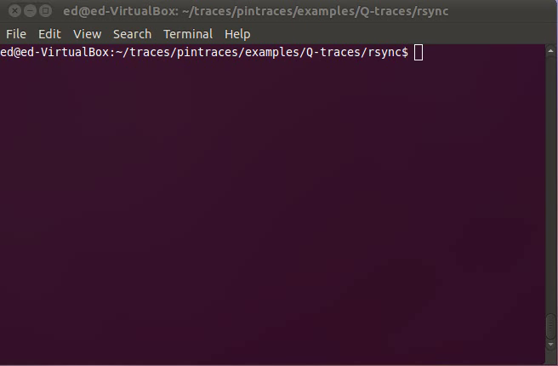
Demo!

Slide 47
Overview
Background: Defenses and Return Oriented Programming (ROP)
Q: ROP + Hardening
Automatic ROP
Automatic Hardening
Evaluation
Limitations
Conclusion

Slide 48
Evaluation Questions
Can Q harden exploits for real binary programs?
How much unrandomized code is sufficient to create ROP payloads?

Slide 49
Real Exploits
Q was able to automatically harden nine exploits downloaded from exploit-db.com
Name | Total Time | OS
Free CD to MP3 Converter | 130s | Windows 7
Fatplayer | 133s | Windows 7
A-PDF Converter | 378s | Windows 7
A-PDF Converter (SEH exploit) | 357s | Windows 7
MP3 CD Converter Pro | 158s | Windows 7
rsync | 65s | Linux
opendchub | 225s | Linux
gv | 237s | Linux
Proftpd | 44s | Linux

Slide 50
ROP Probability
Given program size, what is the probability Q can create a payload?
Measure over all programs in /usr/bin
Depends on target computation
Call functions statically or dynamically linked by the program (blue on next slide)
Call any function in libc (red; harder)
system, execv, connect, mprotect, …

Slide 51
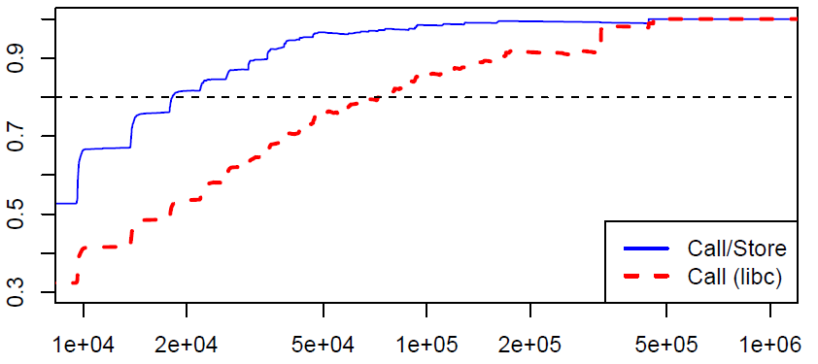
ROP Probability
Probability that attack works
Call linked functions in 80% of programs >= true (20KB)
Call libc functions in 80% of programs >= nslookup (100KB)
Program Size (bytes)

Slide 52
Overview
Background: Defenses and Return Oriented Programming (ROP)
Q: ROP + Hardening
Automatic ROP
Automatic Hardening
Evaluation
Limitations
Conclusion

Slide 53
Limitations
Single path (trace-based) analysis
restrictive; prevents finding exploits
Q’s gadgets types are not Turing-complete
Calling system(“/bin/sh”) or mprotect() usually enough
Comparison with related work
Q cannot find conditional gadgets
Potential automation of interesting work on ROP without Returns [CDSSW10]

Slide 54
Overview
Background: Defenses and Return Oriented Programming (ROP)
Q: ROP + Hardening
Automatic ROP
Automatic Hardening
Evaluation
Limitations
Conclusion

Slide 55
Conclusion
We built Q, a system that automatically hardens exploits to bypass defenses
Challenge: Reusing small amounts of code
Q automatically hardened nine real exploits found in the wild against latest OS defenses
Takeaway: Unrandomized code is dangerous
20KB makes DEP+ASLR ineffective

Slide 56
Thanks! ☺
Questions?
Check out some of the gadgets Q can find at http://plaid.cylab.cmu.edu:8080/~ed/gadgets
Edward J. Schwartz
edmcman@cmu.edu
http://www.ece.cmu.edu/~ejschwar

Slide 57
Related Work
Seminal ROP Paper [S07]
Found Turing-complete gadgets in libc mostly by hand
Automatic ROP [HHF09,DKW10]
Focuses on large code bases (libc, mobile libraries)
Surgically Returning to Libc, [RMPB09]
Calculated address of libc functions using ROP gadgets from program image ☺
Implements a subset of our gadgets ☹
Immunity’s DEPLIB, [No Paper]
Tool for creating ROP payloads
Also uses SMT for gadget discovery ☺
No public evaluation that we know of ☹

Slide 58
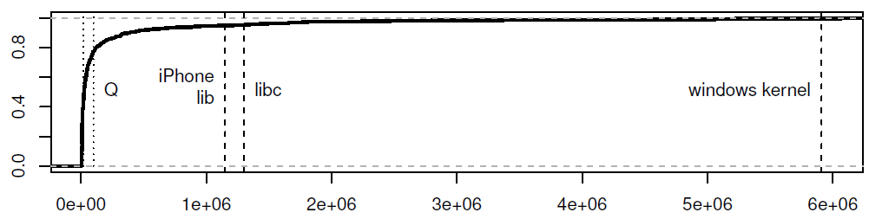
Sizes of Gadget Sources
Ratio
File size
(bytes)

Slide 59
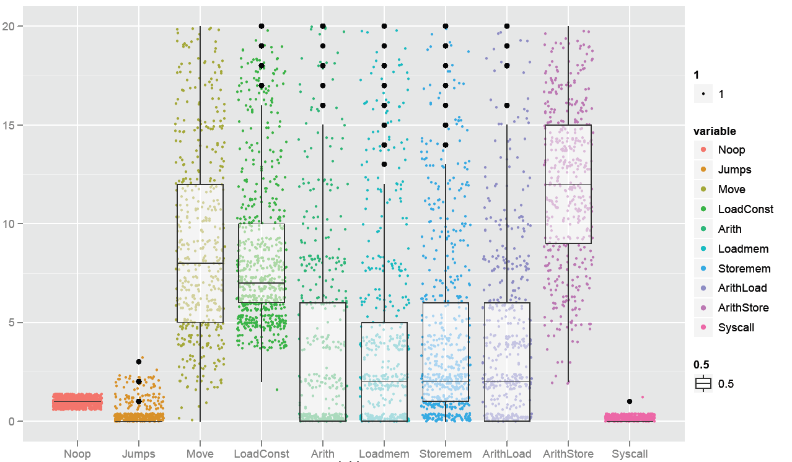
Types of Gadgets
Number of StoreMem
Number of ArithStore

