Slide 1
Native x86 Decompilation Using Semantics-Preserving Structural Analysis and Iterative Control-Flow Structuring
Edward J. Schwartz*, JongHyup Lee✝, Maverick Woo*, and David Brumley*
Carnegie Mellon University *
Korea National University of Transportation ✝

Slide 2
Which would you rather analyze?
Functions
Types
push %ebp
mov %esp,%ebp
sub $0x10,%esp
movl $0x1,-0x4(%ebp)
jmp 1d <f+0x1d>
mov -0x4(%ebp),%eax
imul 0x8(%ebp),%eax
mov %eax,-0x4(%ebp)
subl $0x1,0x8(%ebp)
cmpl $0x1,0x8(%ebp)
jg f <f+0xf>
mov -0x4(%ebp),%eax
leave
ret
Variables
int f(int c) {
int accum = 1;
for (; c > 1; c--) {
accum = accum * c;
}
return accum;
}
Control
Flow

Slide 3
int f (int x) {
int y = 1;
while (x > y) {
y++;
}
return y;
int f (int a) {
int v = 1;
while (a > v++) {}
return v;
Original
Source
Recovered
Source
Decompiler
Compiler
010100101010101001010110111010101001010101010101111100010100010101101001010100010010101101010101011010111
Compiled
Binary

Slide 4
Decompilers for Software Security
Manual reverse-engineering
Traditional decompiler application
Apply wealth of existing source-code techniques to compiled programs [Chang06]
Find bugs, vulnerabilities
Heard at Usenix Security 2013, during Dowsing for Overflows
“We need source code to access the high-level control flow structure and types”

Slide 5
Desired Properties for Security
Effective abstraction recovery
Abstractions improve comprehension

Slide 6
Effective Abstraction Recovery
s1;
while (e1) {
if (e2) { break; }
s2;
}
s3;
s1;
L1: if (e1) { goto L2; }
else { goto L4; }
L2: if (e2) { goto L4; }
L3: s2; goto L1;
L4: s3;
More
Abstract
Less Abstract

Slide 7
Desired Properties for Security
Effective abstraction recovery
Abstractions improve comprehension
Correctness
Buggy(Decompiled) ➔ Buggy(Original)

Slide 8
Correctness
int f (int x) {
int y = 1;
while (x > y) {
y++;
}
return y;
int f (int a) {
int v = 1;
while (a > v++) {}
return v;
Original
Source
Recovered
Source
Decompiler
Compiler
Are these two programs semantically equivalent?
010100101010101001010110111010101001010101010101111100010100010101101001010100010010101101010101011010111
Compiled
Binary

Slide 9
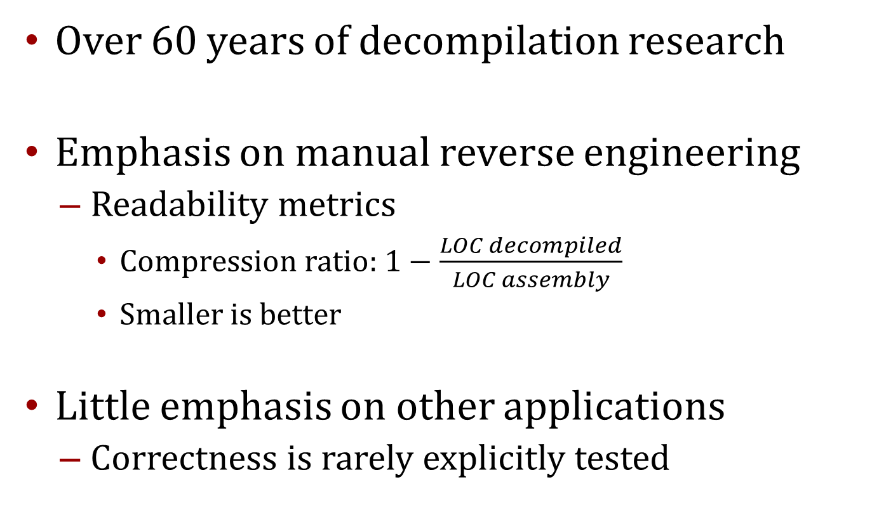
Prior Work on Decompilation
Over 60 years of decompilation research
Emphasis on manual reverse engineering
Readability metrics
Compression ratio: $1−\frac{LOC decompiled}{LOC assembly}$
Smaller is better
Little emphasis on other applications
Correctness is rarely explicitly tested

Slide 10
The Phoenix C Decompiler

Slide 11
How to build a better decompiler?
Recover missing abstractions one at a time
Semantics preserving abstraction recovery
Rewrite program to use abstraction
Don’t change behavior of program
Similar to compiler optimization passes

Slide 12
Semantics Preservation
Abstraction
Recovery
s1;
L1: if (e1) { goto L2; }
else { goto L4; }
L2: if (e2) { goto L4; }
L3: s2; goto L1;
L4: s3;
s1;
while (e1) {
if (e2) { break; }
s2;
}
s3;
Are these two programs semantically equivalent?

Slide 13
How to build a better decompiler?
Recover missing abstractions one at a time
Semantics preserving abstraction recovery
Rewrite program to use abstraction
Don’t change behavior of program
Similar to compiler optimization passes
Challenge: building semantics preserving recovery algorithms
This talk
Focus on control flow structuring
Empirical demonstration

Slide 14
Phoenix Overview
010100101010101001010110111010101001010101010101111100010100010101101001010100010010101101010101011010111
CFG Recovery
Type Recovery
int f (int x) {
int y = 1;
while (x > y) {
y++;
}
return y;
Source-code Output
Control
Flow
Structuring
New in Phoenix

Slide 15
Control Flow Graph Recovery
010100101010101001010110111010101001010101010101111100010100010101101001010100010010101101010101011010111
¬e
e
CFG Recovery
Vertex represents straight-line binary code
Edges represents possible control-flow transitions
Challenge: Where does jmp %eax go?
Phoenix uses Value Set Analysis [Balakrishnan10]

Slide 16
Type Inference on Executables (TIE) [Lee11]
How does each instruction constrain the types?
movl (%eax), %ebx
Constraint 1: %eax is a pointer to type <a>
Constraint 2: %ebx has type <a>
Solve all constraints to find <a>

Slide 17
Control Flow Structuring

Slide 18
Control Flow Structuring
if (e)
{…;}
else
{…;}
Compilation
e
¬e
if (e)
{…;}
else
{…;}
Control Flow Structuring
?
e
¬e

Slide 19
Control Flow Structuring: Don’t Reinvent the Wheel
Existing algorithms
Interval analysis [Allen70]
Identifies intervals or regions
Structural analysis [Sharir80]
Classifies regions into more specific types
Both have been used in decompilers
Phoenix based on structural analysis

Slide 20
Structural Analysis
Iteratively match patterns to CFG
Collapse matching regions
Returns a skeleton: while (e) { if (e’) {…} }
B1
B1
B2
B3
B2
if-then-else
while

Slide 21
Structural Analysis Example
SEQ
WHILE
ITE 1
SEQ 1
...;
while (...) { if (...) {...} else {...} };
...; ...;

Slide 22
Structural Analysis Property Checklist
Effective abstraction recovery

Slide 23
Structural Analysis Property Checklist
Effective abstraction recovery
Graceless failures for unstructured programs
break, continue, and goto statements
Failures cascade to large subgraphs

Slide 24
Unrecovered Structure
s1;
while (e1) {
if (e2) { break; }
s2;
}
s3;
s1;
L1: if (e1) { goto L2; }
else { goto L4; }
L2: if (e2) { goto L4; }
L3: s2; goto L1;
L4: s3;
Fix: New structuring algorithm featuring
Iterative Refinement
Original
Decompiled
SEQ
UNKNOWN
This break edge prevents progress

Slide 25
Iterative Refinement
Remove edges that are preventing a match
Represent in decompiled source as break, goto, continue
Allows structuring algorithm to make more progress

Slide 26
Iterative Refinement
s1;
while (e1) {
if (e2) { break; }
s2;
}
s3;
s1;
while (e1) {
if (e2) { break; }
s2;
}
s3;
Original
Decompiled
SEQ
WHILE
BREAK
SEQ 1

Slide 27
Structural Analysis Property Checklist
Effective abstraction recovery
Graceless failures for unstructured programs
break, continue, and gotos
Failures cascade to large subgraphs
Correctness

Slide 28
Structural Analysis Property Checklist
Effective abstraction recovery
Graceless failures for unstructured programs
break, continue, and gotos
Failures cascade to large subgraphs
Correctness
Not originally intended for decompilation
Structure can be incorrect for decompilation

Slide 29
Natural Loop Correctness Problem
NATURAL
LOOP
y≠2
x≠1
Fix: Ensure patterns are Semantics Preserving
y=2
x=1
y=2
x=1
Non-determinism
while (true) {
s1; if (x==1) goto L2;
if (y==2) goto L1;
}

Slide 30
Semantics Preservation
Applies inside of control flow structuring too
NATURAL
LOOP
y≠2
x≠1
y=2
x=1
y=2
x=1

Slide 31
Phoenix Implementation and Evaluation

Slide 32
Readability: Phoenix Output
int f (void) {
int a = 42;
int b = 0;
while (a) {
if (b) {
puts("c");
break;
} else {
puts("d");
}
a--;
b++;
}
puts ("e");
return 0;
}
t_reg32 f (void) {
t_reg32 v20 = 42;
t_reg32 v24;
for (v24 = 0; v20 != 0;
v24 = v24 + 1) {
if (v24 != 0) {
puts ("c");
break;
}
puts ("d");
v20 = v20 - 1;
}
puts ("e");
return 0;
}
Original
Decompiled

Slide 33
Large Scale Experiment Details
Decompilers tested
Phoenix
Hex-Rays (industry state of the art)
Boomerang (academic state of the art)
Boomerang
Did not terminate in <1 hour for most programs
GNU coreutils 8.17, compiled with gcc
Programs of varying complexity
Test suite

Slide 34
Metrics (end-to-end decompiler)
Effective abstraction recovery
Control flow structuring
Correctness

Slide 35
Control Flow Structure: Gotos Emitted (Fewer Better)

Slide 36
Control Flow Structure: Gotos Emitted (Fewer is Better)

Slide 37
Ideal: Correctness
int f (int x) {
int y = 1;
while (x > y) {
y++;
}
return y;
int f (int a) {
int v = 1;
while (a > v++) {}
return v;
Original
Source
Recovered
Source
Decompiler
Compiler
Are these two programs semantically equivalent?
010100101010101001010110111010101001010101010101111100010100010101101001010100010010101101010101011010111
Compiled
Binary

Slide 38

Scalable: Testing
int f (int x) {
int y = 1;
while (x > y) {
y++;
}
return y;
int f (int a) {
int v = 1;
while (a > v++) {}
return v;
Passes tests
Passes tests
Original
Source
Recovered
Source
Decompiler
Compiler
Is the decompiled program consistent with test requirements?
010100101010101001010110111010101001010101010101111100010100010101101001010100010010101101010101011010111
Compiled
Binary

Slide 39
Number of Correct Utilities
107
All Utilities

Slide 40
Correctness
All known correctness errors attributed to type recovery
No known problems in control flow structuring
Rare issues in TIE revealed by Phoenix stress testing
Even one type error can cause incorrectness
Undiscovered variables
Overly general type information

Slide 41
Conclusion
Phoenix decompiler
Ultimate goal: Correct, abstract decompilation
Control-flow structuring algorithm
Iterative refinement
Semantics preserving schemas
End-to-end correctness and abstraction recovery experiments on >100 programs
Phoenix
Control flow structuring: ☺
Correctness: 50% ☹
Correct, abstract decompilation of real programs is within reach
This paper: improving control flow structuring
Next direction: improved static type recovery

Slide 42
Thanks! ☺
Questions?
Edward J. Schwartz
edmcman@cmu.edu
http://www.ece.cmu.edu/~ejschwar

Slide 43
END

