Slide 1


A Generic Technique for Automatically Finding Defense-Aware Code Reuse Attacks
Edward J. Schwartz, Cory F. Cohen, Jeffrey S. Gennari
Stephanie M. Schwartz

Slide 2
A Very, Very Short Crash Course on Code Reuse Attacks

Slide 3
Background: Shellcode
Memory
High
movl $42, 0x8048423
Stack
Library Code
Heap
Program Code
Low

Slide 4
Background: Data Execution Prevention (DEP)
Goal
Prevent attacker from inserting executable code into memory (for the exploit's computation)
Implementation
Memory should never be writable and executable at the same time

Slide 5
Background: Code Reuse Attacks
Memory
High
Shellcode
Stack
movl $42, 0x8048423
Return-to-libc
addr1:
pop %eax
ret
Library Code
addr2:
pop %ebx
ret
Return-oriented programming
Heap
Program Code
addr3:
mov %ebx, (%eax)
ret
Low
Writable
Executable

Slide 6
Background: Code Reuse Attacks
Return Oriented Programming (ROP)
ROP ⊂ Code Reuse
Find gadgets, code sequences ending in ret, that perform useful actions
Very similar to processor instructions
ret allows gadgets to be chained together
addr1:
pop %eax
ret
addr2:
pop %ebx
ret
addr3:
mov %ebx, (%eax)
ret

Slide 7
Control Flow Integrity (CFI)
Determine valid control flow transitions at compile time and prevent invalid transitions at run time

Slide 8
Defenses ➔ Substantially Less Code Available for Reuse

Slide 9
Existing Work in Automating Code Reuse Attacks
Existing Work is Hard-coded to Specific Configuration
System | DEP (Only) | CFI | Generic Defense
traitor Roemer 2009 | ✔ | ✘ | ✘
Kornau 2009 | ✔ | ✘ | ✘
Q Schwartz 2011 | ✔ | ✘ | ✘
Wollgast 2016 | ✔ | ✔ | ✘
BOPC Ispoglou 2018 | ✘ | ✔ | ✘
Our Goal | ✔ | ✔ | ✔
(coarse-grained)
(fine-grained)

Slide 10
What is a code reuse attack?
A code reuse attack is a program execution:
That respects DEP
Starts from a specific vulnerability
Different vulnerabilities yield different amounts of control over the program state
Reaches a goal state
Depends on the attacker's goals
Spawning a shell or writing a particular value to memory
This sounds like software model checking…

Slide 11
Software Model Checking
Entry
Point
Program Behavior
Error State
Is the error state reachable from the entry point?
Code Reuse Attacks
Vulnera-bility
Behavior of Reused Code
Goal State
Is the goal state reachable from the vulnerability?

Slide 12
The Big Idea
Cast code reuse attacks as a software model checking problem and solve it using an existing technique

Slide 13
Limbo
We created a prototype called Limbo based on these ideas
Reasons about code reuse attacks in a very general way
Because it searches based on reachability
Other automated techniques implement a predefined strategy
Can search for attacks even in the presence of unknown defenses
Implementation of defense must be observable
Built on top of ForAllSecure's Mayhem concolic executor
Helps solve the software model checking problem

Slide 14
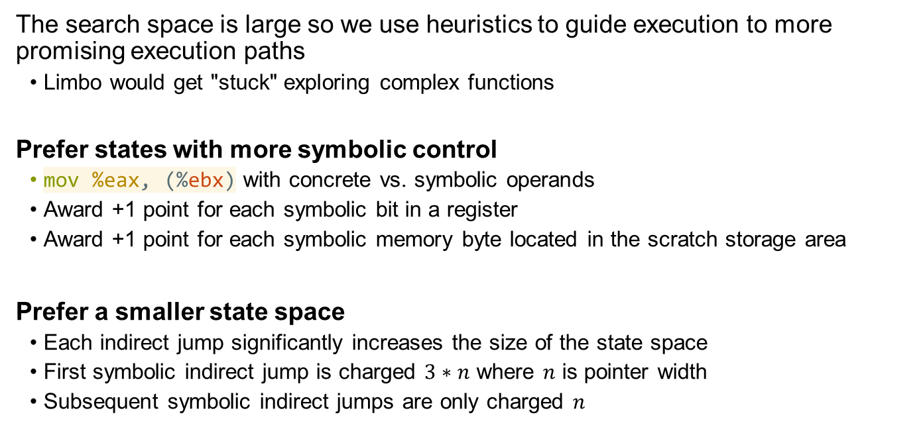
Concolic Execution Search Heuristics
The search space is large so we use heuristics to guide execution to more promising execution paths
Limbo would get "stuck" exploring complex functions
Prefer states with more symbolic control
mov %eax, (%ebx) with concrete vs. symbolic operands
Award +1 point for each symbolic bit in a register
Award +1 point for each symbolic memory byte located in the scratch storage area
Prefer a smaller state space
Each indirect jump significantly increases the size of the state space
First symbolic indirect jump is charged $3∗n$ where $n$ is pointer width
Subsequent symbolic indirect jumps are only charged $n$

Slide 15
Research Questions
RQ1: Can Limbo discover code reuse attacks in the presence of fine-grained CFI?
RQ2: How much executable code does Limbo require to produce code reuse attacks?
RQ3: How sensitive is Limbo to its heuristics?
RQ4: Can Limbo discover new techniques?

Slide 16
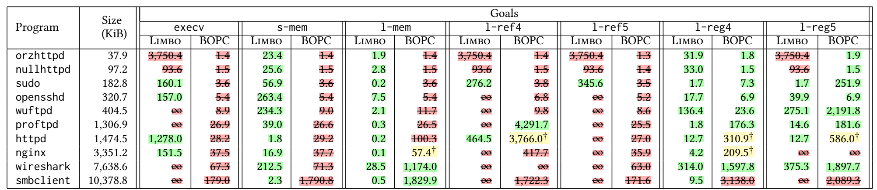
RQ1: Can Limbo discover code reuse attacks in the presence of fine-grained CFI?
4-0-0 Win-Loss-Tie
10-0-0
7-0-3
1-1-1
1-0-0
1-0-9
0-2-6
Experimental configuration similar to state-of-the-art (BOPC, Ispoglou 2018)

Slide 17
Limitations
Inherited by concolic execution
Constraints take too many resources to solve
Path explosion problem
Mitigated by Limbo's heuristics
More of a problem on larger programs, complex goals ☹
Implementation
Mayhem only supports 32-bit Linux executables ☹
Limbo's heuristics are designed to be platform agnostic ☺
We have a post-publication prototype in angr that is multi-platform
Ask questions!

Slide 18
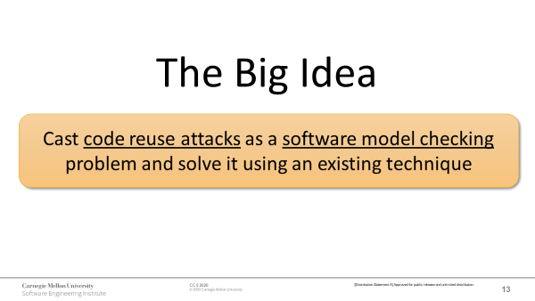
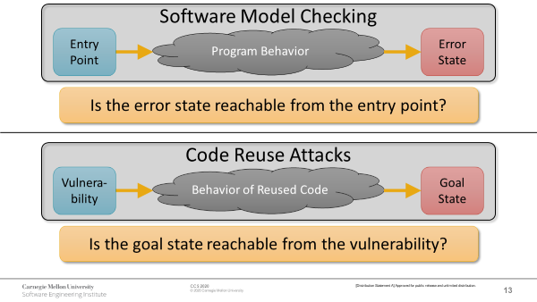
Conclusion
Cast code reuse attacks as a software model checking problem
Can reason about defenses ☺
Does not use a fixed strategy ☺
Very computationally expensive ☹
Performs better on smaller programs ☹

Slide 19
Questions?
Contact
Edward J. Schwartz
Senior Research Scientist
CMU/SEI/CERT/Threat Analysis
eschwartz@cert.org

