Slide 1


BLT Model Meeting 2
Eduardo Miguel Zanette
Ecology, Evolution and Biodiversity Graduate Program
Master’s student – Laboratory of Primatology
São Paulo State University
2022-04-25d

Slide 2
INDEX
PREVIOUS DECISIONS & MODEL v1 pendencies
Debugging and cleaning
Flowchart
Step lenght/Turning angles
Resource visitation rules
Foraging
Memory
Idle behavior
NEXT STEPS
Output validation
Implementation: spatial memory

Slide 3
1) PREVIOUS DECISIONS & WHAT HAS BEEN DONE SO FAR
a) Debugging and Cleaning
Various days working out through bugs and schedule related problems (tree targets, loops, etc)
Resulted in model v1

Slide 4
1) PREVIOUS DECISIONS & WHAT HAS BEEN DONE SO FAR
b) Flowchart
Three flowcharts: one for general procedures and other two for behaviors and tree targets
Model more easily communicable and documented

Slide 5
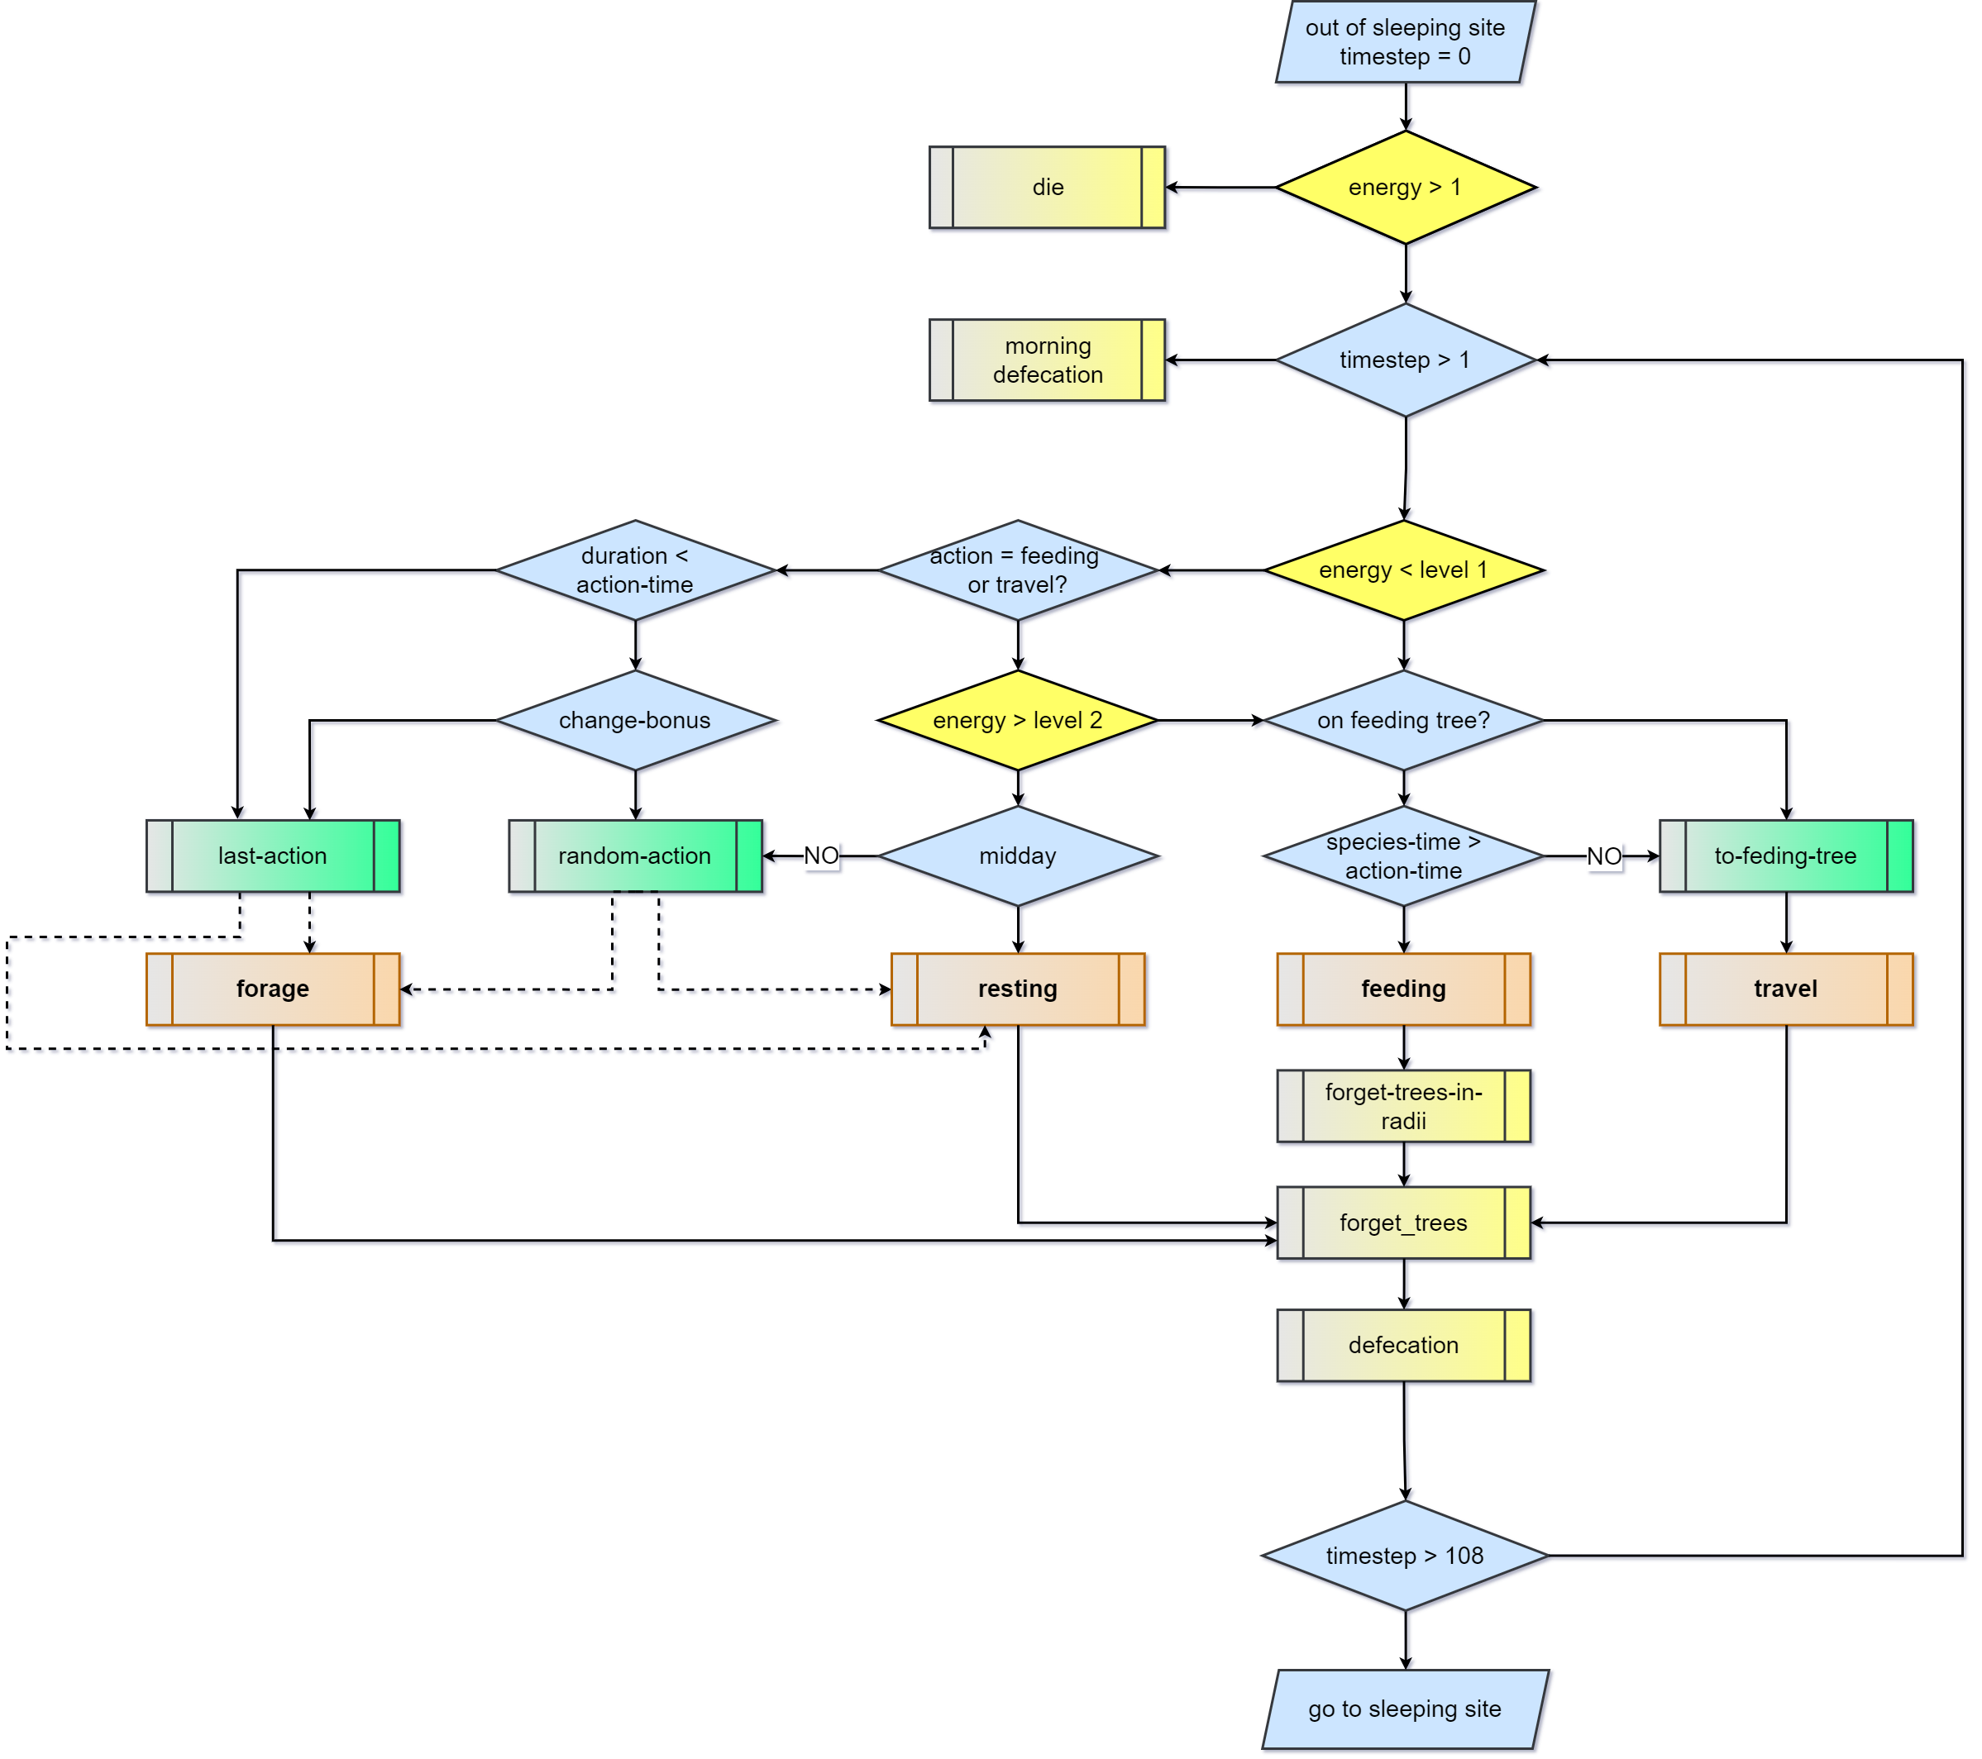
1) PREVIOUS DECISIONS & WHAT HAS BEEN DONE SO FAR
b) Flowchart
Three flowcharts: one for general procedures and other two for behaviors and tree targets
Model more easily communicable and documented

Slide 6
1) PREVIOUS DECISIONS & WHAT HAS BEEN DONE SO FAR
c) Step length and turning angles
Contrarious to what I thought, variation in the step length and turning angles is not a strong pattern.

Slide 7
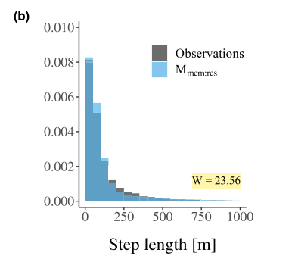
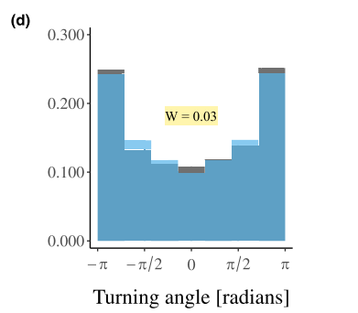
1) PREVIOUS DECISIONS & WHAT HAS BEEN DONE SO FAR
c) Step length and turning angles
Contrarious to what I thought, variation in the step length and turning angles is not a strong pattern.
It makes more sense to use it as pattern for validation (as home range, DPL, etc) in the Pattern Oriented Modelling approach.
Ranc et al 2022

Slide 8
1) PREVIOUS DECISIONS & WHAT HAS BEEN DONE SO FAR
c) Step length and turning angles
Contrarious to what I thought, variation in the step length and turning angles is not a strong pattern.
It makes more sense to use it as pattern for validation (as home range, DPL, etc) in the Pattern Oriented Modelling approach.
We are still struggling to find a way for tamarins to make distinct step lengths at each timestep without the patch approach (patch-memory)
Very interesting meeting with Nathan Ranc last week
Ranc et al 2022

Slide 9
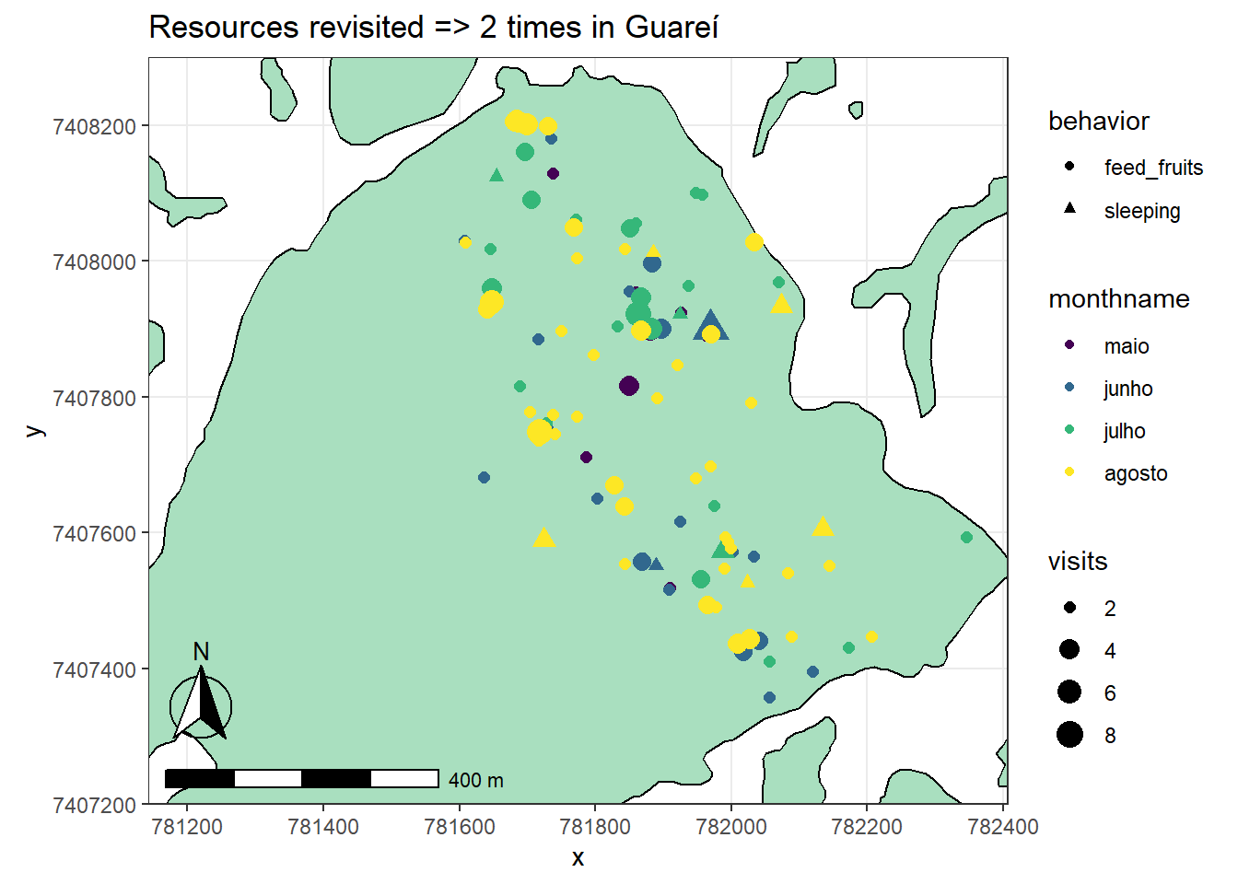
1) PREVIOUS DECISIONS & WHAT HAS BEEN DONE SO FAR
d) Resource Visitation rules
Besides problem with the recurse package, we couldn’t find a strong rule for revisitation counts
Time related revisitations still to be assessed (Time since last visits, residence time)

Slide 10
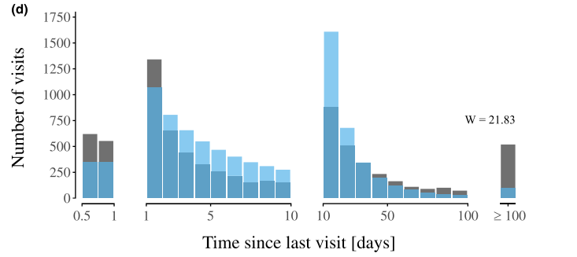
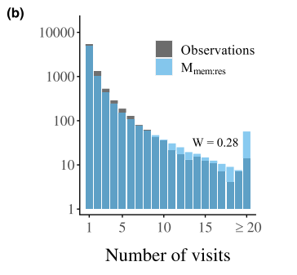
1) PREVIOUS DECISIONS & WHAT HAS BEEN DONE SO FAR
d) Resource Visitation rules
Besides problem with the recurse package, we couldn’t find a strong rule for revisitation counts
Time related revisitations still to be assessed (Time since last visits, residence time)
Might be another interesting pattern for validation:
Patch level as in Ranc et al 2022
Tree level
Remains to be explored by time frames (to be discussed with Anne and Felipe on 27/04/22)
Ranc et al 2022

Slide 11
1) PREVIOUS DECISIONS & WHAT HAS BEEN DONE SO FAR
e) Foraging
Tamarins are still not properly bouncing at the border of the fragment (while foraging)
Foraging occurs for too long

Slide 12
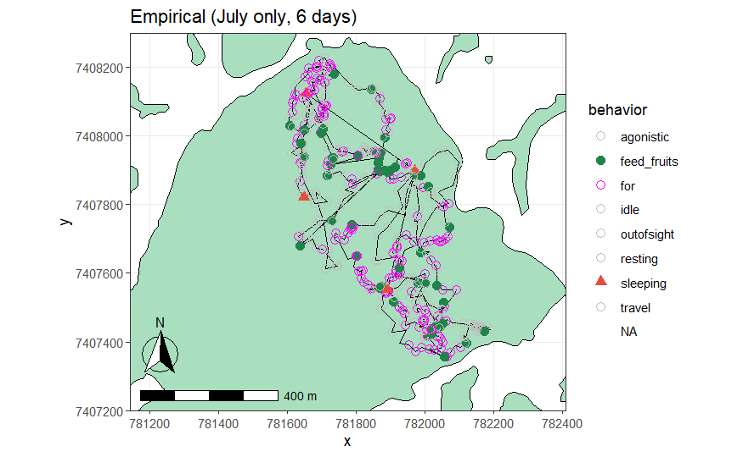
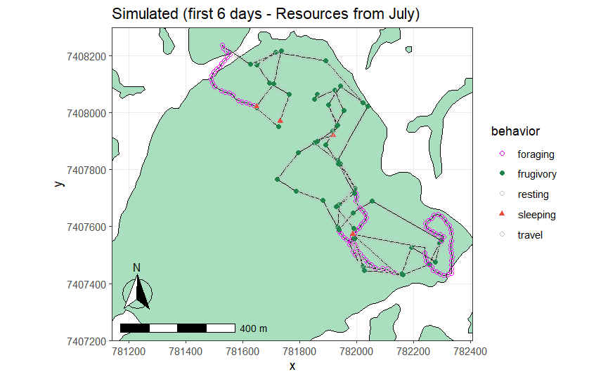
1) PREVIOUS DECISIONS & WHAT HAS BEEN DONE SO FAR
e) Foraging
Tamarins are still not properly bouncing at the border of the fragment (while foraging)
Foraging occurs for too long

Slide 13
1) PREVIOUS DECISIONS & WHAT HAS BEEN DONE SO FAR
f) Memory
Ranc et al 2022 paper on home range formation redirected our implementation ideas related to the making tamarins to cover all the home range (patch-based memory)
We don’t have good results to show yet

Slide 14
1) PREVIOUS DECISIONS & WHAT HAS BEEN DONE SO FAR
f) Memory
Ranc et al 2022 paper on home range formation redirected our implementation ideas related to the making tamarins to cover all the home range (patch-based memory)
We don’t have good results to show yet
Working memory (the animal remembers that it has visited the resource/patch) implemented as ‘step_forget’: not sure if results get better with this implementation

Slide 15
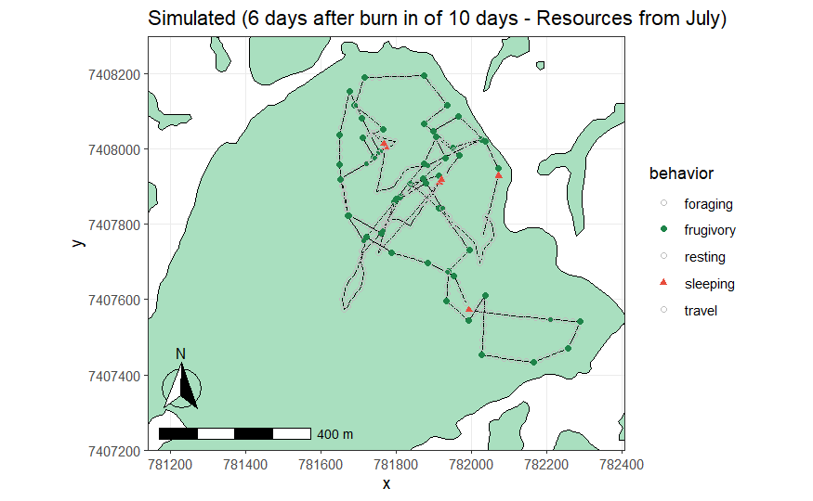
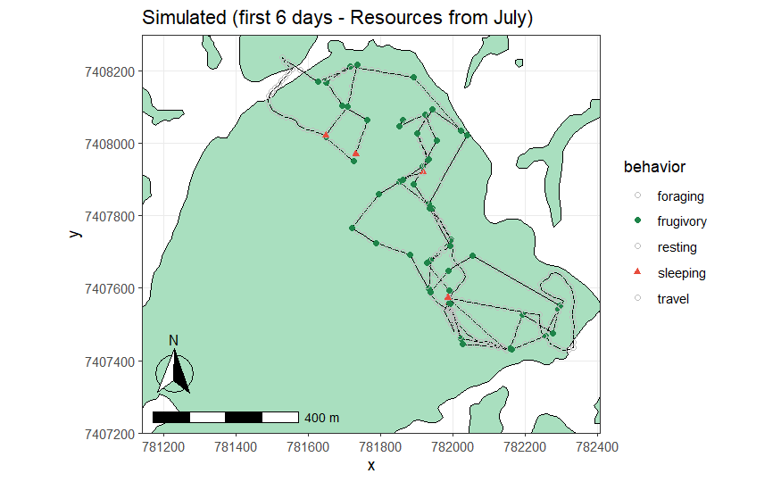
1) PREVIOUS DECISIONS & WHAT HAS BEEN DONE SO FAR
f) Memory
Ranc et al 2022 paper on home range formation redirected our implementation ideas related to the making tamarins to cover all the home range (patch-based memory)
We don’t have good results to show yet
Working memory (the animal remembers that it has visited the resource/patch) implemented as ‘step_forget’: not sure if results get better with this implementation

Slide 16
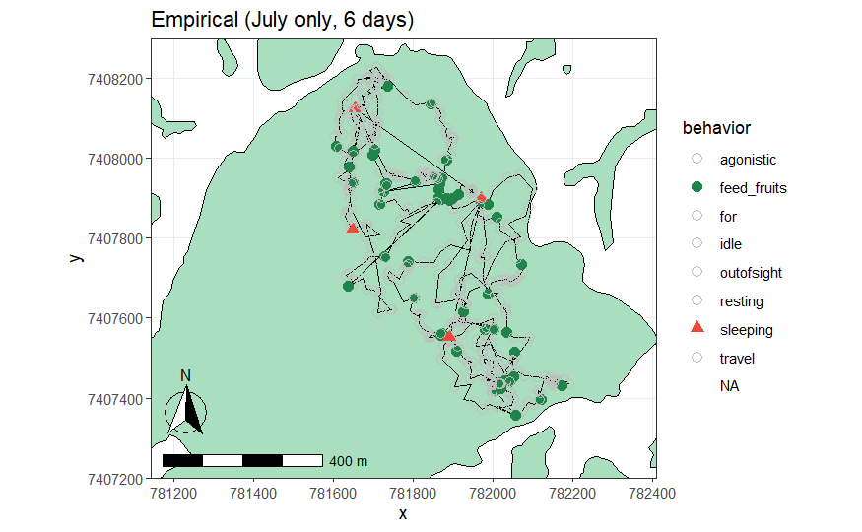
1) PREVIOUS DECISIONS & WHAT HAS BEEN DONE SO FAR
f) Memory
DPL, step lengths and turning angles are very similar before and after the burn-in period, but revisitations and routes seem more "natural” (documented somewhere else)

Slide 17
1) PREVIOUS DECISIONS & WHAT HAS BEEN DONE SO FAR
f) Memory
DPL, step lengths and turning angles are very similar before and after the burn-in period, but revisitations and routes seem more "natural” (documented somewhere else)
“Burn-in” period must be thoroughly tested

Slide 18
1) PREVIOUS DECISIONS & WHAT HAS BEEN DONE SO FAR
g) Idle behavior
Composes majority of behaviors in Guareí
Is comparable between Anne and Felipe datasets, not sure for Santa Maria (Ynes dataset)
Problem if we are using activity budget for validation

Slide 19
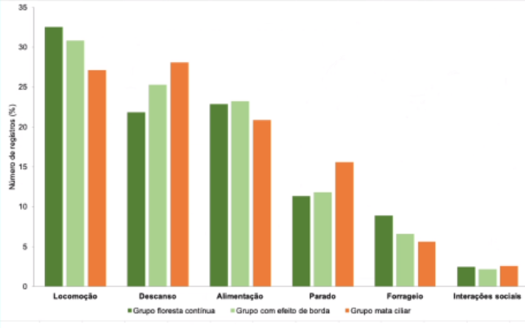
1) PREVIOUS DECISIONS & WHAT HAS BEEN DONE SO FAR
g) Idle behavior
Composes majority of behaviors in Guareí
Is comparable between Anne and Felipe datasets, not sure for Santa Maria (Ynes dataset)
Problem if we are using activity budget for validation
(Anne results)

Slide 20
1) PREVIOUS DECISIONS & WHAT HAS BEEN DONE SO FAR
Questions?
e) Memory
Ranc et al 2022 paper on home range formation redirected our implementation ideas related to the making tamarins to cover all the home range (patch-based memory)
We don’t have good results to show yet
Working memory (the animal remembers that it has visited the resource/patch) implemented as ‘step_forget’ -> not sure if results get better than without this implementation

Slide 21
2) NEXT STEPS
a) Output validation -> PRIORITY
NEXT PRESENTATIONS:
(Model v1 will be used)
Wiegand seminar: 12/05
NWFVA: 18/05
Results for CBPr Congress: 18/05

Slide 22
2) NEXT STEPS
a) Output validation -> PRIORITY
Problem with nlrx
nlrx is handy for sensitivity analysis, genethic algorithm
In contact with Sebastian Hanss (nrlx package maintainer)
If we can’t solve it, we will output everything as files (takes more time but we have halfway done already)

Slide 23
2) NEXT STEPS
a) Output validation -> PRIORITY
Problem with nlrx
nlrx is handy for sensitivity analysis, genethic algorithm
In contact with Sebastian Hanss (nrlx package maintainer)
If we can’t solve it, we will output everything as files (takes more time but we have halfway done already)
Pattern Oriented Modelling
Still need to run home range analysis
Still need to solve the activity budget output of the model (idle and other behaviors) -> to be done on Apr. 27th

Slide 24
2) NEXT STEPS
b) Implementation: spatial memory
Memory patch-based -> to make tamarins attract more to unvisited patches (Ranc et al 2022)
Ronald has tried some stuff but we still don’t have something ready to show

